Slide 1
ACTS 1:12-26
www.BiblePoint.com
2011 © Single Initiative LLC
Notes:
Copyright © 2000-2011. All rights reserved. Bible Point is a registered trademark of Single Initiative, LLC. All other trademarks acknowledged.
Bible Point contains graphics from Bible Point artists. These illustrations belong to Bible Point and the respective artists. You may use the designs and illustrations for graphical illustration of lessons free and without special permission, provided they are not used in any way that maligns the Christian faith. Furthermore, republication or production of any illustration by any other graphic service whether it be in book, in a machine-readable form, or in any other design resource is strictly prohibited. Furthermore, they cannot be duplicated or resold as any other form of publishing, clip art, or graphic resource.
So What does it mean? (A simple translations of the legal jargon)
So, if you don’t own the presentation(s), graphic(s), and text(s) how can you legally use them? The purchase of the license allows you to use all the images in the product. However, the actual ownership and copyright of the presentation(s), graphic(s), and text(s) remain the property of Bible Point and its licensors. If you had plans on using this product in your “for sale” work—think again!
License Agreement
Article 1: License Grant
All the graphics and text in Bible Point presentations (excluding quotes from the Bible and stated sources) are the intellectual and real property of Bible Point and its licensors, and is protected by law, including United States copyright laws and international treaties. Bible Point grants to you a license:
1. To use the presentation in a single church, single school, or single office of a Christian organization.
2. To make a single archival back-up copy of the program.
3. To modify the presentation(s) and merge with other presentations in a single church, school, or Christian organization.
4. To transfer to another party if that party agrees to accept the terms and conditions of this agreement, and you do not retain any copies of the presentation, whether printed, machine readable, modified, or merged form.
Article 2: Terms
This license is effective until terminated. You may terminate the license at any time by destroying the presentation(s), graphic(s), or text(s) together with all copies, modifications and merged portions in any form. Bible Point may terminate your license if you fail to comply with this Agreement. You agree, upon such termination, for any reason, to destroy the presentation(s), graphics, and text(s) with all copies, modifications, and merged portions in any form.
Article 3: Disclaimers
1. Bible Point presentations, graphics, and texts are licensed to you As Is. You, the consumer, bear the entire risk relating to the quality and performance of the presentation(s), graphic(s), or text(s). In no event will Bible Point be liable for damages resulting from any defect.
2. Thirty-day limited warrantee on disks. Bible Point warrants the disks to be free of defects in material and workmanship under normal use for 30 days after purchase. During the 30-day period you may return a defective presentation, graphic, or text with proof of purchase and it will be replaced without charge, unless the presentation is damaged by misuse.
Article 4: General
1. You may not sub-license, assign, or transfer the license of the presentation(s), graphic(s), or text(s) except as provided by this Agreement.
2. This Agreement will be governed by the laws of the State of Michigan.
So What does it mean? (A simple translations of the legal jargon)
May I let someone borrow or copy my licensed Bible Point presentation (even after I modified it)? As long as it is within your local church, or single school, or the immediate office of a Christian organization you may. Otherwise, please refer the person interested in borrowing to: http://www.biblepoint.com or E-mail: dh@biblepoint.com with any related questions.
---------------------------------------------------------------------------------------------------------------------------
Scripture taken from the HOLY BIBLE, NEW INTERNATIONAL VERSION®. NIV®. Copyright©1973, 1978, 1984 by International Bible Society. Used by permission of Zondervan. All rights reserved.

Slide 2

A Study in the
Book of ACTS
D
I
F
F
E
R
E
N
C
E
making a
Notes:
Difference

Slide 3
The Disciples Who
Make a Difference:

Slide 4
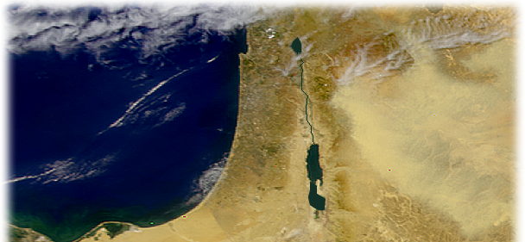
FOLLOW THE LORD’S WILL
¹² Then they returned to Jerusalem from the hill called the Mount of Olives, a Sabbath day's walk from the city.

Slide 5
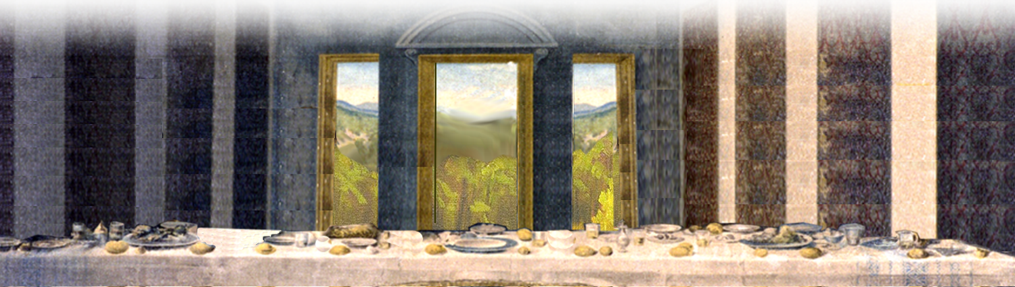
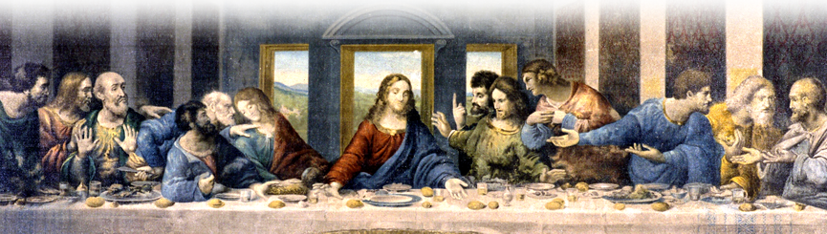
VARIETY OF BACKGROUNDS
¹³ When they arrived, they went upstairs to the room where they were staying.
Notes:
Lord’s Supper = Free = from http://upload.wikimedia.org/wikipedia/commons/4/44/La_C%C3%A8ne.JPG

Slide 6
VARIETY OF BACKGROUNDS
¹³ …Those present were Peter, John, James and Andrew; Philip and Thomas, Bartholomew and Matthew; James son of Alphaeus and Simon the Zealot, and Judas son of James.
Notes:
Lord’s Supper = Free = from http://upload.wikimedia.org/wikipedia/commons/4/44/La_C%C3%A8ne.JPG

Slide 7

VARIETY OF BACKGROUNDS
¹³ …Those present were Peter, John, James and Andrew; Philip and Thomas, Bartholomew and Matthew; James son of Alphaeus and Simon the Zealot, and Judas son of James.
Notes:
Lord’s Supper = Free = from http://upload.wikimedia.org/wikipedia/commons/4/44/La_C%C3%A8ne.JPG

Slide 8
VARIETY OF BACKGROUNDS
¹³ …Those present were Peter, John, James and Andrew; Philip and Thomas, Bartholomew and Matthew; James son of Alphaeus and Simon the Zealot, and Judas son of James.
Notes:
Lord’s Supper = Free = from http://upload.wikimedia.org/wikipedia/commons/4/44/La_C%C3%A8ne.JPG

Slide 9
VARIETY OF BACKGROUNDS
¹³ …Those present were Peter, John, James and Andrew; Philip and Thomas, Bartholomew and Matthew; James son of Alphaeus and Simon the Zealot, and Judas son of James.
Notes:
Lord’s Supper = Free = from http://upload.wikimedia.org/wikipedia/commons/4/44/La_C%C3%A8ne.JPG

Slide 10
VARIETY OF BACKGROUNDS
¹³ …Those present were Peter, John, James and Andrew; Philip and Thomas, Bartholomew and Matthew; James son of Alphaeus and Simon the Zealot, and Judas son of James.
Notes:
Lord’s Supper = Free = from http://upload.wikimedia.org/wikipedia/commons/4/44/La_C%C3%A8ne.JPG

Slide 11
VARIETY OF BACKGROUNDS
¹³ …Those present were Peter, John, James and Andrew; Philip and Thomas, Bartholomew and Matthew; James son of Alphaeus and Simon the Zealot, and Judas son of James.
Notes:
Lord’s Supper = Free = from http://upload.wikimedia.org/wikipedia/commons/4/44/La_C%C3%A8ne.JPG

Slide 12
VARIETY OF BACKGROUNDS
¹³ …Those present were Peter, John, James and Andrew; Philip and Thomas, Bartholomew and Matthew; James son of Alphaeus and Simon the Zealot, and Judas son of James.
Notes:
Lord’s Supper = Free = from http://upload.wikimedia.org/wikipedia/commons/4/44/La_C%C3%A8ne.JPG

Slide 13
VARIETY OF BACKGROUNDS
¹³ …Those present were Peter, John, James and Andrew; Philip and Thomas, Bartholomew and Matthew; James son of Alphaeus and Simon the Zealot, and Judas son of James.
Notes:
Lord’s Supper = Free = from http://upload.wikimedia.org/wikipedia/commons/4/44/La_C%C3%A8ne.JPG

Slide 14
VARIETY OF BACKGROUNDS
¹³ …Those present were Peter, John, James and Andrew; Philip and Thomas, Bartholomew and Matthew; James son of Alphaeus and Simon the Zealot, and Judas son of James.
Notes:
Lord’s Supper = Free = from http://upload.wikimedia.org/wikipedia/commons/4/44/La_C%C3%A8ne.JPG

Slide 15
VARIETY OF BACKGROUNDS
¹³ …Those present were Peter, John, James and Andrew; Philip and Thomas, Bartholomew and Matthew; James son of Alphaeus and Simon the Zealot, and Judas son of James.
Notes:
Lord’s Supper = Free = from http://upload.wikimedia.org/wikipedia/commons/4/44/La_C%C3%A8ne.JPG

Slide 16
VARIETY OF BACKGROUNDS
¹³ …Those present were Peter, John, James and Andrew; Philip and Thomas, Bartholomew and Matthew; James son of Alphaeus and Simon the Zealot, and Judas son of James.
Notes:
Lord’s Supper = Free = from http://upload.wikimedia.org/wikipedia/commons/4/44/La_C%C3%A8ne.JPG

Slide 17
VARIETY OF BACKGROUNDS
¹³ …Those present were Peter, John, James and Andrew; Philip and Thomas, Bartholomew and Matthew; James son of Alphaeus and Simon the Zealot, and Judas son of James. (Judas Iscariot)
x
Notes:
Lord’s Supper = Free = from http://upload.wikimedia.org/wikipedia/commons/4/44/La_C%C3%A8ne.JPG

Slide 18

PRAY TOGETHER
¹⁴ They all joined together constantly in prayer, along with the women and Mary the mother of Jesus, and with his brothers.
Notes:
Praying hands = FREE = www.sxc.com image: 159064_5896

Slide 19
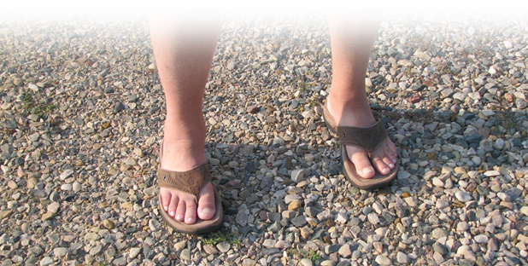
TAKE A STAND
¹⁵ In those days Peter stood up among the believers (a group numbering about a hundred and twenty)
Notes:
FEET = FREE for reuse from = BiblePoint photo

Slide 20

LIVE BY THE SCRIPTURES
¹⁶ and said, "Brothers, the Scripture had to be fulfilled which the Holy Spirit spoke long ago through the mouth of David concerning Judas, who served as guide for those who arrested Jesus--
¹⁷ he was one of our number and shared in this ministry.”
Notes:
Hebrew Writing = FREE for reuse from http://upload.wikimedia.org/wikipedia/commons/b/b9/Targum.jpg

Slide 21
LIVE BY THE SCRIPTURES
¹⁸ (With the reward he got for his wickedness, Judas bought a field; there he fell headlong, his body burst open and all his intestines spilled out.
¹⁹ Everyone in Jerusalem heard about this, so they called that field in their language Akeldama, that is, Field of Blood.)

Slide 22
LIVE BY THE SCRIPTURES
²⁰ "For," said Peter, "it is written in the book of Psalms,
'May his place be deserted;
let there be no one to dwell in it,'
and,
'May another take his place of leadership.’ "

Slide 23
Value Commitment
²¹ Therefore it is necessary to choose one of the men who have been with us the whole time the Lord Jesus went in and out among us,
²² beginning from John's baptism to the time when Jesus was taken up from us. For one of these must become a witness with us of his resurrection."

Slide 24

Depend on God’s Direction
²³ So they proposed two men: Joseph called Barsabbas (also known as Justus) and Matthias.
²⁴ Then they prayed, "Lord, you know everyone's heart. Show us which
of these two you have chosen
²⁵ to take over this apostolic
ministry, which Judas left to go
where he belongs."
Notes:
Sign free from = http://www.sxc.hu/photo/770389

Slide 25
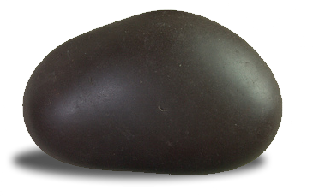
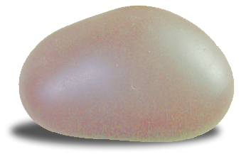
Depend on God’s Direction
²⁶ Then they cast lots, and the lot fell to Matthias; so he was added to the eleven apostles
Notes:
Stones = FREE for use with credit to http://www.flickr.com/photos/taunaki/4382105528/sizes/l/in/photostream/

Slide 26
Conclusion:
Disciples who make a difference:
FOLLOW of the Lord’s Will
Have a VARIOUS Background
PRAY together
Take a STAND
Live by the SCRIPTURES
Value COMMITMENT
Depend on God’s DIRECTION

Slide 27
Let’s Pray.

