Slide 1
ACTS 1:1-12
www.BiblePoint.com
2011 © Single Initiative LLC
Notes:
Copyright © 2000-2011. All rights reserved. Bible Point is a registered trademark of Single Initiative, LLC. All other trademarks acknowledged.
Bible Point contains graphics from Bible Point artists. These illustrations belong to Bible Point and the respective artists. You may use the designs and illustrations for graphical illustration of lessons free and without special permission, provided they are not used in any way that maligns the Christian faith. Furthermore, republication or production of any illustration by any other graphic service whether it be in book, in a machine-readable form, or in any other design resource is strictly prohibited. Furthermore, they cannot be duplicated or resold as any other form of publishing, clip art, or graphic resource.
So What does it mean? (A simple translations of the legal jargon)
So, if you don’t own the presentation(s), graphic(s), and text(s) how can you legally use them? The purchase of the license allows you to use all the images in the product. However, the actual ownership and copyright of the presentation(s), graphic(s), and text(s) remain the property of Bible Point and its licensors. If you had plans on using this product in your “for sale” work—think again!
License Agreement
Article 1: License Grant
All the graphics and text in Bible Point presentations (excluding quotes from the Bible and stated sources) are the intellectual and real property of Bible Point and its licensors, and is protected by law, including United States copyright laws and international treaties. Bible Point grants to you a license:
1. To use the presentation in a single church, single school, or single office of a Christian organization.
2. To make a single archival back-up copy of the program.
3. To modify the presentation(s) and merge with other presentations in a single church, school, or Christian organization.
4. To transfer to another party if that party agrees to accept the terms and conditions of this agreement, and you do not retain any copies of the presentation, whether printed, machine readable, modified, or merged form.
Article 2: Terms
This license is effective until terminated. You may terminate the license at any time by destroying the presentation(s), graphic(s), or text(s) together with all copies, modifications and merged portions in any form. Bible Point may terminate your license if you fail to comply with this Agreement. You agree, upon such termination, for any reason, to destroy the presentation(s), graphics, and text(s) with all copies, modifications, and merged portions in any form.
Article 3: Disclaimers
1. Bible Point presentations, graphics, and texts are licensed to you As Is. You, the consumer, bear the entire risk relating to the quality and performance of the presentation(s), graphic(s), or text(s). In no event will Bible Point be liable for damages resulting from any defect.
2. Thirty-day limited warrantee on disks. Bible Point warrants the disks to be free of defects in material and workmanship under normal use for 30 days after purchase. During the 30-day period you may return a defective presentation, graphic, or text with proof of purchase and it will be replaced without charge, unless the presentation is damaged by misuse.
Article 4: General
1. You may not sub-license, assign, or transfer the license of the presentation(s), graphic(s), or text(s) except as provided by this Agreement.
2. This Agreement will be governed by the laws of the State of Michigan.
So What does it mean? (A simple translations of the legal jargon)
May I let someone borrow or copy my licensed Bible Point presentation (even after I modified it)? As long as it is within your local church, or single school, or the immediate office of a Christian organization you may. Otherwise, please refer the person interested in borrowing to: http://www.biblepoint.com or E-mail: dh@biblepoint.com with any related questions.
---------------------------------------------------------------------------------------------------------------------------
Scripture taken from the HOLY BIBLE, NEW INTERNATIONAL VERSION®. NIV®. Copyright©1973, 1978, 1984 by International Bible Society. Used by permission of Zondervan. All rights reserved.

Slide 2

A Study in the
Book of ACTS
D
I
F
F
E
R
E
N
C
E
making a
Notes:
Background for this series is a collage designed by BiblePoint utilizing:
Hands = FREE for reuse from = http://imagebase.davidniblack.com/main.php?g2_itemId=1823
Parchment = Licensed and NOT free for reuse = dreamstime_5003869

Slide 3
INTERESTING INTRO:

Slide 4

BOOK II
¹ In my former book, Theophilus, I wrote about all that Jesus began to do and to teach ² until the day he was taken up to heaven, after giving instructions through the Holy Spirit to the apostles he had chosen.
Notes:
Open book = FREE = from Dreamstime

Slide 5
The life that makes a difference is:

Slide 6
PERSUADED LIFE

Slide 7
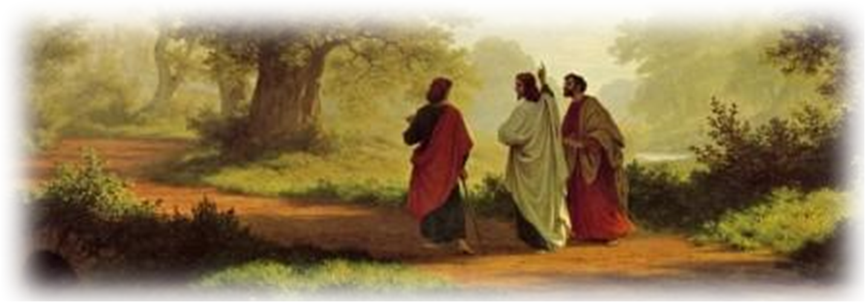

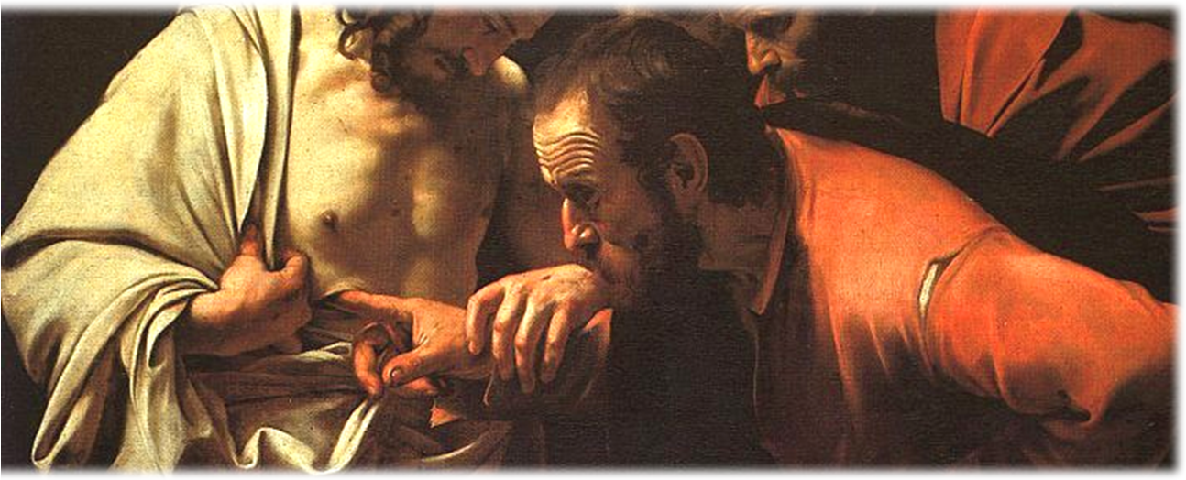
PERSUADED LIFE
³ After his suffering, he showed himself to these men and gave many convincing proofs that he was alive. He appeared to them over a period of forty days and spoke about the kingdom of God.
Notes:
Emmaus Road = FREE =BiblePoint photo

Slide 8
PATIENT LIFE

Slide 9

WAITING FOR…
⁴ On one occasion, while he was eating with them, he gave them this command: "Do not leave Jerusalem, but wait for the gift my Father promised, which you have heard me speak about. ⁵ For John baptized with water, but in a few days you will be baptized with the Holy Spirit.”
Notes:
Clock = FREE = http://www.dreamstime.com/isolated-clock-02-free-stock-image-imagefree717584

Slide 10

WAITING FOR…
⁶ So when they met together, they asked him, "Lord, are you at this time going to restore the kingdom to Israel?“
⁷ He said to them: "It is not for you to know the times or dates the Father has set by his own authority.
Notes:
DO NOT REPRODUCE --Crown licensed from Dreamstime: http://www.dreamstime.com/royalty-free-stock-photo-crown-image16949605

Slide 11
POWERFUL LIFE

Slide 12

POWERFUL LIFE
⁸ But you will receive power when the Holy Spirit comes on you; ….”
Notes:
Plug = FREE = dreamstimefree_873776

Slide 13

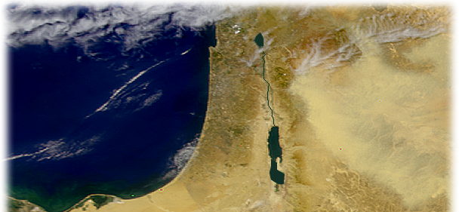
POWERFUL LIFE
⁸ But you will receive power when the Holy Spirit comes on you; and you will be my witnesses in Jerusalem, and in all Judea
and Samaria, and to the ends of the earth.”
Notes:
Map = FREE= NASA

Slide 14
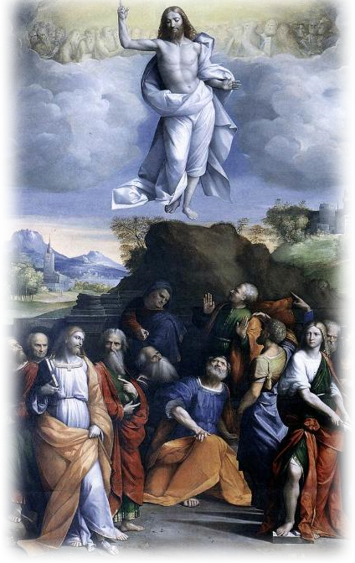
POWERFUL LIFE
⁹ After he said this, he was taken up before their very eyes, and a cloud hid him from their sight.
Notes:
AscensionofJesus = free from = http://upload.wikimedia.org/wikipedia/commons/3/38/AscensionofJesus.jpg

Slide 15
PROMISING LIFE

Slide 16
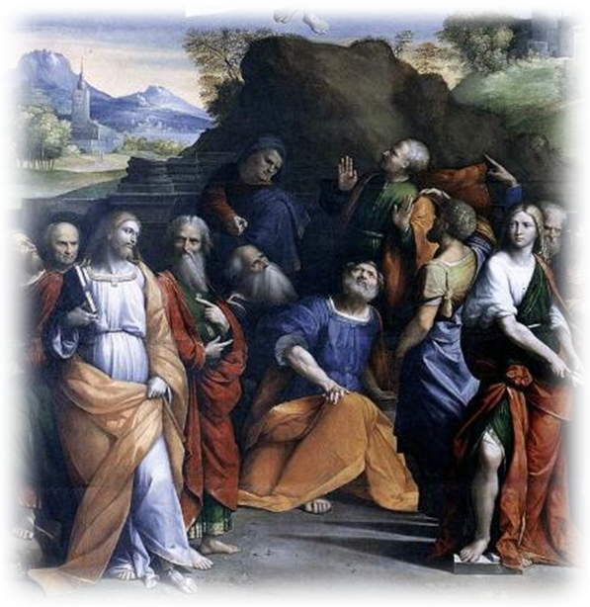
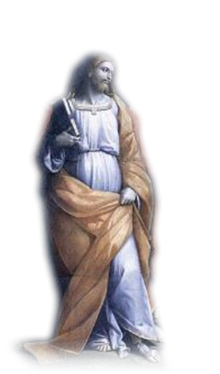
PROMISING LIFE
¹⁰ They were looking intently up into the sky as he was going, when suddenly two men dressed in white stood beside them.

Slide 17
PROMISING LIFE
¹¹ "Men of Galilee," they said, "why do you stand here looking into the sky? This same Jesus, who has been taken from you into heaven, will come back in the same way you have seen him go into heaven."

Slide 18
FINAL THOUGHT
¹² Then they returned to Jerusalem from the hill called the Mount of Olives, a Sabbath day's walk from the city.

Slide 19
Let’s Pray.

