Slide 1
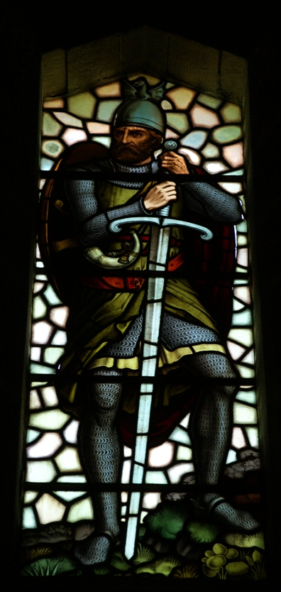
INVOLVES…
Notes:
Background stained glass = FREE = from https://upload.wikimedia.org/wikipedia/commons/2/26/Wallace_Monument_20080505_Stained_glass_William_Wallace.jpg

Slide 2
I. A Man of God who:
Notes:
Man of God = FREE = BiblePoint
There are over 80 references to “man of God” in the NIV Bible. But only refers to a handful of people: Moses the man of God; Elijah, the great prophet was a man of God; King David was a man of God; other prophets are called “man of God.”
Now Paul calls Timothy was a “man of God.”
You must spend time with God to be a man or woman of God. Spending time in the Bible, prayer, witness, and with God’s people.

Slide 3
1- Flees (the love of money) 6:11
¹¹ But you, man of God, flee from all this,
Notes:
Flee = FREE = from http://www.flickr.com/photos/eddypedro/9659086460/sizes/z/in/photostream/
Sometime running away is a sign of weakness—but here it is a sign of strength.
Kenny Rogers put it this way: You got to know when to hold ‘em, know when to fold ‘em know hen to walk away and know when to run.
The proverbs puts it like this ...
⁴ Do not answer a fool according to his folly, or you will be like him yourself.
⁵ Answer a fool according to his folly, or he will be wise in his own eyes. (Pro 26:4-5 NIV)
You have to know when it right to flee ... And from what to flee ...
Flee from the Prosperity gospel. (using religion to get rich). Man of God is not about $, he is about souls, salvation, etc. From being a Charlatan

Slide 4
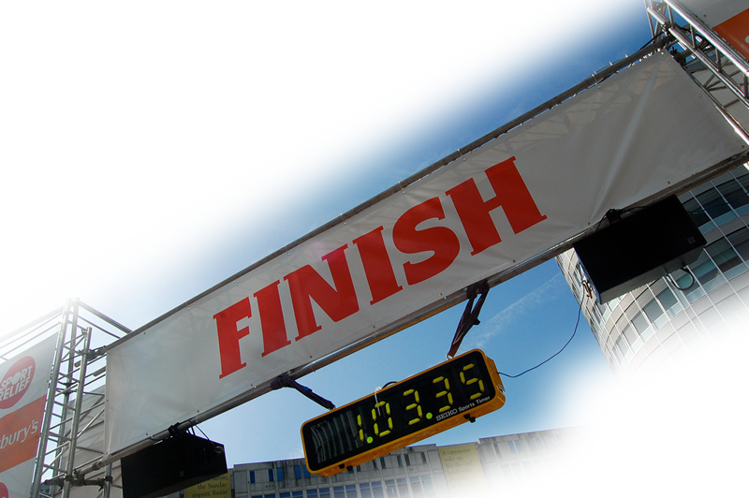
2- Pursues … 6:11
¹¹ But you, man of God, flee from all this, and pursue righteousness, godliness, faith, love, endurance and gentleness.
Notes:
Finish line = FREE = from http://www.flickr.com/photos/jayneandd/4450623309/sizes/l/in/photostream/
Pursues what is “right”
Pursues what is like “God”
Pursues what is “truthworhy”
Pursues what is true “love” = seeking another’s highest good
Pursues to the end
Pursues what is “gentle”
It’s not about the money!!!!

Slide 5
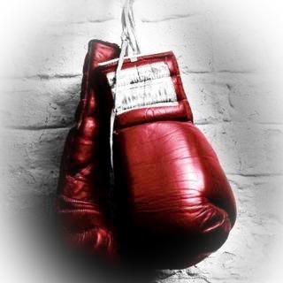
3- Fights for Faith … 6:12
¹² Fight the good fight of the faith.
Notes:
Boxing gloves = FREE = http://www.flickr.com/photos/generationbass/5415099282/
Literally, “keep on fighting” (present tense imperative)
He puts up a fight –a good one for “the faith.” The teachings of Jesus and the Bible. We battle like Jesus who clobbered his adversaries, Satan, Scribes, Pharisees, Sadducees with the Bible.

Slide 6
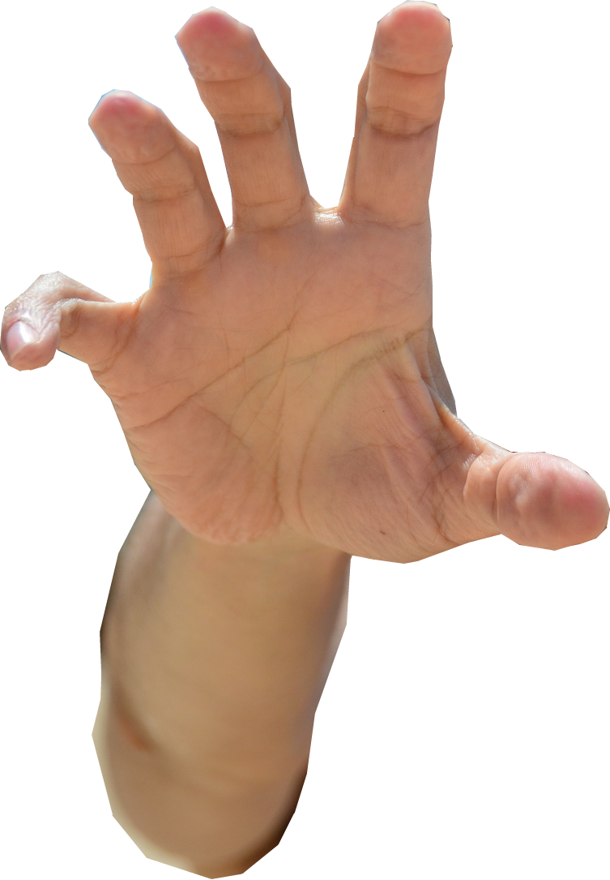
4- Takes Hold … 6:12
¹² Fight the good fight of the faith. Take hold of the eternal life to which you were called when you made your good confession in the presence of many witnesses. ¹³ In the sight of God, who gives life to everything, and of Christ Jesus, who while testifying before Pontius Pilate made the good confession,
Notes:
Grab = FREE = from http://www.flickr.com/photos/robertschrader/8023718020/sizes/h/in/photostream/
You receive eternal life at the moment you placed faith in Christ. You already have eternal life, so what does it mean to “take hold of it?” I suggest it means that you appropriate the life that is coming in eternity, now! So take hold of it now—live like it now.

Slide 7
4- Takes Hold … 6:12
¹² Fight the good fight of the faith. Take hold of the eternal life to which you were called when you made your good confession in the presence of many witnesses. ¹³ In the sight of God, who gives life to everything, and of Christ Jesus, who while testifying before Pontius Pilate made the good confession,
Notes:
Grab = FREE = from http://www.flickr.com/photos/robertschrader/8023718020/sizes/h/in/photostream/
You receive it a moment you placed faith in Christ. You already have eternal life, so what does it mean to “take hold of it?” I suggest it means that you appropriate the life that is coming in eternity, now! So now take hold of it now—live like it.

Slide 8
4- Takes Hold … 6:12
¹² Fight the good fight of the faith. Take hold of the eternal life to which you were called when you made your good confession in the presence of many witnesses. ¹³ In the sight of God, who gives life to everything, and of Christ Jesus, who while testifying before Pontius Pilate made the good confession,
Notes:
Grab = FREE = from http://www.flickr.com/photos/robertschrader/8023718020/sizes/h/in/photostream/
You receive it a moment you placed faith in Christ. You already have eternal life, so what does it mean to “take hold of it?” I suggest it means that you appropriate the life that is coming in eternity, now! So now take hold of it now—live like it.

Slide 9
4- Takes Hold … 6:12
¹² Fight the good fight of the faith. Take hold of the eternal life to which you were called when you made your good confession in the presence of many witnesses. ¹³ In the sight of God, who gives life to everything, and of Christ Jesus, who while testifying before Pontius Pilate made the good confession,
Notes:
Grab = FREE = from http://www.flickr.com/photos/robertschrader/8023718020/sizes/h/in/photostream/
Jesus made a good confession:
³³ Pilate then went back inside the palace, summoned Jesus and asked him, "Are you the king of the Jews?"
³⁴ "Is that your own idea," Jesus asked, "or did others talk to you about me?"
³⁵ "Am I a Jew?" Pilate replied. "It was your people and your chief priests who handed you over to me. What is it you have done?"
³⁶ Jesus said, "My kingdom is not of this world. If it were, my servants would fight to prevent my arrest by the Jews. But now my kingdom is from another place." (Joh 18:33-36 NIV)
³⁷ "You are a king, then!" said Pilate. Jesus answered, "You are right in saying I am a king. In fact, for this reason I was born, and for this I came into the world, to testify to the truth. Everyone on the side of truth listens to me." (Joh 18:37 NIV)

Slide 10
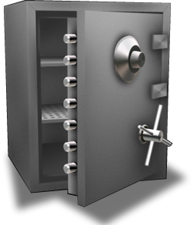
5- Keeps … 6:13-14
¹³… I charge you ¹⁴ to keep this command without spot or blame until the appearing of our Lord Jesus Christ,
Notes:
Safe = FREE = from http://commons.wikimedia.org/wiki/File:Safe_icon.jpg
Keep = secure it, make it safe, don’t loose it, put it in a safe. Protect this

Slide 11
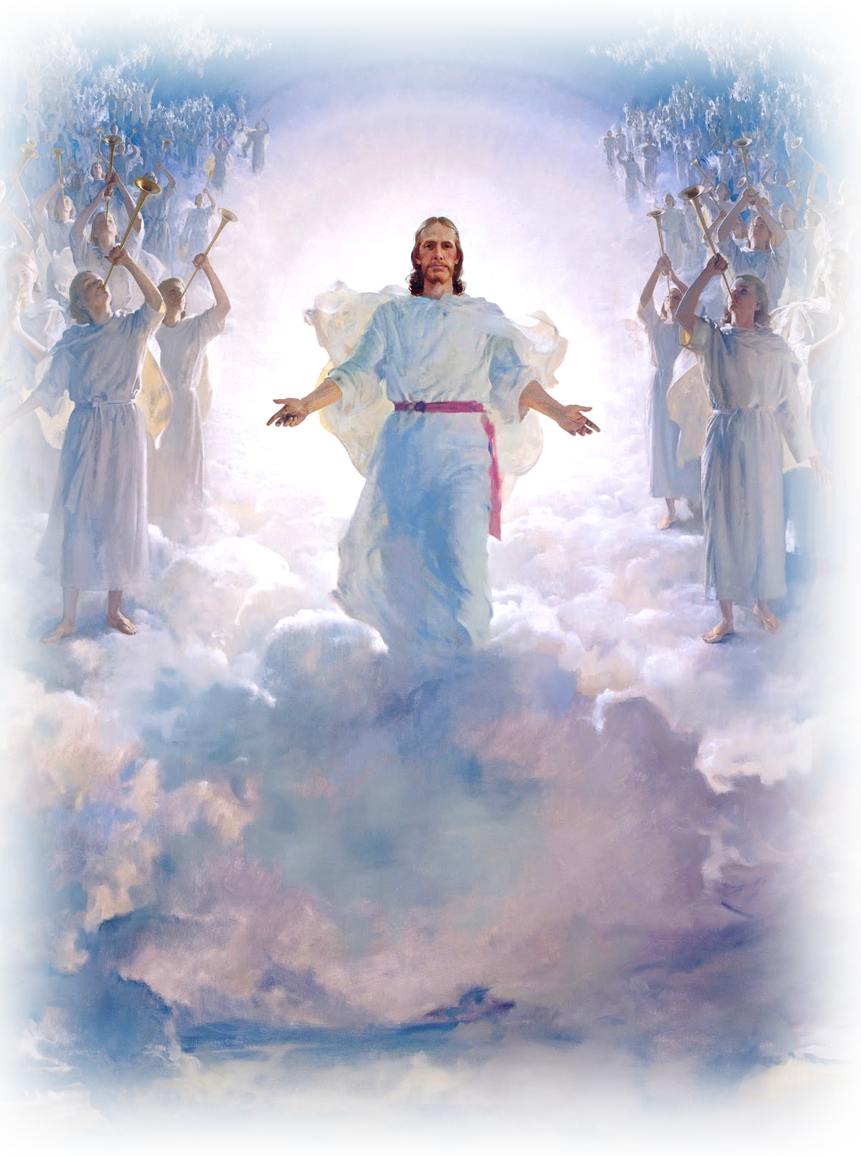
5- Keeps … 6:13-14
¹³… I charge you ¹⁴ to keep this command without spot or blame until the appearing of our Lord Jesus Christ,
Notes:
Safe = FREE = from http://commons.wikimedia.org/wiki/File:Safe_icon.jpg
Keep = secure it, make it safe, don’t loose it, put it in a safe. Protect this

Slide 12
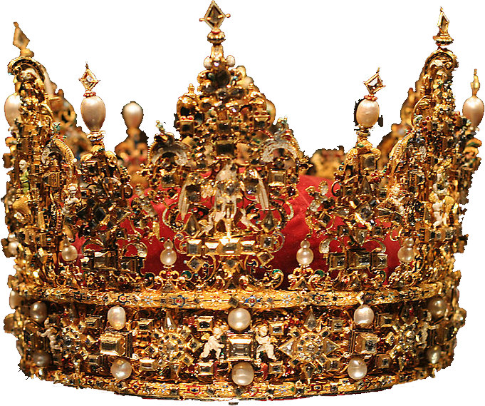
6- Acknowledges … 6:15-16
¹⁵ which God will bring about in his own time--God, the blessed and only Ruler, the King of kings and Lord of lords, ¹⁶ who alone is immortal and who lives in unapproachable light, whom no one has seen or can see. To him be honor and might forever. Amen.

Slide 13
6- Acknowledges … 6:15-16
¹⁵ which God will bring about in his own time--God, the blessed and only Ruler, the King of kings and Lord of lords, ¹⁶ who alone is immortal and who lives in unapproachable light, whom no one has seen or can see. To him be honor and might forever. Amen.

Slide 14
6- Acknowledges … 6:15-16
¹⁵ which God will bring about in his own time--God, the blessed and only Ruler, the King of kings and Lord of lords, ¹⁶ who alone is immortal and who lives in unapproachable light, whom no one has seen or can see. To him be honor and might forever. Amen.

Slide 15
6- Acknowledges … 6:15-16
¹⁵ which God will bring about in his own time--God, the blessed and only Ruler, the King of kings and Lord of lords, ¹⁶ who alone is immortal and who lives in unapproachable light, whom no one has seen or can see. To him be honor and might forever. Amen.

Slide 16
6- Acknowledges … 6:15-16
¹⁵ which God will bring about in his own time--God, the blessed and only Ruler, the King of kings and Lord of lords, ¹⁶ who alone is immortal and who lives in unapproachable light, whom no one has seen or can see. To him be honor and might forever. Amen.

Slide 17
6- Acknowledges … 6:15-16
¹⁵ which God will bring about in his own time--God, the blessed and only Ruler, the King of kings and Lord of lords, ¹⁶ who alone is immortal and who lives in unapproachable light, whom no one has seen or can see. To him be honor and might forever. Amen.
Notes:
As mind blowing as it may seem—God is not like us at all.
His is the creator God—we are creatures
He is Most High Ruler – we are lowly creatures
He rules over everything—we only think we rule over something
He never dies—we have an appointment with death
He lives in an effulgence of glory—we love darkness rather than light
He is invisible—we only think we are—there is nothing hidden from his sight.
He is worthy of honor forever—we are a fleeting vapor
Here’s the problem—we think we are bigger than we really are, and think is smaller that He really is.
We need to acknowledge Him—there is no one else like Him.

Slide 18
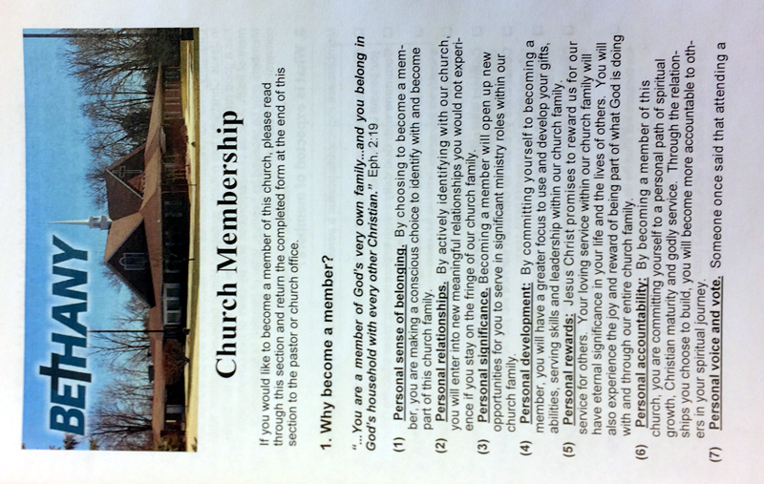
II. Church Members who:

Slide 19
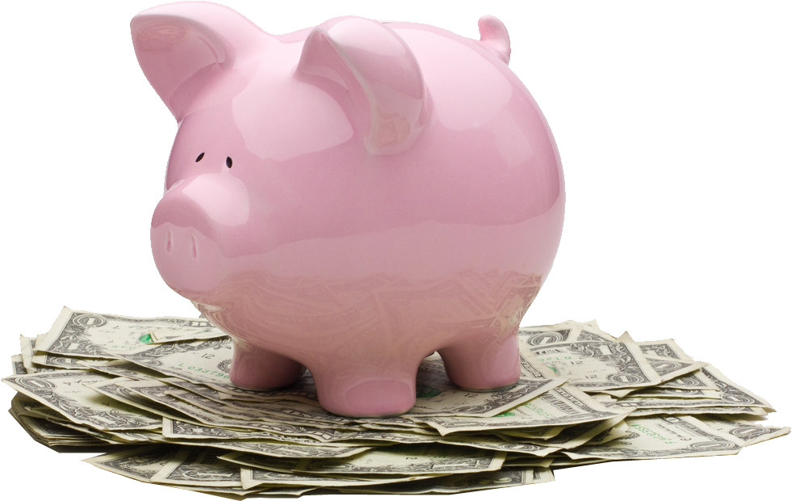
1- Accumulate Wealth 6:17
¹⁷ Command those who are rich in this present world
Notes:
Hope = FREE = from http://www.flickr.com/photos/lexrex/63744965/sizes/z/in/photostream/
Accumalte wealth = not to get wealth, but expects us to accumulate wealth. I’ve been in 3rd world nations—everyone here is wealthier.

Slide 20
1- Accumulate Wealth 6:17
¹⁷ Command those who are rich in this present world
Notes:
Hope = FREE = from http://www.flickr.com/photos/lexrex/63744965/sizes/z/in/photostream/
You are wealthy.

Slide 21
2- Hope in God 6:17
¹⁷ Command those who are rich in this present world not to be arrogant nor to put their hope in wealth, which is so uncertain,
Notes:
Hope = FREE = from http://www.flickr.com/photos/lexrex/63744965/sizes/z/in/photostream/
I should not be arrogant in my wealth—in fact, I was shamed by the Philippines pastor who ministered to his church with far less resources than i did.

Slide 22
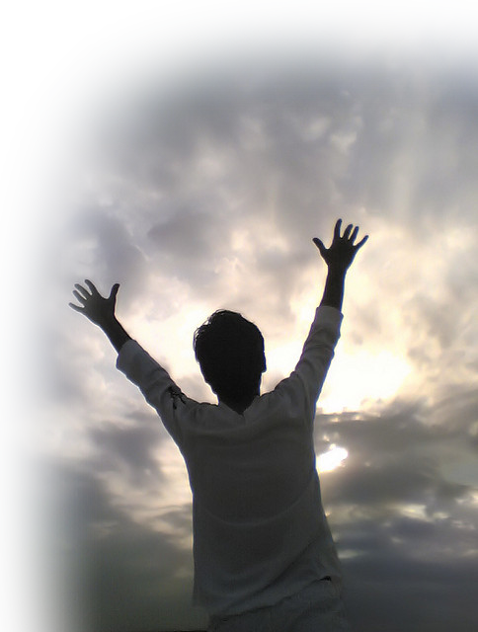
2- Hope in God 6:17
¹⁷ Command those who are rich in this present world not to be arrogant nor to put their hope in wealth, which is so uncertain, but to put their hope in God, who richly provides us with everything for our enjoyment.
Notes:
Hope = FREE = from http://www.flickr.com/photos/lexrex/63744965/sizes/z/in/photostream/

Slide 23
2- Hope in God 6:17
¹⁷ Command those who are rich in this present world not to be arrogant nor to put their hope in wealth, which is so uncertain, but to put their hope in God, who richly provides us with everything for our enjoyment.
Notes:
Hope = FREE = from http://www.flickr.com/photos/lexrex/63744965/sizes/z/in/photostream/
Q. 1. What is the chief end of man? A. Man’s chief end is to glorify God, and to enjoy him forever.
Here God wants us to enjoy all that He provides us. He wants to bless us – not curse us!

Slide 24
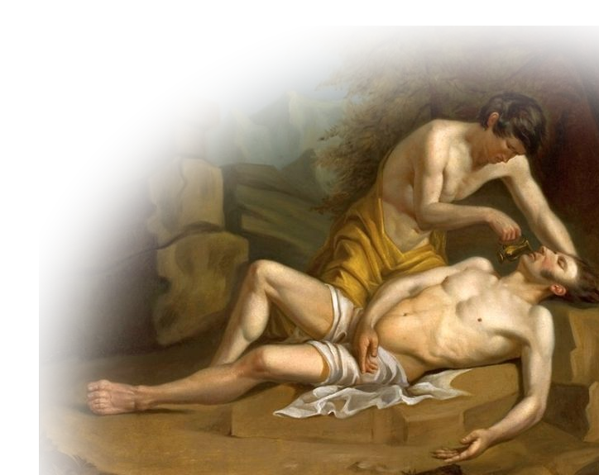
3- Do Good Deeds 6:18
¹⁸ Command them to do good, to be rich in good deeds,
Notes:
Good Samaritan = FREE = from http://commons.wikimedia.org/wiki/File:Sobiepan_Good_Samaritan.jpg
Often the people who you expect to be there are the last to do so. The Samaritan –was least expected.

Slide 25
4- Share Generously 6:18
¹⁸ Command them to do good, to be rich in good deeds, and to be generous and willing to share.
Notes:
Good Samaritan = FREE = from http://commons.wikimedia.org/wiki/File:Sobiepan_Good_Samaritan.jpg

Slide 26
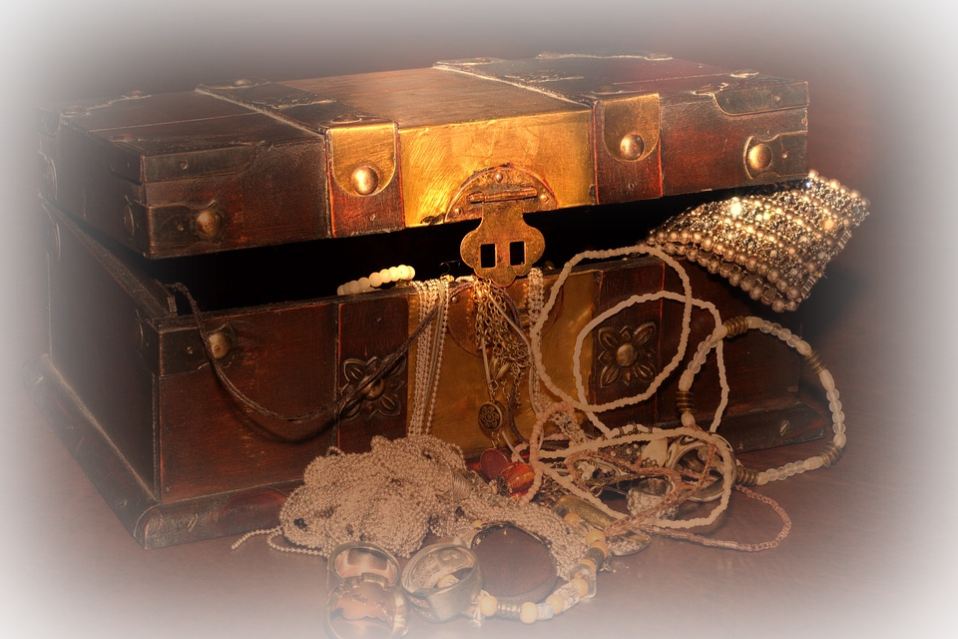
5- Lay Up Treasure 6:19
¹⁹ In this way they will lay up treasure for themselves as a firm foundation for the coming age,
Notes:
Treasures = FREE = http://blog.truffleshuffle.co.uk/wp-content/uploads/2017/01/treasure.jpg

Slide 27
5- Lay Up Treasure 6:19
¹⁹ In this way they will lay up treasure for themselves as a firm foundation for the coming age,
Notes:
Treasures = FREE = http://blog.truffleshuffle.co.uk/wp-content/uploads/2017/01/treasure.jpg
There once was a rich man who was near death. He was very grieved because he had worked so hard for his money and he wanted to be able to take it with him to heaven. So he began to pray that he might be able to take some of his wealth with him.
An angel hears his plea and appears to him. "Sorry, but you can't take your wealth with you."
The man implores the angel to speak to God to see if He might bend the rules. The man continues to pray that his wealth could FOLLOW him. The angel reappears and informs the man that God has decided to allow him to take one suitcase with him. Overjoyed, the man gathers his largest suitcase and fills it with pure gold bars and places it beside his bed.
Soon afterward the man dies and shows up at the Gates of Heaven to greet St. Peter. St. Peter, seeing the suitcase says, "Hold on, you can't bring that in here!"
But, the man explains to St. Peter that he has permission and asks him to verify his story with the Lord. Sure enough, St. Peter checks and comes back saying, "You're right. You are allowed one suitcase, but I'm supposed to check its contents before letting it through."
St. Peter opens the suitcase to inspect the worldly items that the man found too precious to leave behind and exclaims, "You brought pavement?!!!"

Slide 28
6- Take Hold on Life 6:19
¹⁹ In this way they will lay up treasure for themselves as a firm foundation for the coming age, so that they may take hold of the life that is truly life.
Notes:
Grab = FREE = from http://www.flickr.com/photos/robertschrader/8023718020/sizes/h/in/photostream/
Invest in what really matters—life—”Church Life!

Slide 29
III. Sons in the Faith who:

Slide 30
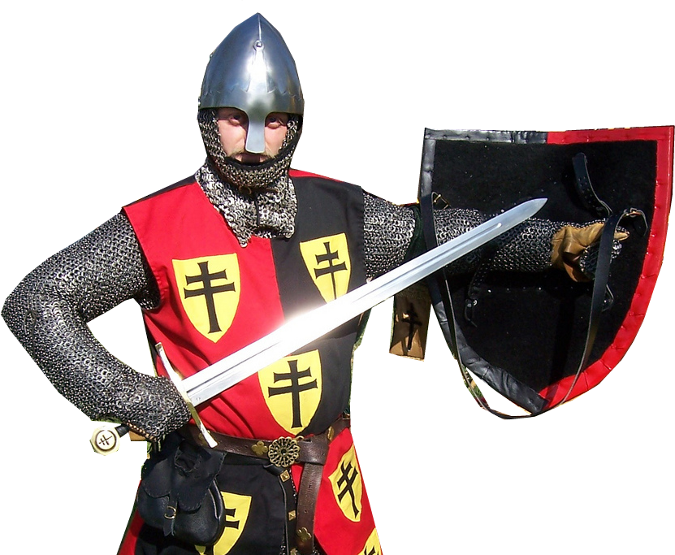
1- Guard the Faith 6:20
²⁰ Timothy, guard what has been entrusted to your care.
Notes:
Knight = FREE = from http://www.flickr.com/photos/8765199@N07/2578187756/sizes/l/in/photostream/

Slide 31
2- Turn Away Godlessness 6:20
²⁰ Timothy, guard what has been entrusted to your care. Turn away from godless chatter and the opposing ideas of what is falsely called knowledge,

Slide 32
3- Stay True 6:21
²¹ which some have professed and in so doing have wandered from the faith. Grace be with you.

Slide 33
Let’s Sum It Up!
To Get the MOST our of CHURCH …
Bethany needs:

Slide 34
Let’s Sum It Up!
To Get the MOST our of CHURCH …
Bethany needs:
A Man of God to lead!

Slide 35
Let’s Sum It Up!
To Get the MOST our of CHURCH …
Bethany needs:
A Man of God to lead!
A Faithful people to follow!

Slide 36
Let’s Sum It Up!
To Get the MOST our of CHURCH …
Bethany needs:
A Man of God to lead!
A Faithful people to follow!
Younger generation (like Timothy) to pass it on to!
Notes:
Roy and Lila Neal – invested in my ministry when a college and seminary student. Investing in the younger generation to pass it on.

Slide 37
Let’s Pray

