Slide 1
Notes:
Background stained glass = Licensed from bigstock photos. Not for reuse elsewhere. http://www.bigstockphoto.com/image-84022553/stock-photo-stained-glass-window-church

Slide 2
When you do ... Church Will Make an IMPACT on YOU!
Notes:
Background stained glass = Licensed from bigstock photos. Not for reuse elsewhere. http://www.bigstockphoto.com/image-84022553/stock-photo-stained-glass-window-church

Slide 3
1—It Impacts Your Job!
Before Your UNBELIEVING BOSS
Notes:
Hiring sign = FREE = from http://www.flickr.com/photos/magnetbox/2704415839/

Slide 4
1—It Impacts Your Job!
Before Your UNBELIEVING BOSS
¹ All who are under the yoke of slavery should consider their masters worthy of full respect, so that God's name and our teaching may not be slandered.
Notes:
Hiring sign = FREE = from http://www.flickr.com/photos/magnetbox/2704415839/

Slide 5
1—It Impacts Your Job!
Before Your UNBELIEVING BOSS
¹ All who are under the yoke of slavery should consider their masters worthy of full respect, so that God's name and our teaching may not be slandered.
²³ Whatever you do, work at it with all your heart, as working for the Lord, not for men, (Col 3:23)
Notes:
Hiring sign = FREE = from http://www.flickr.com/photos/magnetbox/2704415839/
Cloud = FREE = https://pixabay.com/en/clouds-sky-blue-clouds-form-white-1468272/

Slide 6
1—It Impacts Your Job!
Before Your BELIEVER BOSS
² Those who have believing masters are not to show less respect for them because they are brothers. Instead, they are to serve them even better, because those who benefit from their service are believers, and dear to them. These are the things you are to teach and urge on them.
Notes:
Take the slave Onesimus from Philemon as a case in point.
Waiter= https://pixabay.com/en/cafe-waiter-operation-flirt-kundin-1699126/

Slide 7
2—It Impacts Your Teaching
Notes:
Bible = FREE = from http://commons.wikimedia.org/wiki/File:La_Bible,_Notre-Dame_du_Taur,_septembre_2011.jpg

Slide 8
2—It Impacts Your Teaching
You Discern Sound Teaching
³ If anyone teaches false doctrines and does not agree to the sound instruction of our Lord Jesus Christ and to godly teaching,
Notes:
Bible = FREE = from http://commons.wikimedia.org/wiki/File:La_Bible,_Notre-Dame_du_Taur,_septembre_2011.jpg

Slide 9
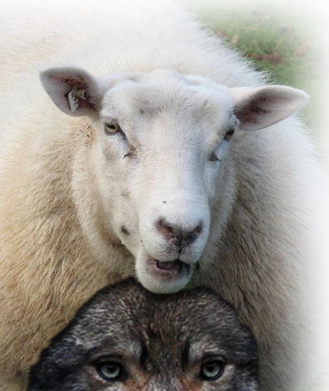
2—It Impacts Your Teaching
Avoid False Teachers
⁴ he is conceited and understands nothing. He has an unhealthy interest in controversies and quarrels about words that result in envy, strife, malicious talk, evil suspicions
Notes:
Cf. Matthew 7:15 "Watch out for false prophets. They come to you in sheep's clothing, but inwardly they are ferocious wolves. (Mat 7:15 NIV)
Wolf in sheep’s clothing = FREE = from http://www.flickr.com/photos/pierre_tourigny/367078204/sizes/o/in/photostream/

Slide 10
2—It Impacts Your Teaching
Matthew 7:15
Watch out for false prophets. They come to you in sheep's clothing, but inwardly they are ferocious wolves.
Avoid False Teachers
⁴ he is conceited and understands nothing. He has an unhealthy interest in controversies and quarrels about words that result in envy, strife, malicious talk, evil suspicions
Notes:
Cf. Matthew 7:15 "Watch out for false prophets. They come to you in sheep's clothing, but inwardly they are ferocious wolves. (Mat 7:15 NIV)
Wolf in sheep’s clothing = FREE = from http://www.flickr.com/photos/pierre_tourigny/367078204/sizes/o/in/photostream/

Slide 11
2—It Impacts Your Teaching
Matthew 7:15
Avoid False Teachers
⁴ he is conceited and understands nothing. He has an unhealthy interest in controversies and quarrels about words that result in envy, strife, malicious talk, evil suspicions
Notes:
Cf. Matthew 7:15 "Watch out for false prophets. They come to you in sheep's clothing, but inwardly they are ferocious wolves. (Mat 7:15 NIV)
Wolf in sheep’s clothing = FREE = from http://www.flickr.com/photos/pierre_tourigny/367078204/sizes/o/in/photostream/

Slide 12
2—It Impacts Your Teaching
Matthew 7:15
Avoid False Teachers
⁴ he is conceited and understands nothing. He has an unhealthy interest in controversies and quarrels about words that result in envy, strife, malicious talk, evil suspicions
Notes:
Cf. Matthew 7:15 "Watch out for false prophets. They come to you in sheep's clothing, but inwardly they are ferocious wolves. (Mat 7:15 NIV)
Wolf in sheep’s clothing = FREE = from http://www.flickr.com/photos/pierre_tourigny/367078204/sizes/o/in/photostream/

Slide 13
2—It Impacts Your Teaching
Matthew 7:15
Avoid False Teachers
⁴ he is conceited and understands nothing. He has an unhealthy interest in controversies and quarrels about words that result in envy, strife, malicious talk, evil suspicions
Notes:
Cf. Matthew 7:15 "Watch out for false prophets. They come to you in sheep's clothing, but inwardly they are ferocious wolves. (Mat 7:15 NIV)
Wolf in sheep’s clothing = FREE = from http://www.flickr.com/photos/pierre_tourigny/367078204/sizes/o/in/photostream/

Slide 14
2—It Impacts Your Teaching
Matthew 7:15
Avoid False Teachers
⁴ he is conceited and understands nothing. He has an unhealthy interest in controversies and quarrels about words that result in envy, strife, malicious talk, evil suspicions
Notes:
Cf. Matthew 7:15 "Watch out for false prophets. They come to you in sheep's clothing, but inwardly they are ferocious wolves. (Mat 7:15 NIV)
Wolf in sheep’s clothing = FREE = from http://www.flickr.com/photos/pierre_tourigny/367078204/sizes/o/in/photostream/

Slide 15
2—It Impacts Your Teaching
Matthew 7:15
Now days it’s the POLITICALLY CORRECT!
Avoid False Teachers
⁴ he is conceited and understands nothing. He has an unhealthy interest in controversies and quarrels about words that result in envy, strife, malicious talk, evil suspicions
Notes:
Cf. Matthew 7:15 "Watch out for false prophets. They come to you in sheep's clothing, but inwardly they are ferocious wolves. (Mat 7:15 NIV)
Wolf in sheep’s clothing = FREE = from http://www.flickr.com/photos/pierre_tourigny/367078204/sizes/o/in/photostream/

Slide 16
2—It Impacts Your Teaching
Matthew 7:15
Avoid False Teachers
⁴ he is conceited and understands nothing. He has an unhealthy interest in controversies and quarrels about words that result in envy, strife, malicious talk, evil suspicions
Notes:
Cf. Matthew 7:15 "Watch out for false prophets. They come to you in sheep's clothing, but inwardly they are ferocious wolves. (Mat 7:15 NIV)
Wolf in sheep’s clothing = FREE = from http://www.flickr.com/photos/pierre_tourigny/367078204/sizes/o/in/photostream/

Slide 17
2—It Impacts Your Teaching
Matthew 7:15
Avoid False Teachers
⁴ he is conceited and understands nothing. He has an unhealthy interest in controversies and quarrels about words that result in envy, strife, malicious talk, evil suspicions
Notes:
Cf. Matthew 7:15 "Watch out for false prophets. They come to you in sheep's clothing, but inwardly they are ferocious wolves. (Mat 7:15 NIV)
Wolf in sheep’s clothing = FREE = from http://www.flickr.com/photos/pierre_tourigny/367078204/sizes/o/in/photostream/

Slide 18
2—It Impacts Your Teaching
Matthew 7:15
Avoid False Teachers
⁴ he is conceited and understands nothing. He has an unhealthy interest in controversies and quarrels about words that result in envy, strife, malicious talk, evil suspicions
Notes:
Cf. Matthew 7:15 "Watch out for false prophets. They come to you in sheep's clothing, but inwardly they are ferocious wolves. (Mat 7:15 NIV)
Wolf in sheep’s clothing = FREE = from http://www.flickr.com/photos/pierre_tourigny/367078204/sizes/o/in/photostream/

Slide 19
2—It Impacts Your Teaching
Matthew 7:15
Avoid False Teachers
⁴ he is conceited and understands nothing. He has an unhealthy interest in controversies and quarrels about words that result in envy, strife, malicious talk, evil suspicions
Notes:
Cf. Matthew 7:15 "Watch out for false prophets. They come to you in sheep's clothing, but inwardly they are ferocious wolves. (Mat 7:15 NIV)
Wolf in sheep’s clothing = FREE = from http://www.flickr.com/photos/pierre_tourigny/367078204/sizes/o/in/photostream/

Slide 20
2—It Impacts Your Teaching
Matthew 7:15
Avoid False Teachers
⁴ he is conceited and understands nothing. He has an unhealthy interest in controversies and quarrels about words that result in envy, strife, malicious talk, evil suspicions
Now days it’s FAKE NEWS!
Notes:
Cf. Matthew 7:15 "Watch out for false prophets. They come to you in sheep's clothing, but inwardly they are ferocious wolves. (Mat 7:15 NIV)
Wolf in sheep’s clothing = FREE = from http://www.flickr.com/photos/pierre_tourigny/367078204/sizes/o/in/photostream/

Slide 21
2—It Impacts Your Teaching
Avoid Charlatans
⁵ and constant friction between men of corrupt mind, who have been robbed of the truth ...
Notes:
Robber = FREE = from http://www.bigstockphoto.com/download/bid-6844583/

Slide 22
2—It Impacts Your Teaching
Avoid Charlatans
⁵ ... and who think that godliness is a means to financial gain.
Notes:
Robber = FREE = from http://www.bigstockphoto.com/download/bid-6844583/
Paul is telling Timothy that he is saying that the so called “Prosperity Gospel Preachers” are “False Teachers.”
Godliness is NOT a means to financial gain!!!
The true gospel is about the saving grace of the Lord Jesus Christ. Forgiveness of sins and assurance of eternal life!

Slide 23
2—It Impacts Your Teaching
Now days it’s the PROSPERITY GOSPEL!
Avoid Charlatans
⁵ ... and who think that godliness is a means to financial gain.
Notes:
Robber = FREE = from http://www.bigstockphoto.com/download/bid-6844583/
Paul is telling Timothy that he is saying that the so called “Prosperity Gospel Preachers” are “False Teachers.”
Godliness is NOT a means to financial gain!!!
The true gospel is about the saving grace of the Lord Jesus Christ. Forgiveness of sins and assurance of eternal life!

Slide 24
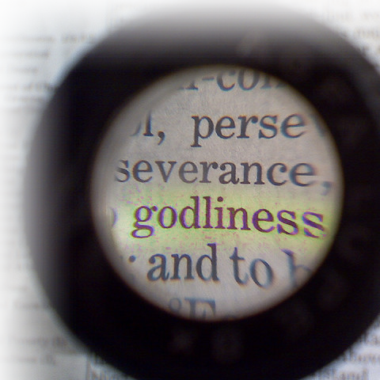
3—It Impacts Your Life-Style
Notes:
Magnified “godliness” = FREE = from http://www.flickr.com/photos/jnswanson/2252516924/sizes/z/in/photostream/
Phil “learned to be content” but how?
Be content with what you have – God is enough
Godliness with contentment brings great gain.
Not godliness alone nor contentment alone you must have both!

Slide 25
3—It Impacts Your Life-Style
⁶ But godliness with contentment is great gain. ⁷ For we brought nothing into the world, and we can take nothing out of it.
Notes:
Magnified “godliness” = FREE = from http://www.flickr.com/photos/jnswanson/2252516924/sizes/z/in/photostream/
Phil “learned to be content” but how?
Be content with what you have – God is enough
Godliness with contentment brings great gain.
Not godliness alone nor contentment alone you must have both!

Slide 26
3—It Impacts Your Life-Style
⁶ But godliness with contentment is great gain. ⁷ For we brought nothing into the world, and we can take nothing out of it.
The Equation
Notes:
Magnified “godliness” = FREE = from http://www.flickr.com/photos/jnswanson/2252516924/sizes/z/in/photostream/
Phil “learned to be content” but how?
Be content with what you have – God is enough
Godliness with contentment brings great gain.
Not godliness alone nor contentment alone you must have both!

Slide 27
3—It Impacts Your Life-Style
⁶ But godliness with contentment is great gain. ⁷ For we brought nothing into the world, and we can take nothing out of it.
The Equation
Godliness
Notes:
Magnified “godliness” = FREE = from http://www.flickr.com/photos/jnswanson/2252516924/sizes/z/in/photostream/
Phil “learned to be content” but how?
Be content with what you have – God is enough
Godliness with contentment brings great gain.
Not godliness alone nor contentment alone you must have both!

Slide 28
3—It Impacts Your Life-Style
⁶ But godliness with contentment is great gain. ⁷ For we brought nothing into the world, and we can take nothing out of it.
The Equation
Godliness
+ Contentment
Notes:
Magnified “godliness” = FREE = from http://www.flickr.com/photos/jnswanson/2252516924/sizes/z/in/photostream/
Phil “learned to be content” but how?
Be content with what you have – God is enough
Godliness with contentment brings great gain.
Not godliness alone nor contentment alone you must have both!

Slide 29
3—It Impacts Your Life-Style
⁶ But godliness with contentment is great gain. ⁷ For we brought nothing into the world, and we can take nothing out of it.
The Equation
Godliness
+ Contentment
= GREAT GAIN
Notes:
Magnified “godliness” = FREE = from http://www.flickr.com/photos/jnswanson/2252516924/sizes/z/in/photostream/
Phil “learned to be content” but how?
Be content with what you have – God is enough
Godliness with contentment brings great gain.
Not godliness alone nor contentment alone you must have both!

Slide 30
3—It Impacts Your Life-Style
⁶ But godliness with contentment is great gain. ⁷ For we brought nothing into the world, and we can take nothing out of it.
The Equation
Godliness
+ Contentment
= GREAT GAIN
Phil 4:11-13
Notes:
Magnified “godliness” = FREE = from http://www.flickr.com/photos/jnswanson/2252516924/sizes/z/in/photostream/
Phil “learned to be content” but how?
Be content with what you have – God is enough
Godliness with contentment brings great gain.
Not godliness alone nor contentment alone you must have both!

Slide 31
3—It Impacts Your Life-Style
I have learned to be content whatever the circumstances.
¹² I know what it is to be in need, and I know what it is to have plenty. I have learned the secret of being content in any and every situation, whether well fed or hungry, whether living in plenty or in want.
⁶ But godliness with contentment is great gain. ⁷ For we brought nothing into the world, and we can take nothing out of it.
The Equation
Godliness
+ Contentment
= GREAT GAIN
Phil 4:11-13
Notes:
Magnified “godliness” = FREE = from http://www.flickr.com/photos/jnswanson/2252516924/sizes/z/in/photostream/
Phil “learned to be content” but how?
Be content with what you have – God is enough
Godliness with contentment brings great gain.
Not godliness alone nor contentment alone you must have both!

Slide 32
3—It Impacts Your Life-Style
THE SECRET IS:
¹³ I can do everything through him who gives me strength.
⁶ But godliness with contentment is great gain. ⁷ For we brought nothing into the world, and we can take nothing out of it.
The Equation
Godliness
+ Contentment
= GREAT GAIN
Phil 4:11-13
Notes:
Magnified “godliness” = FREE = from http://www.flickr.com/photos/jnswanson/2252516924/sizes/z/in/photostream/
Phil “learned to be content” but how?
Be content with what you have – God is enough
Godliness with contentment brings great gain.
Not godliness alone nor contentment alone you must have both!

Slide 33
3—It Impacts Your Life-Style
⁶ But godliness with contentment is great gain. ⁷ For we brought nothing into the world, and we can take nothing out of it.
Notes:
Magnified “godliness” = FREE = from http://www.flickr.com/photos/jnswanson/2252516924/sizes/z/in/photostream/
Phil “learned to be content” but how?
Be content with what you have – God is enough
Godliness with contentment brings great gain.
Not godliness alone nor contentment alone you must have both!

Slide 34
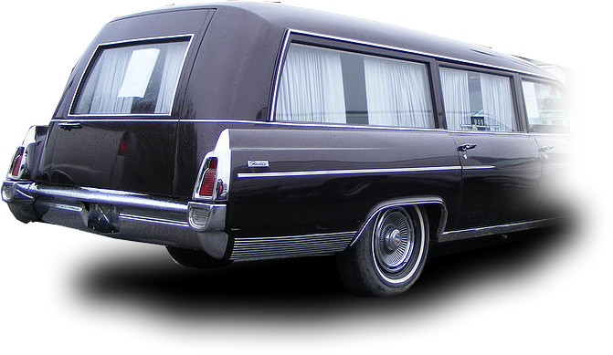
3—It Impacts Your Life-Style
⁶ But godliness with contentment is great gain. ⁷ For we brought nothing into the world, and we can take nothing out of it.
Notes:
Magnified “godliness” = FREE = from http://www.flickr.com/photos/jnswanson/2252516924/sizes/z/in/photostream/
Phil “learned to be content” but how?
Be content with what you have – God is enough
Godliness with contentment brings great gain.
Not godliness alone nor contentment alone you must have both!

Slide 35
3—It Impacts Your Life-Style
⁸ But if we have food and clothing, we will be content with that.
The Equation
Godliness
+ Contentment
= GREAT GAIN
Phil 4:11,12
Notes:
Stork =FREE = from http://commons.wikimedia.org/wiki/File:Stork_with_new-born_child.png
U-haul = FREE = from http://www.flickr.com/photos/ooocha/2854462353/sizes/l/in/photostream/
Magnified “godliness” = FREE = from http://www.flickr.com/photos/jnswanson/2252516924/sizes/z/in/photostream/
Phil “learned to be content” but how?
Be content with what you have – God is enough
Godliness with contentment brings great gain.
Not godliness alone nor contentment alone you must have both!

Slide 36
4—It Impacts Your Money
Notes:
Money trap = FREE = from http://www.flickr.com/photos/bitzcelt/3058009462/sizes/l/in/photostream/

Slide 37
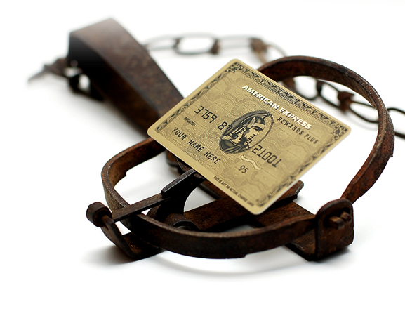
4—It Impacts Your Money
You AVOID ...
⁹ People who want to get rich fall into temptation and a trap and into many foolish and harmful desires that plunge men into ruin and destruction.
Notes:
Money trap = FREE = from http://www.flickr.com/photos/bitzcelt/3058009462/sizes/l/in/photostream/

Slide 38
4—It Impacts Your Money
You AVOID ...
⁹ People who want to get rich fall into temptation and a trap and into many foolish and harmful desires that plunge men into ruin and destruction.
Notes:
Money trap = FREE = from http://www.flickr.com/photos/bitzcelt/3058009462/sizes/l/in/photostream/

Slide 39
4—It Impacts Your Money
¹⁰ For the love of money is a root of all kinds of evil.
Notes:
Money heart = free= from http://www.flickr.com/photos/thomashawk/2232775569/sizes/z/in/photostream/
For where your treasure is, there your heart will be also. (Mat 6:21 NIV)

Slide 40
4—It Impacts Your Money
¹⁰ For the love of money is a root of all kinds of evil.
For where your treasure is, there your heart will be also. (Mat 6:21)
Notes:
Money heart = free= from http://www.flickr.com/photos/thomashawk/2232775569/sizes/z/in/photostream/
For where your treasure is, there your heart will be also. (Mat 6:21 NIV)

Slide 41
4—It Impacts Your Money
¹⁰ For the love of money is a root of all kinds of evil. Some people, eager for money, have wandered from the faith and pierced themselves with many griefs.
Notes:
Money heart = free= from http://www.flickr.com/photos/thomashawk/2232775569/sizes/z/in/photostream/
For where your treasure is, there your heart will be also. (Mat 6:21 NIV)

Slide 42
4—It Impacts Your Money
¹⁰ For the love of money is a root of all kinds of evil. Some people, eager for money, have wandered from the faith and pierced themselves with many griefs.
Notes:
Money heart = free= from http://www.flickr.com/photos/thomashawk/2232775569/sizes/z/in/photostream/
For where your treasure is, there your heart will be also. (Mat 6:21 NIV)
Grief = https://pixabay.com/en/woman-old-senior-desperation-grief-1246587/

Slide 43
Take this thought with YOU!
When you Get the MOST out of CHURCH, it impacts every aspect of your life for good!

Slide 44
Take this thought with YOU!
When you Get the MOST out of CHURCH, it impacts every aspect of your life for good!
What you do—Your JOB!

Slide 45
Take this thought with YOU!
When you Get the MOST out of CHURCH, it impacts every aspect of your life for good!
What you do—Your JOB!
What you think—Your TEACHING!

Slide 46
Take this thought with YOU!
When you Get the MOST out of CHURCH, it impacts every aspect of your life for good!
What you do—Your JOB!
What you think—Your TEACHING!
How you live—Your LIFE-STYLE!

Slide 47
Take this thought with YOU!
When you Get the MOST out of CHURCH, it impacts every aspect of your life for good!
What you do—Your JOB!
What you think—Your TEACHING!
How you live—Your LIFE-STYLE!
What you love—Your MONEY!

Slide 48
Take this thought with YOU!
When you Get the MOST out of CHURCH, it impacts every aspect of your life for good!

Slide 49
Take this thought with YOU!
When you Get the MOST out of CHURCH, it impacts every aspect of your life for good!
So, why would you ever miss?

Slide 50
Take this thought with YOU!
When you Get the MOST out of CHURCH, it impacts every aspect of your life for good!
So, plan to attend every service?
Plan to be faithful and then watch the impact it has on your life.

Slide 51
LET’S PRAY!

