Slide 1
By Getting Down to Business!
Notes:
Cathedral Background = FREE = from http://www.flickr.com/photos/maveric2003/3173540730/sizes/l/in/photostream/

Slide 2
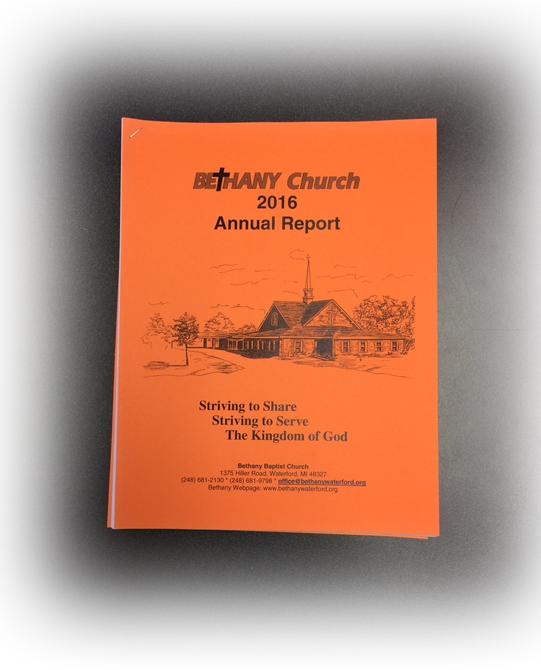
Getting Down to Business

Slide 3
1- Financial Business

Slide 4
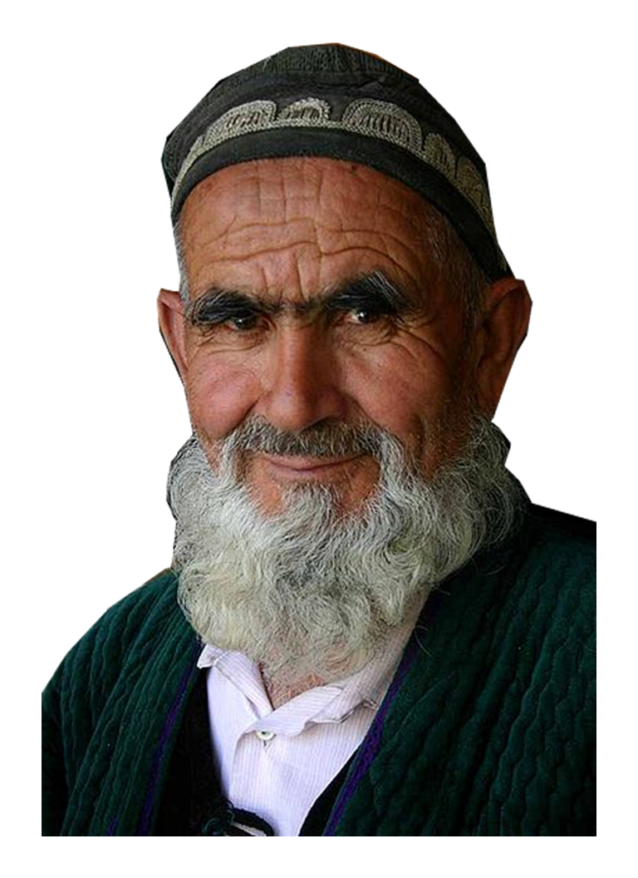
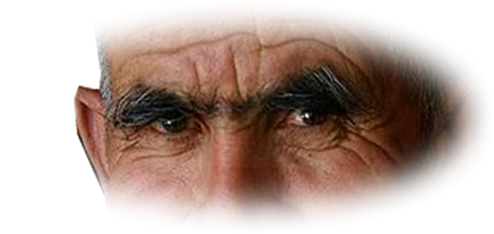
1- Financial Business
Re: The Pastor’s Job
¹⁷ The elders who direct the affairs of the church well are worthy of double honor,

Slide 5
1- Financial Business
Re: The Pastor’s Job
¹⁷ The elders who direct the affairs of the church well are worthy of double honor,
Notes:
Hand = FREE = from http://www.fotopedia.com/items/flickr-5730487325

Slide 6
1- Financial Business
Re: The Pastor’s Job
¹⁷ The elders who direct the affairs of the church well are worthy of double honor,
Notes:
Hand = FREE = from http://www.fotopedia.com/items/flickr-5730487325

Slide 7
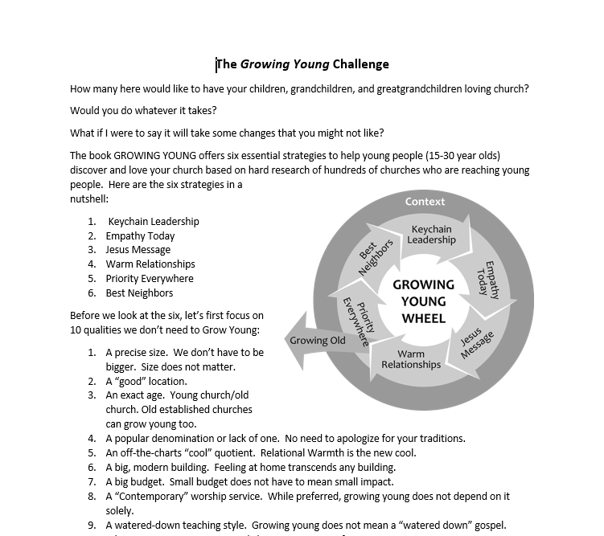
1- Financial Business
Re: The Pastor’s Job
¹⁷ The elders who direct the affairs of the church well are worthy of double honor,
Notes:
Hand = FREE = from http://www.fotopedia.com/items/flickr-5730487325

Slide 8
1- Financial Business
Re: The Pastor’s Pay
¹⁷ The elders who direct the affairs of the church well are worthy of double honor,

Slide 9
1- Financial Business
Re: The Pastor’s Work
¹⁷ The elders who direct the affairs of the church well are worthy of double honor, especially those whose work is preaching and teaching.

Slide 10
1- Financial Business
Re: The Pastor’s Work
¹⁷ The elders who direct the affairs of the church well are worthy of double honor, especially those whose work is preaching and teaching.

Slide 11
1- Financial Business
The REASON
¹⁸ For the Scripture says,

Slide 12
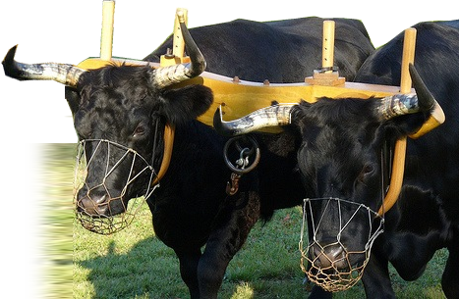
1- Financial Business
The REASON
¹⁸ For the Scripture says, "Do not muzzle the ox while it is treading out the grain,”
Notes:
http://plimtuna.files.wordpress.com/2010/03/muzzled_oxen.jpg

Slide 13
1- Financial Business
The REASON
¹⁸ For the Scripture says, "Do not muzzle the ox while it is treading out the grain,”
Deuteronomy 25:4
Notes:
http://plimtuna.files.wordpress.com/2010/03/muzzled_oxen.jpg

Slide 14
1- Financial Business
The REASON
¹⁸ For the Scripture says, "Do not muzzle the ox while it is treading out the grain," and "The worker deserves his wages.”
Notes:
Money = FREE = from http://www.flickr.com/photos/68751915@N05/6722544475/sizes/l/in/photostream/

Slide 15
1- Financial Business
The REASON
¹⁸ For the Scripture says, "Do not muzzle the ox while it is treading out the grain," and "The worker deserves his wages.” LUKE 10:7
Notes:
Money = FREE = from http://www.flickr.com/photos/68751915@N05/6722544475/sizes/l/in/photostream/

Slide 16
2- Legal Business
¹⁹ Do not entertain an accusation against an elder unless it is brought by two or three witnesses.
Notes:
Accusing = FREE = from http://www.flickr.com/photos/lachlanhardy/3045949192/
Watch out for “Fake News.” Find the sources!

Slide 17
3- Scandalous Business
²⁰ Those who sin are to be rebuked publicly, so that the others may take warning.

Slide 18
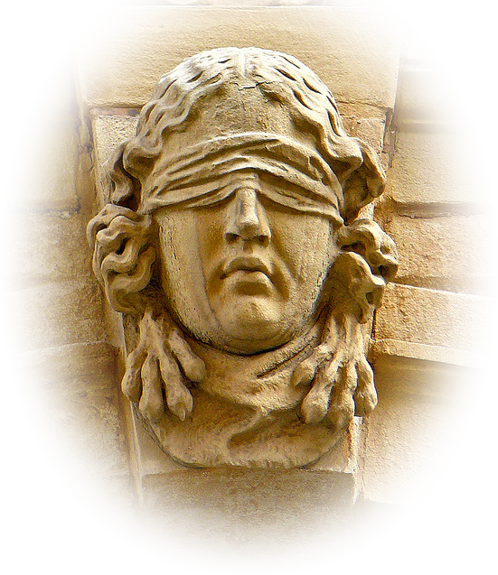
4- Fair Business
²¹ I charge you, in the sight of God and Christ Jesus and the elect angels, to keep these instructions without partiality, and to do nothing out of favoritism.
Notes:
Blind = FREE= from http://www.flickr.com/photos/atoach/2830780815/sizes/z/in/photostream/

Slide 19
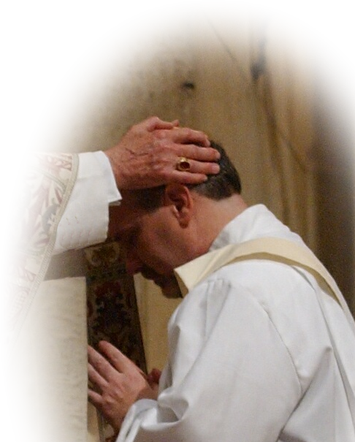
5- Leadership Business
²² Do not be hasty in the laying on of hands,
Notes:
Laying on hands = FREE = from http://www.flickr.com/photos/smoses/3391246992/sizes/o/in/photostream/

Slide 20
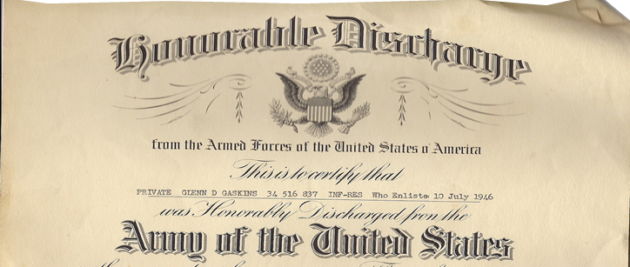
6- Honorable Business
²² Do not be hasty in the laying on of hands, and do not share in the sins of others. Keep yourself pure.

Slide 21
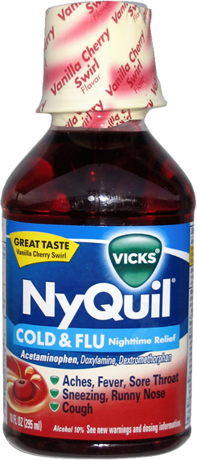
7- Personal Business
²³ Stop drinking only water, and use a little wine because of your stomach and your frequent illnesses.
Notes:
NyQuil = FREE = from http://www.flickr.com/photos/theimpulsivebuy/5484083665/sizes/l/in/photostream/

Slide 22
8- Problem Solving Bus.
²⁴ The sins of some men are obvious, reaching the place of judgment ahead of them; the sins of others trail behind them. ²⁵ In the same way, good deeds are obvious, and even those that are not cannot be hidden.
Notes:
Ministry is a Problem Solving Business. Identify the problem and solve the problem.

Slide 23
8- Problem Solving Bus.
²⁴ The sins of some men are obvious, reaching the place of judgment ahead of them; the sins of others trail behind them. ²⁵ In the same way, good deeds are obvious, and even those that are not cannot be hidden.
Notes:
Ministry is a Problem Solving Business. Identify the problem and solve the problem.
³ "But if you fail to do this, you will be sinning against the LORD; and you may be sure that your sin will find you out. (Num 32:23 NIV)

Slide 24
8- Problem Solving Bus.
²⁴ The sins of some men are obvious, reaching the place of judgment ahead of them; the sins of others trail behind them. ²⁵ In the same way, good deeds are obvious, and even those that are not cannot be hidden.
Notes:
Ministry is a Problem Solving Business. Identify the problem and solve the problem.

Slide 25
8- Problem Solving Bus.
²⁴ The sins of some men are obvious, reaching the place of judgment ahead of them; the sins of others trail behind them. ²⁵ In the same way, good deeds are obvious, and even those that are not cannot be hidden.
Notes:
Ministry is a Problem Solving Business. Identify the problem and solve the problem.

Slide 26
It’s almost time for us to Get Down to Business
With reports on:

Slide 27
It’s almost time for us to Get Down to Business
With reports on:
Finances matters

Slide 28
It’s almost time for us to Get Down to Business
With reports on:
Finances matters
Pastoral matters

Slide 29
It’s almost time for us to Get Down to Business
With reports on:
Finances matters
Pastoral matters
Legal matters

Slide 30
It’s almost time for us to Get Down to Business
With reports on:
Finances matters
Pastoral matters
Legal matters
Problem solving matters

Slide 31
Let’s Pray

