Slide 1
By Caring for People in Need!
Notes:
Cathedral Background = FREE = from http://www.flickr.com/photos/maveric2003/3173540730/sizes/l/in/photostream/

Slide 2
I. Caring for the Congregation
Notes:
Old man = FREE = from http://commons.wikimedia.org/wiki/File:Felicyn_Oldman.jpg
Old woman = FREE = BiblePoint
Young man
Young woman = FREE = BiblePoint

Slide 3
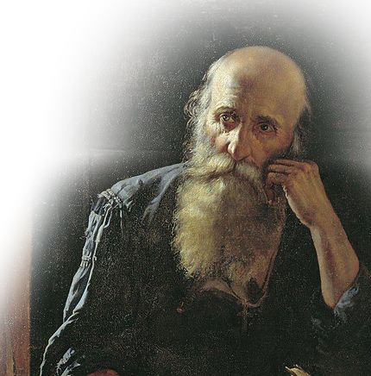
I. Caring for the Congregation
¹ Do not rebuke an older man harshly, but exhort him as if he were your father. Treat younger men as brothers,
² older women as mothers, and younger women as sisters, with absolute purity.
Notes:
Old man = FREE = from http://commons.wikimedia.org/wiki/File:Felicyn_Oldman.jpg
Old woman = FREE = BiblePoint
Young man
Young woman = FREE = BiblePoint

Slide 4
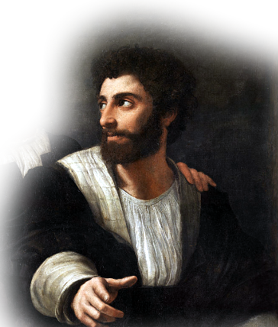
I. Caring for the Congregation
¹ Do not rebuke an older man harshly, but exhort him as if he were your father. Treat younger men as brothers,
² older women as mothers, and younger women as sisters, with absolute purity.
Notes:
Old man = FREE = from http://commons.wikimedia.org/wiki/File:Felicyn_Oldman.jpg
Old woman = FREE = BiblePoint
Young man
Young woman = FREE = BiblePoint

Slide 5
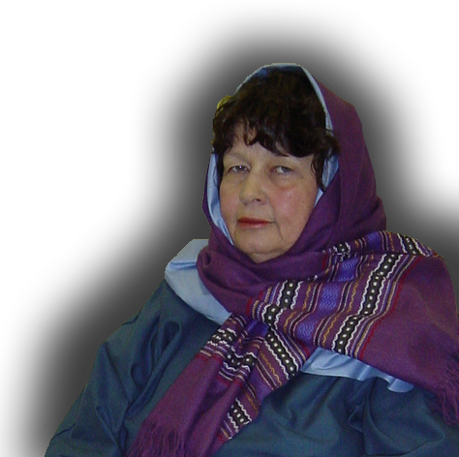
I. Caring for the Congregation
¹ Do not rebuke an older man harshly, but exhort him as if he were your father. Treat younger men as brothers,
² older women as mothers, and younger women as sisters, with absolute purity.
Notes:
Old man = FREE = from http://commons.wikimedia.org/wiki/File:Felicyn_Oldman.jpg
Old woman = FREE = BiblePoint
Young man
Young woman = FREE = BiblePoint

Slide 6
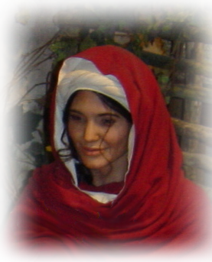
I. Caring for the Congregation
¹ Do not rebuke an older man harshly, but exhort him as if he were your father. Treat younger men as brothers,
² older women as mothers, and younger women as sisters, with absolute purity.
Notes:
Old man = FREE = from http://commons.wikimedia.org/wiki/File:Felicyn_Oldman.jpg
Old woman = FREE = BiblePoint
Young man
Young woman = FREE = BiblePoint

Slide 7
I. Caring for the Congregation
¹ Do not rebuke an older man harshly, but exhort him as if he were your father. Treat younger men as brothers,
² older women as mothers, and younger women as sisters, with absolute purity.
So What does this all mean?
Notes:
Old man = FREE = from http://commons.wikimedia.org/wiki/File:Felicyn_Oldman.jpg
Old woman = FREE = BiblePoint
Young man
Young woman = FREE = BiblePoint

Slide 8
I. Caring for the Congregation
¹ Do not rebuke an older man harshly, but exhort him as if he were your father. Treat younger men as brothers,
² older women as mothers, and younger women as sisters, with absolute purity.
So What does this all mean?
We’re FAMILY!
Notes:
Old man = FREE = from http://commons.wikimedia.org/wiki/File:Felicyn_Oldman.jpg
Old woman = FREE = BiblePoint
Young man
Young woman = FREE = BiblePoint

Slide 9
II. Caring for the Needy
³ Give proper recognition to those widows who are really in need.

Slide 10
II. Caring for the Needy
³ Give proper recognition to those widows who are really in need.
Every church has the needy

Slide 11
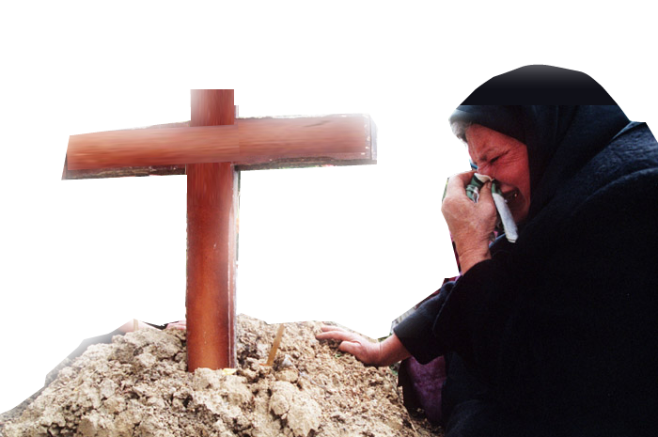
1- Recognize Degrees of Need
³ Give proper recognition to those widows who are really in need.
Notes:
Widow = FREE = from http://commons.wikimedia.org/wiki/File:Evstafiev-bosnia-sarajevo-woman-cries-at-grave.jpg

Slide 12
1- Recognize Degrees of Need
⁵ The widow who is really in need and left all alone ...
Notes:
Widow = FREE = from http://commons.wikimedia.org/wiki/File:Evstafiev-bosnia-sarajevo-woman-cries-at-grave.jpg

Slide 13
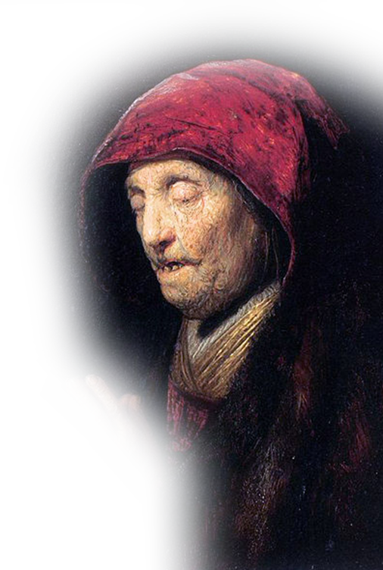
2- Note the Character
⁵ The widow who is really in need and left all alone puts her hope in God and continues night and day to pray and to ask God for help. ⁶ But the widow who lives for pleasure is dead even while she lives. ⁷ Give the people these instructions, too, so that no one may be open to blame.
HOPEFUL
Notes:
Old praying woman = FREE = from http://commons.wikimedia.org/wiki/File:Rembrandt_-_Old_Woman_Praying_-_WGA19161.jpg

Slide 14
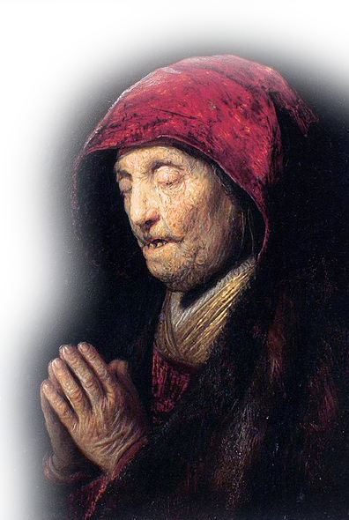
2- Note the Character
⁵ The widow who is really in need and left all alone puts her hope in God and continues night and day to pray and to ask God for help. ⁶ But the widow who lives for pleasure is dead even while she lives. ⁷ Give the people these instructions, too, so that no one may be open to blame.
PRAYERFUL
Notes:
Old praying woman = FREE = from http://commons.wikimedia.org/wiki/File:Rembrandt_-_Old_Woman_Praying_-_WGA19161.jpg

Slide 15
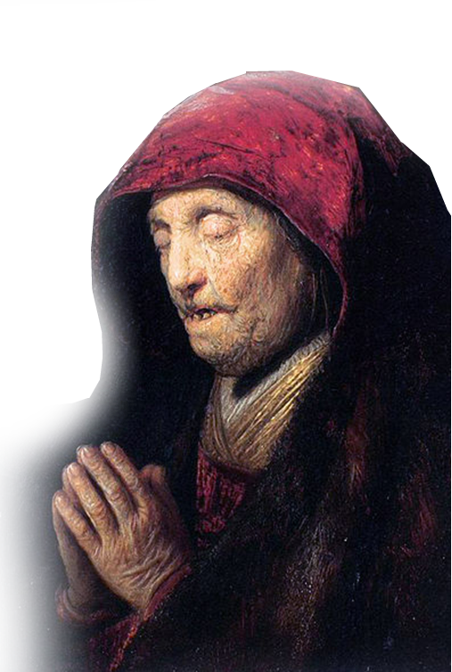
2- Note the Character
⁵ The widow who is really in need and left all alone puts her hope in God and continues night and day to pray and to ask God for help. ⁶ But the widow who lives for pleasure is dead even while she lives. ⁷ Give the people these instructions, too, so that no one may be open to blame.
SPIRITUAL
Notes:
Old praying woman = FREE = from http://commons.wikimedia.org/wiki/File:Rembrandt_-_Old_Woman_Praying_-_WGA19161.jpg

Slide 16
2- Note the Character
⁵ The widow who is really in need and left all alone puts her hope in God and continues night and day to pray and to ask God for help. ⁶ But the widow who lives for pleasure is dead even while she lives. ⁷ Give the people these instructions, too, so that no one may be open to blame.
BLAMELESS
Notes:
Old praying woman = FREE = from http://commons.wikimedia.org/wiki/File:Rembrandt_-_Old_Woman_Praying_-_WGA19161.jpg

Slide 17
3- Assess the Qualifications
⁵ The widow who is really in need and left all alone
ALONE
Notes:
Old praying woman = FREE = from http://commons.wikimedia.org/wiki/File:Rembrandt_-_Old_Woman_Praying_-_WGA19161.jpg

Slide 18
3- Assess the Qualifications
⁹ No widow may be put on the list of widows unless she is over sixty, has been faithful to her husband, ¹⁰ and is well known for her good deeds, such as bringing up children, showing hospitality, washing the feet of the saints, helping those in trouble and devoting herself to all kinds of good deeds.
OVER 60
Notes:
Old praying woman = FREE = from http://commons.wikimedia.org/wiki/File:Rembrandt_-_Old_Woman_Praying_-_WGA19161.jpg

Slide 19
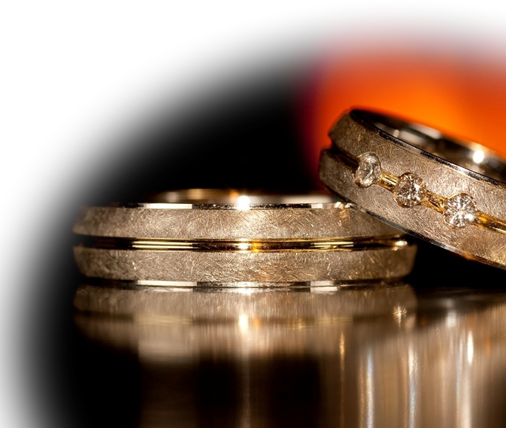
3- Assess the Qualifications
⁹ No widow may be put on the list of widows unless she is over sixty, has been faithful to her husband, ¹⁰ and is well known for her good deeds, such as bringing up children, showing hospitality, washing the feet of the saints, helping those in trouble and devoting herself to all kinds of good deeds.
ONE-MAN WOMAN
Notes:
Old praying woman = FREE = from http://commons.wikimedia.org/wiki/File:Rembrandt_-_Old_Woman_Praying_-_WGA19161.jpg

Slide 20
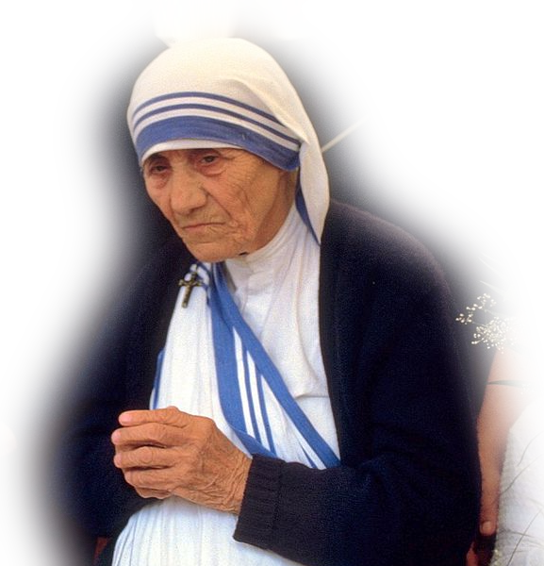
3- Assess the Qualifications
GOOD DEEDS
⁹ No widow may be put on the list of widows unless she is over sixty, has been faithful to her husband, ¹⁰ and is well known for her good deeds, such as bringing up children, showing hospitality, washing the feet of the saints, helping those in trouble and devoting herself to all kinds of good deeds.
Notes:
Mother Teresa = FREE = from http://commons.wikimedia.org/wiki/File:MotherTeresa_094.jpg
a disciple named Tabitha (which, when translated, is Dorcas), who was always doing good and helping the poor. (Act 9:36 NIV)

Slide 21
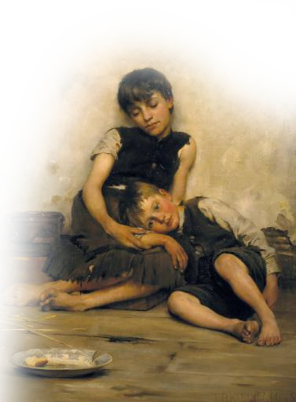
3- Assess the Qualifications
GOOD MOM
⁹ No widow may be put on the list of widows unless she is over sixty, has been faithful to her husband, ¹⁰ and is well known for her good deeds, such as bringing up children, showing hospitality, washing the feet of the saints, helping those in trouble and devoting herself to all kinds of good deeds.
Notes:
Orphans = FREE = from http://upload.wikimedia.org/wikipedia/commons/4/4c/Thomas_kennington_orphans_1885.jpg

Slide 22
3- Assess the Qualifications
ENTERTAINS
STRANGERS
⁹ No widow may be put on the list of widows unless she is over sixty, has been faithful to her husband, ¹⁰ and is well known for her good deeds, such as bringing up children, showing hospitality, washing the feet of the saints, helping those in trouble and devoting herself to all kinds of good deeds.
Notes:
Open House = FREE = from http://www.flickr.com/photos/orinrobertjohn/2506181668/sizes/l/in/photostream/

Slide 23
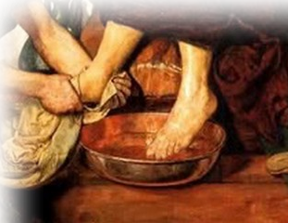
3- Assess the Qualifications
COURTEOUS
⁹ No widow may be put on the list of widows unless she is over sixty, has been faithful to her husband, ¹⁰ and is well known for her good deeds, such as bringing up children, showing hospitality, washing the feet of the saints, helping those in trouble and devoting herself to all kinds of good deeds.
Notes:
Foot Washing = FREE = from http://commons.wikimedia.org/wiki/File:FootWashing.jpg

Slide 24
3- Assess the Qualifications
HELPFUL
⁹ No widow may be put on the list of widows unless she is over sixty, has been faithful to her husband, ¹⁰ and is well known for her good deeds, such as bringing up children, showing hospitality, washing the feet of the saints, helping those in trouble and devoting herself to all kinds of good deeds.
Notes:
Helping hand = LICENSED AND NOT FOR REUSE ELSEWHERE.

Slide 25
3- Assess the Qualifications
DEVOTED
⁹ No widow may be put on the list of widows unless she is over sixty, has been faithful to her husband, ¹⁰ and is well known for her good deeds, such as bringing up children, showing hospitality, washing the feet of the saints, helping those in trouble and devoting herself to all kinds of good deeds.
Notes:
Dove = FREE = from http://en.wikipedia.org/wiki/File:Gian_Lorenzo_Bernini_-_Dove_of_the_Holy_Spirit.JPG

Slide 26
So what does it mean to us?
We must help believers who are truly needy
within the household of faith!

Slide 27
III. Caring for Family
Notes:
Family photo = NOT FOR COMERCIAL USE.

Slide 28
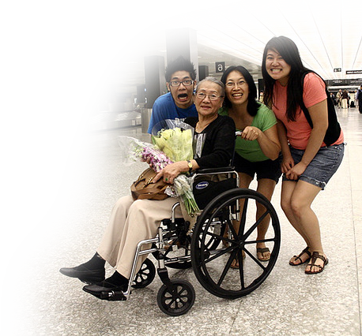
III. Caring for Family
⁴ But if a widow has children or grandchildren, these should learn first of all to put their religion into practice by caring for their own family …
Notes:
Family photo = NOT FOR COMERCIAL USE.

Slide 29
1-Repay Your Parents
⁴ But if a widow has children or grandchildren, these should learn first of all to put their religion into practice by caring for their own family and so repaying their parents and grandparents, for this is pleasing to God.
Notes:
Hand full of hundreds = FREE = from http://commons.wikimedia.org/wiki/File:American_Cash.JPG
http://money.cnn.com/2017/01/09/pf/cost-of-raising-a-child-2015/

Slide 30
1-Repay Your Parents
CNN Money
“It costs $233,610 to raise a child”
Jan 9, 2017
⁴ But if a widow has children or grandchildren, these should learn first of all to put their religion into practice by caring for their own family and so repaying their parents and grandparents, for this is pleasing to God.
Notes:
Hand full of hundreds = FREE = from http://commons.wikimedia.org/wiki/File:American_Cash.JPG
http://money.cnn.com/2017/01/09/pf/cost-of-raising-a-child-2015/

Slide 31
2-Keep the Faith
⁸ If anyone does not provide for his relatives, and especially for his immediate family, he has denied the faith and is worse than an unbeliever.
Notes:
Bible = FREE

Slide 32
Here’s the Point ...
Families are to take the lead...
the church is to fill the gap!

Slide 33
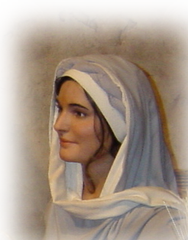
IV. Caring for “Not so Needy”
¹¹ As for younger widows, do not put them on such a list.

Slide 34
1- Examine their Desires
¹¹ As for younger widows, do not put them on such a list. For when their sensual desires overcome their dedication to Christ, they want to marry. ¹² Thus they bring judgment on themselves, because they have broken their first pledge.

Slide 35
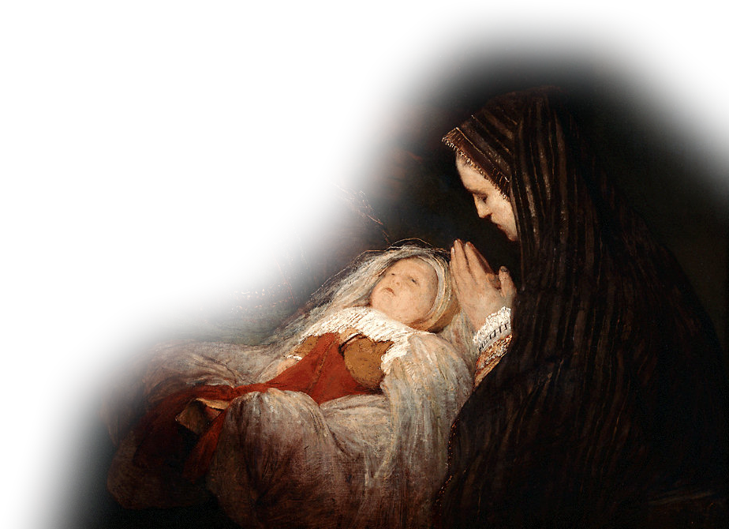
2- Examine their Commitment
¹¹ As for younger widows, do not put them on such a list. For when their sensual desires overcome their dedication to Christ, they want to marry. ¹² Thus they bring judgment on themselves, because they have broken their first pledge.
Notes:
Anna = FREE = from http://en.wikipedia.org/wiki/File:Aert_de_Gelder_-_Het_loflied_van_Simeon.jpg
Compare Anna ³⁶ There was also a prophetess, Anna, the daughter of Phanuel, of the tribe of Asher. She was very old; she had lived with her husband seven years after her marriage,
³⁷ and then was a widow until she was eighty-four. She never left the temple but worshiped night and day, fasting and praying.
³⁸ Coming up to them at that very moment, she gave thanks to God and spoke about the child to all who were looking forward to the redemption of Jerusalem.
(Luk 2:36-38 NIV)

Slide 36
3- Examine their Habits
¹³ Besides, they get into the habit of being idle and going about from house to house. And not only do they become idlers, but also gossips and busybodies, saying things they ought not to.
LAZINESS
Notes:
Feet up = FREE = from http://photos1.blogger.com/img/197/1543/640/50381385108_0_ALB2.jpg

Slide 37
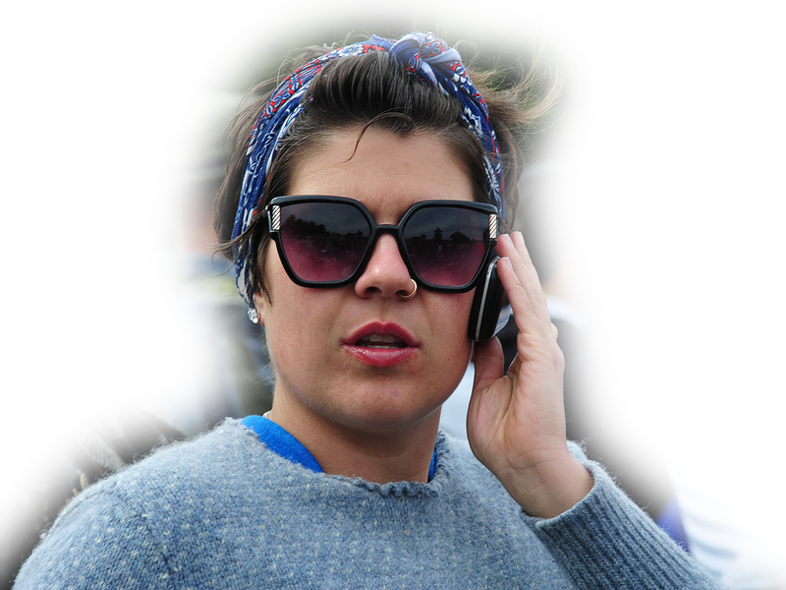
3- Examine their Habits
¹³ Besides, they get into the habit of being idle and going about from house to house. And not only do they become idlers, but also gossips and busybodies, saying things they ought not to.
Gossip
Notes:
On phone = FREE = from http://www.flickr.com/photos/chrishunkeler/6917600592/sizes/c/in/photostream/

Slide 38
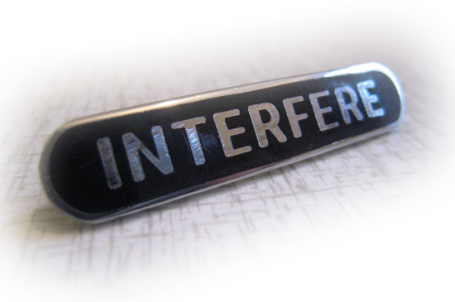
3- Examine their Habits
¹³ Besides, they get into the habit of being idle and going about from house to house. And not only do they become idlers, but also gossips and busybodies, saying things they ought not to.
Meddlers
Notes:
Interfere sign = from http://theoryofsupply.com/Interfere.htm

Slide 39
Here’s the big idea ...
There must be accountability in your CHARITY!

Slide 40
4-Counsel the Needy
¹⁴ So I counsel younger widows to marry, to have children, to manage their homes and to give the enemy no opportunity for slander. ¹⁵ Some have in fact already turned away to follow Satan
Notes:
Counseling sign = FREE = from http://www.flickr.com/photos/86530412@N02/8225379965/
Personally, I don’t think we should help financially anyone who refuse to take Financial Peace University.
But what if they cannot afford it—we have scholarships available so anyone who needs it can take it to get themselves on track.

Slide 41
4-Counsel the Needy
¹⁴ So I counsel younger widows to marry, to have children, to manage their homes and to give the enemy no opportunity for slander. ¹⁵ Some have in fact already turned away to follow Satan
Notes:
Counseling sign = FREE = from http://www.flickr.com/photos/86530412@N02/8225379965/
Personally, I don’t think we should help financially anyone who refuse to take Financial Peace University.
But what if they cannot afford it—we have scholarships available so anyone who needs it can take it to get themselves on track.

Slide 42
4-Counsel the Needy
¹⁴ So I counsel younger widows to marry, to have children, to manage their homes and to give the enemy no opportunity for slander. ¹⁵ Some have in fact already turned away to follow Satan
Notes:
Counseling sign = FREE = from http://www.flickr.com/photos/86530412@N02/8225379965/
Personally, I don’t think we should help financially anyone who refuse to take Financial Peace University.
But what if they cannot afford it—we have scholarships available so anyone who needs it can take it to get themselves on track.

Slide 43
Sometimes ...
Counsel is better than handouts!

Slide 44
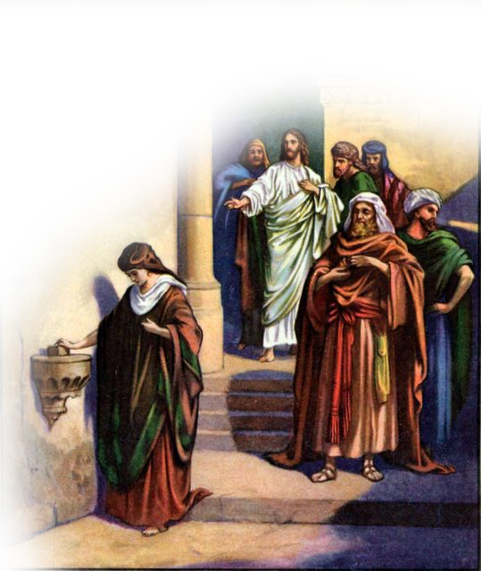
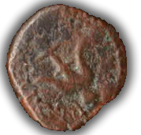
V. The Needy need to Help the Needy
Notes:
Widow’s mite.

Slide 45
V. The Needy need to Help the Needy
¹⁶ If any woman who is a believer has widows in her family, she should help them and not let the church be burdened with them,
Notes:
Widow’s mite.

Slide 46
V. The Needy need to Help the Needy
¹⁶ If any woman who is a believer has widows in her family, she should help them and not let the church be burdened with them, so that the church can help those widows who are really in need.
Notes:
Widow’s mite.

Slide 47
The Bottom Line:
[Do] not let the church be burdened with them [i.e., the needy], so that the church can help those widows who are really in need.

Slide 48
Getting the MOST out of CHURCH

Slide 49
Getting the MOST out of CHURCH
Requires taking care of the needy...
The needy who are in the CONGREGATION

Slide 50
Getting the MOST out of CHURCH
Requires taking care of the needy...
The needy who are in the CONGREGATION
The needy who are REALLY NEEDY

Slide 51
Getting the MOST out of CHURCH
Requires taking care of the needy...
The needy who are in the CONGREGATION
The needy who are REALLY NEEDY
The really needy who are in your FAMILY

Slide 52
Getting the MOST out of CHURCH
Requires taking care of the needy...
The needy who are in the CONGREGATION
The needy who are REALLY NEEDY
The really needy who are in your FAMILY
The really needy—Not the “Not-So-Needy!”

Slide 53
Getting the MOST out of CHURCH
Requires taking care of the needy...
The needy who are in the CONGREGATION
The needy who are REALLY NEEDY
The really needy who are in your FAMILY
The really needy—Not the “Not-So-Needy!”
That the NEEDY help the REALLY NEEDY too!

Slide 54
When we have a focus like that
We’ll Get the MOST out of CHURCH!

Slide 55
Let’s Pray

