Slide 1
1 Timothy 4:6-16

Slide 2
⁶ If you point these things out to the brothers, you will be a good minister of Christ Jesus, brought up in the truths of the faith and of the good teaching that you have followed.
Notes:
Open bible = FREE = from http://www.sxc.hu/browse.phtml?f=download&id=835822

Slide 3
1-Points Things Out
⁶ If you point these things out to the brothers, you will be a good minister of Christ Jesus, brought up in the truths of the faith and of the good teaching that you have followed.
Notes:
Open bible = FREE = from http://www.sxc.hu/browse.phtml?f=download&id=835822

Slide 4
1-Points Things Out
⁶ If you point these things out to the brothers, you will be a good minister of Christ Jesus, brought up in the truths of the faith and of the good teaching that you have followed.
What things?
Notes:
Open bible = FREE = from http://www.sxc.hu/browse.phtml?f=download&id=835822

Slide 5
1-Points Things Out
⁶ If you point these things out to the brothers, you will be a good minister of Christ Jesus, brought up in the truths of the faith and of the good teaching that you have followed.
Notes:
Open bible = FREE = from http://www.sxc.hu/browse.phtml?f=download&id=835822

Slide 6
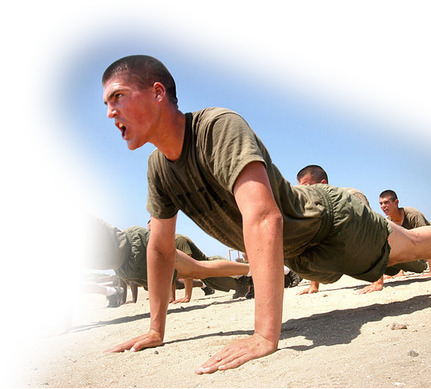
2-Trains in Godliness
⁷ Have nothing to do with godless myths and old wives' tales; rather, train yourself to be godly.
⁸ For physical training is of some value, but godliness has value for all things, holding promise for both the present life and the life to come.
Notes:
Exercise = FREE = From http://en.wikipedia.org/wiki/File:Marines_do_pushups.jpg
Train yourself to be like God implies: hard work called a work out! Get in the Word and “Workout!”
It takes time and energy.
The reward is both now and later!

Slide 7
2-Trains in Godliness
⁷ Have nothing to do with godless myths and old wives' tales; rather, train yourself to be godly.
⁸ For physical training is of some value, but godliness has value for all things, holding promise for both the present life and the life to come.
Notes:
Myths and wives tales // stuff that does not matter; like. church marketing schemes and entertainment tricks to grow a church—you may get numbers but do you get spiritual growth\?

Slide 8
2-Trains in Godliness
⁷ Have nothing to do with godless myths and old wives' tales; rather, train yourself to be godly.
⁸ For physical training is of some value, but godliness has value for all things, holding promise for both the present life and the life to come.
Notes:
The reward is both now and later!

Slide 9
2-Trains in Godliness
⁷ Have nothing to do with godless myths and old wives' tales; rather, train yourself to be godly.
⁸ For physical training is of some value, but godliness has value for all things, holding promise for both the present life and the life to come.
Notes:
The reward is both now and later!

Slide 10
3-Hopes in God
⁹ This is a trustworthy saying that deserves full acceptance ¹⁰ (and for this we labor and strive), that we have put our hope in the living God, who is the Savior of all men, and especially of those who believe.
Notes:
You can place your hope elsewhere. In talent, intellect, personality, charm, money, people, power, authority, etc.
But the minister doing Church God’s way puts his trust in the Living God!

Slide 11
3-Hopes in God
⁹ This is a trustworthy saying that deserves full acceptance ¹⁰ (and for this we labor and strive), that we have put our hope in the living God, who is the Savior of all men, and especially of those who believe.
Notes:
You can take this to the bank. You can stake your life on this. You can trust this—so accept it.

Slide 12
3-Hopes in God
⁹ This is a trustworthy saying that deserves full acceptance ¹⁰ (and for this we labor and strive), that we have put our hope in the living God, who is the Savior of all men, and especially of those who believe.
Notes:
God is the Savior and yet it is Jesus who saves; therefore, Jesus is God who saves!

Slide 13
3-Hopes in God
⁹ This is a trustworthy saying that deserves full acceptance ¹⁰ (and for this we labor and strive), that we have put our hope in the living God, who is the Savior of all men, and especially of those who believe.
Notes:
Savior of all men (not that all men are saved—but He is the only provision for salvation—so if any are to be saved, He is the savior) Like a life guard at a swimming pool. He is the savior for all swimmers—but if a swimmer fights the life guard off he will perish on his own. So he is especially the savior for those who accept his rescue effort. As the text says “especially of those who believe.” Romans 10:9,10.

Slide 14
4- Teaches the Truth
¹¹ Command and teach these things.

Slide 15
5- Sets an Example
¹² Don't let anyone look down on you because you are young, but set an example for the believers in speech, in life, in love, in faith and in purity.

Slide 16
5- Sets an Example
¹² Don't let anyone look down on you because you are young, but set an example for the believers in speech, in life, in love, in faith and in purity.
Notes:
Young pastors lack two important ingredients: Authority and Experience. Too often a young minister will let the title go to his head and expect people to do as he says. Paul’s cure to this is to set the example—do as I do (not as I say). That gains respect and experience.
Paul is counseling this young Pastor to not be intimidated by the Elderly in spite of his inexperience. How can you gain experience without getting started. What a wonderful opportunity for a congregation, to provide the opportunity to a young minister (to make mistakes and learn success).

Slide 17
5- Sets an Example
¹² Don't let anyone look down on you because you are young, but set an example for the believers in speech, in life, in love, in faith and in purity.

Slide 18
5- Sets an Example
¹² Don't let anyone look down on you because you are young, but set an example for the believers in speech, in life, in love, in faith and in purity.

Slide 19
5- Sets an Example
¹² Don't let anyone look down on you because you are young, but set an example for the believers in speech, in life, in love, in faith and in purity.

Slide 20
5- Sets an Example
¹² Don't let anyone look down on you because you are young, but set an example for the believers in speech, in life, in love, in faith and in purity.

Slide 21
5- Sets an Example
¹² Don't let anyone look down on you because you are young, but set an example for the believers in speech, in life, in love, in faith and in purity.

Slide 22
6- Focuses on the Word
¹³ Until I come, devote yourself to the public reading of Scripture, to preaching and to teaching.

Slide 23
6- Focuses on the Word
¹³ Until I come, devote yourself to the public reading of Scripture, to preaching and to teaching.

Slide 24
6- Focuses on the Word
¹³ Until I come, devote yourself to the public reading of Scripture, to preaching and to teaching.

Slide 25
6- Focuses on the Word
¹³ Until I come, devote yourself to the public reading of Scripture, to preaching and to teaching.

Slide 26
6- Focuses on the Word
¹⁴ Do not neglect your gift, which was given you through a prophetic message when the body of elders laid their hands on you.

Slide 27
7- Gives Himself Wholly
¹⁵ Be diligent in these matters; give yourself wholly to them, so that everyone may see your progress.
Notes:
His preoccupation is in the Word – not visitation, not golfing, not music, not organizing, not committees, community organizing, not social justice, not saving the planet, not going green, not counseling, etc. --but the Word!

Slide 28
7- Gives Himself Wholly
¹⁵ Be diligent in these matters; give yourself wholly to them, so that everyone may see your progress.
reading of Scripture, to preaching and to teaching ....
gift ... through message
Notes:
His preoccupation is in the Word – not visitation, not golfing, not music, not organizing, not committees, community organizing, not social justice, not saving the planet, not going green, not counseling, etc. --but the Word!

Slide 29
8–Watches Himself
¹⁶ Watch your life and doctrine closely. Persevere in them, because if you do, you will save both yourself and your hearers.
¹⁶ Watch your life and doctrine closely. Persevere in them, because if you do, you will save both yourself and your hearers.

Slide 30
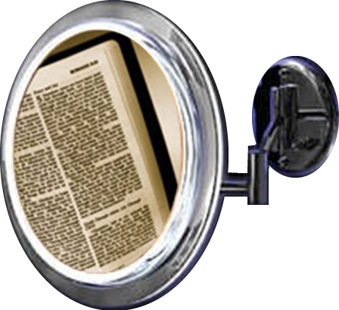
8–Watches Himself
¹⁶ Watch your life and doctrine closely. Persevere in them, because if you do, you will save both yourself and your hearers.
¹⁶ Watch your life and doctrine closely. Persevere in them, because if you do, you will save both yourself and your hearers.

Slide 31
8–Watches Himself
¹⁶ Watch your life and doctrine closely. Persevere in them, because if you do, you will save both yourself and your hearers.
¹⁶ Watch your life and doctrine closely. Persevere in them, because if you do, you will save both yourself and your hearers.

Slide 32
8–Watches Himself
¹⁶ Watch your life and doctrine closely. Persevere in them, because if you do, you will save both yourself and your hearers.
¹⁶ Watch your life and doctrine closely. Persevere in them, because if you do, you will save both yourself and your hearers.

Slide 33
8–Watches Himself
¹⁶ Watch your life and doctrine closely. Persevere in them, because if you do, you will save both yourself and your hearers.
¹⁶ Watch your life and doctrine closely. Persevere in them, because if you do, you will save both yourself and your hearers.

Slide 34
Let’s Sum It Up!

Slide 35
Let’s Sum It Up!
This is the kind of Pastor YOU NEED!

Slide 36
Let’s Sum It Up!
This is the kind of Pastor YOU NEED!
I hope it’s the kind of Pastor YOU WANT!

Slide 37
Let’s Sum It Up!
This is the kind of Pastor YOU NEED!
I hope it’s the kind of Pastor YOU WANT!
This is the kind of Pastor I WANT TO BE!

Slide 38
Let’s Sum It Up!
With such a minister and his ministry
you will ...

Slide 39
Let’s Sum It Up!
With such a minister and his ministry
you will ... Get the MOST out of CHURCH!

Slide 40
Let’s PRAY!

