Slide 1
with Godly Leaders
Notes:
This presentation uses the “Elephant” font
Background stained glass = FREE = from http://www.flickr.com/photos/stockphotosforfree/7190209497/sizes/l/in/photostream/

Slide 2
Our Theme “Getting the MOST out of CHURCH”
3:14 Although I hope to come to you soon, I am writing you these instructions so that,
¹⁵ if I am delayed, you will know how people ought to conduct themselves
Notes:
Background stained glass = FREE = from http://www.flickr.com/photos/stockphotosforfree/7190209497/sizes/l/in/photostream/

Slide 3
Our Theme “Getting the MOST out of CHURCH”
This theme follows a catalog of qualifications for Godly leaders
3:14 Although I hope to come to you soon, I am writing you these instructions so that,
¹⁵ if I am delayed, you will know how people ought to conduct themselves
Notes:
Background stained glass = FREE = from http://www.flickr.com/photos/stockphotosforfree/7190209497/sizes/l/in/photostream/

Slide 4
NOW Four Reasons Why Our Church Needs Godly Leaders
Because of …
Notes:
Background stained glass = FREE = from http://www.flickr.com/photos/stockphotosforfree/7190209497/sizes/l/in/photostream/

Slide 5
1-Who We ARE!

Slide 6
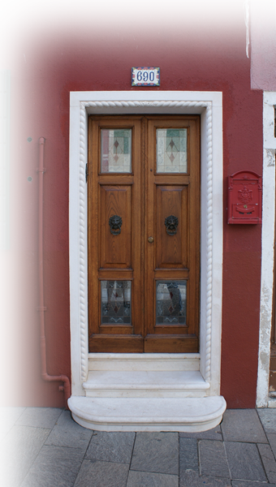
God’s Household
you will know how people ought to conduct themselves in God's household,
Notes:
Door = FREE = from BiblePoint

Slide 7
God’s Household
you will know how people ought to conduct themselves in God's household,
Don't you know that you yourselves are God's temple and that God's Spirit lives in you? 1 Cor 3:16
Notes:
Door = FREE = from BiblePoint

Slide 8
God’s Household
you will know how people ought to conduct themselves in God's household,
¹⁹ Do you not know that your body is a temple of the Holy Spirit, who is in you, whom you have received from God? You are not your own; ²⁰ you were bought at a price. Therefore honor God with your body. 1 Cor 6:19-20
Notes:
Door = FREE = from BiblePoint

Slide 9
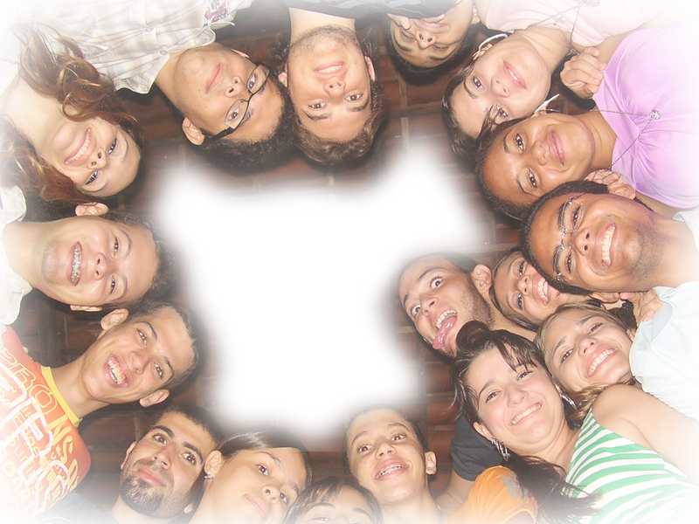
Assembly of God
you will know how people ought to conduct themselves in God's household, which is the church of the living God,
ekklasia
Notes:
Assembly = FREE = from http://www.flickr.com/photos/brazilnut72/2247691834/sizes/l/in/photostream/

Slide 10
Assembly of God
you will know how people ought to conduct themselves in God's household, which is the church of the living God,
εκκλησια
ekklasia
Notes:
Assembly = FREE = from http://www.flickr.com/photos/brazilnut72/2247691834/sizes/l/in/photostream/

Slide 11
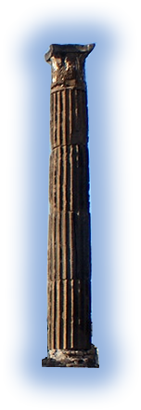
Pillar of Truth
T
R
U
T
H
you will know how people ought to conduct themselves in God's household, which is the church of the living God, the pillar and foundation of the truth.
Notes:
Pillar from Pompey = FREE = from BiblePoint.

Slide 12
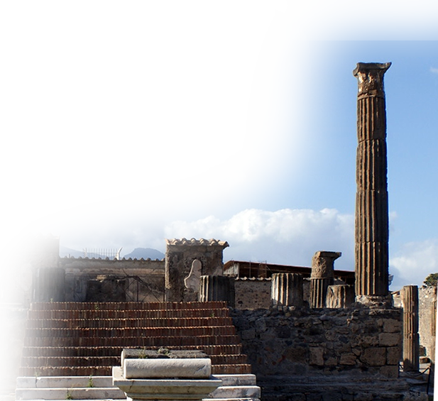
Foundation of Truth
T
R
U
T
H
you will know how people ought to conduct themselves in God's household, which is the church of the living God, the pillar and foundation of the truth.
TRUTH
Notes:
Pillar from Pompey = FREE = from BiblePoint.

Slide 13
2-What the Jesus DID!
¹⁶ Beyond all question, the mystery of godliness is great:
Notes:
Baby in manger = Licensed from istock = not for reuse

Slide 14
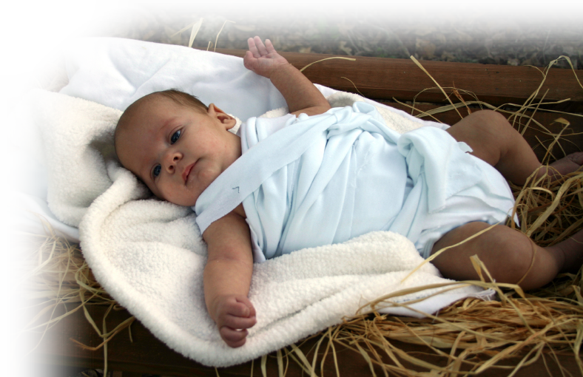
Jesus APPEARED
He appeared in a body, was vindicated by the Spirit,
was seen by angels,
was preached among the nations,
was believed on in the world,
was taken up in glory.
Notes:
Lit=made manifiest cf. John 1:1 & 14

Slide 15
Jesus was VINDICATED!
He appeared in a body, was vindicated by the Spirit,
was seen by angels,
was preached among the nations,
was believed on in the world,
was taken up in glory.

Slide 16
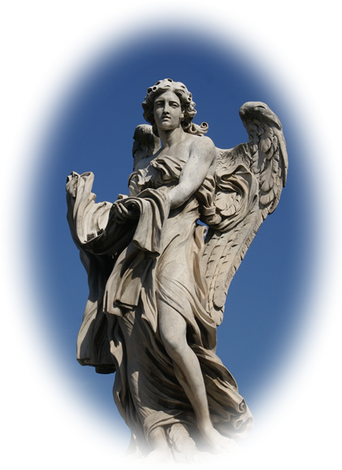
Jesus was SEEN!
He appeared in a body, was vindicated by the Spirit,
was seen by angels,
was preached among the nations,
was believed on in the world,
was taken up in glory.
Notes:
Angel = FREE = from BiblePoint photo

Slide 17
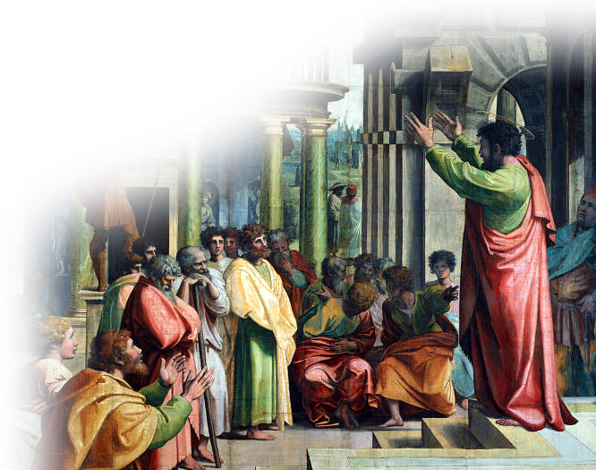
Jesus was PREACHED!
He appeared in a body, was vindicated by the Spirit,
was seen by angels,
was preached among the nations,
was believed on in the world,
was taken up in glory.
Notes:
Paul preaching = FREE = from http://en.wikipedia.org/wiki/File:V%26A_-_Raphael,_St_Paul_Preaching_in_Athens_(1515).jpg

Slide 18
Jesus BELIEVED ON!
He appeared in a body, was vindicated by the Spirit,
was seen by angels,
was preached among the nations,
was believed on in the world,
was taken up in glory.
Notes:
World =free= nasa

Slide 19
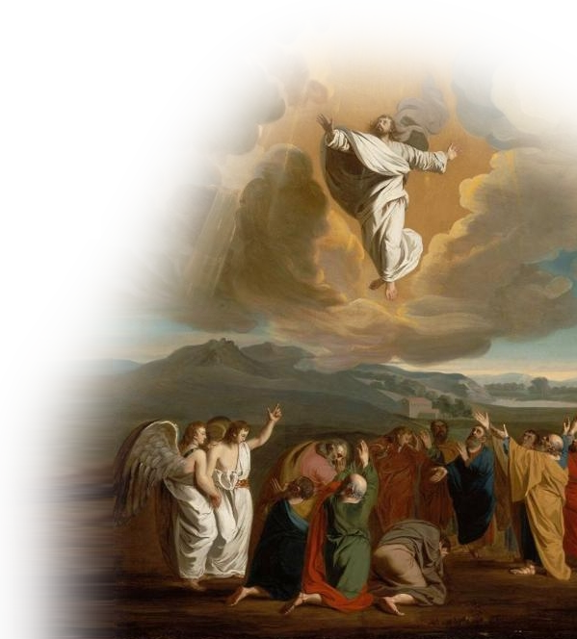
Jesus was TAKEN UP!
He appeared in a body, was vindicated by the Spirit,
was seen by angels,
was preached among the nations,
was believed on in the world,
was taken up in glory.
Notes:
Ascension = FREE =from http://en.wikipedia.org/wiki/File:Jesus_ascending_to_heaven.jpg

Slide 20
3-What We OPPOSE
4:1 The Spirit clearly says that in later times some will …

Slide 21
Deserting People
4:1 The Spirit clearly says that in later times some will abandon the faith
Notes:
Hand pushing away = FREE= from http://en.wikipedia.org/wiki/File:Push_Hands-close_up.jpg

Slide 22
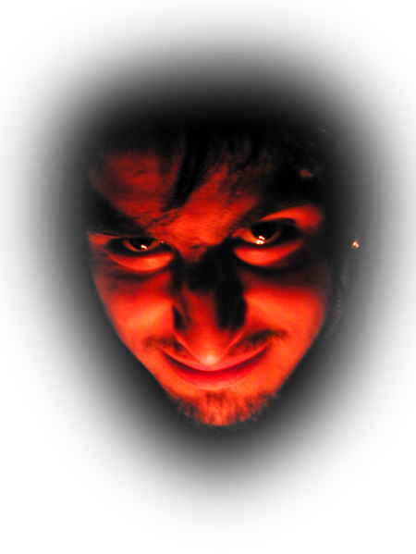
Deceiving Spirits
4:1 The Spirit clearly says that in later times some will abandon the faith and follow deceiving spirits
Notes:
Devil = FREE = from http://www.sxc.hu/photo/229100/?forcedownload=1

Slide 23
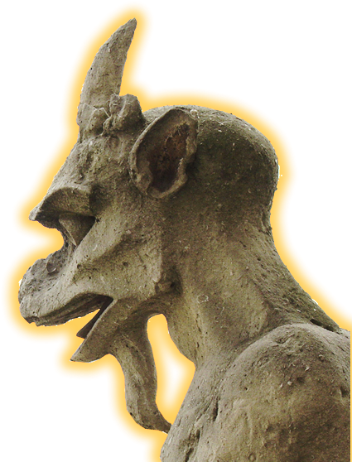
Demonic Teaching
4:1 The Spirit clearly says that in later times some will abandon the faith and follow deceiving spirits and things taught by demons.
Notes:
Gargoyle = FREE = from http://commons.wikimedia.org/wiki/File:Paris_Gargoyle.jpg

Slide 24
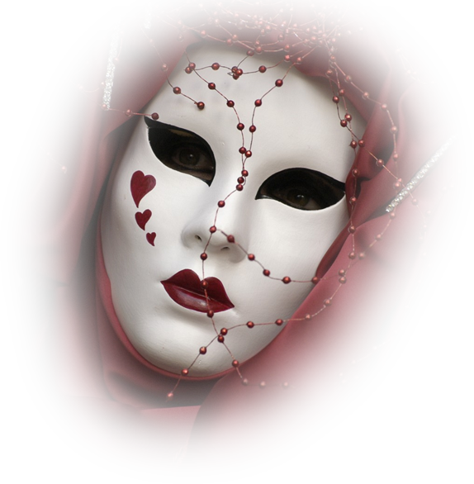
Deceptive Hypocrites
² Such teachings come through hypocritical liars, whose consciences have been seared as with a hot iron.
Notes:
Mask =FREE = from http://www.sxc.hu/browse.phtml?f=download&id=593092

Slide 25
Depriving People
³ They forbid people to marry and order them to abstain from certain foods,
Notes:
Hand pushing away = FREE= from http://en.wikipedia.org/wiki/File:Push_Hands-close_up.jpg

Slide 26
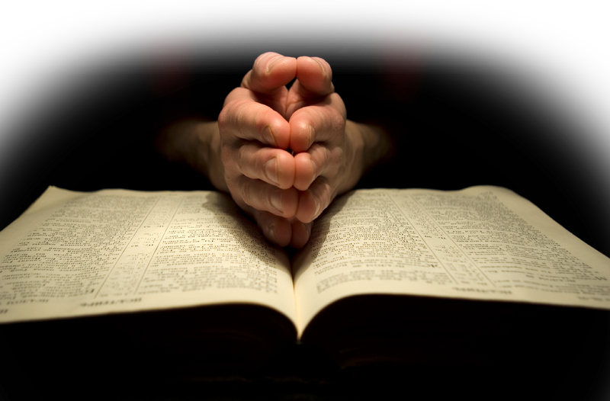
4-What the Church KNOWS!
…order them to abstain from certain foods, which God created to be received with thanksgiving by those who believe and who know the truth.
Notes:
Hands and Bible = Dreamstime photo = not for reuse elsewhere.

Slide 27
4-What the Church KNOWS!
⁴ For everything God created is good, and nothing is to be rejected if it is received with thanksgiving, ⁵ because it is consecrated by the word of God and prayer.

Slide 28
Let’s Sum It Up!
We need godly leaders because of …

Slide 29
Let’s Sum It Up!
We need godly leaders because of …
Who we are—God’s Church

Slide 30
Let’s Sum It Up!
We need godly leaders because of …
Who we are—God’s Church
What Jesus did—Appeared

Slide 31
Let’s Sum It Up!
We need godly leaders because of …
Who we are—God’s Church
What Jesus did—Appeared
What we oppose—Hypocrisy

Slide 32
Let’s Sum It Up!
We need godly leaders because of …
Who we are—God’s Church
What Jesus did—Appeared
What we oppose—Hypocrisy
What we know—the TRUTH

Slide 33
You See ...
Godly leaders will guide us so we
“Get the MOST out of CHURCH”

Slide 34
You See ...
Godly leaders will guide us so we
“Get the MOST out of CHURCH”
Of course we must FOLLOW their LEAD!

Slide 35
Let’s PRAY!

