Slide 2
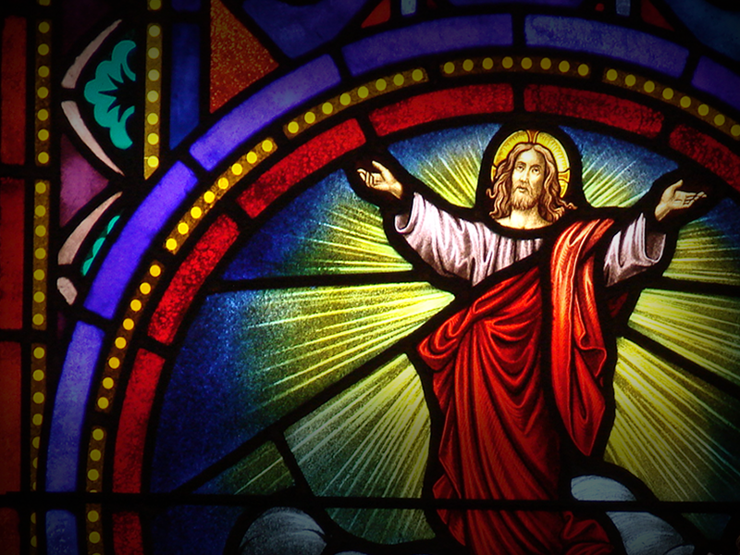
Takes a certain kind of Leader

Slide 3
Takes a certain kind of Leader
One that God uses!

Slide 4
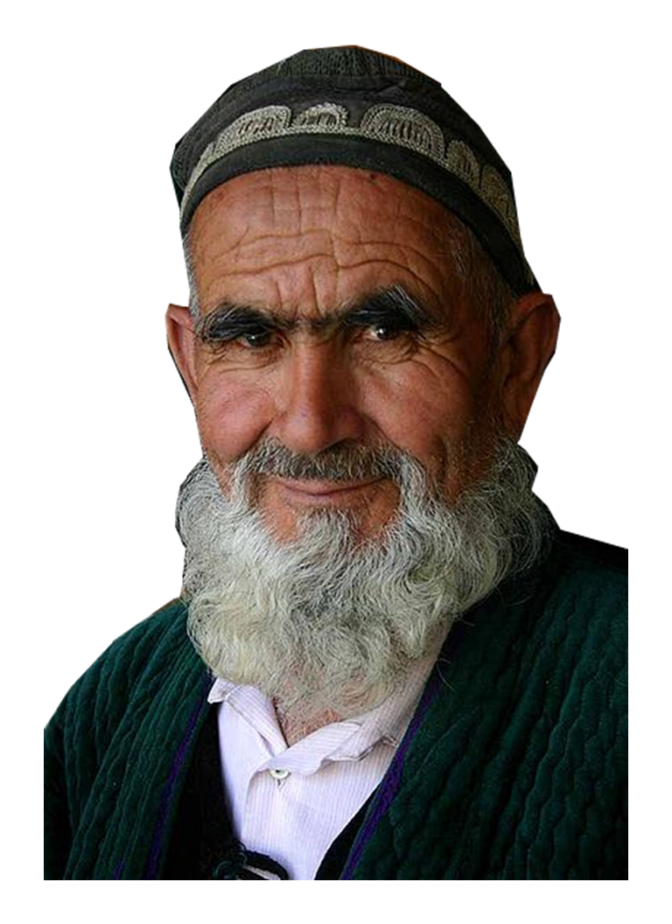
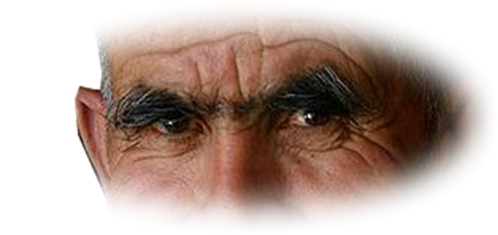
There are two classes …
I – “An OVERSEER” 3:1
Here is a trustworthy saying: If anyone sets his heart on being an overseer, he desires a noble task.
Notes:
Old Man = FREE = from http://commons.wikimedia.org/wiki/File:Old_bearded_man_from_Tajikistan.jpg
Servant = FREE = from http://www.sxc.hu/browse.phtml?f=download&id=157966

Slide 5
There are two classes …
I – “An OVERSEER” 3:1
Here is a trustworthy saying: If anyone sets his heart on being an overseer, he desires a noble task.
Elder
Notes:
Old Man = FREE = from http://commons.wikimedia.org/wiki/File:Old_bearded_man_from_Tajikistan.jpg
Servant = FREE = from http://www.sxc.hu/browse.phtml?f=download&id=157966

Slide 6
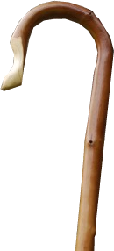
There are two classes …
I – “An OVERSEER” 3:1
Here is a trustworthy saying: If anyone sets his heart on being an overseer, he desires a noble task.
Elder
, Pastor
Notes:
Old Man = FREE = from http://commons.wikimedia.org/wiki/File:Old_bearded_man_from_Tajikistan.jpg
Servant = FREE = from http://www.sxc.hu/browse.phtml?f=download&id=157966

Slide 7
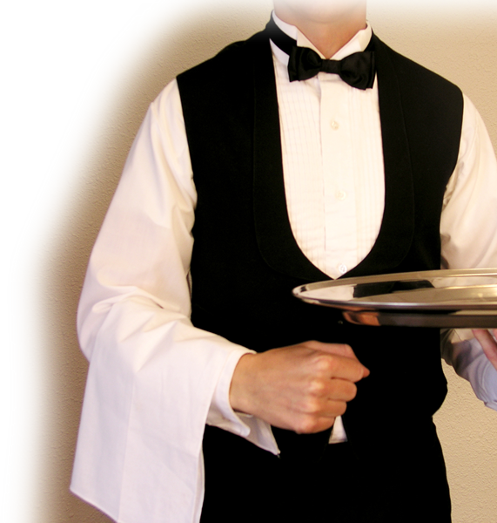
There are two classes …
I – “An OVERSEER” 3:1
Here is a trustworthy saying: If anyone sets his heart on being an overseer, he desires a noble task.
Elder
II – “Deacons” 3:8
, Pastor
Notes:
Old Man = FREE = from http://commons.wikimedia.org/wiki/File:Old_bearded_man_from_Tajikistan.jpg
Servant = FREE = from http://www.sxc.hu/browse.phtml?f=download&id=157966

Slide 8
Pastor’s Positively Considered:

Slide 9
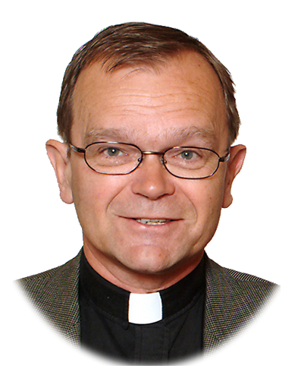
1. Blameless
² Now the overseer must be above reproach, the husband of but one wife, temperate, self-controlled, respectable, hospitable, able to teach,
Notes:
Minister = FREE = from http://commons.wikimedia.org/wiki/File:Sven-erik_brodd.jpg public domain.

Slide 10
1. Blameless
² Now the overseer must be above reproach, the husband of but one wife, temperate, self-controlled, respectable, hospitable, able to teach,
Notes:
Minister = FREE = from http://commons.wikimedia.org/wiki/File:Sven-erik_brodd.jpg public domain.

Slide 11
1. Blameless
² Now the overseer must be above reproach, the husband of but one wife, temperate, self-controlled, respectable, hospitable, able to teach,
Notes:
Minister = FREE = from http://commons.wikimedia.org/wiki/File:Sven-erik_brodd.jpg public domain.

Slide 12
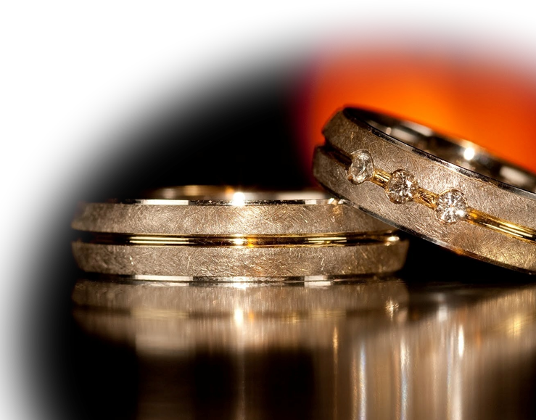
2. Exclusive
² Now the overseer must be above reproach, the husband of but one wife, temperate, self-controlled, respectable, hospitable, able to teach,
Notes:
Wedding rings = FREE = from http://www.fotopedia.com/albums/qhbxvpRE5yg/entries/klkltwviMXY.

Slide 13
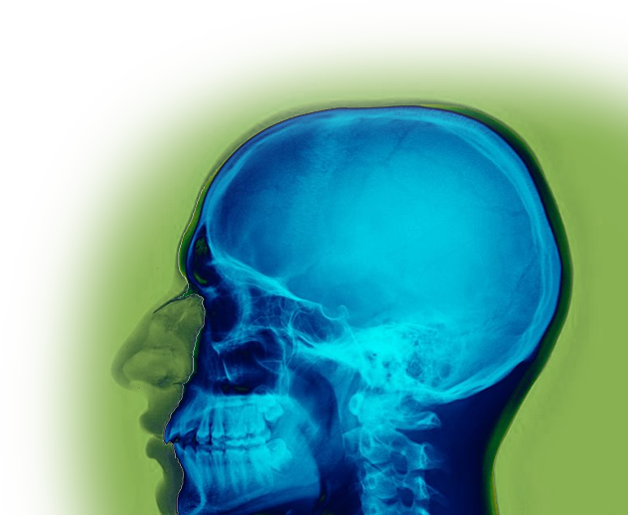
3. Clear Headed
² Now the overseer must be above reproach, the husband of but one wife, temperate, self-controlled, respectable, hospitable, able to teach,
Notes:
Clear Headed = Sane = Sound Mind = Sober Thinker = Thinks Clearly
X-Ray = FREE = from http://commons.wikimedia.org/wiki/File:Rad_160601_Skull_X-ray_False_color.nevit.jpg

Slide 14
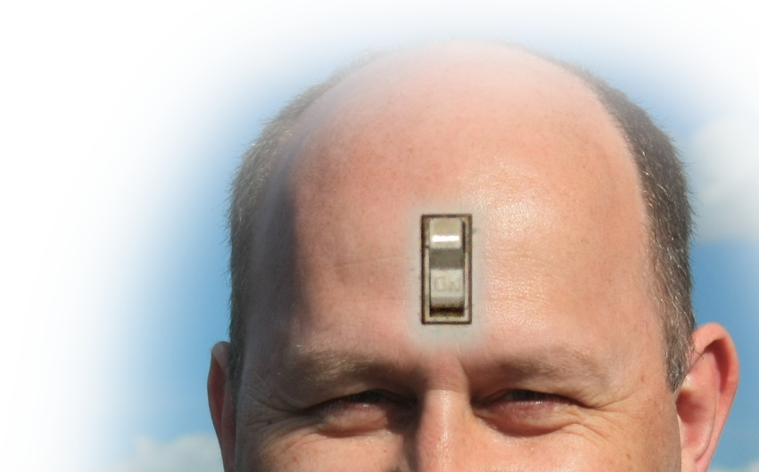
4. Self-Controlled
² Now the overseer must be above reproach, the husband of but one wife, temperate, self-controlled, respectable, hospitable, able to teach,
Notes:
Bald man = FREE = modified from http://www.rgbstock.com/download/ColinBrough/n9ExeOu.jpg

Slide 15
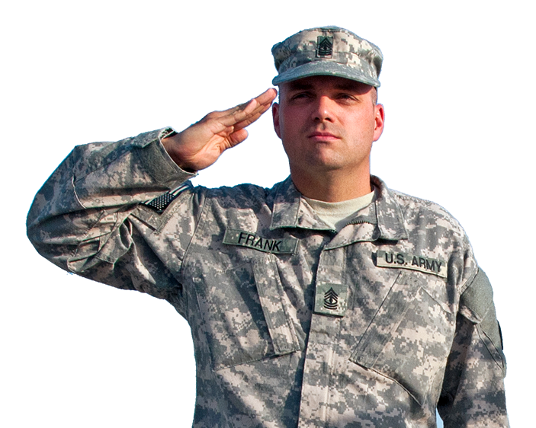
5. Respectable
² Now the overseer must be above reproach, the husband of but one wife, temperate, self-controlled, respectable, hospitable, able to teach,
Notes:
Salute = FREE = from http://www.flickr.com/photos/316thesc/8005537891/sizes/o/in/photostream/

Slide 16
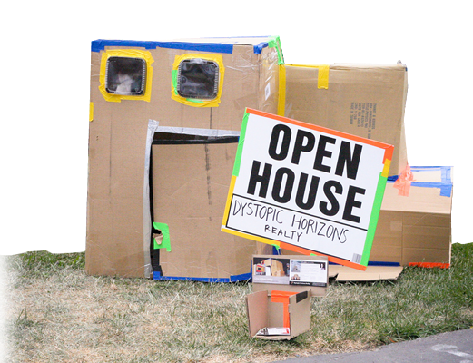
6. Hospitable
² Now the overseer must be above reproach, the husband of but one wife, temperate, self-controlled, respectable, hospitable, able to teach,
Notes:
Open House = FREE = from http://www.flickr.com/photos/orinrobertjohn/2506181668/sizes/l/in/photostream/

Slide 17
7. A Teacher
² Now the overseer must be above reproach, the husband of but one wife, temperate, self-controlled, respectable, hospitable, able to teach,
Notes:
Teacher sign = FREE = from http://www.flickr.com/photos/wfryer/204073798/sizes/o/in/photostream/

Slide 18
Pastor’s Negatively Considered:

Slide 19
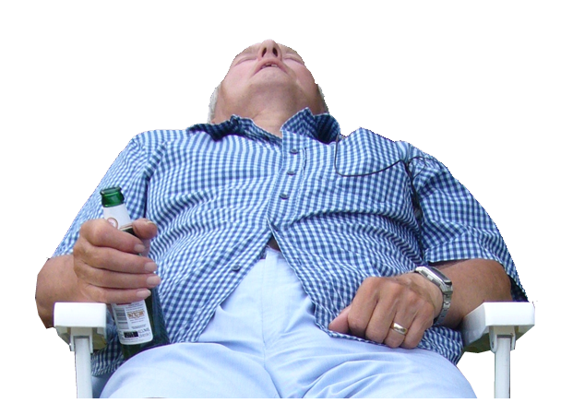
8. Not a Drunk
³ not given to drunkenness, not violent but gentle, not quarrelsome, not a lover of money.
Notes:
Snooze = FREE = from http://www.rgbstock.com/download/chidseyc/mtLIhPE.jpg

Slide 20
9. Not a Bully
³ not given to drunkenness, not violent but gentle, not quarrelsome, not a lover of money.
Notes:
Bully-Free = FREE = from http://wvbullyfree.com/

Slide 21
10. Not Argumentative
³ not given to drunkenness, not violent but gentle, not quarrelsome, not a lover of money.
Notes:
Quarrelsome = FREE = from http://www.sxc.hu/browse.phtml?f=download&id=616825

Slide 22
11. Not Money Hungry
³ not given to drunkenness, not violent but gentle, not quarrelsome, not a lover of money.
Notes:
Money fist = FREE = from http://www.flickr.com/photos/rockylubbers/6174172046/sizes/l/in/photostream/

Slide 23
12. A Manager
⁴ He must manage his own family well and see that his children obey him with proper respect. ⁵ (If anyone does not know how to manage his own family, how can he take care of God's church?)
Notes:
Manager sign = FREE = from http://www.sxc.hu/browse.phtml?f=download&id=101233

Slide 24
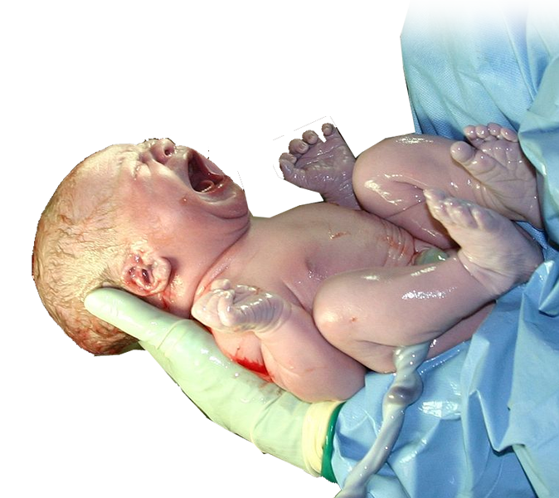
13. Not A Newbie
⁶ He must not be a recent convert, or he may become conceited and fall under the same judgment as the devil.
Notes:
Newborn = FREE = from http://en.wikipedia.org/wiki/File:HumanNewborn.JPG

Slide 25
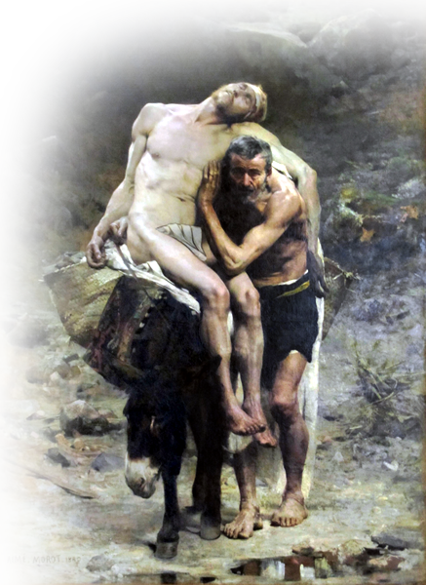
14. With a Good Reputation
⁷ He must also have a good reputation with outsiders, so that he will not fall into disgrace and into the devil's trap.
Notes:
Good Samaritan – FREE – http://upload.wikimedia.org/wikipedia/commons/0/0f/Aime-Morot-Le-bon-Samaritain.JPG

Slide 26
II. Men Deacons Considered

Slide 27
1. Respectable
⁸ Deacons, likewise, are to be men worthy of respect, sincere, not indulging in much wine, and not pursuing dishonest gain.
Notes:
Salute = FREE = from http://www.flickr.com/photos/316thesc/8005537891/sizes/o/in/photostream/

Slide 28
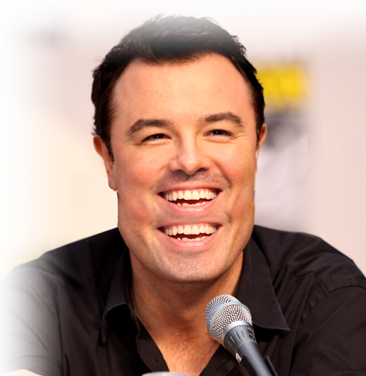
2. Sincere
⁸ Deacons, likewise, are to be men worthy of respect, sincere, not indulging in much wine, and not pursuing dishonest gain.
Notes:
Double Mouth = FREE = from http://en.wikipedia.org/wiki/File:Seth_MacFarlane_by_Gage_Skidmore_5.jpg
Gage Skidmore

Slide 29
2. Sincere
⁸ Deacons, likewise, are to be men worthy of respect, sincere, not indulging in much wine, and not pursuing dishonest gain.
NOT double-tongued
Notes:
Double Mouth = FREE = from http://en.wikipedia.org/wiki/File:Seth_MacFarlane_by_Gage_Skidmore_5.jpg
Gage Skidmore

Slide 30
3. Sober
⁸ Deacons, likewise, are to be men worthy of respect, sincere, not indulging in much wine, and not pursuing dishonest gain.
Notes:
Snooze = FREE = from http://www.rgbstock.com/download/chidseyc/mtLIhPE.jpg

Slide 31
4. Not Greedy
⁸ Deacons, likewise, are to be men worthy of respect, sincere, not indulging in much wine, and not pursuing dishonest gain.
Notes:
Money fist = FREE = from http://www.flickr.com/photos/rockylubbers/6174172046/sizes/l/in/photostream/

Slide 32
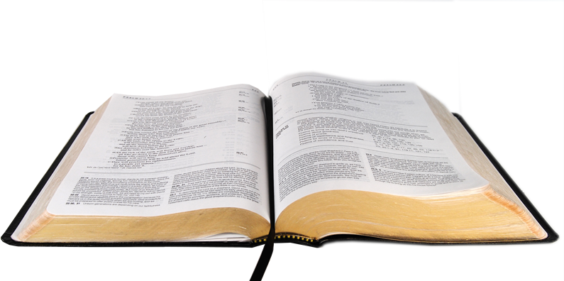
5. Doctrinally Sound
⁹ They must keep hold of the deep truths of the faith with a clear conscience.
Notes:
Open Bible = FREE = from http://www.sxc.hu/browse.phtml?f=download&id=1016625

Slide 33
6. Proven
¹⁰ They must first be tested; and then if there is nothing against them, let them serve as deacons.
Notes:
Approved = FREE = from http://www.flickr.com/photos/42106306@N00/4380803535/sizes/o/in/photostream/

Slide 34
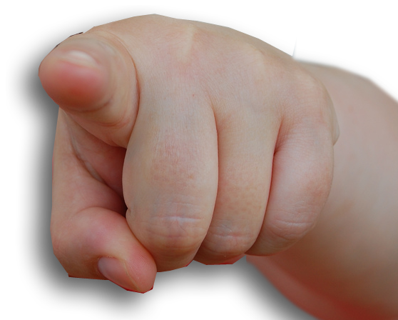
7. Blameless
¹⁰ They must first be tested; and then if there is nothing against them, let them serve as deacons.
Notes:
“Cannot be called into account”, Unaccused, Blameless =
Finger Pointing: http://www.flickr.com/photos/1uk3/1677426833/sizes/l/in/photostream/

Slide 35
Women Deacons …
¹¹ In the same way, their wives [literally, “women”]

Slide 36
8. Respectable
¹¹ In the same way, their wives [literally, “women”] are to be women worthy of respect, not malicious talkers but temperate and trustworthy in everything.
Notes:
Salute = FREE = from http://www.flickr.com/photos/316thesc/8005537891/sizes/o/in/photostream/

Slide 37
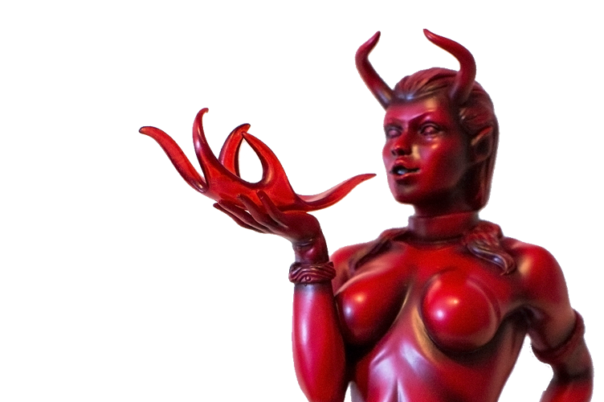
9. Not Diabolical
¹¹ In the same way, their wives [literally, “women”] are to be women worthy of respect, not malicious talkers but temperate and trustworthy in everything.
Notes:
Demonic woman = FREE = from http://www.flickr.com/photos/robboudon/9486513215/sizes/k/in/photostream/

Slide 38
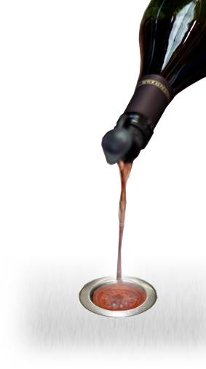
10. Sober
¹¹ In the same way, their wives [literally, “women”] are to be women worthy of respect, not malicious talkers but temperate and trustworthy in everything.
Literally means: “abstaining from wine”
Notes:
Wine bottle = FREE = from http://www.flickr.com/photos/lpwines/6141755648/sizes/o/in/photostream/

Slide 39
11. Dependable
¹¹ In the same way, their wives [literally, “women”] are to be women worthy of respect, not malicious talkers but temperate and trustworthy in everything.
Notes:
Catching baby = FREE = from http://www.sxc.hu/browse.phtml?f=download&id=992546

Slide 40
Back to Men Deacons …

Slide 41
12. Exclusive Husband
¹² A deacon must be the husband of but one wife and must manage his children and his household well.

Slide 42
13. Family Manager
¹² A deacon must be the husband of but one wife and must manage his children and his household well.
Notes:
Manager sign = FREE = from http://www.sxc.hu/browse.phtml?f=download&id=101233

Slide 43
14. A Servant
¹³ Those who have served well gain an excellent standing and great assurance in their faith in Christ Jesus.
Notes:
Servant = FREE = from http://www.sxc.hu/browse.phtml?f=download&id=157966

Slide 44
When Godly Leaders Lead

Slide 45
When Godly Leaders Lead
We’ll Get the MOST out of CHURCH

Slide 46
Let’s PRAY!

