Slide 1
To do so YOU MUST ...
Notes:
This presentation uses “Elephant” font

Slide 2
Worship:
Traditional,
Contemporary
Or God’s Way?

Slide 3
Worship:
Traditional,
Contemporary
Or God’s Way?

Slide 4
“Instructions on Worship”

Slide 5
“Instructions on Worship”
Not what you would expect …
Not about Music!!!!!

Slide 6
“Instructions on Worship”
¹⁶ Let the word of Christ dwell in you richly as you teach and admonish one another with all wisdom, and as you sing psalms, hymns and spiritual songs with gratitude in your hearts to God. (Col. 3:16)
Not what you would expect …
Not about Music!!!!!

Slide 7
Worship God’s Way involves:

Slide 8
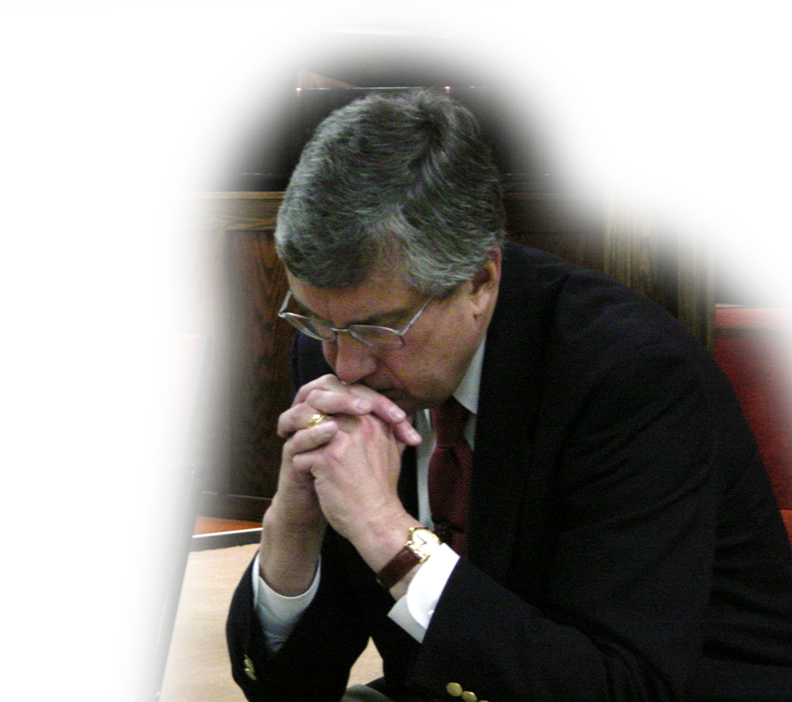
1. All Sorts of Prayers
I urge, then, first of all, that requests, prayers, intercession and thanksgiving be made for everyone-- ² for kings and all those in authority, that we may live peaceful and quiet lives in all godliness and holiness. (1Tim 2:1-2 )
Notes:
Praying = FREE = from BiblePoint
Request = ask for something
Prayers = conversation with God
Intercession = pray for someone else’s request
Thanksgiving = verbal display of gratitude

Slide 9
1. All Sorts of Prayers
I urge, then, first of all, that requests, prayers, intercession and thanksgiving be made for everyone-- ² for kings and all those in authority, that we may live peaceful and quiet lives in all godliness and holiness. (1Tim 2:1-2 )
Notes:
Praying = FREE = from BiblePoint
Nero is the Emperor – evil, persecutor of the Church

Slide 10
1. All Sorts of Prayers
I urge, then, first of all, that requests, prayers, intercession and thanksgiving be made for everyone-- ² for kings and all those in authority, that we may live peaceful and quiet lives in all godliness and holiness. (1Tim 2:1-2 )
Notes:
Praying = FREE = from BiblePoint
It would be almost 250 years later that Constantine would bring peace by converting to Christianity.

Slide 11
1. All Sorts of Prayers
I urge, then, first of all, that requests, prayers, intercession and thanksgiving be made for everyone-- ² for kings and all those in authority, that we may live peaceful and quiet lives in all godliness and holiness. (1Tim 2:1-2 )
M.Y. Name
America
My son’s salvation
My mother’s health
Worship Leader
More Youth
Prayer Cards
Notes:
Praying = FREE = from BiblePoint

Slide 12
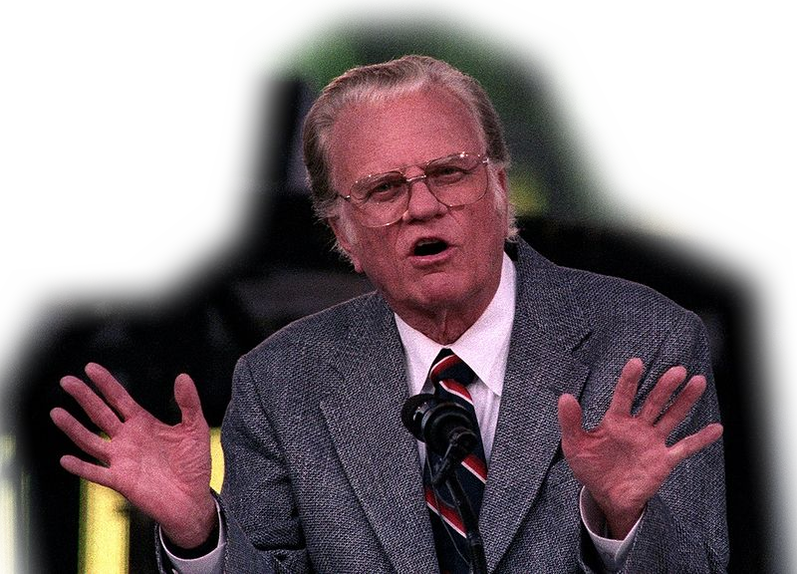
2. Seeker Sensitivity
³ This is good, and pleases God our Savior, ⁴ who wants all men to be saved and to come to a knowledge of the truth.
Notes:
Billy Graham = FREE= from http://commons.wikimedia.org/wiki/File:Billy_Graham_Cleveland.JPG

Slide 13
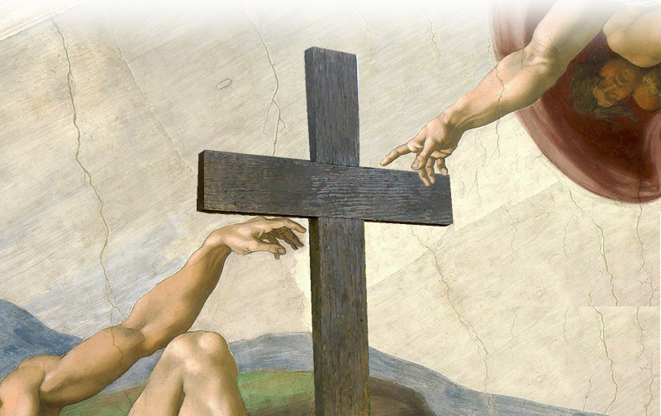
3. A God Connection
⁵ For there is one God and one mediator between God and men, the man Christ Jesus, ⁶ who gave himself as a ransom for all men
Notes:
Creation of Man = FREE = from http://upload.wikimedia.org/wikipedia/commons/b/b4/Michelangelo_-_Creation_of_Adam.jpg
Cross = free= from http://upload.wikimedia.org/wikipedia/commons/4/45/Wooden_crosses_in_St_Pancras_%26_Islington_Cemetery.jpg

Slide 14
3. A God Connection
⁵ For there is one God and one mediator between God and men, the man Christ Jesus, ⁶ who gave himself as a ransom for all men
Notes:
Creation of Man = FREE = from http://upload.wikimedia.org/wikipedia/commons/b/b4/Michelangelo_-_Creation_of_Adam.jpg
Cross = free= from http://upload.wikimedia.org/wikipedia/commons/4/45/Wooden_crosses_in_St_Pancras_%26_Islington_Cemetery.jpg

Slide 15
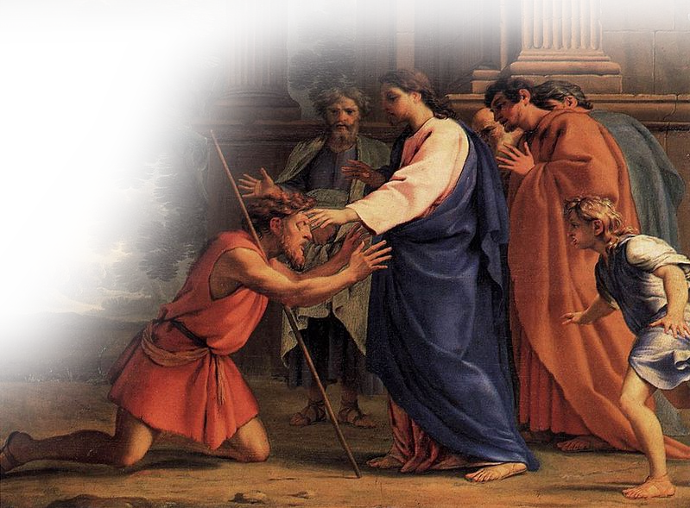
4. Timely Testimonies
⁵ For there is one God and one mediator between God and men, the man Christ Jesus, ⁶ who gave himself as a ransom for all men— the testimony given in its proper time.
Notes:
Healing the blindman =FREE= from http://commons.wikimedia.org/wiki/File:Eustache_Le_Sueur_003.jpg

Slide 16
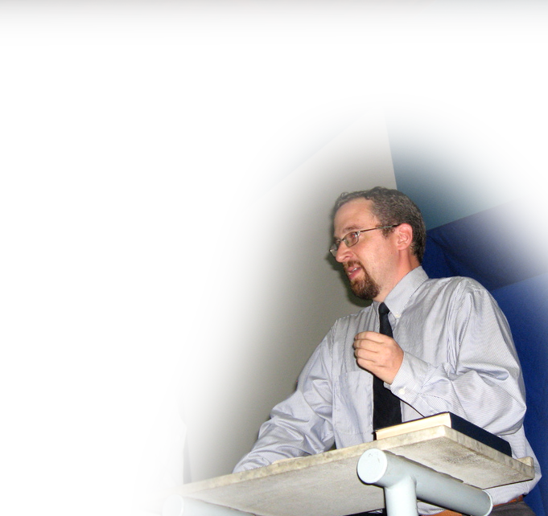
5. Preaching/Teaching Truth
⁷ And for this purpose I was appointed a herald and an apostle--I am telling the truth, I am not lying--and a teacher of the true faith to the Gentiles.
Notes:
Preacher = FREE = from http://www.flickr.com/photos/brazilnut72/3698737284/sizes/l/in/photostream/

Slide 17
6. More Prayer
⁸ I want men everywhere to lift up holy hands in prayer, without anger or disputing.
Notes:
Hand up praying = Licensed from iStock photos and Not for Reuse.

Slide 18
7. Appropriate Modesty
⁹ I also want women to dress modestly, with decency and propriety, not with braided hair or gold or pearls or expensive clothes, ¹⁰ but with good deeds, appropriate for women who profess to worship God.
Notes:
Runway models = FREE = from http://en.wikipedia.org/wiki/File:Yigal_Azrouel_Fashion_Show.jpg

Slide 19
8. Learning Attitude
¹¹ A woman should learn in quietness and full submission. ¹² I do not permit a woman to teach or to have authority over a man; she must be silent.
Notes:
Books = FREE = http://www.flickr.com/photos/abee5/8314929977/sizes/l/in/photostream/

Slide 20
8. Learning Attitude
¹¹ A woman should learn in quietness and full submission. ¹² I do not permit a woman to teach or to have authority over a man; she must be silent.
Notes:
Books = FREE = http://www.flickr.com/photos/abee5/8314929977/sizes/l/in/photostream/

Slide 21
8. Learning Attitude
¹¹ A woman should learn in quietness and full submission. ¹² I do not permit a woman to teach or to have authority over a man; she must be silent.
Notes:
Books = FREE = http://www.flickr.com/photos/abee5/8314929977/sizes/l/in/photostream/

Slide 22
9. Biblical Explanations
Notes:
Biblical Explanations:
From Creation – God Created Man first (and God told him not to eat of the tree of the knowledge of good and evil) and then God created the woman as his companion and help mate (It was Adam that instructed her regarding the prohibition of eating from the tree of the knowledge of good and evil (Eve was not yet created when God prohibited Adam).
From the Fall – In Genesis 3 Eve knew the Lord’s command through her husband’s telling her what the Lord had commanded regarding eat from the tree of the knowledge of good and evil. The woman was deceived by the serpent’s lies rather than her husband’s truth. She accepted Satan’s lie that she would be like God (one up on Adam) rather than Adam’s truth from God. So she was both “Unlearned and Insubordinate.”
From Salvation – In the curses upon the Man (regarding the ground), the Woman (regarding pain in childbearing) and in the curse upon the serpent (on belly licking dust) is the hope of Salvation. It has to do with the Woman’s seed having ultimate victory over the serpent. Here’s the catch, the woman has no seed—she has eggs. So the expression woman’s seed is a reference to the virgin Mary’s child Christ (since she had seed without a man). The reference changes from “The woman” is to “women” in verse 15, since it was not Eve’s Child (Abel, Cain, nor Seth through whom this promise was fulfilled). It was another woman, Mary’s child, Jesus. So all women’s salvation comes from the child bearing of the Messianic seed Jesus.
Quickly the apostle adds, that the women must believe to be saved, have genuine love and holiness with a life that shows it.

Slide 23
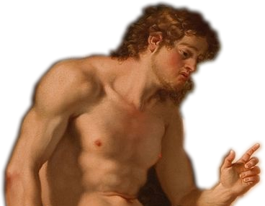
9. Biblical Explanations
From CREATION:
¹³ For Adam was formed first, then Eve.
Notes:
Biblical Explanations:
From Creation – God Created Man first (and God told him not to eat of the tree of the knowledge of good and evil) and then God created the woman as his companion and help mate (It was Adam that instructed her regarding the prohibition of eating from the tree of the knowledge of good and evil (Eve was not yet created when God prohibited Adam).
From the Fall – In Genesis 3 Eve knew the Lord’s command through her husband’s telling her what the Lord had commanded regarding eat from the tree of the knowledge of good and evil. The woman was deceived by the serpent’s lies rather than her husband’s truth. She accepted Satan’s lie that she would be like God (one up on Adam) rather than Adam’s truth from God. So she was both “Unlearned and Insubordinate.”
From Salvation – In the curses upon the Man (regarding the ground), the Woman (regarding pain in childbearing) and in the curse upon the serpent (on belly licking dust) is the hope of Salvation. It has to do with the Woman’s seed having ultimate victory over the serpent. Here’s the catch, the woman has no seed—she has eggs. So the expression woman’s seed is a reference to the virgin Mary’s child Christ (since she had seed without a man). The reference changes from “The woman” is to “women” in verse 15, since it was not Eve’s Child (Abel, Cain, nor Seth through whom this promise was fulfilled). It was another woman, Mary’s child, Jesus. So all women’s salvation comes from the child bearing of the Messianic seed Jesus.
Quickly the apostle adds, that the women must believe to be saved, have genuine love and holiness with a life that shows it.

Slide 24
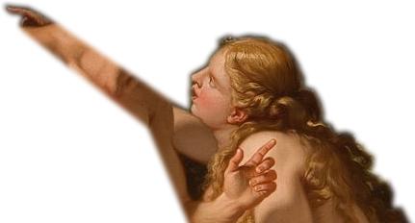
9. Biblical Explanations
From CREATION:
¹³ For Adam was formed first, then Eve.
Notes:
Biblical Explanations:
From Creation – God Created Man first (and God told him not to eat of the tree of the knowledge of good and evil) and then God created the woman as his companion and help mate (It was Adam that instructed her regarding the prohibition of eating from the tree of the knowledge of good and evil (Eve was not yet created when God prohibited Adam).
From the Fall – In Genesis 3 Eve knew the Lord’s command through her husband’s telling her what the Lord had commanded regarding eat from the tree of the knowledge of good and evil. The woman was deceived by the serpent’s lies rather than her husband’s truth. She accepted Satan’s lie that she would be like God (one up on Adam) rather than Adam’s truth from God. So she was both “Unlearned and Insubordinate.”
From Salvation – In the curses upon the Man (regarding the ground), the Woman (regarding pain in childbearing) and in the curse upon the serpent (on belly licking dust) is the hope of Salvation. It has to do with the Woman’s seed having ultimate victory over the serpent. Here’s the catch, the woman has no seed—she has eggs. So the expression woman’s seed is a reference to the virgin Mary’s child Christ (since she had seed without a man). The reference changes from “The woman” is to “women” in verse 15, since it was not Eve’s Child (Abel, Cain, nor Seth through whom this promise was fulfilled). It was another woman, Mary’s child, Jesus. So all women’s salvation comes from the child bearing of the Messianic seed Jesus.
Quickly the apostle adds, that the women must believe to be saved, have genuine love and holiness with a life that shows it.

Slide 25
9. Biblical Explanations
From THE FALL:
¹⁴ And Adam was not the one deceived; it was the woman who was deceived and became a sinner.
Notes:
Biblical Explanations:
From Creation – God Created Man first (and God told him not to eat of the tree of the knowledge of good and evil) and then God created the woman as his companion and help mate (It was Adam that instructed her regarding the prohibition of eating from the tree of the knowledge of good and evil (Eve was not yet created when God prohibited Adam).
From the Fall – In Genesis 3 Eve knew the Lord’s command through her husband’s telling her what the Lord had commanded regarding eat from the tree of the knowledge of good and evil. The woman was deceived by the serpent’s lies rather than her husband’s truth. She accepted Satan’s lie that she would be like God (one up on Adam) rather than Adam’s truth from God. So she was both “Unlearned and Insubordinate.”
From Salvation – In the curses upon the Man (regarding the ground), the Woman (regarding pain in childbearing) and in the curse upon the serpent (on belly licking dust) is the hope of Salvation. It has to do with the Woman’s seed having ultimate victory over the serpent. Here’s the catch, the woman has no seed—she has eggs. So the expression woman’s seed is a reference to the virgin Mary’s child Christ (since she had seed without a man). The reference changes from “The woman” is to “women” in verse 15, since it was not Eve’s Child (Abel, Cain, nor Seth through whom this promise was fulfilled). It was another woman, Mary’s child, Jesus. So all women’s salvation comes from the child bearing of the Messianic seed Jesus.
Quickly the apostle adds, that the women must believe to be saved, have genuine love and holiness with a life that shows it.

Slide 26
9. Biblical Explanations
From SALVATION:
¹⁵ But women will be saved through child-bearing—if they continue in faith, love and holiness with propriety.
Notes:
Biblical Explanations:
From Creation – God Created Man first (and God told him not to eat of the tree of the knowledge of good and evil) and then God created the woman as his companion and help mate (It was Adam that instructed her regarding the prohibition of eating from the tree of the knowledge of good and evil (Eve was not yet created when God prohibited Adam).
From the Fall – In Genesis 3 Eve knew the Lord’s command through her husband’s telling her what the Lord had commanded regarding eat from the tree of the knowledge of good and evil. The woman was deceived by the serpent’s lies rather than her husband’s truth. She accepted Satan’s lie that she would be like God (one up on Adam) rather than Adam’s truth from God. So she was both “Unlearned and Insubordinate.”
From Salvation – In the curses upon the Man (regarding the ground), the Woman (regarding pain in childbearing) and in the curse upon the serpent (on belly licking dust) is the hope of Salvation. It has to do with the Woman’s seed having ultimate victory over the serpent. Here’s the catch, the woman has no seed—she has eggs. So the expression woman’s seed is a reference to the virgin Mary’s child Christ (since she had seed without a man). The reference changes from “The woman” is to “women” in verse 15, since it was not Eve’s Child (Abel, Cain, nor Seth through whom this promise was fulfilled). It was another woman, Mary’s child, Jesus. So all women’s salvation comes from the child bearing of the Messianic seed Jesus.
Quickly the apostle adds, that the women must believe to be saved, have genuine love and holiness with a life that shows it.

Slide 27
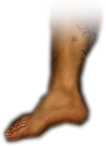
9. Biblical Explanations
From SALVATION:
¹⁵ But women will be saved through child-bearing—if they continue in faith, love and holiness with propriety.
Notes:
Biblical Explanations:
From Creation – God Created Man first (and God told him not to eat of the tree of the knowledge of good and evil) and then God created the woman as his companion and help mate (It was Adam that instructed her regarding the prohibition of eating from the tree of the knowledge of good and evil (Eve was not yet created when God prohibited Adam).
From the Fall – In Genesis 3 Eve knew the Lord’s command through her husband’s telling her what the Lord had commanded regarding eat from the tree of the knowledge of good and evil. The woman was deceived by the serpent’s lies rather than her husband’s truth. She accepted Satan’s lie that she would be like God (one up on Adam) rather than Adam’s truth from God. So she was both “Unlearned and Insubordinate.”
From Salvation – In the curses upon the Man (regarding the ground), the Woman (regarding pain in childbearing) and in the curse upon the serpent (on belly licking dust) is the hope of Salvation. It has to do with the Woman’s seed having ultimate victory over the serpent. Here’s the catch, the woman has no seed—she has eggs. So the expression woman’s seed is a reference to the virgin Mary’s child Christ (since she had seed without a man). The reference changes from “The woman” is to “women” in verse 15, since it was not Eve’s Child (Abel, Cain, nor Seth through whom this promise was fulfilled). It was another woman, Mary’s child, Jesus. So all women’s salvation comes from the child bearing of the Messianic seed Jesus.
Quickly the apostle adds, that the women must believe to be saved, have genuine love and holiness with a life that shows it.

Slide 28
9. Biblical Explanations
From SALVATION:
¹⁵ But women will be saved through child-bearing—if they continue in faith, love and holiness with propriety.
Notes:
Biblical Explanations:
From Creation – God Created Man first (and God told him not to eat of the tree of the knowledge of good and evil) and then God created the woman as his companion and help mate (It was Adam that instructed her regarding the prohibition of eating from the tree of the knowledge of good and evil (Eve was not yet created when God prohibited Adam).
From the Fall – In Genesis 3 Eve knew the Lord’s command through her husband’s telling her what the Lord had commanded regarding eat from the tree of the knowledge of good and evil. The woman was deceived by the serpent’s lies rather than her husband’s truth. She accepted Satan’s lie that she would be like God (one up on Adam) rather than Adam’s truth from God. So she was both “Unlearned and Insubordinate.”
From Salvation – In the curses upon the Man (regarding the ground), the Woman (regarding pain in childbearing) and in the curse upon the serpent (on belly licking dust) is the hope of Salvation. It has to do with the Woman’s seed having ultimate victory over the serpent. Here’s the catch, the woman has no seed—she has eggs. So the expression woman’s seed is a reference to the virgin Mary’s child Christ (since she had seed without a man). The reference changes from “The woman” is to “women” in verse 15, since it was not Eve’s Child (Abel, Cain, nor Seth through whom this promise was fulfilled). It was another woman, Mary’s child, Jesus. So all women’s salvation comes from the child bearing of the Messianic seed Jesus.
Quickly the apostle adds, that the women must believe to be saved, have genuine love and holiness with a life that shows it.

Slide 29
Here’s the Point:
Worship is much more than
Traditional or
Contemporary!

Slide 30
Here’s the Point:
Worship is much more than
Traditional or
Contemporary!
It’s PRAYING, EVANGELIZING, CONNECTING WITH GOD, TESTIFYING, PREACHING/TEACHING, GOOD DEEDING, LEARNING, & EXPLAINING GOD’S WORD!

Slide 31
The perfect application …

Slide 32
The perfect application …
Join us tonight for the ...

Slide 33
LET’S PRAY!

