Slide 1
How to Get the MOST out of CHURCH
A study of 1 Timothy

Slide 2
The Purpose of the letter:
¹⁴ Although I hope to come to you soon, I am writing you these instructions so that, ¹⁵ if I am delayed, you will know how people ought to conduct themselves in God's household, which is the church of the living God, the pillar and foundation of the truth. 1 Timothy 3:14-16
Notes:
My assessment: If you do church correctly, you’ll get more out of it.

Slide 3
Last time we said ...

Slide 4
TODAY ... We Must ...
Focus on Salvation

Slide 5
Salvation is at the Heart of it
¹⁵ Here is a trustworthy saying that deserves full acceptance: Christ Jesus came into the world to save sinners --of whom I am the worst. (1Timothy 1:15)

Slide 6
The Savior!
¹⁵ Here is a trustworthy saying that deserves full acceptance: Christ Jesus came into the world to save sinners --of whom I am the worst. (1Timothy 1:15)

Slide 7
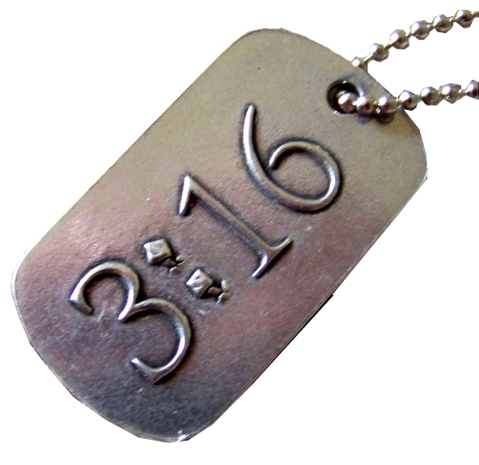
His Mission
¹⁵ Here is a trustworthy saying that deserves full acceptance: Christ Jesus came into the world to save sinners --of whom I am the worst. (1Timothy 1:15)
Notes:
3:16 = FREE =from http://www.flickr.com/photos/eatacrayon/2509422011/sizes/l/in/photostream/

Slide 8
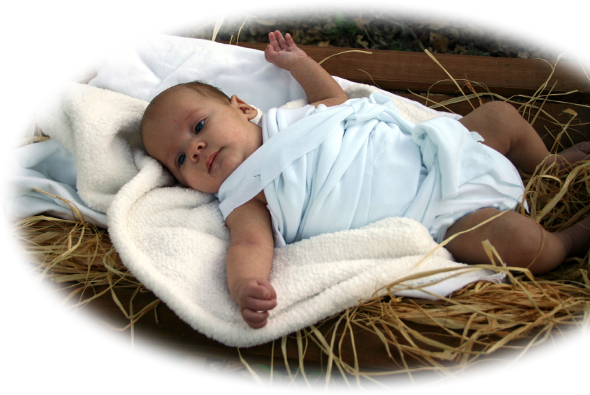
His Destination
¹⁵ Here is a trustworthy saying that deserves full acceptance: Christ Jesus came into the world to save sinners --of whom I am the worst. (1Timothy 1:15)

Slide 9
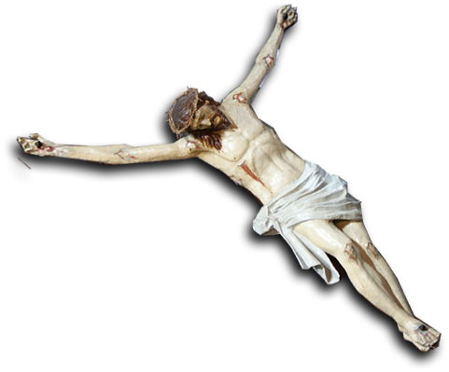
His Purpose
¹⁵ Here is a trustworthy saying that deserves full acceptance: Christ Jesus came into the world to save sinners --of whom I am the worst. (1Timothy 1:15)
Notes:
Crucifix = FREE = From Bible Point

Slide 10
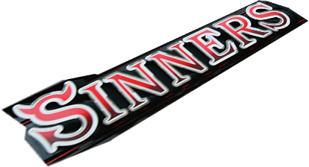
His People
¹⁵ Here is a trustworthy saying that deserves full acceptance: Christ Jesus came into the world to save sinners --of whom I am the worst. (1Timothy 1:15)
Notes:
Sinners = FREE = from http://www.flickr.com/photos/biscuitsmlp/2248219227/

Slide 11
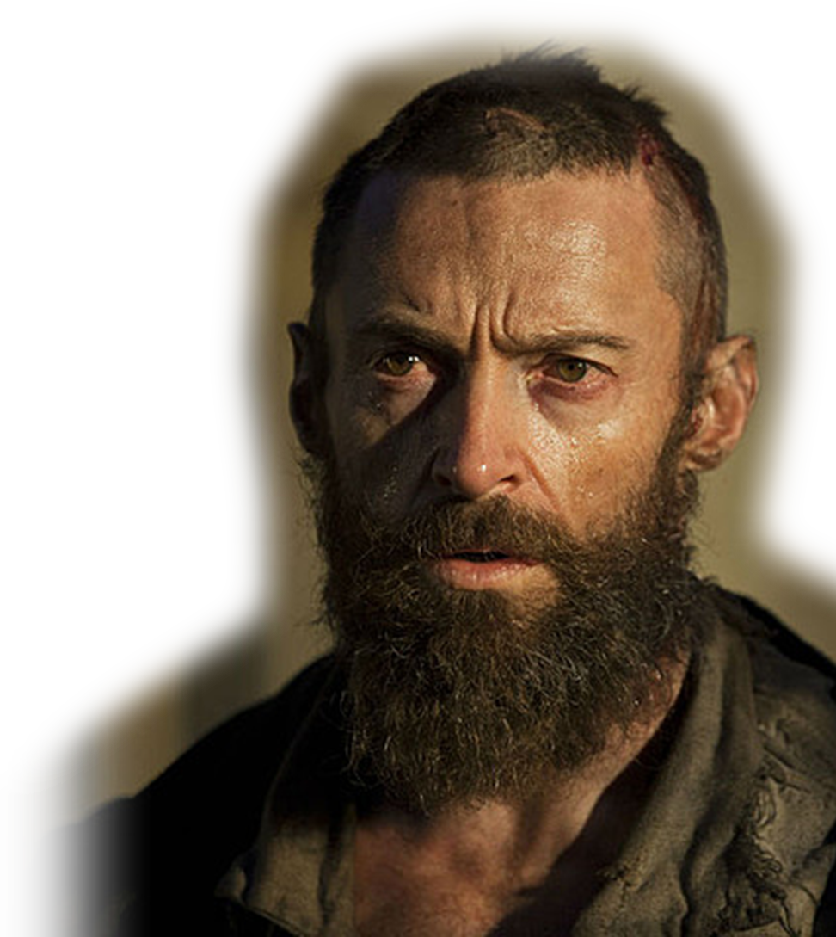
His People
¹⁵ Here is a trustworthy saying that deserves full acceptance: Christ Jesus came into the world to save sinners --of whom I am the worst. (1Timothy 1:15)
Notes:
Jesus = Licenses and not for reuse.

Slide 12
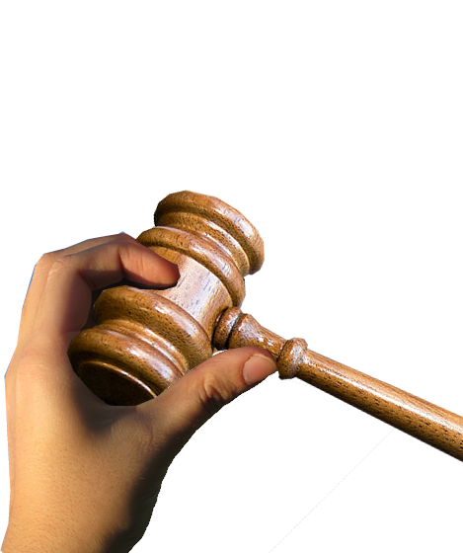
His Mercy
¹⁶ But for that very reason I was shown mercy
Notes:
Hand = FREE = from http://www.rgbstock.com/photo/mgtgF4U/sky+love
Gavel = FREE = from http://commons.wikimedia.org/wiki/File:Gavel_(8189587238).jpg

Slide 13
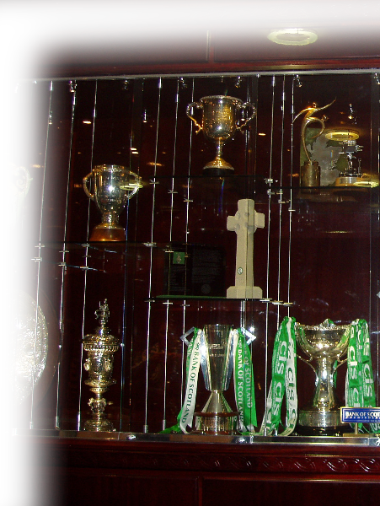
His Showcase
¹⁶ But for that very reason I was shown mercy so that in me, the worst of sinners, Christ Jesus might display his unlimited patience as an example for those who would believe on him and receive eternal life. (1Timothy 1:16)
Notes:
Showcase = FREE = From http://commons.wikimedia.org/wiki/File:Celtic_FC_trophy_case.JPG

Slide 14
His Glory
¹⁷ Now to the King eternal, immortal, invisible, the only God, be honor and glory for ever and ever. Amen. (1Timothy 1:17)
Notes:
Spotlight = FREE = from http://www.sxc.hu/photo/1261069

Slide 15
Salvation makes us Thankful

Slide 16
Thankful for His Strength
¹² I thank Christ Jesus our Lord, who has given me strength,

Slide 17
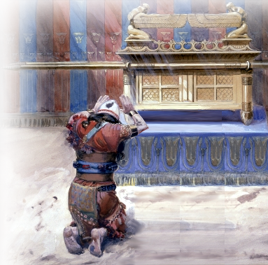
Thankful for His Consideration
¹² I thank Christ Jesus our Lord, who has given me strength, that he considered me faithful,
¹⁸ Then King David went in and sat before the LORD, and he said: "Who am I, O Sovereign LORD, and what is my family, that you have brought me this far?" (2 Samuel 7:18)
Notes:
David before the Lord = FREE = http://en.wikipedia.org/wiki/File:Tissot_Moses_and_Joshua_in_the_Tabernacle.jpg

Slide 18
Thankful for His Appointment
¹² I thank Christ Jesus our Lord, who has given me strength, that he considered me faithful, appointing me to his service.
Notes:
David before the Lord = FREE = http://en.wikipedia.org/wiki/File:Tissot_Moses_and_Joshua_in_the_Tabernacle.jpg

Slide 19
Thankful for His MERCY
¹³ Even though I was once a blasphemer and a persecutor and a violent man, I was shown mercy because I acted in ignorance and unbelief.

Slide 20
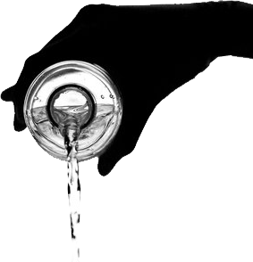
Thankful for His GRACE
¹⁴ The grace of our Lord was poured out on me abundantly,
GRACE
Notes:
POURING = FREE =from http://www.rgbstock.com/photo/meXVb1s/The+element+of+life

Slide 21
Thankful for the Faith
¹⁴ The grace of our Lord was poured out on me abundantly, along with the faith
FAITH

Slide 22
Thankful for His Love
¹⁴ The grace of our Lord was poured out on me abundantly, along with the faith and love that are in Christ Jesus.
LOVE

Slide 23
Salvation secured by Faith

Slide 24
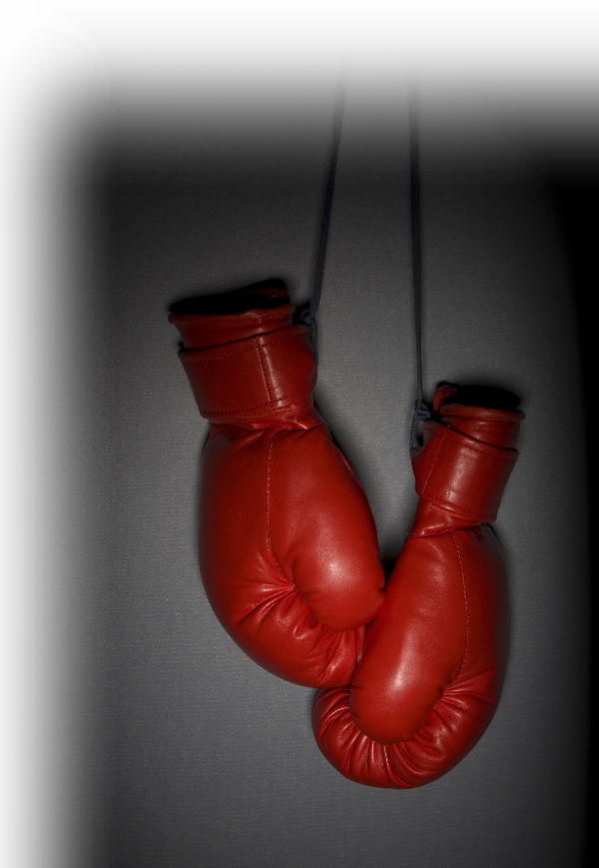
Faith worth Fighting For
¹⁸ Timothy, my son, I give you this instruction in keeping with the prophecies once made about you, so that by following them you may fight the good fight,
Notes:
Boxing gloves = Licensed and NOT for REUSE elsewhere.

Slide 25
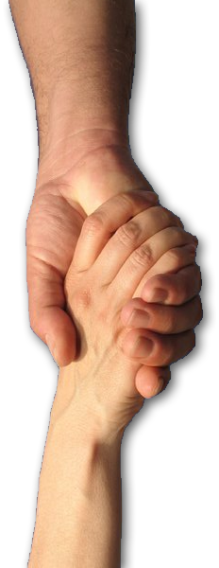
Faith worth Holding On To
¹⁹ holding on to faith and a good conscience. Some have rejected these and so have shipwrecked their faith.
Notes:
Hands = FREE = from http://www.rgbstock.com/photo/mhAUFjc/make+a+deal+1

Slide 26
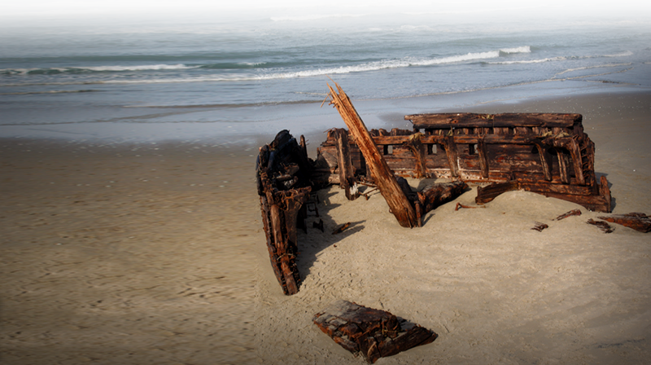
Faith worth Holding On To
¹⁹ holding on to faith and a good conscience. Some have rejected these and so have shipwrecked their faith.
Notes:
Hands = FREE = from http://www.rgbstock.com/photo/mhAUFjc/make+a+deal+1

Slide 27
Faith worth Holding On To
¹⁹ holding on to faith and a good conscience. Some have rejected these and so have shipwrecked their faith.
1. Storm - Capsize
Notes:
Hands = FREE = from http://www.rgbstock.com/photo/mhAUFjc/make+a+deal+1

Slide 28
Faith worth Holding On To
¹⁹ holding on to faith and a good conscience. Some have rejected these and so have shipwrecked their faith.
1. Storm - Capsize
2. War – Attacked
Notes:
Hands = FREE = from http://www.rgbstock.com/photo/mhAUFjc/make+a+deal+1

Slide 29
Faith worth Holding On To
¹⁹ holding on to faith and a good conscience. Some have rejected these and so have shipwrecked their faith.
1. Storm - Capsize
2. War – Attacked
3. Bad Design -- Malfunction
Notes:
Hands = FREE = from http://www.rgbstock.com/photo/mhAUFjc/make+a+deal+1

Slide 30
Faith worth Holding On To
¹⁹ holding on to faith and a good conscience. Some have rejected these and so have shipwrecked their faith.
1. Storm - Capsize
2. War – Attacked
3. Bad Design -- Malfunction
4. Incompetent Captain – Run aground
Notes:
Hands = FREE = from http://www.rgbstock.com/photo/mhAUFjc/make+a+deal+1

Slide 31
Faith worth Holding On To
¹⁹ holding on to faith and a good conscience. Some have rejected these and so have shipwrecked their faith. ²⁰ Among them are Hymenaeus and Alexander, whom I have handed over to Satan to be taught not to blaspheme.
1. Storm - Capsize
2. War – Attacked
3. Bad Design -- Malfunction
4. Incompetent Captain – Run aground
Notes:
Hands = FREE = from http://www.rgbstock.com/photo/mhAUFjc/make+a+deal+1

Slide 32
Here’s the POINT!
How do you get MORE out of CHURCH?
Answer: FOCUS ON SALVATION

Slide 33
Let’s Pray!

