Slide 1
A Study of 1 Timothy

Slide 2
Introduction
¹ Paul, an apostle of Christ Jesus by the command of God our Savior and of Christ Jesus our hope,
² To Timothy my true son in the faith: Grace, mercy and peace from God the Father and Christ Jesus our Lord.

Slide 3
Purpose for Writing:
¹⁴ Although I hope to come to you soon, I am writing you these instructions so that, ¹⁵ if I am delayed, you will know how people ought to conduct themselves in God's household, which is the church of the living God, the pillar and foundation of the truth. 1 Timothy 3:14-16

Slide 4
To Get the MOST out of CHURCH
You Must ...

Slide 5
Begin with the Word 1:1-3

Slide 6
Begin with the Word 1:1-3
³ As I urged you when I went into Macedonia, stay there in Ephesus so that you may command certain men not to teach false doctrines any longer ...

Slide 7
Begin with the Word 1:1-3
³ As I urged you when I went into Macedonia, stay there in Ephesus so that you may command certain men not to teach false doctrines any longer ...
So where do you find correct doctrine?

Slide 8
Begin with the Word 1:1-3
2 Timothy 3:16-17 ¹⁶ All Scripture is God-breathed and is useful for teaching, rebuking, correcting and training in righteousness, ¹⁷ so that the man of God may be thoroughly equipped for every good work.

Slide 9
Begin with the Word 1:1-3
2 Timothy 3:16-17 ¹⁶ All Scripture is God-breathed and is useful for teaching, rebuking, correcting and training in righteousness, ¹⁷ so that the man of God may be thoroughly equipped for every good work.

Slide 10
Begin with the Word 1:1-3
2 Timothy 3:16-17 ¹⁶ All Scripture is God-breathed and is useful for teaching, rebuking, correcting and training in righteousness, ¹⁷ so that the man of God may be thoroughly equipped for every good work.

Slide 11
Begin with the Word 1:1-3
2 Timothy 3:16-17 ¹⁶ All Scripture is God-breathed and is useful for teaching, rebuking, correcting and training in righteousness, ¹⁷ so that the man of God may be thoroughly equipped for every good work.
DOCTRINE

Slide 12
Begin with the Word 1:1-3
2 Timothy 3:16-17 ¹⁶ All Scripture is God-breathed and is useful for teaching, rebuking, correcting and training in righteousness, ¹⁷ so that the man of God may be thoroughly equipped for every good work.

Slide 13
Begin with the Word 1:1-3
2 Timothy 3:16-17 ¹⁶ All Scripture is God-breathed and is useful for teaching, rebuking, correcting and training in righteousness, ¹⁷ so that the man of God may be thoroughly equipped for every good work.

Slide 14
Begin with the Word 1:1-3
2 Timothy 3:16-17 ¹⁶ All Scripture is God-breathed and is useful for teaching, rebuking, correcting and training in righteousness, ¹⁷ so that the man of God may be thoroughly equipped for every good work.

Slide 15
Begin with the Word 1:1-3
2 Timothy 3:16-17 ¹⁶ All Scripture is God-breathed and is useful for teaching, rebuking, correcting and training in righteousness, ¹⁷ so that the man of God may be thoroughly equipped for every good work.

Slide 16
Defend the Word 1:3-4
Notes:
Evolution is a myth – reputable scientist must leave room for intelligent design.
Political Correctness has substituted for genealogies in our day
Evolution chart = FREE = from http://www.flickr.com/photos/tones_space/194265401/sizes/o/in/photostream/
PC logo = FREE = from http://commons.wikimedia.org/wiki/File:No_Political_Correctness.svg

Slide 17
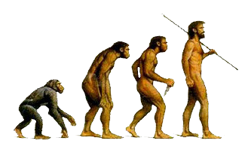
Defend the Word 1:3-4
3 ... command certain men not ...⁴ nor to devote themselves to myths and endless genealogies. These promote controversies rather than God's work--which is by faith.
Notes:
Evolution is a myth – reputable scientist must leave room for intelligent design.
Political Correctness has substituted for genealogies in our day
Evolution chart = FREE = from http://www.flickr.com/photos/tones_space/194265401/sizes/o/in/photostream/
PC logo = FREE = from http://commons.wikimedia.org/wiki/File:No_Political_Correctness.svg

Slide 18
Defend the Word 1:3-4
3 ... command certain men not ...⁴ nor to devote themselves to myths and endless genealogies. These promote controversies rather than God's work--which is by faith.
Notes:
Evolution is a myth – reputable scientist must leave room for intelligent design.
Political Correctness has substituted for genealogies in our day
Evolution chart = FREE = from http://www.flickr.com/photos/tones_space/194265401/sizes/o/in/photostream/
PC logo = FREE = from http://commons.wikimedia.org/wiki/File:No_Political_Correctness.svg

Slide 19
Be Shaped by the Word 1:5
Notes:
Heart pages = FREE = from http://crisraquel.deviantart.com/art/Twilight-Love-158495733

Slide 20
Be Shaped by the Word 1:5
⁵ The goal of this command is love, which comes from a pure heart and a good conscience and a sincere faith.
Notes:
Heart pages = FREE = from http://crisraquel.deviantart.com/art/Twilight-Love-158495733

Slide 21
Be Shaped by the Word 1:5
⁵ The goal of this command is love, which comes from a pure heart and a good conscience and a sincere faith.
Notes:
Heart pages = FREE = from http://crisraquel.deviantart.com/art/Twilight-Love-158495733

Slide 22
Be Shaped by the Word 1:5
⁵ The goal of this command is love, which comes from a pure heart and a good conscience and a sincere faith.
Notes:
Heart pages = FREE = from http://crisraquel.deviantart.com/art/Twilight-Love-158495733

Slide 23
Be Shaped by the Word 1:5
⁵ The goal of this command is love, which comes from a pure heart and a good conscience and a sincere faith.
Notes:
Heart pages = FREE = from http://crisraquel.deviantart.com/art/Twilight-Love-158495733

Slide 24
Know the Word 1:6-7

Slide 25
Know the Word 1:6-7
⁶ Some have wandered away from these and turned to meaningless talk. ⁷ They want to be teachers of the law, but they do not know what they are talking about or what they so confidently affirm.

Slide 26
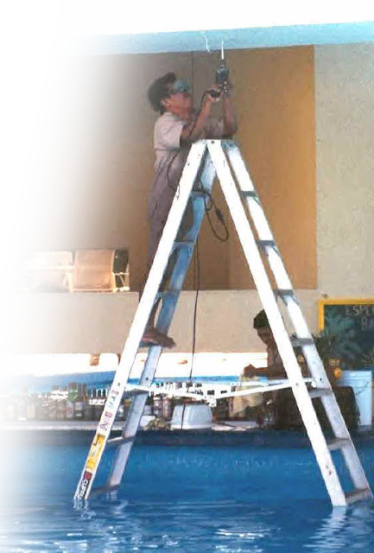
Properly Use the Word 1:8-11
Notes:
Historical grammatical literal common sense interpretation – NOT Davinci code or Bible Code non-sense
a workman who does not need to be ashamed and who correctly handles the word of truth. (2Ti 2:15 NIV)
Man on ladder = from http://abestair.blogspot.com/2012/09/improper-ladder-placement.html#.UlBQoMbkvf0

Slide 27
Properly Use the Word 1:8-11
⁸ We know that the law is good if one uses it properly.
Notes:
Historical grammatical literal common sense interpretation – NOT Davinci code or Bible Code non-sense
a workman who does not need to be ashamed and who correctly handles the word of truth. (2Ti 2:15 NIV)
Man on ladder = from http://abestair.blogspot.com/2012/09/improper-ladder-placement.html#.UlBQoMbkvf0

Slide 28
Properly Use the Word 1:8-11
⁸ We know that the law is good if one uses it properly.
Be diligent to present yourself approved to God as a workman who does not need to be ashamed, handling accurately the word of truth. 2 Timothy 2:15 (NAS)
Notes:
Historical grammatical literal common sense interpretation – NOT Davinci code or Bible Code non-sense
a workman who does not need to be ashamed and who correctly handles the word of truth. (2Ti 2:15 NIV)
Man on ladder = from http://abestair.blogspot.com/2012/09/improper-ladder-placement.html#.UlBQoMbkvf0

Slide 29
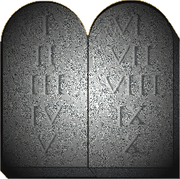
Properly Use the Word 1:8-11
⁹ We also know that law is made not for the righteous
Notes:
¹⁹ What, then, was the purpose of the law? It was added because of transgressions until the Seed to whom the promise referred had come. (Gal 3:19 NIV)
through the law we become conscious of sin. (Rom 3:20 NIV)
¹⁵ because law brings wrath. (Rom 4:15 NIV)
²⁰ The law was added so that the trespass might increase.
But where sin increased, grace increased all the more, (Rom 5:20 NIV)

Slide 30
Properly Use the Word 1:8-11
⁹ We also know that law is made not for the righteous
¹⁹ What, then, was the purpose of the law? It was added because of transgressions until the Seed to whom the promise referred had come. Galatians 3:19
Notes:
¹⁹ What, then, was the purpose of the law? It was added because of transgressions until the Seed to whom the promise referred had come. (Gal 3:19 NIV)
through the law we become conscious of sin. (Rom 3:20 NIV)
¹⁵ because law brings wrath. (Rom 4:15 NIV)
²⁰ The law was added so that the trespass might increase.
But where sin increased, grace increased all the more, (Rom 5:20 NIV)

Slide 31
Properly Use the Word 1:8-11
⁹ We also know that law is made not for the righteous
... through the law we become conscious of sin. Romans 3:20
Notes:
¹⁹ What, then, was the purpose of the law? It was added because of transgressions until the Seed to whom the promise referred had come. (Gal 3:19 NIV)
¹⁵ because law brings wrath. (Rom 4:15 NIV)
²⁰ The law was added so that the trespass might increase.
But where sin increased, grace increased all the more, (Rom 5:20 NIV)
The righteous do not need the law—they do right, they are righteous. Therefore the law is for the unrighteous ...

Slide 32
Properly Use the Word 1:8-11
⁹ We also know that law is made not for the righteous
¹⁵ because law brings wrath. Romans 4:15
Notes:
²⁰ The law was added so that the trespass might increase.
But where sin increased, grace increased all the more, (Rom 5:20 NIV)
The righteous do not need the law—they do right, they are righteous. Therefore the law is for the unrighteous ...

Slide 33
Properly Use the Word 1:8-11
⁹ We also know that law is made not for the righteous
²⁰ The law was added so that the trespass might increase. But where sin increased, grace increased all the more, Romans 5:20
Notes:
The righteous do not need the law—they do right, they are righteous. Therefore the law is for the unrighteous ...

Slide 34
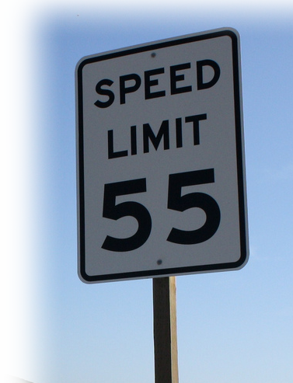
Properly Use the Word 1:8-11
⁹ We also know that law is made not for the righteous but for lawbreakers
Notes:
Source = Unknown?

Slide 35
Properly Use the Word 1:8-11
⁹ We also know that law is made not for the righteous but for lawbreakers and rebels,
Notes:
Speed sign = FREE = from http://www.flickr.com/photos/lofink/4399899417/sizes/l/in/photostream/

Slide 36
Properly Use the Word 1:8-11
⁹ We also know that law is made not for the righteous but for lawbreakers and rebels, the ungodly and sinful,
Notes:
Speed sign = FREE = from http://www.flickr.com/photos/lofink/4399899417/sizes/l/in/photostream/

Slide 37
Properly Use the Word 1:8-11
⁹ We also know that law is made not for the righteous but for lawbreakers and rebels, the ungodly and sinful, the unholy and irreligious;
Notes:
Speed sign = FREE = from http://www.flickr.com/photos/lofink/4399899417/sizes/l/in/photostream/

Slide 38
Properly Use the Word 1:8-11
⁹ We also know that law is made not for the righteous but for lawbreakers and rebels, the ungodly and sinful, the unholy and irreligious; for those who kill their fathers or mothers, for murderers,
Notes:
Speed sign = FREE = from http://www.flickr.com/photos/lofink/4399899417/sizes/l/in/photostream/

Slide 39
Properly Use the Word 1:8-11
⁹ We also know that law is made not for the righteous but for lawbreakers and rebels, the ungodly and sinful, the unholy and irreligious; for those who kill their fathers or mothers, for murderers,
¹⁰ for adulterers and perverts,
Notes:
Speed sign = FREE = from http://www.flickr.com/photos/lofink/4399899417/sizes/l/in/photostream/

Slide 40
Properly Use the Word 1:8-11
⁹ We also know that law is made not for the righteous but for lawbreakers and rebels, the ungodly and sinful, the unholy and irreligious; for those who kill their fathers or mothers, for murderers,
¹⁰ for adulterers and perverts, for slave traders and liars and perjurers--and ...
Notes:
Speed sign = FREE = from http://www.flickr.com/photos/lofink/4399899417/sizes/l/in/photostream/

Slide 41
Properly Use the Word 1:8-11
for whatever else is contrary to the sound doctrine ¹¹ that conforms to the glorious gospel of the blessed God, which he entrusted to me.

Slide 42
Here’s the point ...

Slide 43
Here’s the point ...
To Get the MOST out of CHURCH
YOU MUST BE in the WORD!

Slide 44
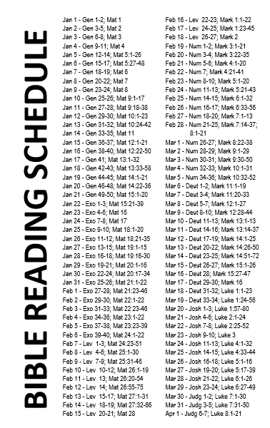
To help you we have prepared

Slide 45
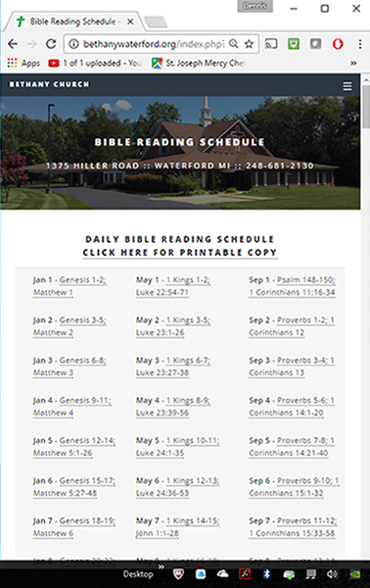
To help you we have prepared

Slide 46
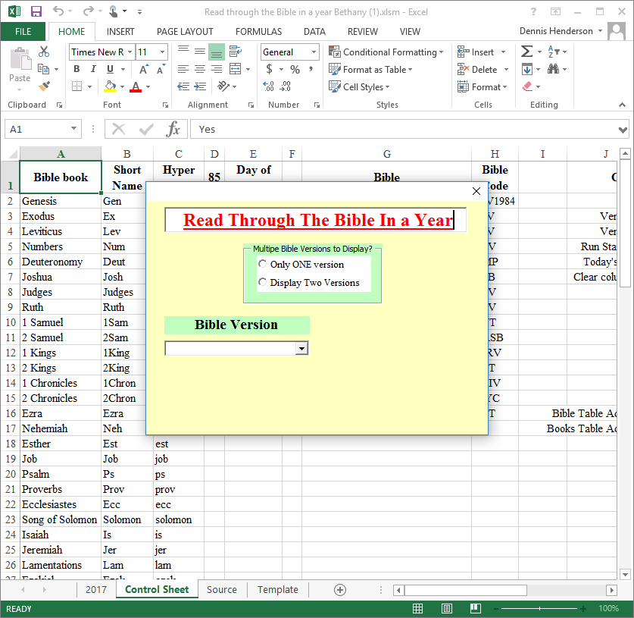
To help you we have prepared

Slide 47
To help you we have prepared

Slide 48
To help you we have prepared

Slide 49
Get in the WORD!

Slide 50
Let’s Pray!

