Slide 2
A Study of 1 Timothy

Slide 3
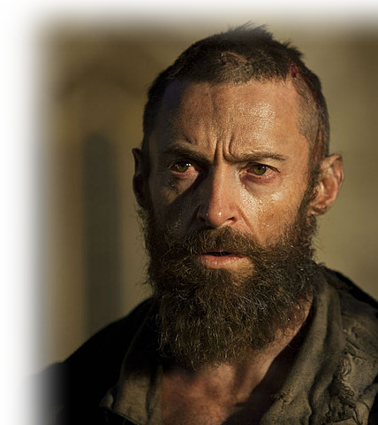
1 Timothy
^{1:1} Paul, an apostle of Christ Jesus by the command of God our Savior and of Christ Jesus our hope,
Notes:
Paul = http://screencrush.com/442/files/2015/04/Hugh-Jackman.jpg?w=720&cdnnode=1

Slide 4
Who is This Guy Paul?
^{1:1} Paul, an apostle of Christ Jesus by the command of God our Savior and of Christ Jesus our hope,

Slide 5
Who is This Guy Paul? -- A JEW
^{Phi 3:4} ... If anyone else thinks he has reasons to put confidence in the flesh, I have more: ⁵ circumcised on the eighth day, of the people of Israel, of the tribe of Benjamin, a Hebrew of Hebrews; in regard to the law, a Pharisee; ⁶ as for zeal, persecuting the church; as for legalistic righteousness, faultless. ⁷ But whatever was to my profit I now consider loss for the sake of Christ.
(Phi 3:4-7 NIV)

Slide 6
Who is This Guy Paul? -- A JEW
^{Phi 3:4} ... If anyone else thinks he has reasons to put confidence in the flesh, I have more: ⁵ circumcised on the eighth day, of the people of Israel, of the tribe of Benjamin, a Hebrew of Hebrews; in regard to the law, a Pharisee; ⁶ as for zeal, persecuting the church; as for legalistic righteousness, faultless. ⁷ But whatever was to my profit I now consider loss for the sake of Christ.
(Phi 3:4-7 NIV)

Slide 7
Who is This Guy Paul? -- A JEW
^{Phi 3:4} ... If anyone else thinks he has reasons to put confidence in the flesh, I have more: ⁵ circumcised on the eighth day, of the people of Israel, of the tribe of Benjamin, a Hebrew of Hebrews; in regard to the law, a Pharisee; ⁶ as for zeal, persecuting the church; as for legalistic righteousness, faultless. ⁷ But whatever was to my profit I now consider loss for the sake of Christ.
(Phi 3:4-7 NIV)

Slide 8
Who is This Guy Paul? -- A JEW
^{Phi 3:4} ... If anyone else thinks he has reasons to put confidence in the flesh, I have more: ⁵ circumcised on the eighth day, of the people of Israel, of the tribe of Benjamin, a Hebrew of Hebrews; in regard to the law, a Pharisee; ⁶ as for zeal, persecuting the church; as for legalistic righteousness, faultless. ⁷ But whatever was to my profit I now consider loss for the sake of Christ.
(Phi 3:4-7 NIV)

Slide 9
Who is This Guy Paul? -- A JEW
^{Phi 3:4} ... If anyone else thinks he has reasons to put confidence in the flesh, I have more: ⁵ circumcised on the eighth day, of the people of Israel, of the tribe of Benjamin, a Hebrew of Hebrews; in regard to the law, a Pharisee; ⁶ as for zeal, persecuting the church; as for legalistic righteousness, faultless. ⁷ But whatever was to my profit I now consider loss for the sake of Christ.
(Phi 3:4-7 NIV)

Slide 10
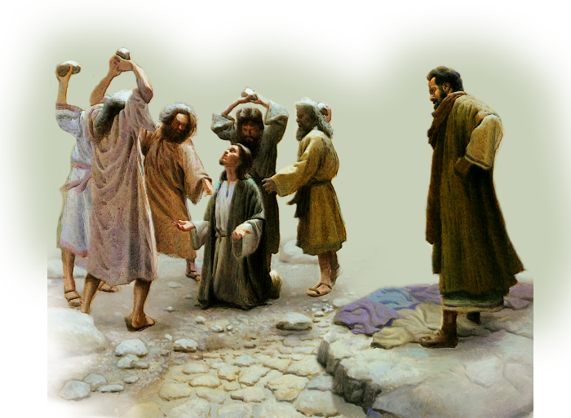
Who is This Guy Paul? A.K.A. SAUL
^{Acts 7:58} Meanwhile, the witnesses laid their clothes at the feet of a young man named Saul. ⁵⁹ While they were stoning him, Stephen prayed, "Lord Jesus, receive my spirit.“ ⁶⁰ Then he fell on his knees and cried out, "Lord, do not hold this sin against them." When he had said this, he fell asleep.
(Act 7:58-60 NIV) And Saul was there, giving approval to his death. On that day a great persecution broke out against the church at Jerusalem, and all except the apostles were scattered throughout Judea and Samaria.
² Godly men buried Stephen and mourned deeply for him.
³ But Saul began to destroy the church. (Act 8:1-3 NIV)
Notes:
Stoning Stephen = http://omegaopc.org/wp-content/uploads/2015/07/Stoning-Stephen2.png

Slide 11
Who is This Guy Paul? A.K.A. SAUL
^{Acts 8:1} And Saul was there, giving approval to his death. On that day a great persecution broke out against the church at Jerusalem, .... ³ But Saul began to destroy the church.

Slide 12
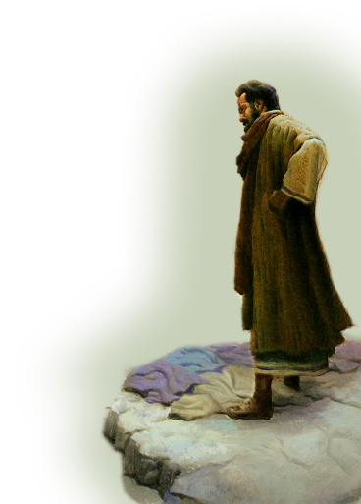
Who is This Guy Paul? A CONVERT
^{Acts 9:1} Meanwhile, Saul was still breathing out murderous threats against the Lord's disciples. He went to the high priest ² and asked him for letters to the synagogues in Damascus, so that if he found any there who belonged to the Way, whether men or women, he might take them as prisoners to Jerusalem.

Slide 13
Who is This Guy Paul? A CONVERT
³ As he neared Damascus on his journey, suddenly a light from heaven flashed around him. ⁴ He fell to the ground and heard a voice say to him, "Saul, Saul, why do you persecute me?“

Slide 14
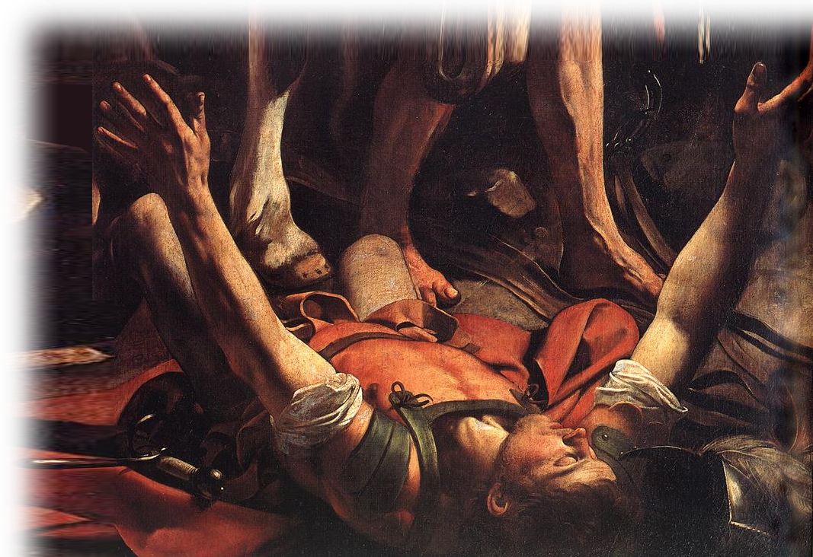
Who is This Guy Paul? A CONVERT
³ As he neared Damascus on his journey, suddenly a light from heaven flashed around him. ⁴ He fell to the ground and heard a voice say to him, "Saul, Saul, why do you persecute me?“
Notes:
Paul = https://upload.wikimedia.org/wikipedia/commons/3/36/Michelangelo_Merisi_da_Caravaggio_-_The_Conversion_on_the_Way_to_Damascus_%28detail%29_-_WGA04134.jpg

Slide 15
Who is This Guy Paul? A CONVERT
³ As he neared Damascus on his journey, suddenly a light from heaven flashed around him. ⁴ He fell to the ground and heard a voice say to him, "Saul, Saul, why do you persecute me?“
Notes:
Paul = https://upload.wikimedia.org/wikipedia/commons/3/36/Michelangelo_Merisi_da_Caravaggio_-_The_Conversion_on_the_Way_to_Damascus_%28detail%29_-_WGA04134.jpg

Slide 16
Who is This Guy Paul? A CONVERT
⁵ "Who are you, Lord?" Saul asked. "I am Jesus, whom you are persecuting," he replied. ⁶ "Now get up and go into the city, and you will be told what you must do.“

Slide 17
Who is This Guy Paul? A CONVERT
⁵ "Who are you, Lord?" Saul asked. "I am Jesus, whom you are persecuting," he replied. ⁶ "Now get up and go into the city, and you will be told what you must do.“

Slide 18
Who is This Guy Paul? A CONVERT
⁷ The men traveling with Saul stood there speechless; they heard the sound but did not see anyone.
⁸ Saul got up from the ground, but when he opened his eyes he could see nothing. So they led him by the hand into Damascus.

Slide 19
Who is This Guy Paul? A CONVERT
¹⁰ In Damascus ... the Lord said to Ananias, "Go! This man is my chosen instrument to carry my name before the Gentiles and their kings and before the people of Israel. ¹⁶ I will show him how much he must suffer for my name."

Slide 20
Who is This Guy Paul? A CONVERT
¹⁷ Then Ananias ... Placing his hands on Saul, he said, "Brother Saul, the Lord--Jesus, who appeared to you on the road as you were coming here--has sent me so that you may see again and be filled with the Holy Spirit.“ ¹⁸ Immediately, something like scales fell from Saul's eyes, and he could see again. He got up and was baptized ...
¹⁹ and after taking some food, he regained his strength. Saul spent several days with the disciples in Damascus.
²⁰ At once he began to preach in the synagogues that Jesus is the Son of God.
(Act 9:15-20 NIV)

Slide 21
Who is This Guy Paul? A CONVERT
¹⁷ Then Ananias ... Placing his hands on Saul, he said, "Brother Saul, the Lord--Jesus, who appeared to you on the road as you were coming here--has sent me so that you may see again and be filled with the Holy Spirit.“ ¹⁸ Immediately, something like scales fell from Saul's eyes, and he could see again. He got up and was baptized ...
¹⁹ and after taking some food, he regained his strength. Saul spent several days with the disciples in Damascus.
²⁰ At once he began to preach in the synagogues that Jesus is the Son of God.
(Act 9:15-20 NIV)

Slide 22
Who is This Guy Paul? AN APOSTLE
^{1:1} Paul, an apostle of Christ Jesus by the command of God our Savior and of Christ Jesus our hope, ....

Slide 23
Who is This Guy Paul? AN APOSTLE
^{1:1} Paul, an apostle of Christ Jesus by the command of God our Savior and of Christ Jesus our hope, ....
^{1Cor 15:8} ... last of all he appeared to me also, as to one abnormally born. ⁹ For I am the least of the apostles and do not even deserve to be called an apostle, because I persecuted the church of God.
Gal 1:1 Paul, an apostle--sent not from men nor by man, but by Jesus Christ and God the Father, who raised him from the dead-- (Gal 1:1 NIV)
Inasmuch as I am the apostle to the Gentiles, (Rom 11:13 NIV)

Slide 24
Who is This Guy Paul? AN APOSTLE
^{1:1} Paul, an apostle of Christ Jesus by the command of God our Savior and of Christ Jesus our hope, ....
^{Gal 1:1} Paul, an apostle--sent not from men nor by man, but by Jesus Christ and God the Father, who raised him from the dead—
Inasmuch as I am the apostle to the Gentiles, (Rom 11:13 NIV)

Slide 25
Who is This Guy Paul? AN APOSTLE
^{1:1} Paul, an apostle of Christ Jesus by the command of God our Savior and of Christ Jesus our hope, ....
^{Rom 11:13} Inasmuch as I am the apostle to the Gentiles ....

Slide 26
Who is This Guy Paul? A MISSIONARY
^{Acts 13:2} While they were worshiping the Lord and fasting, the Holy Spirit said, "Set apart for me Barnabas and Saul for the work to which I have called them.“ ³ So after they had fasted and prayed, they placed their hands on them and sent them off.
[on three journeys]

Slide 27
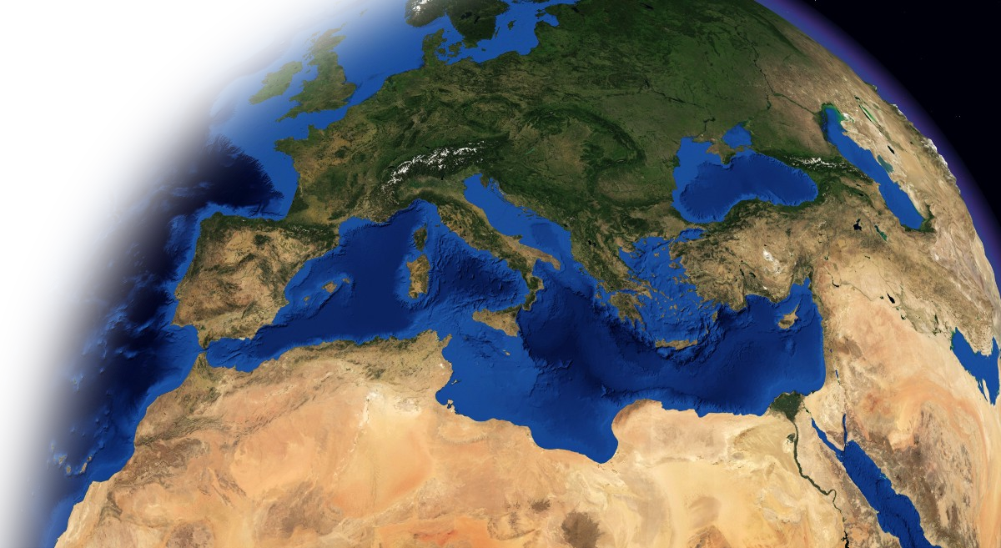
Who is This Guy Paul? A MISSIONARY
Took Three Missionary Journeys

Slide 28
Who is This Guy Paul? A MISSIONARY
Took Three Missionary Journeys

Slide 29
Who is This Guy Paul? A MISSIONARY
Took Three Missionary Journeys

Slide 30
Who is This Guy Paul? A MISSIONARY
Fourth to Imprisonment in Rome

Slide 31
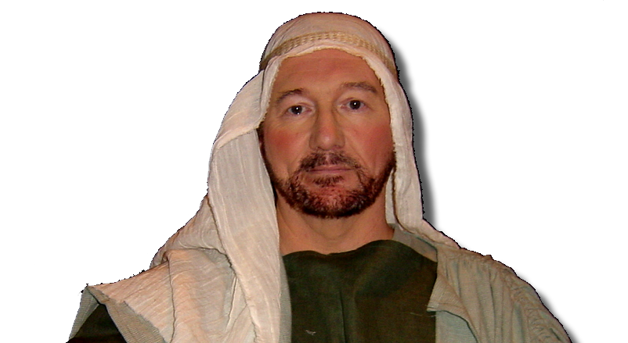
Who is this Timothy?
^{1Tim 1:2} To Timothy my true son in the faith: Grace, mercy and peace from God the Father and Christ Jesus our Lord.

Slide 32
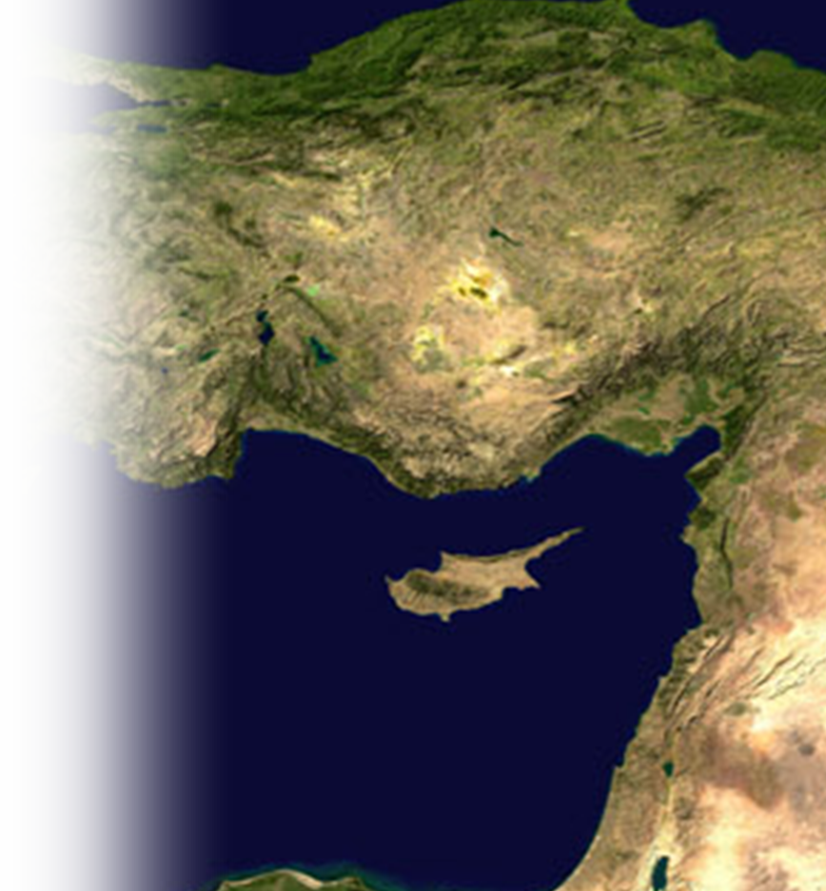
Who is this Timothy? HALF-JEW
^{Acts 16:1} He [i.e.Paul] came to Derbe and then to Lystra, where a disciple named Timothy lived, whose mother was a Jewess and a believer, but whose father was a Greek.

Slide 33
Who is this Timothy? A SPIRITUAL SON
^{1Tim 1:2} To Timothy my true son in the faith: Grace, mercy and peace from God the Father and Christ Jesus our Lord.

Slide 34
Who is this Timothy? APPROVED SON
^{Phil 2:22} But you know that Timothy has proved himself, because as a son with his father he has served with me in the work of the gospel.

Slide 35
Who is this Timothy? YOUNG PASTOR
^{1Tim1:3} As I urged you when I went into Macedonia, stay there in Ephesus so that you may command certain men not to teach false doctrines any longer

Slide 36
What is the CHURCH?
Notes:
Who is the church

Slide 37
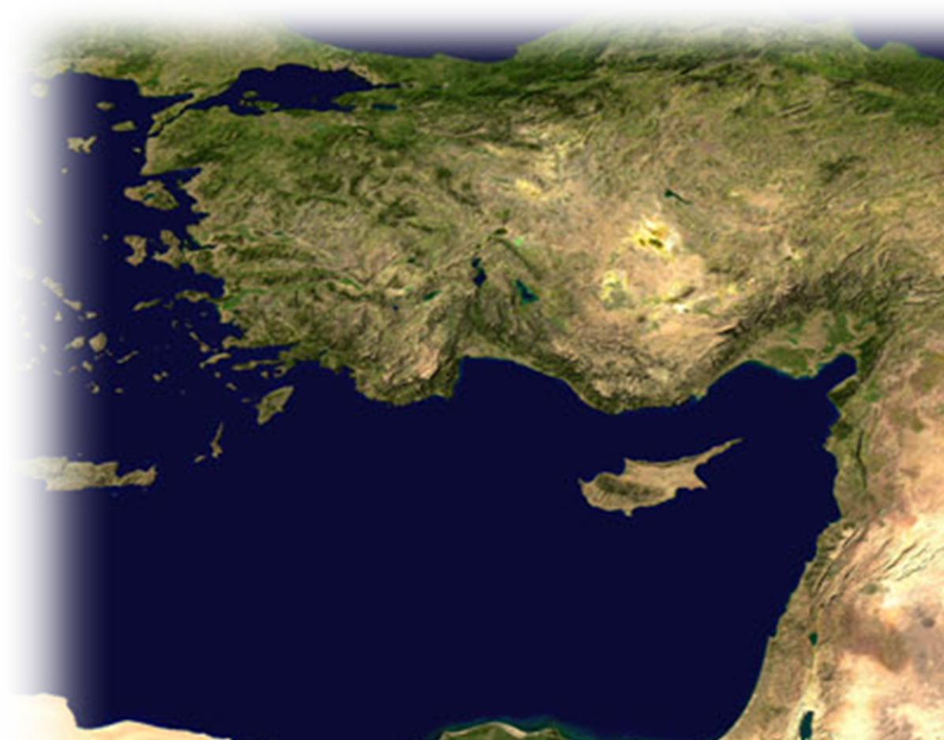
What is the CHURCH? LOCAL GATHERING
^{1 Timothy 1:3} As I urged you when I went into Macedonia, stay there in Ephesus so that you may command certain men not to teach false doctrines any longer

Slide 38
What is the CHURCH? GOD’S HOUSEHOLD
^{1 Tim 3:14} ... I am writing you these instructions so that, ¹⁵ if I am delayed, you will know how people ought to conduct themselves in God's household, which is the church of the living God, the pillar and foundation of the truth.
Notes:
gj

Slide 39
What is the CHURCH? Of the LIVING GOD
^{1 Tim 3:14} ... I am writing you these instructions so that, ¹⁵ if I am delayed, you will know how people ought to conduct themselves in God's household, which is the church of the living God, the pillar and foundation of the truth.
Notes:
gj

Slide 40
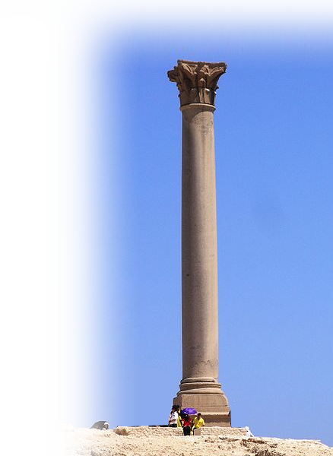
What is the CHURCH? A PILLAR OF TRUTH
^{1 Tim 3:14} ... I am writing you these instructions so that, ¹⁵ if I am delayed, you will know how people ought to conduct themselves in God's household, which is the church of the living God, the pillar and foundation of the truth.
Notes:
Pillar = https://upload.wikimedia.org/wikipedia/commons/thumb/2/21/Alexandria_-_Pompey%27s_Pillar_with_two_sphinx.JPG/800px-Alexandria_-_Pompey%27s_Pillar_with_two_sphinx.JPG

Slide 41
What is the CHURCH? Foundation of T.
^{1 Tim 3:14} ... I am writing you these instructions so that, ¹⁵ if I am delayed, you will know how people ought to conduct themselves in God's household, which is the church of the living God, the pillar and foundation of the truth.
Notes:
Foundation = https://upload.wikimedia.org/wikipedia/commons/7/79/Foundation-M2325.jpg

Slide 42
Here’s the QUESTION of the Day:
What is “Truth?”
Notes:
gj

Slide 43
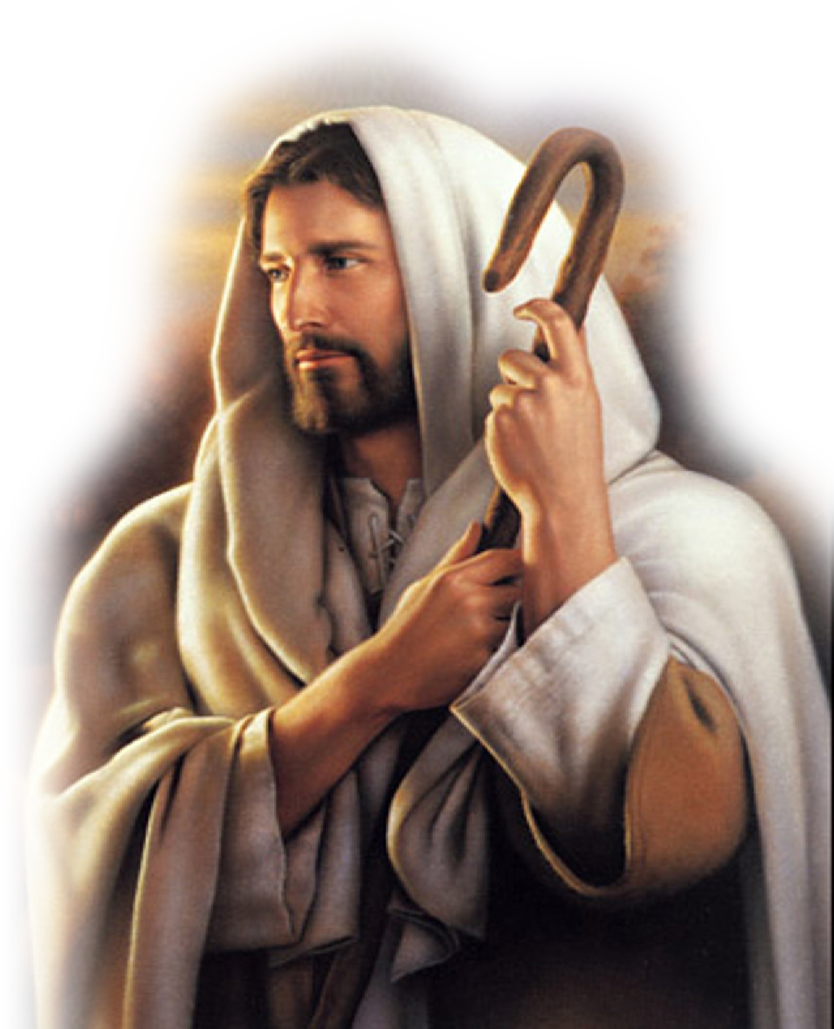
Two-fold Answer:
1-The LIVING WORD!
Jesus answered, "I am the way and the truth and the life. No one comes to the Father except through me. (John 14:6)
Notes:
Jesus https://upload.wikimedia.org/wikipedia/commons/c/cb/Luke_Banks.jpg

Slide 44
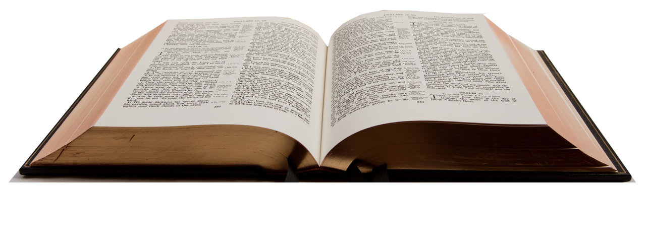
Two-fold Answer:
2-The WRITTEN WORD!
[Jesus prayed,] "Sanctify them by the truth; your word is truth (John 17:17)
Notes:
Je

Slide 45
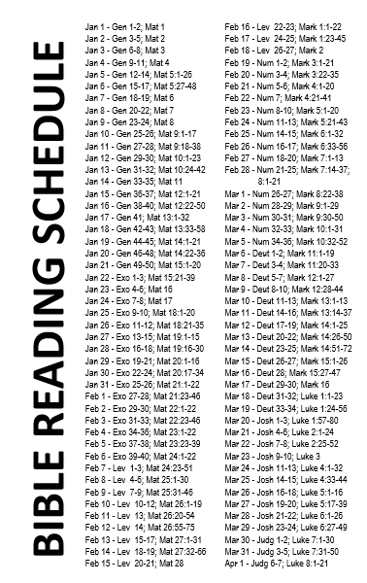
Two-fold Answer:
Notes:
gj

Slide 46
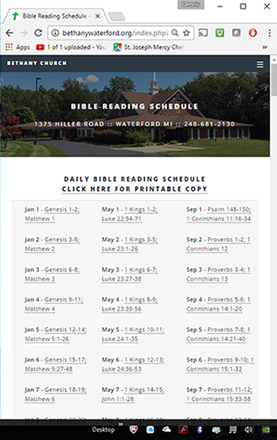
Two-fold Answer:
Notes:
gj

Slide 47
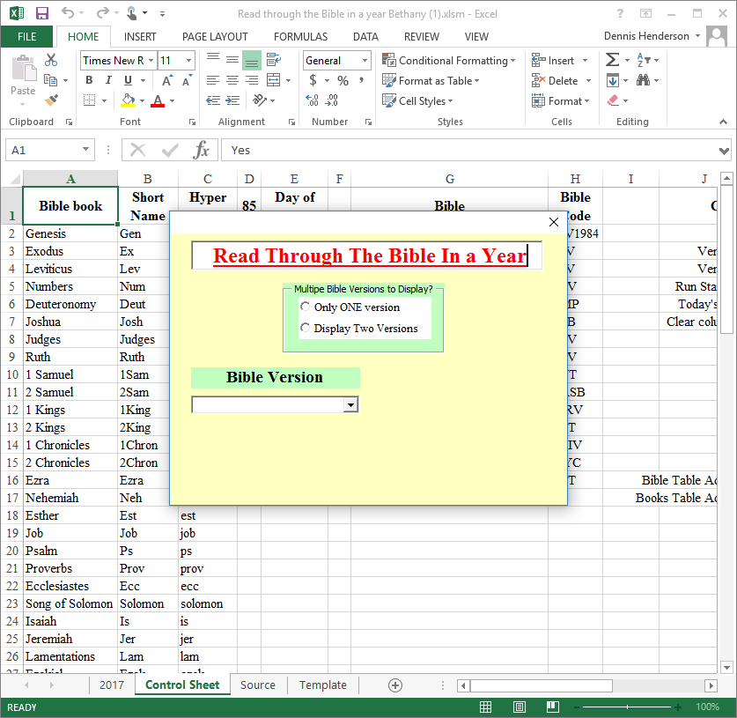
Two-fold Answer:
Notes:
gj

Slide 48
Take this with you:
From Paul’s Life --No one is too deplorable for God and no one is irredeemable by God.

Slide 49
Take this with you:
From Paul’s Life --No one is too deplorable for God and no one is irredeemable by God.
From Timothy’s Life --No one is too young to serve God.

Slide 50
Take this with you:
From Paul’s Life --No one is too deplorable for God and no one is irredeemable by God.
From Timothy’s Life --No one is too young to serve God.
From the Church--The true Church is built on the Truth of God’s Word. So get into the Word!

Slide 51
Let’s Pray!

