Slide 1
Lesson 12
This series uses “Hemi Head Rg” Font
You can get the font FREE at: https://www.dafont.com/hemi-head.font
Or https://fontsfree.net/hemi-head-rg-bold-italic-font-download.html
Or https://www.1001fonts.com/hemi-head-426-font.html
Notes:
Copyright © 2006−2021. All rights reserved. Bible Point is a registered trademark of Dennis Henderson. All other trademarks acknowledged.
Bible Point contains graphics from Bible Point artists. These illustrations belong to Bible Point and the respective artists. You may use the designs and illustrations for graphical illustration of lessons free and without special permission, provided they are not used in any way that maligns the Christian faith. Furthermore, republication or production of any illustration by any other graphic service whether it be in book, in a machine-readable form, or in any other design resource is strictly prohibited. Furthermore, they cannot be duplicated or resold as any other form of publishing, clip art, or graphic resource.
So What does it mean? (A simple translations of the legal jargon)
So, if you don’t own the presentation(s), graphic(s), and text(s) how can you legally use them? The purchase of the license allows you to use all the images in the product. However, the actual ownership and copyright of the presentation(s), graphic(s), and text(s) remain the property of Bible Point and its licensors. If you had plans on using this product in your “for sale” work—think again!
License Agreement
Article 1: License Grant
All the graphics and text in Bible Point presentations (excluding quotes from the Bible and stated sources) are the intellectual and real property of Bible Point and its licensors, and is protected by law, including United States copyright laws and international treaties. Bible Point grants to you a license:
1. To use the presentation in a single church, single school, or single office of a Christian organization.
2. To make a single archival back-up copy of the program.
3. To modify the presentation(s) and merge with other presentations in a single church, school, or Christian organization.
4. To transfer to another party if that party agrees to accept the terms and conditions of this agreement, and you do not retain any copies of the presentation, whether printed, machine readable, modified, or merged form.
Article 2: Terms
This license is effective until terminated. You may terminate the license at any time by destroying the presentation(s), graphic(s), or text(s) together with all copies, modifications and merged portions in any form. Bible Point may terminate your license if you fail to comply with this Agreement. You agree, upon such termination, for any reason, to destroy the presentation(s), graphics, and text(s) with all copies, modifications, and merged portions in any form.
Article 3: Disclaimers
1. Bible Point presentations, graphics, and texts are licensed to you As Is. You, the consumer, bear the entire risk relating to the quality and performance of the presentation(s), graphic(s), or text(s). In no event will Bible Point be liable for damages resulting from any defect.
2. Thirty-day limited warrantee on disks. Bible Point warrants the disks to be free of defects in material and workmanship under normal use for 30 days after purchase. During the 30-day period you may return a defective presentation, graphic, or text with proof of purchase and it will be replaced without charge, unless the presentation is damaged by misuse.
Article 4: General
1. You may not sub-license, assign, or transfer the license of the presentation(s), graphic(s), or text(s) except as provided by this Agreement.
2. This Agreement will be governed by the laws of the State of Michigan.
So What does it mean? (A simple translations of the legal jargon)
May I let someone borrow or copy my licensed Bible Point presentation (even after I modified it)? As long as it is within your local church, or single school, or the immediate office of a Christian organization you may. Otherwise, please refer the person interested in borrowing to: http://www.biblepoint.com or E-mail: dennis@DrDH.net with any related questions.

Slide 2


Finding Victory through …
Notes:
https://watermark.lovepik.com/photo/50083/4881.jpg_wh1200.jpg

Slide 3
Seeking the KINGDOM of GOD!
Notes:
Victory is Found in Covenant Loyalty
To God be the Glory ... Song Great things he has done

Slide 4
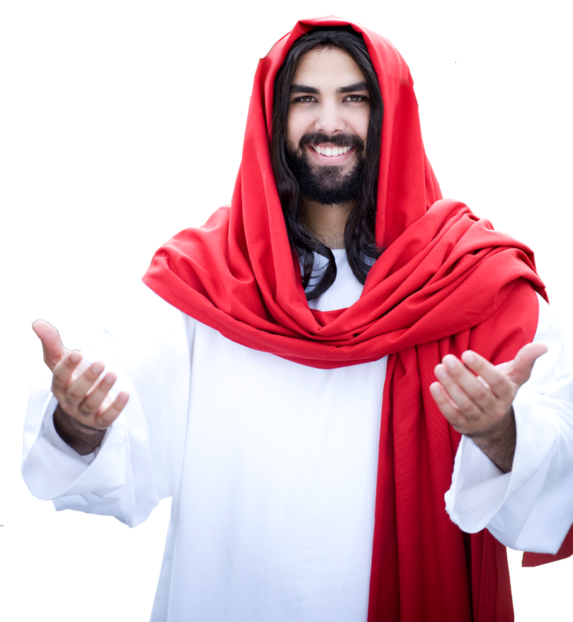
Seeking the KINGDOM of GOD!
But seek first the kingdom of God and his righteousness, and all these things will be added to you.
(Matthew 6:33)
HOW?
Notes:
Victory is Found in Covenant Loyalty
To God be the Glory ... Song Great things he has done

Slide 5
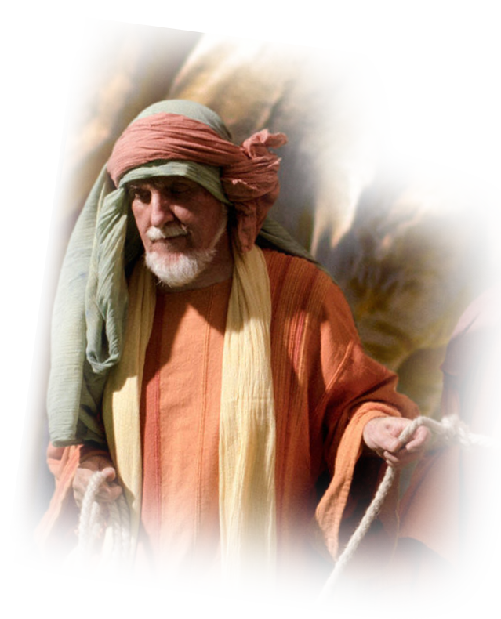
1. By Acting WISELY
Not like Saul …
¹³ And Samuel said to Saul,
"You have done foolishly.” of the LORD your God, with which he commanded you. For then the LORD would have established your kingdom over Israel forever.
What did Saul do?
Notes:
Victory is Found in Covenant Loyalty
To God be the Glory ... Song Great things he has done

Slide 6
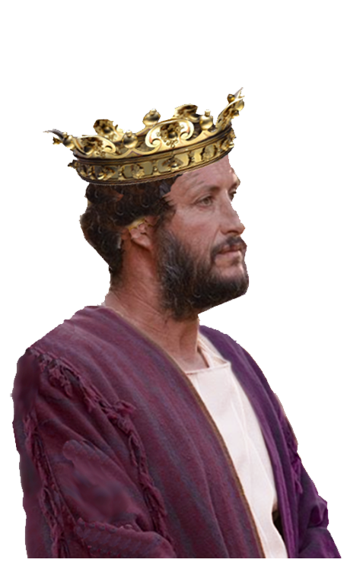
Became Compelled vs Free
¹² … I forced myself, and offered the burnt offering."
Why?
Notes:
Victory is Found in Covenant Loyalty
To God be the Glory ... Song Great things he has done

Slide 7


Became PANICKED vs Calm
⁵ … the Philistines mustered to fight with Israel, …. ⁶ When the men of Israel saw that they were in trouble (for the people were hard pressed), the people hid themselves in caves and in holes and in rocks and in tombs and in cisterns, ⁷ and
some Hebrews crossed the fords of
the Jordan to the land of Gad and
Gilead. Saul was still at Gilgal, and
all the people followed him trembling.
Notes:
https://pixabay.com/illustrations/panic-button-panic-button-emergency-1375952/
https://www.flickr.com/photos/elbragon/5455939124

Slide 8

He Became IMPATIENT vs Waiting
⁸ He waited seven days, the time appointed by Samuel. But Samuel did not come to Gilgal, and the people were scattering from him.

Slide 9
He Became PRESUMPTIVE vs Restrictive
⁹ So Saul said,
"Bring the burnt offering here to me, and the peace offerings."
And he offered the burnt offering. ¹⁰ As soon as he had finished offering the burnt offering, behold, Samuel came. And Saul went out to meet him and greet him.
Notes:
He presumed the prerogatives of the priests (and God), He did not restrict Himself from trespassing the boundaries God set.

Slide 10
He Became DEFENSIVE vs Subjective
¹¹ Samuel said, “
What have you done?"

Slide 11
He Became DEFENSIVE vs Subjective
And Saul said,
"When I saw that the people were scattering from me, and that you did not come within the days appointed, .... ¹² I said, 'Now the Philistines will come down against me …, and I have not sought the favor of the LORD.’
So I forced myself, and offered the burnt offering."
Notes:
My perspective – not Gods
Blame shifting – “YOU” did not come (it’s your fault)
I had to do it …

Slide 12
He Acted UN-WISELY
¹³ And Samuel said to Saul,
"You have done foolishly.
Notes:
Victory is Found in Covenant Loyalty
To God be the Glory ... Song Great things he has done

Slide 13
Seek the KINGDOM of GOD!
But seek first the kingdom of God and his righteousness, and all these things will be added to you.
HOW?
1. By Acting Wisely and …
Notes:
Victory is Found in Covenant Loyalty
To God be the Glory ... Song Great things he has done

Slide 14
2. By Being OBEDIENT
¹³ And Samuel said to Saul,
"You have done foolishly. You have not kept the command of the LORD your God, with which he commanded you.
But Saul was DISOBEDIENT
Notes:
Victory is Found in Covenant Loyalty
To God be the Glory ... Song Great things he has done

Slide 15
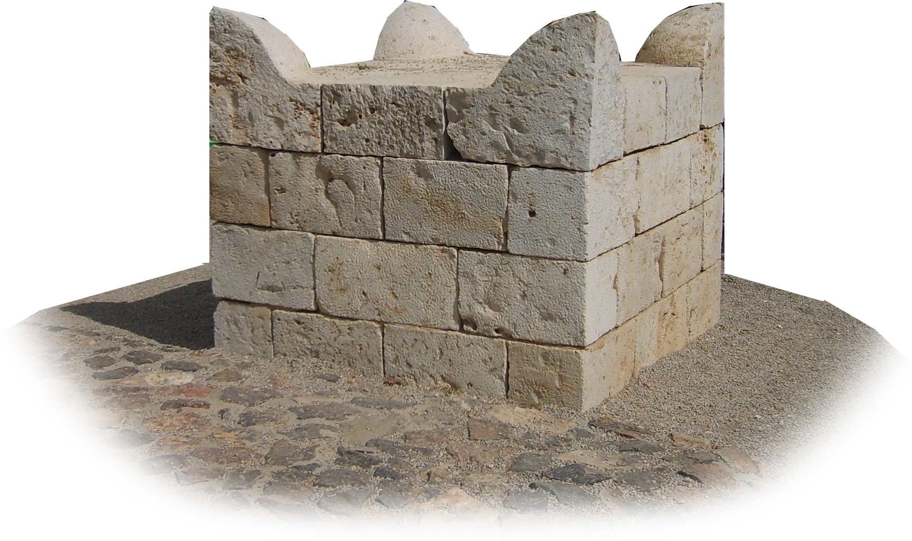

A Pattern of DISOBEDIENCE
1 Samuel 15:22
Behold, to obey is better than sacrifice, and to listen than the fat of rams.
VS.
Notes:
This is the beginning of a pattern of disobedience

Slide 16
Seek the KINGDOM of GOD!
But seek first the kingdom of God and his righteousness, and all these things will be added to you.
HOW?
1. By Acting Wisely ,
2. By Being Obedient and …
Notes:
Victory is Found in Covenant Loyalty
To God be the Glory ... Song Great things he has done

Slide 17
3. By Seeking REWARD
¹³ And Samuel said to Saul,
"You have done foolishly. You have not kept the command of the LORD your God, with which he commanded you. For then the LORD would have established your kingdom over Israel forever.
Reward to be Gained!
Notes:
Victory is Found in Covenant Loyalty
To God be the Glory ... Song Great things he has done

Slide 18
3. By Seeking REWARD
¹³ And Samuel said to Saul,
"You have done foolishly. You have not kept the command of the LORD your God, with which he commanded you. For then the LORD would have established your kingdom over Israel forever. ¹⁴ But now your kingdom shall not continue.
Reward to be Lost!
Notes:
Victory is Found in Covenant Loyalty
To God be the Glory ... Song Great things he has done

Slide 19
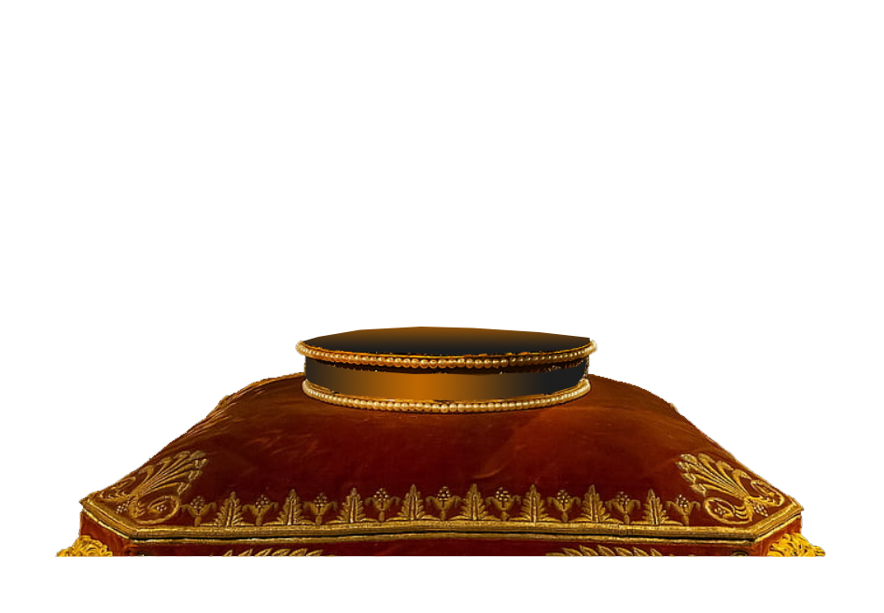


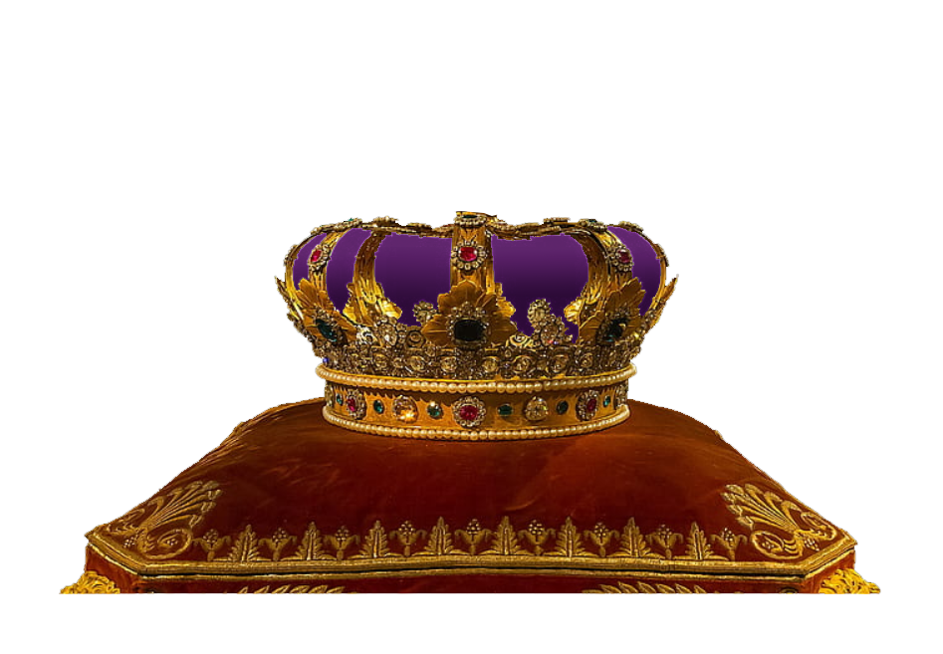
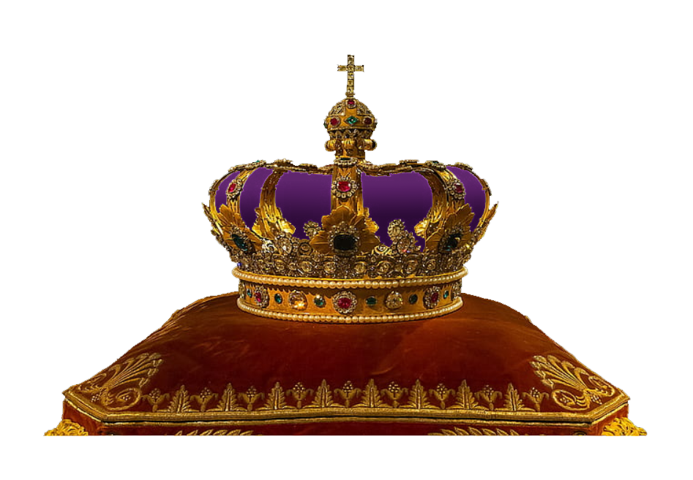
He Lost Potential Blessings
Story of angel and crowns
Notes:
https://i1.pickpik.com/photos/95/54/526/crown-kings-bavaria-germany-preview.jpg

Slide 20
Seek the KINGDOM of GOD!
But seek first the kingdom of God and his righteousness, and all these things will be added to you.
HOW?
1. By Acting Wisely ,
2. By Being Obedient,
3. By Seeking Reward, and …
Notes:
Victory is Found in Covenant Loyalty
To God be the Glory ... Song Great things he has done

Slide 21

4. By CHANGING Heart
¹⁴ …. The LORD has sought out a man after his own heart, and the LORD has commanded him to be prince over his people, because you have not kept what the LORD commanded you."
Notes:
https://i1.pickpik.com/photos/498/665/120/heart-valentine-s-day-hand-love-preview.jpg
Victory is Found in Covenant Loyalty
To God be the Glory ... Song Great things he has done

Slide 22
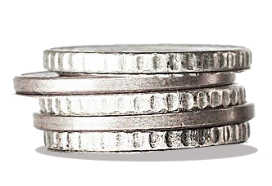
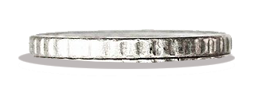
4. By CHANGING Heart
Parable of
the Talents
¹⁴ …. The LORD has sought out a man after his own heart, and the LORD has commanded him to be prince over his people, because you have not kept what the LORD commanded you."
  WHY?
Notes:
Thttps://pixabay.com/photos/money-money-tower-coins-euro-2180330/
alent taken from wicked servant and given to the faithful servant.

Slide 23
4. By CHANGING Heart
Parable of
the Talents
¹⁴ …. The LORD has sought out a man after his own heart, and the LORD has commanded him to be prince over his people, because you have not kept what the LORD commanded you."
Notes:
Talent taken from wicked servant and given to the faithful servant.

Slide 24
Seek the KINGDOM of GOD!
But seek first the kingdom of God and his righteousness, and all these things will be added to you.
HOW?
1. By Acting Wisely,
2. By Being Obedient,
3. By Seeking Reward, and …
4. By Changing Your Heart
Notes:
Victory is Found in Covenant Loyalty
To God be the Glory ... Song Great things he has done

Slide 25
5. By KEEPING True
But seek first the kingdom of God and his righteousness, and all these things will be added to you. ³⁴ Therefore do not be anxious about tomorrow, for tomorrow will be anxious for itself. Sufficient for the day is its own trouble.
Notes:
Victory is Found in Covenant Loyalty
To God be the Glory ... Song Great things he has done

Slide 26
Let’s Repeat … You Seek First
1. By Acting Wisely,
2. By Being Obedient,
3. By Seeking Reward,
4. By Changing Your Heart and …
5. By Keeping True!
Without Anxiety or Worry!

Slide 27
Let’s Pray
Notes:
https://watermark.lovepik.com/photo/50083/4881.jpg_wh1200.jpg

