Slide 1
Lesson 11
This series uses “Hemi Head Rg” Font
You can get the font FREE at: https://www.dafont.com/hemi-head.font
Or https://fontsfree.net/hemi-head-rg-bold-italic-font-download.html
Or https://www.1001fonts.com/hemi-head-426-font.html
Notes:
Copyright © 2006−2021. All rights reserved. Bible Point is a registered trademark of Dennis Henderson. All other trademarks acknowledged.
Bible Point contains graphics from Bible Point artists. These illustrations belong to Bible Point and the respective artists. You may use the designs and illustrations for graphical illustration of lessons free and without special permission, provided they are not used in any way that maligns the Christian faith. Furthermore, republication or production of any illustration by any other graphic service whether it be in book, in a machine-readable form, or in any other design resource is strictly prohibited. Furthermore, they cannot be duplicated or resold as any other form of publishing, clip art, or graphic resource.
So What does it mean? (A simple translations of the legal jargon)
So, if you don’t own the presentation(s), graphic(s), and text(s) how can you legally use them? The purchase of the license allows you to use all the images in the product. However, the actual ownership and copyright of the presentation(s), graphic(s), and text(s) remain the property of Bible Point and its licensors. If you had plans on using this product in your “for sale” work—think again!
License Agreement
Article 1: License Grant
All the graphics and text in Bible Point presentations (excluding quotes from the Bible and stated sources) are the intellectual and real property of Bible Point and its licensors, and is protected by law, including United States copyright laws and international treaties. Bible Point grants to you a license:
1. To use the presentation in a single church, single school, or single office of a Christian organization.
2. To make a single archival back-up copy of the program.
3. To modify the presentation(s) and merge with other presentations in a single church, school, or Christian organization.
4. To transfer to another party if that party agrees to accept the terms and conditions of this agreement, and you do not retain any copies of the presentation, whether printed, machine readable, modified, or merged form.
Article 2: Terms
This license is effective until terminated. You may terminate the license at any time by destroying the presentation(s), graphic(s), or text(s) together with all copies, modifications and merged portions in any form. Bible Point may terminate your license if you fail to comply with this Agreement. You agree, upon such termination, for any reason, to destroy the presentation(s), graphics, and text(s) with all copies, modifications, and merged portions in any form.
Article 3: Disclaimers
1. Bible Point presentations, graphics, and texts are licensed to you As Is. You, the consumer, bear the entire risk relating to the quality and performance of the presentation(s), graphic(s), or text(s). In no event will Bible Point be liable for damages resulting from any defect.
2. Thirty-day limited warrantee on disks. Bible Point warrants the disks to be free of defects in material and workmanship under normal use for 30 days after purchase. During the 30-day period you may return a defective presentation, graphic, or text with proof of purchase and it will be replaced without charge, unless the presentation is damaged by misuse.
Article 4: General
1. You may not sub-license, assign, or transfer the license of the presentation(s), graphic(s), or text(s) except as provided by this Agreement.
2. This Agreement will be governed by the laws of the State of Michigan.
So What does it mean? (A simple translations of the legal jargon)
May I let someone borrow or copy my licensed Bible Point presentation (even after I modified it)? As long as it is within your local church, or single school, or the immediate office of a Christian organization you may. Otherwise, please refer the person interested in borrowing to: http://www.biblepoint.com or E-mail: dennis@DrDH.net with any related questions.

Slide 3


Finding Victory through …
Notes:
https://watermark.lovepik.com/photo/50083/4881.jpg_wh1200.jpg

Slide 4
Loyalty
Notes:
Loyalty seems to have gone out the window…
People are not loyal to any brand of cars any more …
However there is one group that are really loyal … Detroit Lion fans … year after year they loose and the fans keep coming back with “maybe next year.”
Today I want to talk about spiritual loyalty …. Loyalty to the Lord.

Slide 5
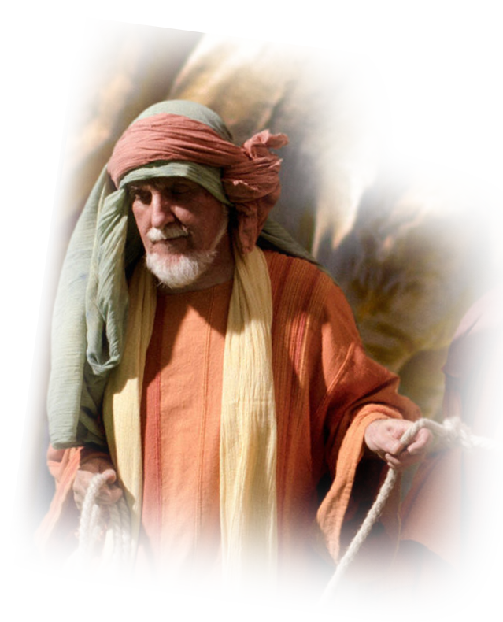
Personal Loyalty Exemplified
12:1 And Samuel said to all Israel,
"Behold, I have obeyed your voice in all that you have said to me and have made a king over you. ² And now, behold, the king walks before you, and I am old and gray; and behold, my sons are with you. I have walked before you from my youth until this day.
Samuel’s Obedience
Notes:
Victory is Found in Covenant Loyalty
To God be the Glory ... Song Great things he has done

Slide 6
Personal Loyalty Exemplified
12:1 And Samuel said to all Israel,
"Behold, I have obeyed your voice in all that you have said to me and have made a king over you. ² And now, behold, the king walks before you, and I am old and gray; and behold, my sons are with you. I have walked before you from my youth until this day.
Samuel’s Longevity
Notes:
Victory is Found in Covenant Loyalty
To God be the Glory ... Song Great things he has done

Slide 7
Personal Loyalty Exemplified
³ Here I am; testify against me before the LORD and before his anointed. Whose ox have I taken? Or whose donkey have I taken? Or whom have I defrauded? Whom have I oppressed? Or from whose hand have I taken a bribe to blind my eyes with it? Testify against me and I will restore it to you.“
Samuel’s
Integrity
Notes:
Victory is Found in Covenant Loyalty
To God be the Glory ... Song Great things he has done

Slide 8
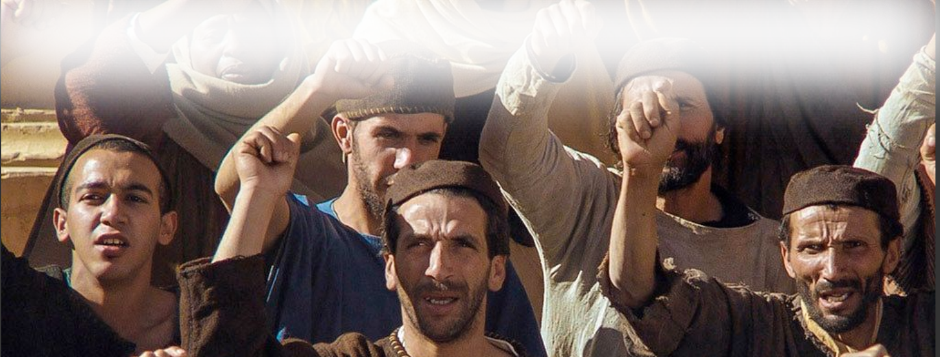
Personal Loyalty Exemplified
⁴ They said, "You have not defrauded us or oppressed us or taken anything from any man's hand.“
People
AGREE
Notes:
Victory is Found in Covenant Loyalty
To God be the Glory ... Song Great things he has done

Slide 9
Personal Loyalty Exemplified
⁵ And he said to them,
"The LORD is witness against you, and his anointed is witness this day, that you have not found anything in my hand."
Samuel’s Witnesses
Notes:
Victory is Found in Covenant Loyalty
To God be the Glory ... Song Great things he has done

Slide 10
Personal Loyalty Exemplified
⁵ They said, "He is witness."
People
AGREE
Notes:
Victory is Found in Covenant Loyalty
To God be the Glory ... Song Great things he has done

Slide 11



Three perspectives of LOYALTY:
PAST
PRESENT
FUTURE

Slide 12
Past Disloyalty Exposed 12:6-15
Notes:
Victory is Found in Covenant Loyalty
To God be the Glory ... Song Great things he has done

Slide 13
Past Disloyalty Exposed 12:6-15
⁶ And Samuel said to the people, "The LORD is witness, …. ⁷ Now therefore stand still that I may plead with you before the LORD concerning all the righteous deeds of the LORD that he performed for you and for your fathers.
God’s Goodness
Notes:
Victory is Found in Covenant Loyalty
To God be the Glory ... Song Great things he has done

Slide 14
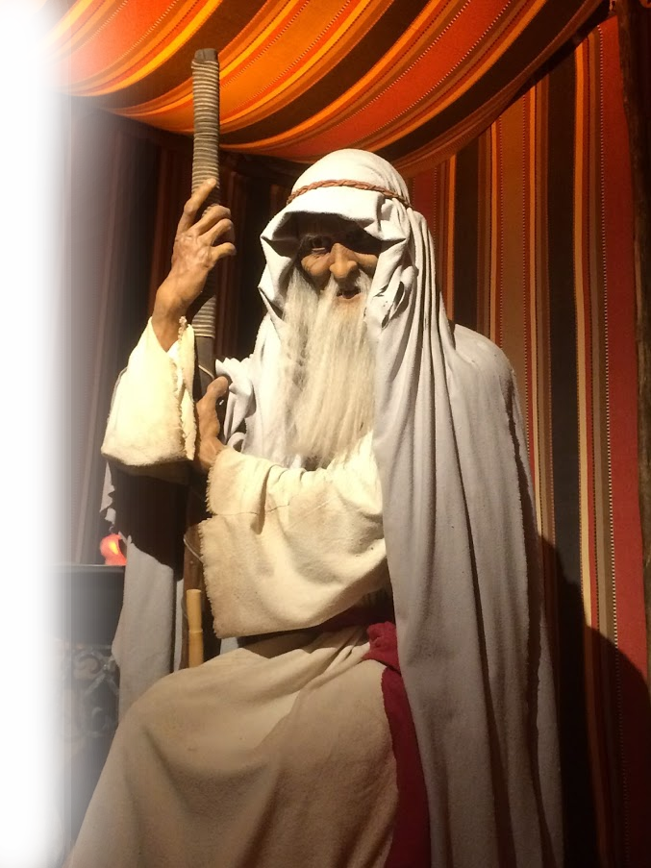
Past Disloyalty Exposed 12:6-15
⁸ When Jacob went into Egypt, and the Egyptians oppressed them, then your fathers cried out to the LORD and the LORD sent Moses and Aaron, who brought your fathers out of Egypt and made them dwell in this place.
Jacob Oppressed in Egypt
Notes:
Victory is Found in Covenant Loyalty
To God be the Glory ... Song Great things he has done

Slide 15
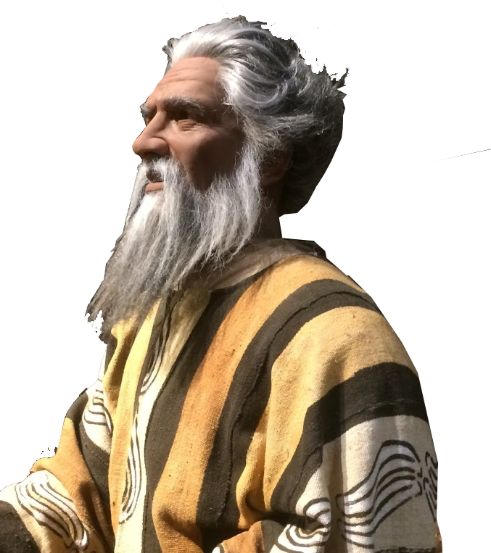
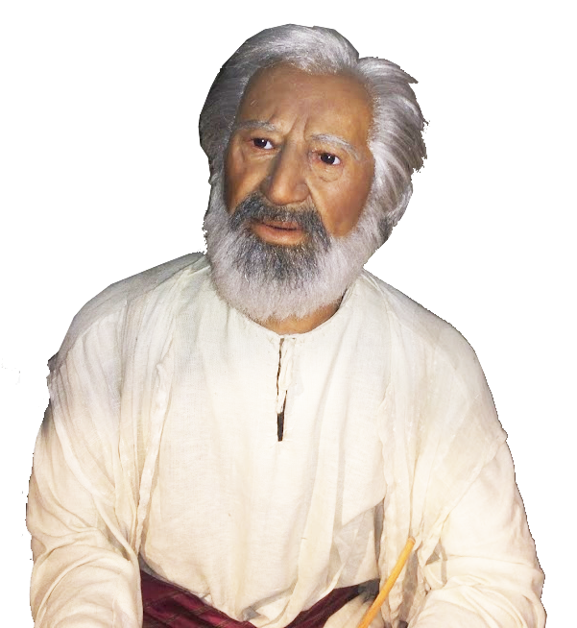
Past Disloyalty Exposed 12:6-15
⁸ When Jacob went into Egypt, and the Egyptians oppressed them, then your fathers cried out to the LORD and the LORD sent Moses and Aaron, who brought your fathers out of Egypt and made them dwell in this place.
God sent Moses
& Aaron
Notes:
Victory is Found in Covenant Loyalty
To God be the Glory ... Song Great things he has done

Slide 16
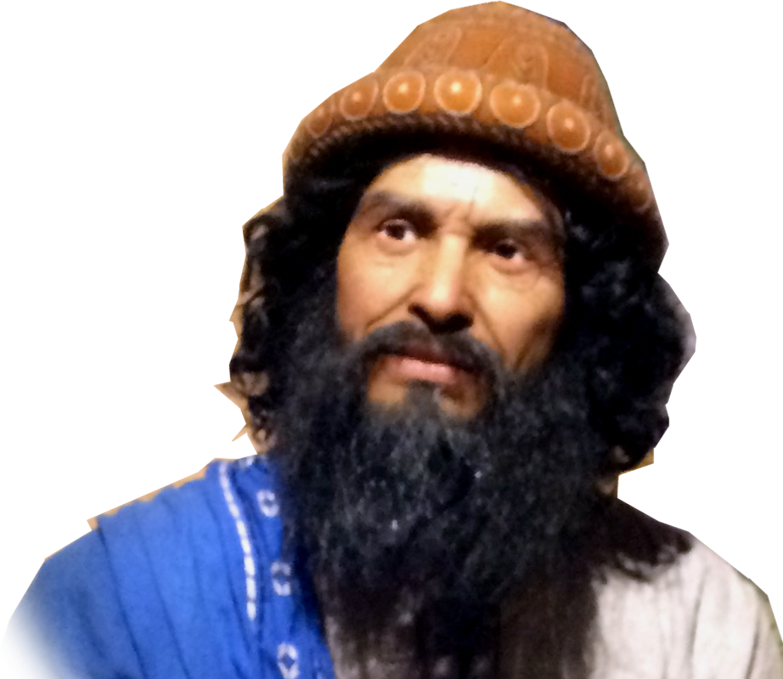
Past Disloyalty Exposed 12:6-15
⁸ When Jacob went into Egypt, and the Egyptians oppressed them, then your fathers cried out to the LORD and the LORD sent Moses and Aaron, who brought your fathers out of Egypt and made them dwell in this place.
Joshua the
Conqueror
Notes:
Victory is Found in Covenant Loyalty
To God be the Glory ... Song Great things he has done

Slide 17

Past Disloyalty Exposed 12:6-15
⁹ But they forgot the LORD their God. And he sold them into the hand of Sisera, commander of the army of Hazor, and into the hand of the Philistines, and into the hand of the king of Moab. And they fought against them.
Lived
Safely
Forgot
God
The Rut
Cycle
Notes:
Victory is Found in Covenant Loyalty
To God be the Glory ... Song Great things he has done

Slide 18
Past Disloyalty Exposed 12:6-15
⁹ But they forgot the LORD their God. And he sold them into the hand of Sisera, commander of the army of Hazor, and into the hand of the Philistines, and into the hand of the king of Moab. And they fought against them.
Lived
Safely
Forgot
God
The Rut
Cycle
Enslaved
by Enemy
Notes:
Victory is Found in Covenant Loyalty
To God be the Glory ... Song Great things he has done

Slide 19
Past Disloyalty Exposed 12:6-15
¹⁰ And they cried out to the LORD and said, 'We have sinned, because we have forsaken the LORD and have served the Baals and the Ashtaroth. But now deliver us out of the hand of our enemies, that we may serve you.’
Lived
Safely
Forgot
God
The Rut
Cycle
Enslaved
by Enemy
Cry out
to God
Notes:
Victory is Found in Covenant Loyalty
To God be the Glory ... Song Great things he has done

Slide 20
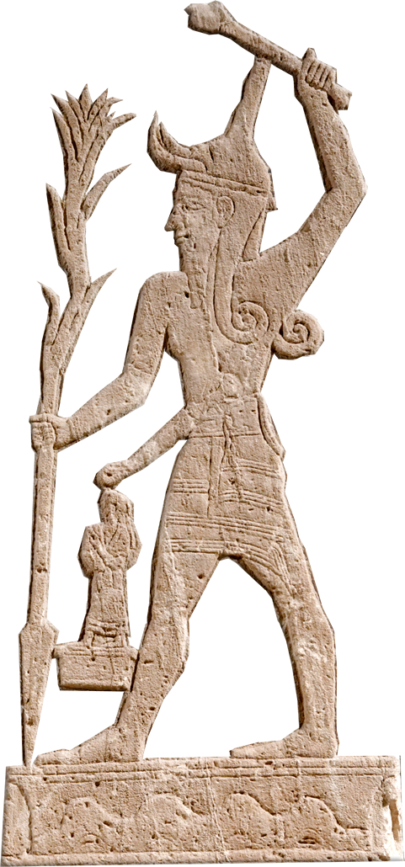
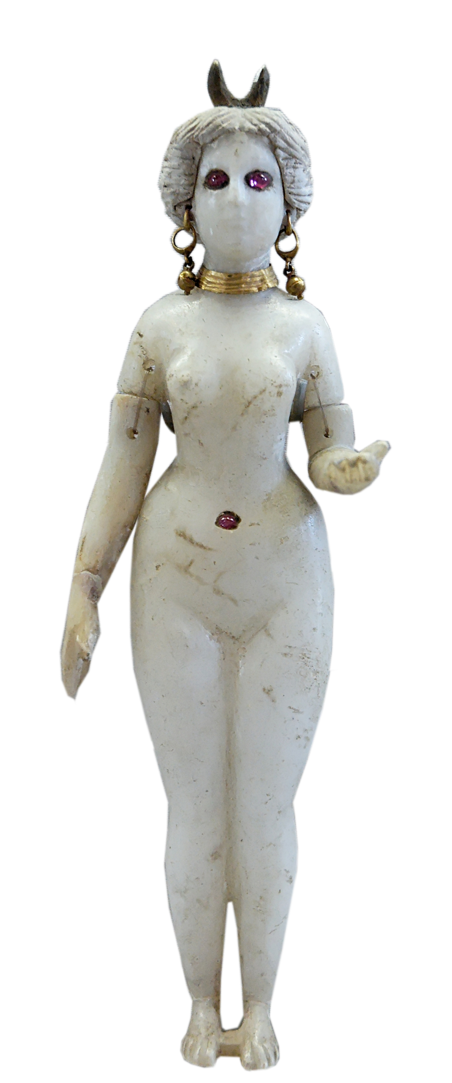
Past Disloyalty Exposed 12:6-15
¹⁰ And they cried out to the LORD and said, 'We have sinned, because we have forsaken the LORD and have served the Baals and the Ashtaroth. But now deliver us out of the hand of our enemies, that we may serve you.’
Lived
Safely
Forgot
God
The Rut
Cycle
Enslaved
by Enemy
Cry out
to God
Notes:
Victory is Found in Covenant Loyalty
To God be the Glory ... Song Great things he has done

Slide 21
Past Disloyalty Exposed 12:6-15
¹¹ And the LORD sent
Jerubbaal and Barak
and Jephthah and
Samuel and delivered
you out of the hand
of your enemies on
every side, and you
lived in safety.
Lived
Safely
Forgot
God
The Rut
Cycle
God Sends
Judge
Enslaved
by Enemy
Cry out
to God
Notes:
Victory is Found in Covenant Loyalty
To God be the Glory ... Song Great things he has done

Slide 22
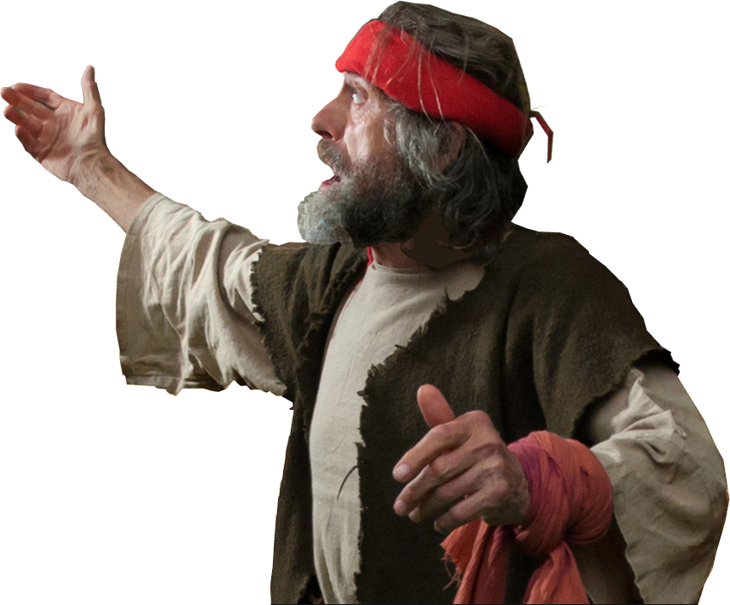
Past Disloyalty Exposed 12:6-15
¹¹ And the LORD sent
Jerubbaal and Barak
and Jephthah and
Samuel and delivered
you out of the hand
of your enemies on
every side, and you
lived in safety.
Lived
Safely
Forgot
God
The Rut
Cycle
God Sends
Judge
Enslaved
by Enemy
Cry out
to God
Notes:
Victory is Found in Covenant Loyalty
To God be the Glory ... Song Great things he has done

Slide 23
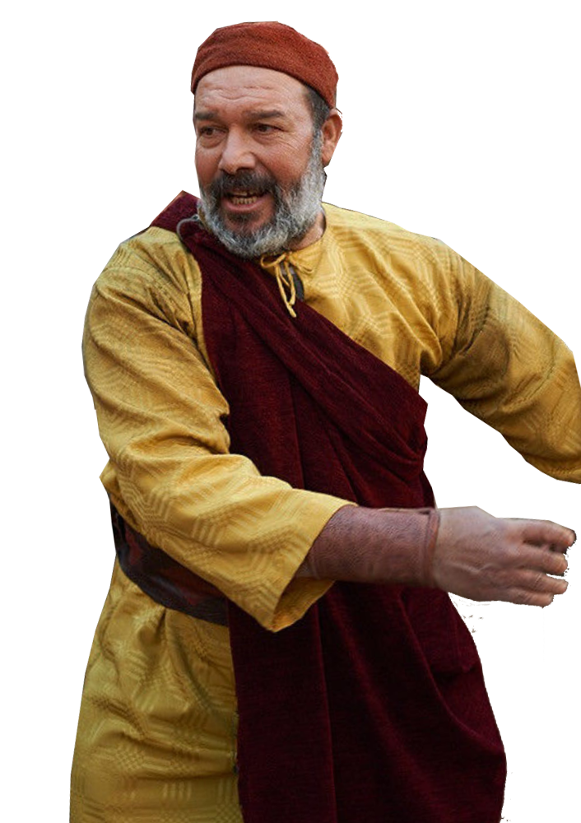
Past Disloyalty Exposed 12:6-15
¹¹ And the LORD sent
Jerubbaal and Barak
and Jephthah and
Samuel and delivered
you out of the hand
of your enemies on
every side, and you
lived in safety.
Lived
Safely
Forgot
God
The Rut
Cycle
God Sends
Judge
Enslaved
by Enemy
Cry out
to God
Notes:
Victory is Found in Covenant Loyalty
To God be the Glory ... Song Great things he has done

Slide 24
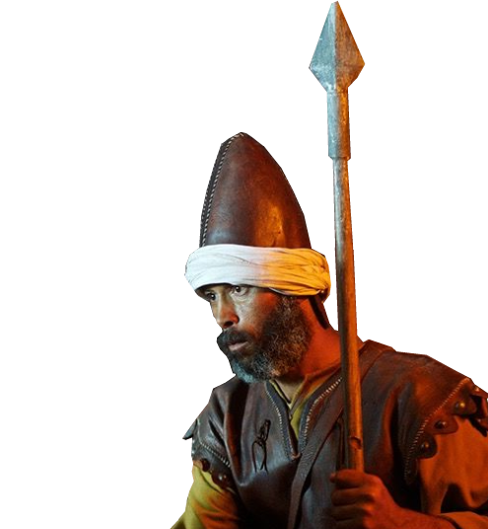
Past Disloyalty Exposed 12:6-15
¹¹ And the LORD sent
Jerubbaal and Barak
and Jephthah and
Samuel and delivered
you out of the hand
of your enemies on
every side, and you
lived in safety.
Lived
Safely
Forgot
God
The Rut
Cycle
God Sends
Judge
Enslaved
by Enemy
Cry out
to God
Notes:
Victory is Found in Covenant Loyalty
To God be the Glory ... Song Great things he has done

Slide 25
Past Disloyalty Exposed 12:6-15
¹¹ And the LORD sent
Jerubbaal and Barak
and Jephthah and
Samuel and delivered
you out of the hand
of your enemies on
every side, and you
lived in safety.
Lived
Safely
Forgot
God
The Rut
Cycle
God Sends
Judge
Enslaved
by Enemy
Cry out
to God
Notes:
Victory is Found in Covenant Loyalty
To God be the Glory ... Song Great things he has done

Slide 26
Past Disloyalty Exposed 12:6-15
¹¹ And the LORD sent
Jerubbaal and Barak
and Jephthah and
Samuel and delivered
you out of the hand
of your enemies on
every side, and you
lived in safety.
Lived
Safely
God Rescues
Forgot
God
The Rut
Cycle
God Sends
Judge
Enslaved
by Enemy
Cry out
to God
Notes:
Victory is Found in Covenant Loyalty
To God be the Glory ... Song Great things he has done

Slide 27
Past Disloyalty Exposed 12:6-15
¹¹ And the LORD sent
Jerubbaal and Barak
and Jephthah and
Samuel and delivered
you out of the hand
of your enemies on
every side, and you
lived in safety.
Lived
Safely
Their disloyalty
did not negate
God’s loyalty!
God Rescues
Forgot
God
The Rut
Cycle
God Sends
Judge
Enslaved
by Enemy
Cry out
to God
Notes:
Victory is Found in Covenant Loyalty
To God be the Glory ... Song Great things he has done

Slide 28
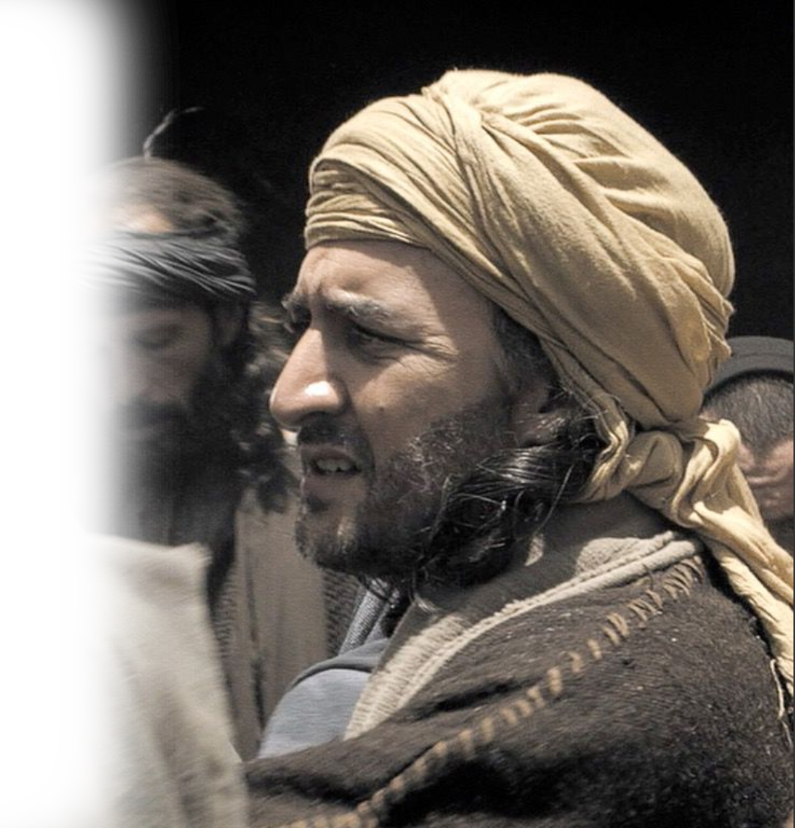
Past Disloyalty Exposed 12:6-15
¹² And when you saw that Nahash the king of the Ammonites came against you, you said to me,
'No, but a king shall reign over us,’
when the LORD your God was your king.
Recent Rejection
Notes:
Victory is Found in Covenant Loyalty
To God be the Glory ... Song Great things he has done

Slide 29
Present Pause: Be Still and See
Notes:
Victory is Found in Covenant Loyalty
To God be the Glory ... Song Great things he has done

Slide 30
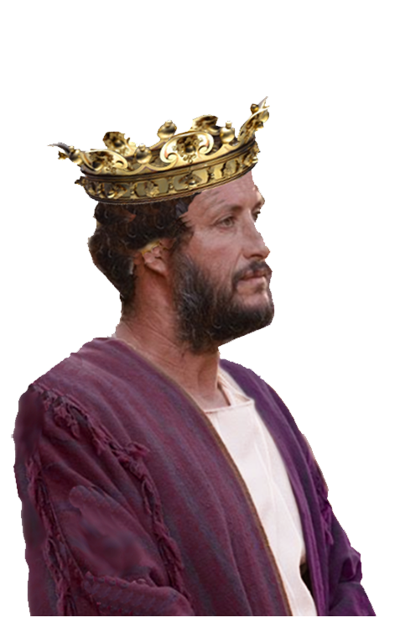
Present Pause: Be Still and See
¹³ And now behold the king whom you have chosen, for whom you have asked; behold, the LORD has set a king over you.
NOW You Have What You Wanted!
Notes:
Victory is Found in Covenant Loyalty
To God be the Glory ... Song Great things he has done

Slide 31

Present Pause: Be Still and See
¹⁴ If you will fear the LORD and serve him and obey his voice and not rebel against the commandment of the LORD, and
if both you and the king who reigns over you will follow the LORD your God, it will be well.
NOW
Serve the LORD
Notes:
Victory is Found in Covenant Loyalty
To God be the Glory ... Song Great things he has done

Slide 32
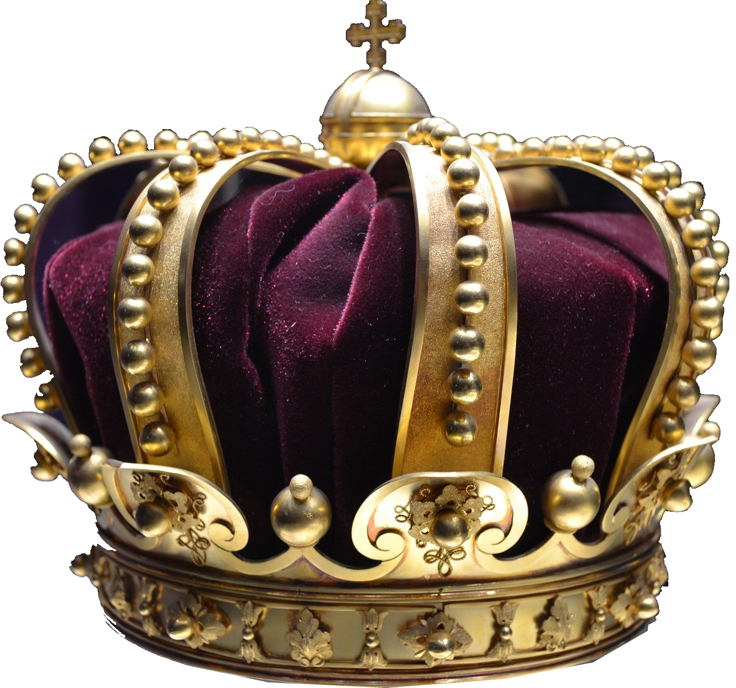
Present Pause: Be Still and See
¹⁴ If you will fear the LORD and serve him and obey his voice and not rebel against the commandment of the LORD, and
if both you and the king who reigns over you will follow the LORD your God, it will be well.
NOW
Serve the LORD
Notes:
Victory is Found in Covenant Loyalty
To God be the Glory ... Song Great things he has done

Slide 33
Present Pause: Be Still and See
¹⁴ If you will fear the LORD and serve him and obey his voice and not rebel against the commandment of the LORD, and
if both you and the king who reigns over you will follow the LORD your God, it will be well.
You Will Be
Blessed!
Notes:
Victory is Found in Covenant Loyalty
To God be the Glory ... Song Great things he has done

Slide 34
Present Pause: Be Still and See
¹⁵ But if you will not obey the voice of the LORD, but rebel against the commandment of the LORD, then the hand of the LORD will be against you and your king.
Or ELSE …
Notes:
Victory is Found in Covenant Loyalty
To God be the Glory ... Song Great things he has done

Slide 35
Present Pause: Be Still and See
¹⁵ But if you will not obey the voice of the LORD, but rebel against the commandment of the LORD, then the hand of the LORD will be against you and your king.
Or ELSE …
Oppressed!
Notes:
Victory is Found in Covenant Loyalty
To God be the Glory ... Song Great things he has done

Slide 36
Present Pause: Be Still and See
⁷ Now therefore stand still
Notes:
Parting the Red Sea https://www.flickr.com/photos/amboo213/7429036760
Victory is Found in Covenant Loyalty
To God be the Glory ... Song Great things he has done

Slide 37

Present Pause: Be Still and See
⁷ Now therefore stand still
^{Exodus 14:16} Now therefore stand still and see this great thing that the LORD will do before your eyes.
Notes:
Parting the Red Sea https://www.flickr.com/photos/amboo213/7429036760
Victory is Found in Covenant Loyalty
To God be the Glory ... Song Great things he has done

Slide 38
Present Pause: Be Still and See
⁷ Now therefore stand still
^{Exodus 14:16} Now therefore stand still and see this great thing that the LORD will do before your eyes.
Stop and Watch!
Notes:
Parting the Red Sea https://www.flickr.com/photos/amboo213/7429036760
Victory is Found in Covenant Loyalty
To God be the Glory ... Song Great things he has done

Slide 39

Present Pause: Be Still and See
¹⁷ Is it not wheat harvest today?
I will call upon the LORD, that he may send thunder and rain. And you shall know and see that your wickedness is great, which you have done in the sight of the LORD, in asking for yourselves a king.“
Stop and Watch!
Notes:
Raining – https://www.needpix.com/photo/download/1499289/rain-clouds-weather-sky-rain-clouds-free-pictures-free-photos-free-images-royalty-free
Lightning --https://photolib.noaa.gov/Portals/0//GravityImages/410/ProportionalFixedWidth/nssl001023111x800x800.jpg
Wheat harvest was a time it rarely rained.
Victory is Found in Covenant Loyalty
To God be the Glory ... Song Great things he has done

Slide 40
Present Pause: Be Still and See
¹⁸ So Samuel called upon the LORD, and the LORD sent thunder and rain that day, and all the people greatly feared the LORD and Samuel.
Stop and Watch!
Notes:
Victory is Found in Covenant Loyalty
To God be the Glory ... Song Great things he has done

Slide 41
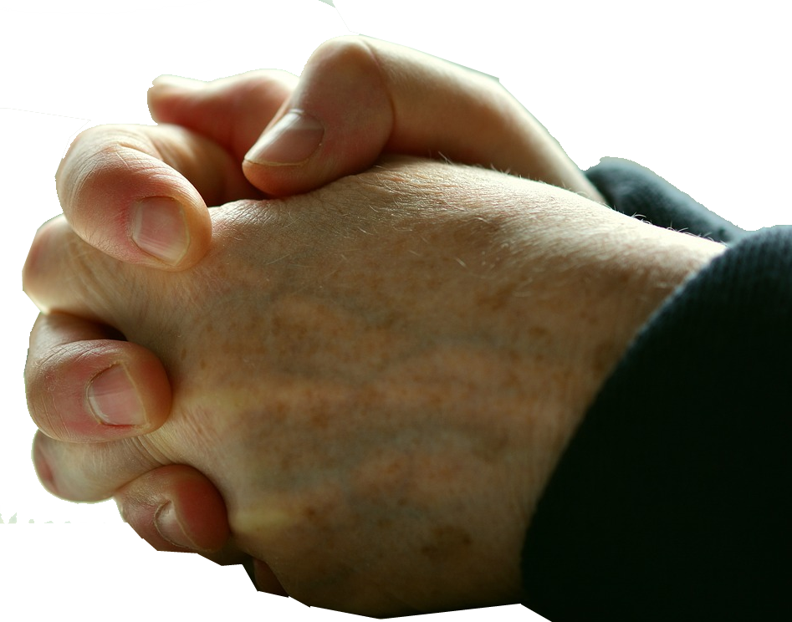
Present Pause: Be Still and See
¹⁹ And all the people said to Samuel,
"Pray for your servants to the LORD your God, that we may not die, for we have added to all our sins this evil, to ask for ourselves a king."
PRAY FOR US!
Notes:
Victory is Found in Covenant Loyalty
To God be the Glory ... Song Great things he has done

Slide 42
Future Loyalty Expected 12:20
Notes:
https://p0.pikrepo.com/preview/557/887/woman-in-black-red-and-white-plaid-dress-shirt-covering-her-face.jpg
Victory is Found in Covenant Loyalty
To God be the Glory ... Song Great things he has done

Slide 43

Future Loyalty Expected 12:20
²⁰ And Samuel said to the people, "Do not be afraid;
Do Not
FEAR
Notes:
https://p0.pikrepo.com/preview/557/887/woman-in-black-red-and-white-plaid-dress-shirt-covering-her-face.jpg
Victory is Found in Covenant Loyalty
To God be the Glory ... Song Great things he has done

Slide 44

Future Loyalty Expected 12:20
²⁰ And Samuel said to the people, "Do not be afraid; you have done all this evil. Yet do not turn aside from following the LORD,
Do Not
TURN ASIDE
Notes:
https://upload.wikimedia.org/wikipedia/commons/thumb/2/2b/MUTCD_R3-3.svg/1000px-MUTCD_R3-3.svg.png
Victory is Found in Covenant Loyalty
To God be the Glory ... Song Great things he has done

Slide 45

Future Loyalty Expected 12:20
²⁰ And Samuel said to the people, "Do not be afraid; you have done all this evil. Yet do not turn aside from following the LORD, but serve the LORD with all your heart.
SERVE
the LORD
Notes:
Victory is Found in Covenant Loyalty
To God be the Glory ... Song Great things he has done

Slide 46
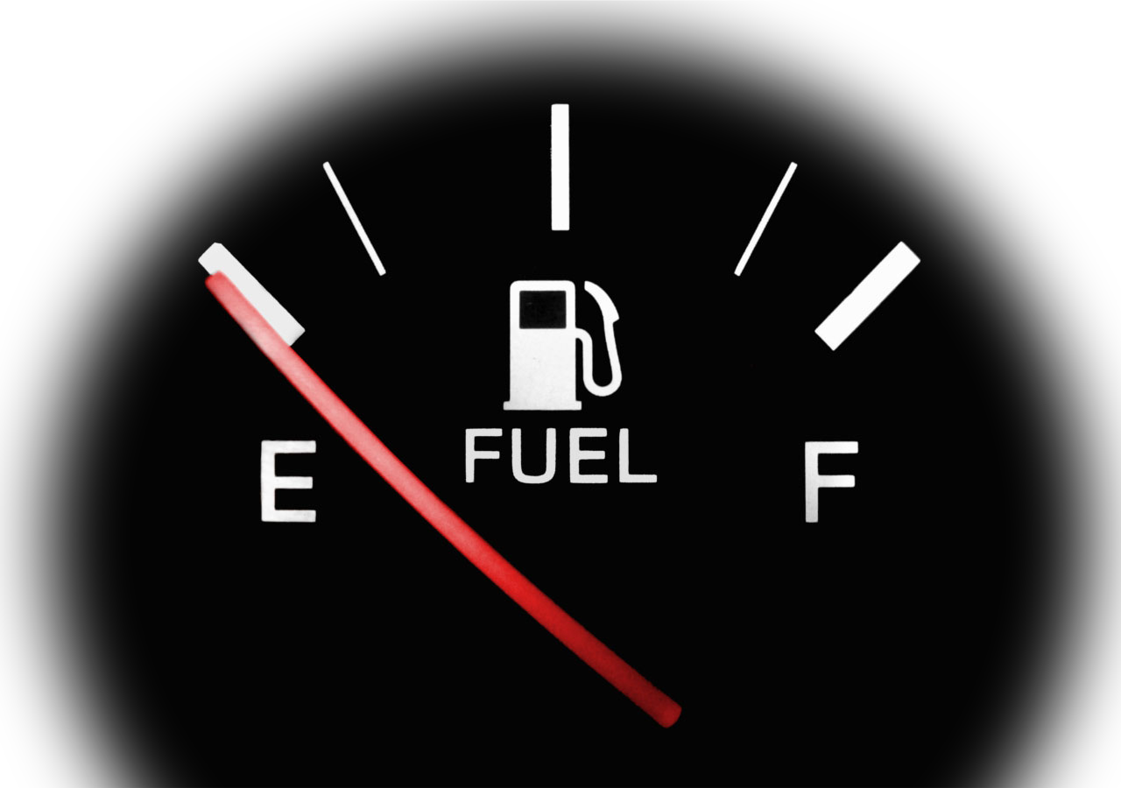
Future Loyalty Expected 12:20
²⁰ And Samuel said to the people, "Do not be afraid; you have done all this evil. Yet do not turn aside from following the LORD, but serve the LORD with all your heart. ²¹ And do not turn aside after empty things that cannot profit or deliver, for they are empty.
Stay FULL
Notes:
https://www.needpix.com/photo/download/1313647/fuel-petrol-gas-gauge-empty-full-black-white-red
Victory is Found in Covenant Loyalty
To God be the Glory ... Song Great things he has done

Slide 47

Future Loyalty Expected 12:20
²² For the LORD will not forsake his people, for his great name's sake, because it has pleased the LORD to make you a people for himself.
TRUST
the LORD!
Notes:
https://www.needpix.com/photo/1295011/jesus-christ-god-gospel-bible-tomb-easter-faith-good-friday
Victory is Found in Covenant Loyalty
To God be the Glory ... Song Great things he has done

Slide 48
Future Loyalty Expected 12:20
²³ Moreover, as for me, far be
it from me that I should sin against the LORD by ceasing to pray for you, and I will instruct you in the good and the right way.
PRAY!
Notes:
Victory is Found in Covenant Loyalty
To God be the Glory ... Song Great things he has done

Slide 49
Final Loyalty Warning 12:24
Notes:
Victory is Found in Covenant Loyalty
To God be the Glory ... Song Great things he has done

Slide 50
Final Loyalty Warning 12:24
²⁴ Only fear the LORD and serve him faithfully with all your heart. For consider what great things he has done for you. ²⁵ But if you still do wickedly, you shall be swept away, both you and your king."
FOCUS on the LORD
Notes:
Victory is Found in Covenant Loyalty
To God be the Glory ... Song Great things he has done

Slide 51

Final Loyalty Warning 12:24
²⁴ Only fear the LORD and serve him faithfully with all your heart. For consider what great things he has done for you. ²⁵ But if you still do wickedly, you shall be swept away, both you and your king."
CONSIDER His
GREATNESS
Notes:
https://en.wikipedia.org/wiki/Galaxy#/media/File:NGC_4414_(NASA-med).jpg
Victory is Found in Covenant Loyalty
To God be the Glory ... Song Great things he has done

Slide 52

Final Loyalty Warning 12:24
²⁴ Only fear the LORD and serve him faithfully with all your heart. For consider what great things he has done for you. ²⁵ But if you still do wickedly, you shall be swept away, both you and your king."
DO NOT GET SWEPT AWAY!
Notes:
Victory is Found in Covenant Loyalty
To God be the Glory ... Song Great things he has done

Slide 53
Let’s Sum It Up …
LOYALTY to the Lord is a matter of TRUST
Samuel TRUSTED the Lord and was LOYAL and was BLESSED
Israel DID NOT TRUST the Lord, was DISLOYAL and was OPPRESSED

Slide 54
Let’s Sum It Up …
LOYALTY to the Lord is a matter of TRUST

Slide 55
Let’s Sum It Up …
LOYALTY to the Lord is a matter of TRUST
Samuel TRUSTED the Lord and was LOYAL and was BLESSED

Slide 56
Let’s Sum It Up …
Proverbs 3:5-6
⁵ Trust in the LORD with all your heart, and do not lean on your own understanding. ⁶ In all your ways acknowledge him, and he will make straight your paths.

Slide 57
Let’s Pray
Notes:
https://watermark.lovepik.com/photo/50083/4881.jpg_wh1200.jpg

Slide 58
Covenant Loyalty
Personal Loyalty Exemplified 12:1-5
Past Disloyalty Exposed 12:6-15
Present Loyalty Paused 12:16-19
Future Loyalty Expected 12:20-25
Final Loyalty Warning 12:24-25
Notes:
Victory is Found in Covenant Loyalty
To God be the Glory ... Song Great things he has done

