Slide 1
Lesson 10
This series uses “Hemi Head Rg” Font
You can get the font FREE at: https://www.dafont.com/hemi-head.font
Or https://fontsfree.net/hemi-head-rg-bold-italic-font-download.html
Or https://www.1001fonts.com/hemi-head-426-font.html
Notes:
Copyright © 2006−2021. All rights reserved. Bible Point is a registered trademark of Dennis Henderson. All other trademarks acknowledged.
Bible Point contains graphics from Bible Point artists. These illustrations belong to Bible Point and the respective artists. You may use the designs and illustrations for graphical illustration of lessons free and without special permission, provided they are not used in any way that maligns the Christian faith. Furthermore, republication or production of any illustration by any other graphic service whether it be in book, in a machine-readable form, or in any other design resource is strictly prohibited. Furthermore, they cannot be duplicated or resold as any other form of publishing, clip art, or graphic resource.
So What does it mean? (A simple translations of the legal jargon)
So, if you don’t own the presentation(s), graphic(s), and text(s) how can you legally use them? The purchase of the license allows you to use all the images in the product. However, the actual ownership and copyright of the presentation(s), graphic(s), and text(s) remain the property of Bible Point and its licensors. If you had plans on using this product in your “for sale” work—think again!
License Agreement
Article 1: License Grant
All the graphics and text in Bible Point presentations (excluding quotes from the Bible and stated sources) are the intellectual and real property of Bible Point and its licensors, and is protected by law, including United States copyright laws and international treaties. Bible Point grants to you a license:
1. To use the presentation in a single church, single school, or single office of a Christian organization.
2. To make a single archival back-up copy of the program.
3. To modify the presentation(s) and merge with other presentations in a single church, school, or Christian organization.
4. To transfer to another party if that party agrees to accept the terms and conditions of this agreement, and you do not retain any copies of the presentation, whether printed, machine readable, modified, or merged form.
Article 2: Terms
This license is effective until terminated. You may terminate the license at any time by destroying the presentation(s), graphic(s), or text(s) together with all copies, modifications and merged portions in any form. Bible Point may terminate your license if you fail to comply with this Agreement. You agree, upon such termination, for any reason, to destroy the presentation(s), graphics, and text(s) with all copies, modifications, and merged portions in any form.
Article 3: Disclaimers
1. Bible Point presentations, graphics, and texts are licensed to you As Is. You, the consumer, bear the entire risk relating to the quality and performance of the presentation(s), graphic(s), or text(s). In no event will Bible Point be liable for damages resulting from any defect.
2. Thirty-day limited warrantee on disks. Bible Point warrants the disks to be free of defects in material and workmanship under normal use for 30 days after purchase. During the 30-day period you may return a defective presentation, graphic, or text with proof of purchase and it will be replaced without charge, unless the presentation is damaged by misuse.
Article 4: General
1. You may not sub-license, assign, or transfer the license of the presentation(s), graphic(s), or text(s) except as provided by this Agreement.
2. This Agreement will be governed by the laws of the State of Michigan.
So What does it mean? (A simple translations of the legal jargon)
May I let someone borrow or copy my licensed Bible Point presentation (even after I modified it)? As long as it is within your local church, or single school, or the immediate office of a Christian organization you may. Otherwise, please refer the person interested in borrowing to: http://www.biblepoint.com or E-mail: dennis@DrDH.net with any related questions.

Slide 2


Finding Victory through
Notes:
https://watermark.lovepik.com/photo/50083/4881.jpg_wh1200.jpg

Slide 3
An Anointed Leader

Slide 4

Israel Wanted a King
^{Judges 17:6} In those days there was no king in Israel.
Everyone did what was right in his own eyes.
^{Judges 18:1} In those days there was no king in Israel.
^{Judges 19:1} In those days, … there was no king in Israel,
^{Judges 21:25} In those days there was no king in Israel.
Everyone did what was right in his own eyes.
Israel Wanted a KING

Slide 5

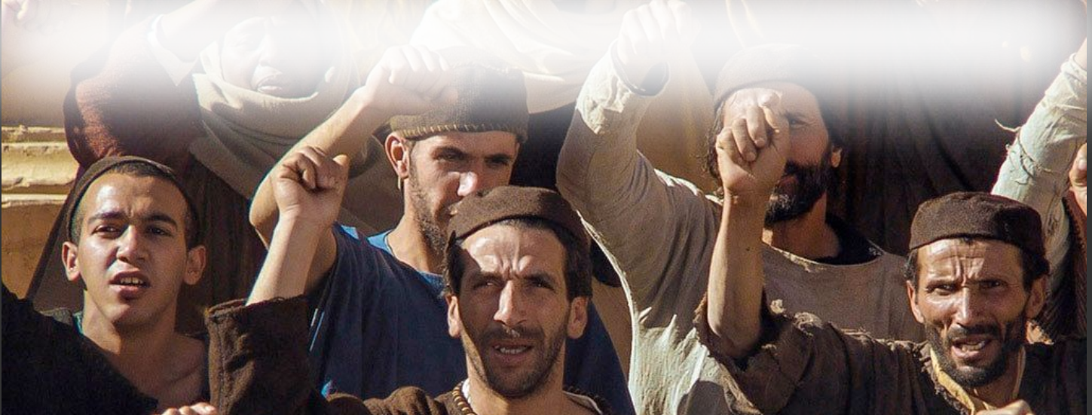
They insisted on a King …
And they said,
"No! But there shall be a king over us … "

Slide 6
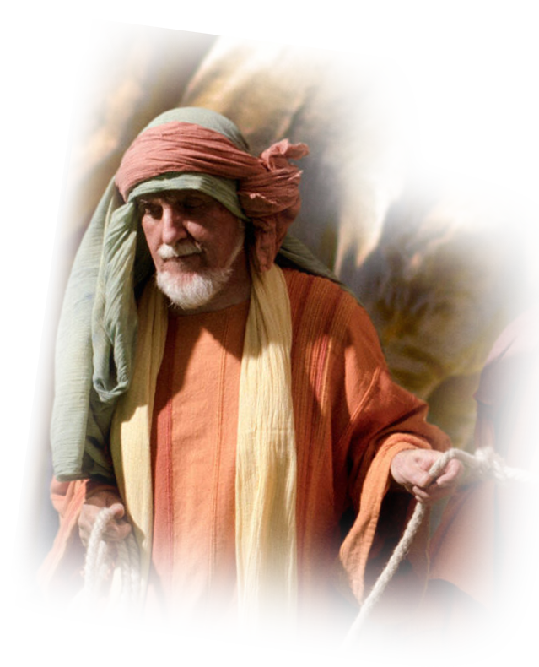
Make them a King!
²² And the LORD
said to Samuel,
"Obey their voice and
make them a king."

Slide 7
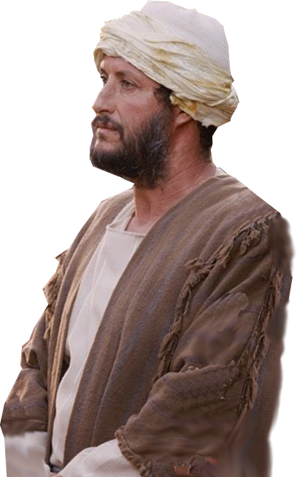
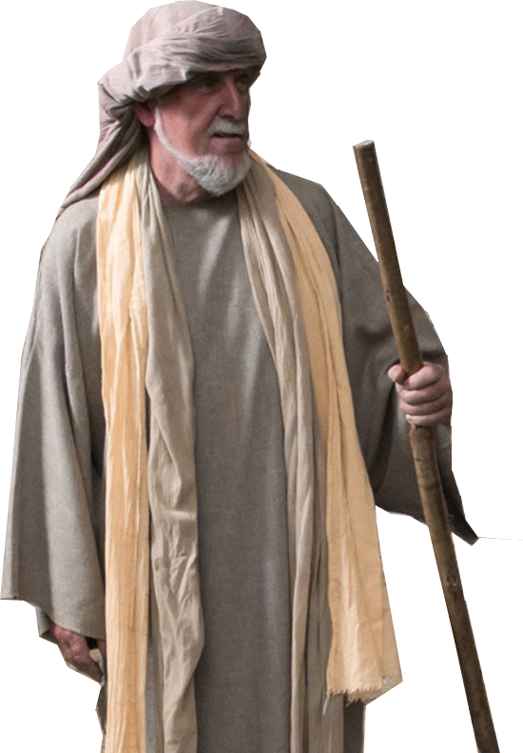
God Providentially used …
A Wealth Man’s Son

Slide 8
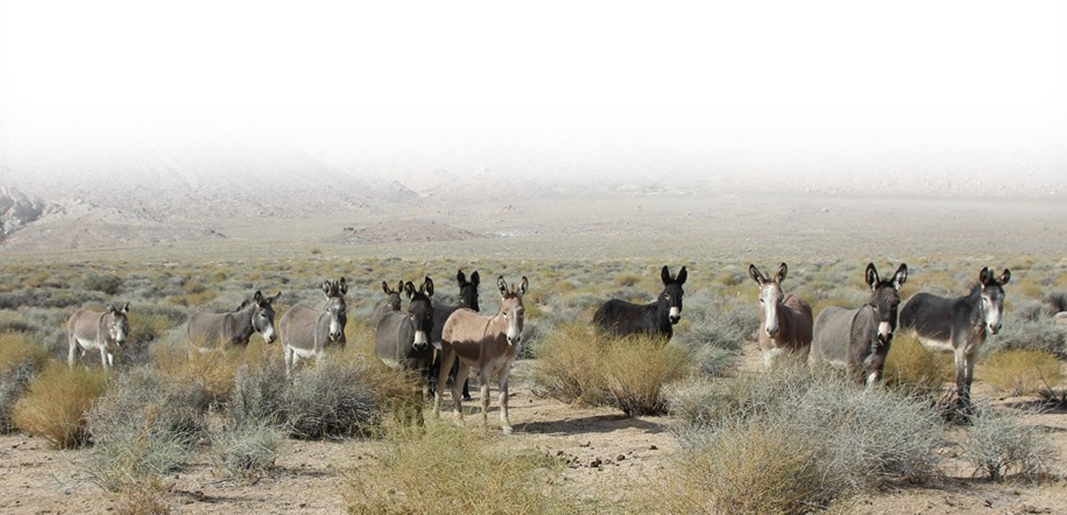
God Providentially used …
A Wealth Man’s Son
Lost Donkeys

Slide 9
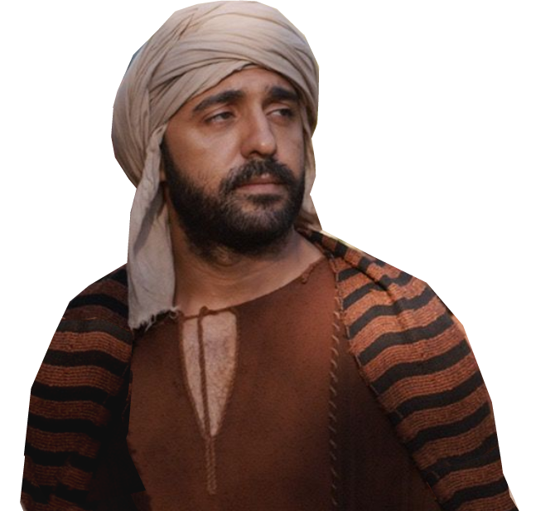
God Providentially used …
A Wealth Man’s Son
Lost Donkeys
A Servant

Slide 10
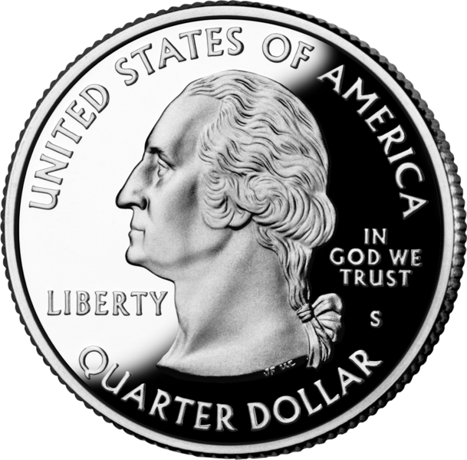
God Providentially used …
A Wealth Man’s Son
Lost Donkeys
A Servant
A Quarter

Slide 11

God Providentially used …
A Wealth Man’s Son
Lost Donkeys
A Servant
A Quarter
Some Girls

Slide 12
God Providentially used …
A Wealth Man’s Son
Lost Donkeys
A Servant
A Quarter
Some Girls

Slide 13
God Providentially used …
A Wealth Man’s Son
Lost Donkeys
A Servant
A Quarter
Some Girls
Samuel

Slide 14

1- God’s Anointed Leader 10:1-18
Notes:
Signs of an anointed leader
1- Spirit of the Lord
2- Changed heart
3- Humility

Slide 15
1- God’s anointed Leader 10:1-18
A Private Ceremony 10:1
Then Samuel took a flask of oil and poured it on his head and kissed him and said,
Notes:
https://www.pickpik.com/olive-oil-green-olive-oil-food-bottle-54846

Slide 16
1- God’s anointed Leader 10:1-18
"Has not the LORD anointed you to be prince over his people Israel? And you shall reign over the people of the LORD and you will save them from the hand of their surrounding enemies. And this shall be the sign to you that the LORD has anointed you to be prince over his heritage.
Four confirming SIGNS
Notes:
Signs of an anointed leader
1- Spirit of the Lord
2- Changed heart
3- Humility

Slide 17
Four confirming signs 2-9
² When you depart from me today, you will meet two men …. they will say to you, 'The donkeys that you went to seek are found, and now your father has ceased to care about the donkeys and is anxious about you, saying, "What shall I do about my son?“’
1-TWO MEN
Notes:
Signs of an anointed leader
1- Spirit of the Lord
2- Changed heart
3- Humility

Slide 18
Four confirming signs 2-9
³ Then you shall go on … and … Three men going up to God at Bethel will meet you there, one carrying three young goats, another carrying three loaves of bread, and another carrying a skin of wine. ⁴ And they will greet you and give you two loaves of bread, ….
2-THREE MEN
Notes:
Signs of an anointed leader
1- Spirit of the Lord
2- Changed heart
3- Humility

Slide 19
Four confirming signs 2-9
⁵ After that you shall come to the city, you will meet a group of prophets coming down from the high place with harp, tambourine, flute, and lyre before them, prophesying.
3-GROUP OF PROPHETS
Notes:
Signs of an anointed leader
1- Spirit of the Lord
2- Changed heart
3- Humility

Slide 20
Four confirming signs 2-9
⁶ Then the Spirit of the LORD will rush upon you, and you will prophesy with them and be turned into another man. ⁷ Now when these signs meet you, do what your hand finds to do, for God is with you.
4-SPIRIT OF
THE LORD
Notes:
Signs of an anointed leader
1- Spirit of the Lord
2- Changed heart
3- Humility

Slide 21
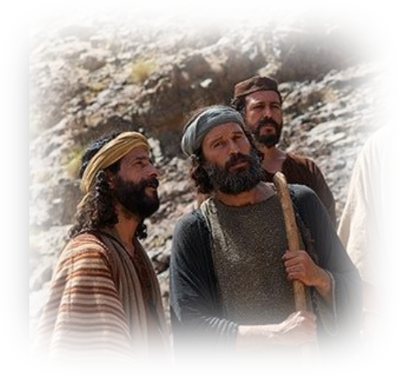
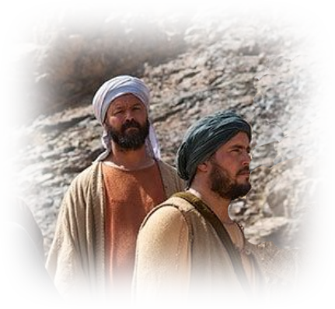
Fulfillment of the Signs 10-16
⁹ … And all these signs came to pass that day.
1-The Two men
2-The Three men

Slide 22
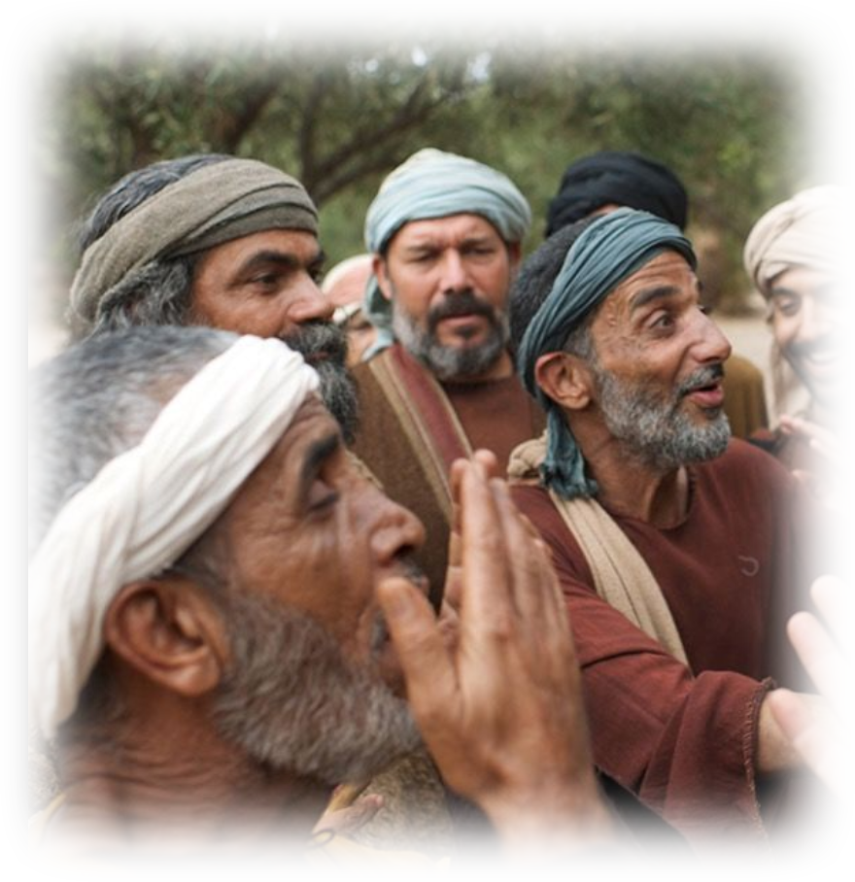
Fulfillment of the signs 10-16
¹⁰ When they came to Gibeah, behold, a group of prophets met him, and the Spirit of God rushed upon him, and he prophesied among them.
3-The Prophets’ Group
Notes:
Signs of an anointed leader
1- Spirit of the Lord
2- Changed heart
3- Humility

Slide 23

Fulfillment of the signs 10-16
¹⁰ When they came to Gibeah, behold, a group of prophets met him, and the Spirit of God rushed upon him, and he prophesied among them.
4-The Spirit
Notes:
Signs of an anointed leader
1- Spirit of the Lord
2- Changed heart
3- Humility

Slide 24
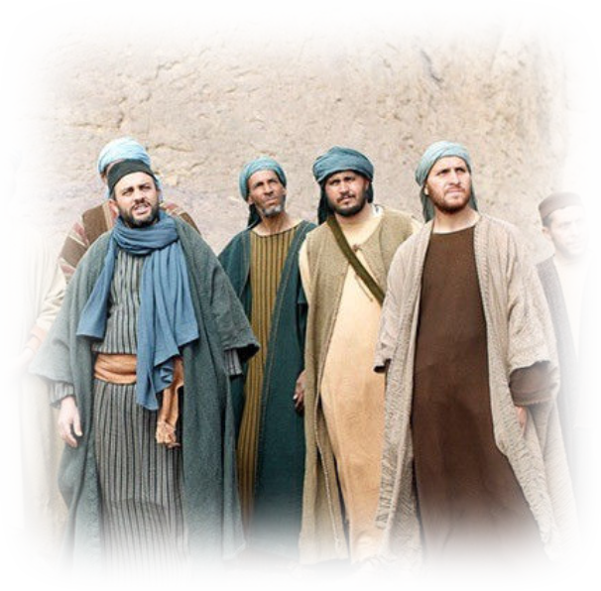
Fulfillment of the signs 10-16
¹¹ And … the people said to one another,
"What has come over the son
of Kish? Is Saul also among the
prophets?
…. ¹³ When he had finished
prophesying, he came to the
high place.
Notes:
Signs of an anointed leader
1- Spirit of the Lord
2- Changed heart
3- Humility

Slide 25
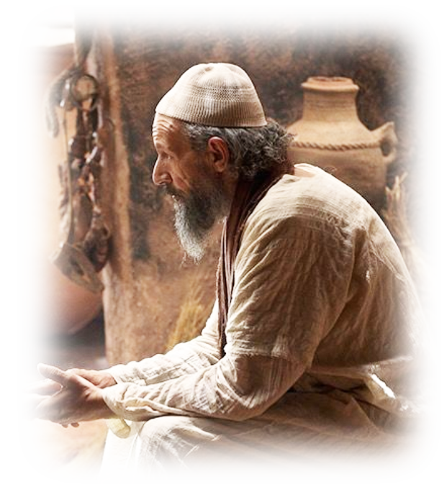
Fulfillment of the signs 10-16
¹⁴ Saul's uncle said to him and to his servant,
"Where did you go?"
And he said,
"To seek the donkeys.
And when we saw they
were not to be found,
we went to Samuel.“
Notes:
Signs of an anointed leader
1- Spirit of the Lord
2- Changed heart
3- Humility

Slide 26
Fulfillment of the signs 10-16
¹⁵ And Saul's uncle said,
"Please tell me what
Samuel said to you.“
¹⁶ And Saul said
to his uncle,
"He told us plainly
that the donkeys had
been found."
Notes:
Signs of an anointed leader
1- Spirit of the Lord
2- Changed heart
3- Humility

Slide 27
Fulfillment of the signs 10-16
But about the matter of the kingdom, of which Samuel had spoken, he did not tell him anything.
All preparing the way for…
Notes:
Four confirming signs that he was the chosen leader of God’s people. And Saul was quite about it.

Slide 28
2- The People’s Accepted Leader 10:17-25
The People proclaim Saul is King

Slide 29
You Asked For It 10:17-19
¹⁷ Now Samuel called the people together ….
¹⁸ And he said to the people of Israel,
"Thus says the LORD, the God of
Israel, 'I brought up Israel out of
Egypt, and I delivered you …..’ ¹⁹
But today you have rejected your
God, who saves you from all your
calamities and your distresses,

Slide 30
You Asked For It 10:17-19
and you have said to him, 'Set a
king over us.' Now therefore
present yourselves before the
LORD by your tribes and by your
thousands."

Slide 31
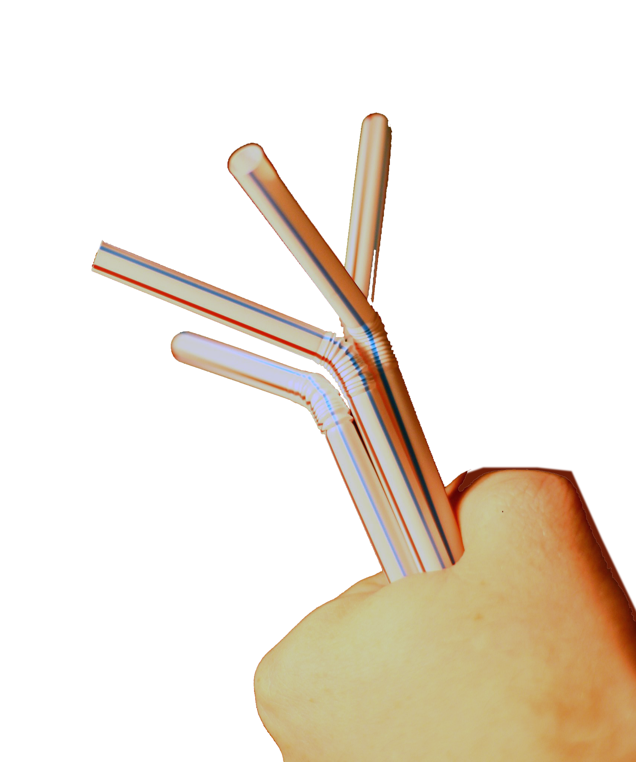
You Got It 10:20-25
²⁰ Then Samuel brought all the tribes of Israel near, and … Saul the
son of Kish was taken by lot. But when they sought him, he could not be found. ²² So they inquired again of the LORD, "Is there a man still to come?" and the LORD said, "Behold, he has hidden himself among the baggage.“
Notes:
https://www.flickr.com/photos/lucianvenutian/1263540856

Slide 32
You Got It 10:20-25
²³ Then they ran and took him from there. And when he stood among the people, he was taller than any of the people from his shoulders upward.
HE WAS EXACTLY WHAT THEY WANTED!

Slide 33
You Got It 10:20-25
²⁴ And Samuel said to all the people,
"Do you see him whom the LORD has chosen? There is none like him among all the people."
HE WAS EXACTLY WHAT THEY WANTED!

Slide 34
You Got It 10:20-25
And all the people shouted,
"Long live the king!“
²⁵ Then Samuel told the people the rights and duties of the king-ship, and he wrote them in a book and laid it up before the LORD. Then Samuel sent all the people away, each one to his home.

Slide 35
Saul Kept Silent 10:26-27
²⁶ Saul also went to his home at Gibeah, and with him went men of valor whose hearts God had touched. ²⁷ But some worthless fellows said, "How can this man save us?" And they despised him and brought him no present.
But he held his peace.
All preparing the way for …

Slide 36
3- The Nation’s Coronated Leader 11:1-14
The Nation Anoints Saul King in a Public Ceremony

Slide 37
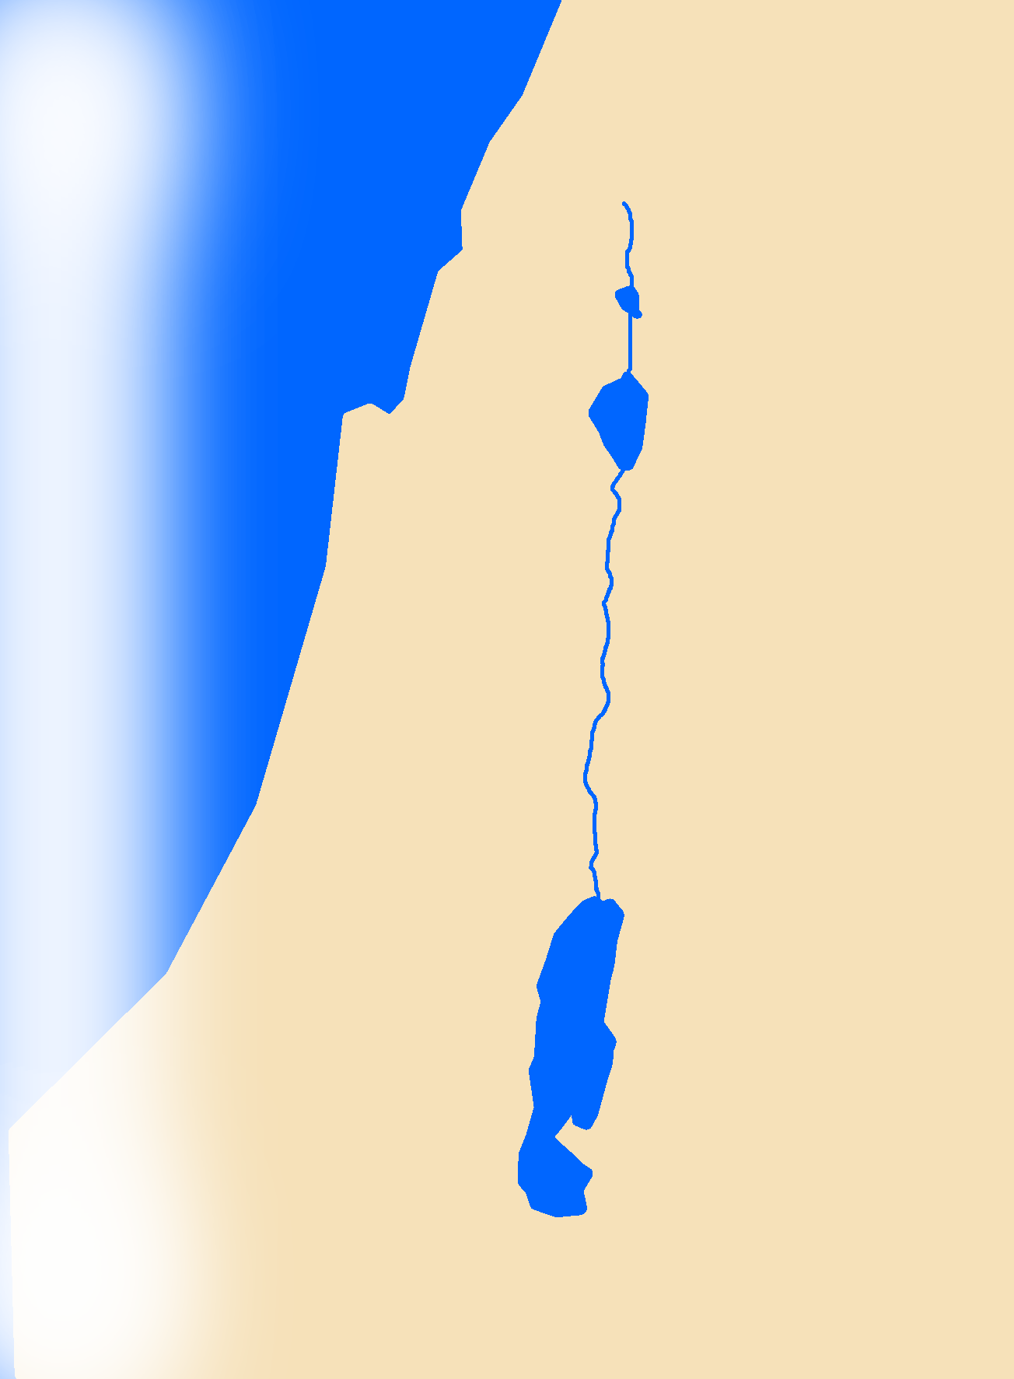
To Lead in Battle 11:1-13
¹ Then Nahash the Ammonite went up and besieged Jabesh-gilead …. ⁶ And the Spirit of God rushed upon Saul when he heard these words, and his anger was greatly kindled.
⁷ … Then the dread of the LORD fell upon the people, and they came out as one man. … ¹¹ … and struck down the Ammonites
Jabesh-gilead
AMMON
Gibeah
Notes:
Cross before crown
Battle before Victory

Slide 38
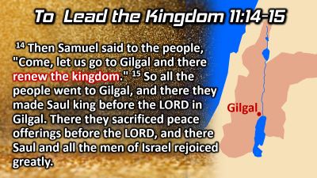
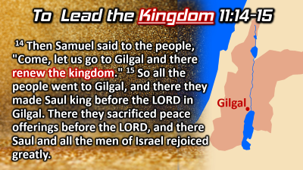
To Lead in Battle 11:1-13
¹ Then Nahash the Ammonite went up and besieged Jabesh-gilead ….
⁶ And the Spirit of God rushed upon Saul when he heard these words, and his anger was greatly kindled.
⁷ … Then the dread of the LORD fell upon the people, and they came out as one man. … ¹¹ … and struck down the Ammonites
Jabesh-gilead
AMMON
Gibeah
Notes:
Cross before crown
Battle before Victory

Slide 39
To Lead in Battle 11:1-13
¹ Then Nahash the Ammonite went up and besieged Jabesh-gilead …. ⁶ And the Spirit of God rushed upon Saul when he heard these words, and his anger was greatly kindled.
⁷ … Then the dread of the LORD fell upon the people, and they came out as one man. … ¹¹ … and struck down the Ammonites
Jabesh-gilead
AMMON
Gibeah
Notes:
Cross before crown
Battle before Victory

Slide 40
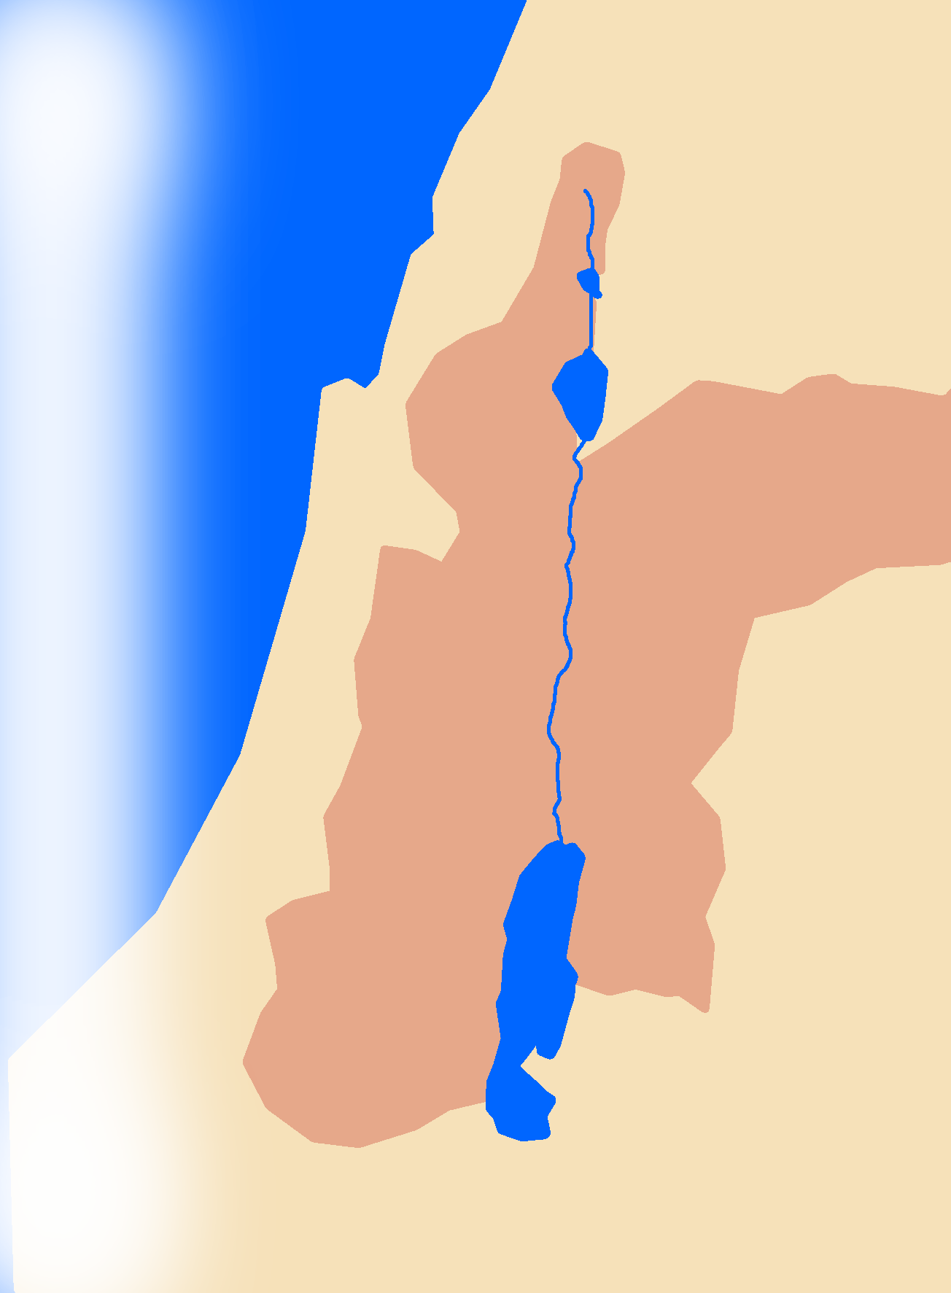
To Lead the Kingdom 11:14-15
¹⁴ Then Samuel said to the people, "Come, let us go to Gilgal and there renew the kingdom." ¹⁵ So all the people went to Gilgal, and there they made Saul king before the LORD in Gilgal. There they sacrificed peace offerings before the LORD, and there Saul and all the men of Israel rejoiced greatly.
Gilgal
Notes:
Cross before crown
Battle before Victory

Slide 41
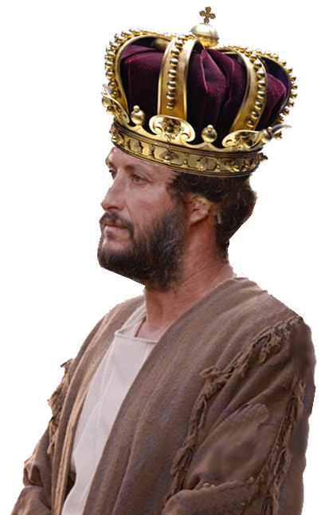
To Lead the Kingdom 11:14-15
¹⁴ Then Samuel said to the people, "Come, let us go to Gilgal and there renew the kingdom." ¹⁵ So all the people went to Gilgal, and there they made Saul king before the LORD in Gilgal. There they sacrificed peace offerings before the LORD, and there Saul and all the men of Israel rejoiced greatly.
Gilgal
Notes:
Cross before crown
Battle before Victory

Slide 42
4- God Empowers the Leader

Slide 43
4- God Empowers the Leader
10:6 Then the Spirit of the LORD will rush upon you, and you will prophesy with them and be turned into another man.
10:10 When they came to Gibeah, behold, a group of prophets met him, and the Spirit of God rushed upon him, and he prophesied among them.
11:6 And the Spirit of God rushed upon Saul when he heard these words, and his anger was greatly kindled.

Slide 44
4- God Empowers the Leader
16:14 Now the Spirit of the LORD departed from Saul, and a harmful spirit from the LORD tormented him.

Slide 45
What’s in it for me?
1- We are anointed with the Spirit too!
²¹ And it is God who establishes us with you in Christ, and has anointed us, ²² and who has also put his seal on us and given us his Spirit in our hearts as a guarantee. (2Corinthians 1:21-22)

Slide 46
What’s in it for me?
1- We are anointed with the Spirit too!
2- Other should see it in you.
You will recognize them by their fruits. (Matthew 7:16)

Slide 47
What’s in it for me?
1- We are anointed with the Spirit too!
2- Other should see it in you.
3- The Church should recognize it in you.
… they recognized the grace given to me. (Galatians 2:9 NIV)

Slide 48
What’s in it for me?
1- We are anointed with the Spirit too!
2- Other should see it in you.
3- The Church should recognize it in you.
4- You should sense the Spirit in you.
The Spirit himself bears witness with our
spirit that we are children of God (Romans 8:16)

Slide 49
Let’s Pray
Notes:
https://watermark.lovepik.com/photo/50083/4881.jpg_wh1200.jpg

