Slide 1
Lesson 9
This series uses “Hemi Head Rg” Font
You can get the font FREE at: https://www.dafont.com/hemi-head.font
Or https://fontsfree.net/hemi-head-rg-bold-italic-font-download.html
Or https://www.1001fonts.com/hemi-head-426-font.html
Notes:
Copyright © 2006−2021. All rights reserved. Bible Point is a registered trademark of Dennis Henderson. All other trademarks acknowledged.
Bible Point contains graphics from Bible Point artists. These illustrations belong to Bible Point and the respective artists. You may use the designs and illustrations for graphical illustration of lessons free and without special permission, provided they are not used in any way that maligns the Christian faith. Furthermore, republication or production of any illustration by any other graphic service whether it be in book, in a machine-readable form, or in any other design resource is strictly prohibited. Furthermore, they cannot be duplicated or resold as any other form of publishing, clip art, or graphic resource.
So What does it mean? (A simple translations of the legal jargon)
So, if you don’t own the presentation(s), graphic(s), and text(s) how can you legally use them? The purchase of the license allows you to use all the images in the product. However, the actual ownership and copyright of the presentation(s), graphic(s), and text(s) remain the property of Bible Point and its licensors. If you had plans on using this product in your “for sale” work—think again!
License Agreement
Article 1: License Grant
All the graphics and text in Bible Point presentations (excluding quotes from the Bible and stated sources) are the intellectual and real property of Bible Point and its licensors, and is protected by law, including United States copyright laws and international treaties. Bible Point grants to you a license:
1. To use the presentation in a single church, single school, or single office of a Christian organization.
2. To make a single archival back-up copy of the program.
3. To modify the presentation(s) and merge with other presentations in a single church, school, or Christian organization.
4. To transfer to another party if that party agrees to accept the terms and conditions of this agreement, and you do not retain any copies of the presentation, whether printed, machine readable, modified, or merged form.
Article 2: Terms
This license is effective until terminated. You may terminate the license at any time by destroying the presentation(s), graphic(s), or text(s) together with all copies, modifications and merged portions in any form. Bible Point may terminate your license if you fail to comply with this Agreement. You agree, upon such termination, for any reason, to destroy the presentation(s), graphics, and text(s) with all copies, modifications, and merged portions in any form.
Article 3: Disclaimers
1. Bible Point presentations, graphics, and texts are licensed to you As Is. You, the consumer, bear the entire risk relating to the quality and performance of the presentation(s), graphic(s), or text(s). In no event will Bible Point be liable for damages resulting from any defect.
2. Thirty-day limited warrantee on disks. Bible Point warrants the disks to be free of defects in material and workmanship under normal use for 30 days after purchase. During the 30-day period you may return a defective presentation, graphic, or text with proof of purchase and it will be replaced without charge, unless the presentation is damaged by misuse.
Article 4: General
1. You may not sub-license, assign, or transfer the license of the presentation(s), graphic(s), or text(s) except as provided by this Agreement.
2. This Agreement will be governed by the laws of the State of Michigan.
So What does it mean? (A simple translations of the legal jargon)
May I let someone borrow or copy my licensed Bible Point presentation (even after I modified it)? As long as it is within your local church, or single school, or the immediate office of a Christian organization you may. Otherwise, please refer the person interested in borrowing to: http://www.biblepoint.com or E-mail: dennis@DrDH.net with any related questions.

Slide 2


Finding Victory in…
Notes:
https://watermark.lovepik.com/photo/50083/4881.jpg_wh1200.jpg

Slide 3
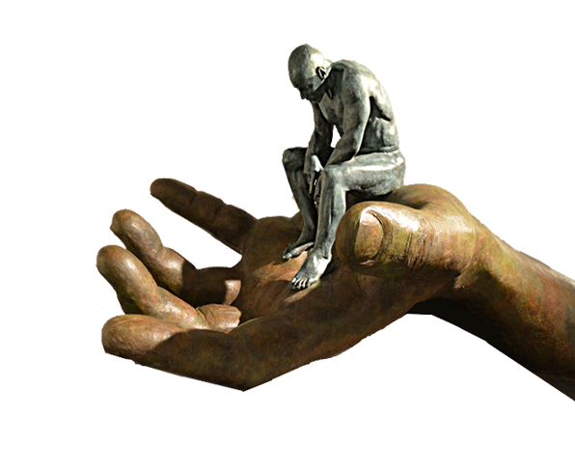
God’s Providence
The definition:
“The continued exercise of God’s divine power, by which He runs the entire universe, in such a way that everything fulfills His intended purpose!”
In other words:
”He’s got the whole world in HIS HANDS!”

Slide 4

In Those Days
^{Judges 17:6} In those days there was no king in Israel.
Everyone did what was right in his own eyes.
^{Judges 18:1} In those days there was no king in Israel.
^{Judges 19:1} In those days, … there was no king in Israel,
^{Judges 21:25} In those days there was no king in Israel.
Everyone did what was right in his own eyes.
Notes:
https://www.publicdomainpictures.net/en/view-image.php?image=161580&picture=judge-gavel

Slide 5
Israel was a Wild West
^{Judges 17:6} In those days there was no king in Israel.
Everyone did what was right in his own eyes.
^{Judges 18:1} In those days there was no king in Israel.
^{Judges 19:1} In those days, … there was no king in Israel,
^{Judges 21:25} In those days there was no king in Israel.
Everyone did what was right in his own eyes.

Slide 6
There was NO King
^{Judges 17:6} In those days there was no king in Israel.
Everyone did what was right in his own eyes.
^{Judges 18:1} In those days there was no king in Israel.
^{Judges 19:1} In those days, … there was no king in Israel,
^{Judges 21:25} In those days there was no king in Israel.
Everyone did what was right in his own eyes.
Israel Wanted a KING

Slide 7

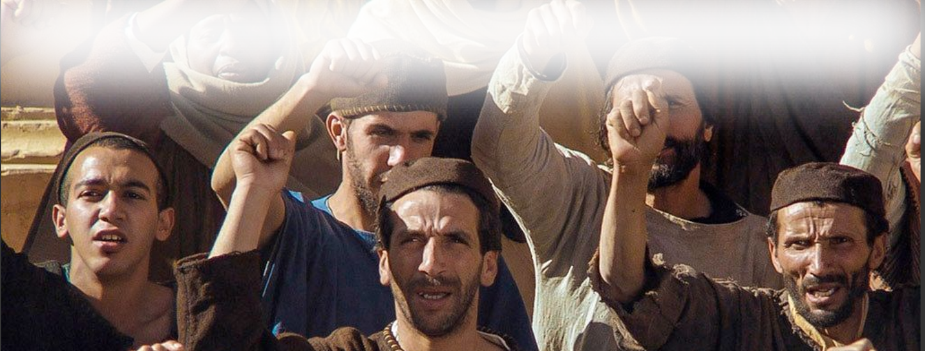
They insisted on a King …
And they said,
"No! But there shall be a king over us … "

Slide 8
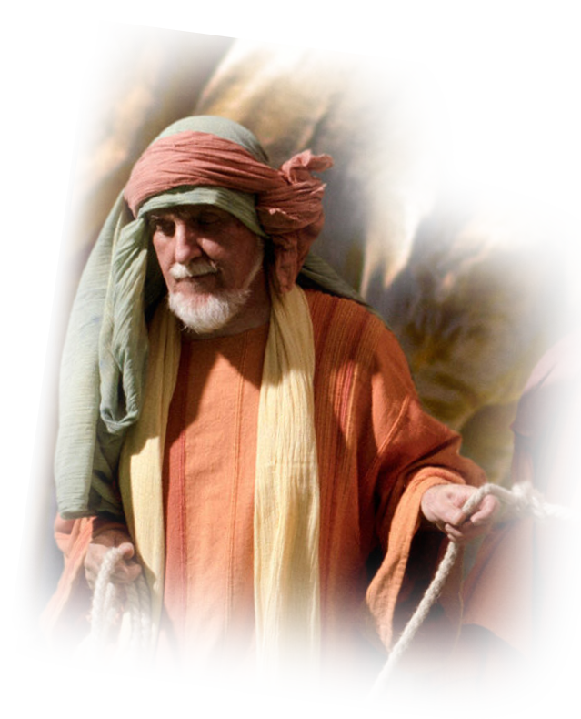
Make them a King!
²² And the LORD
said to Samuel,
"Obey their voice and
make them a king."

Slide 9
It Just So Happened that ...

Slide 10
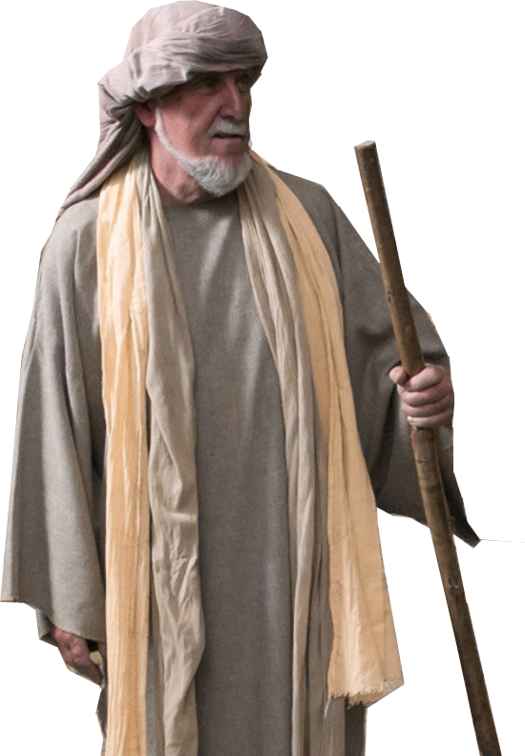
There was a wealthy family 9:1
¹ There was a man of Benjamin whose name was Kish, the son of Abiel, son of
Zeror, son of Becorath, son of
Aphiah, a Benjaminite, a man
of wealth.
Notes:
Rich Ruler image

Slide 11
It Just So Happened that ...

Slide 12
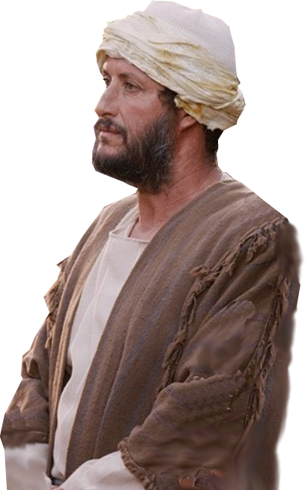
There was a handsome son 9:2
² And he had a son whose name was Saul, a handsome young man. There was not a man among the people of Israel more handsome than he. From his shoulders upward he was taller than any of the people.
Notes:
Rich Ruler image

Slide 13
It Just So Happened that ...

Slide 14
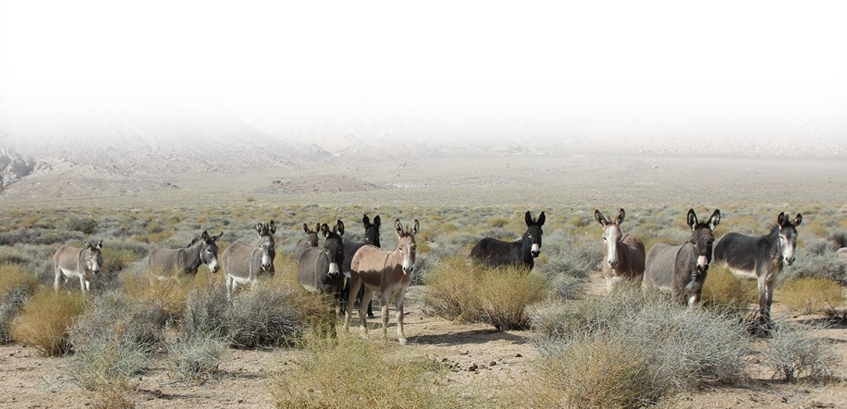
There were some lost donkeys
³ Now the donkeys of Kish, Saul's father, were lost. So Kish said to Saul his son, "Take one of the young men with you, and arise, go and look for the donkeys."

Slide 15
There were some lost donkeys
⁴ And he passed through the hill country of Ephraim and passed through the land of Shalishah, but they did not find them. And they passed through the land of Shaalim, but they were not there. Then they passed through the land of Benjamin, but did not find them.

Slide 16
It Just So Happened that ...

Slide 17
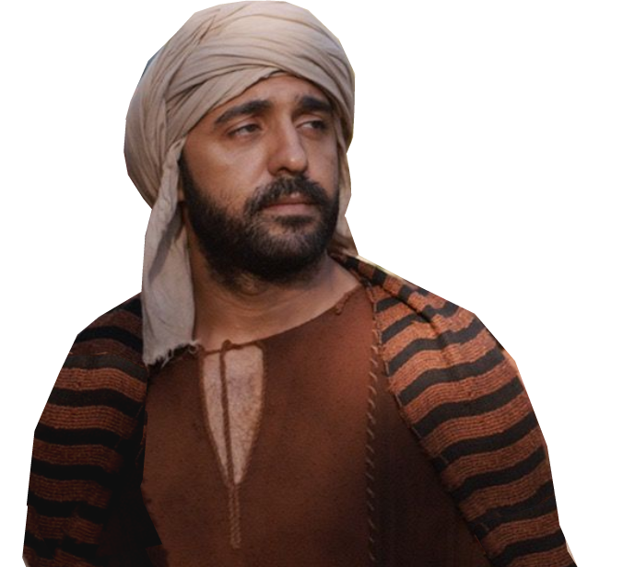
There was a servant who knew
⁵ When they came to the land of Zuph, Saul said to his servant who was with him,
"Come, let us go back,
lest my father cease to
care about the donkeys
and become anxious
about us."

Slide 18
There was a servant who knew
⁶ But he said to him,
"Behold, there is a man of God in this city, and
he is a man who is held in honor; all that he says comes true. So now let us go there. Perhaps he can tell us the way we should go.“

Slide 19
There was a servant who knew
⁷ Then Saul said to his servant,
"But if we go, what can
we bring the man? For
the bread in our sacks
is gone, and there is no present to bring to the
man of God. What do
we have?"

Slide 20
It Just So Happened that ...

Slide 21
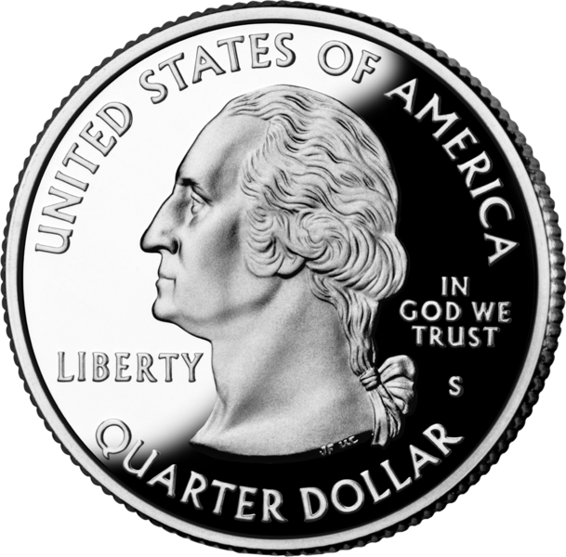
There was a quarter 9:8-10
⁸ The servant answered Saul again,
"Here, I have with me a
quarter of a shekel of
silver, and I will give it
to the man of God to
tell us our way.“

Slide 22

There was a quarter 9:8-10
⁹ (Formerly in Israel, when a man went to inquire of God, he said, "Come, let us go to the seer," for today's "prophet" was formerly called a seer.)
Notes:
https://pixabay.com/illustrations/seer-eye-eye-of-providence-symbol-696312/

Slide 23
There was a quarter 9:8-10
¹⁰ And Saul said to his servant,
"Well said; come, let us go."
So they went to the
city where the man of
God was.

Slide 24
It Just So Happened that ...

Slide 25
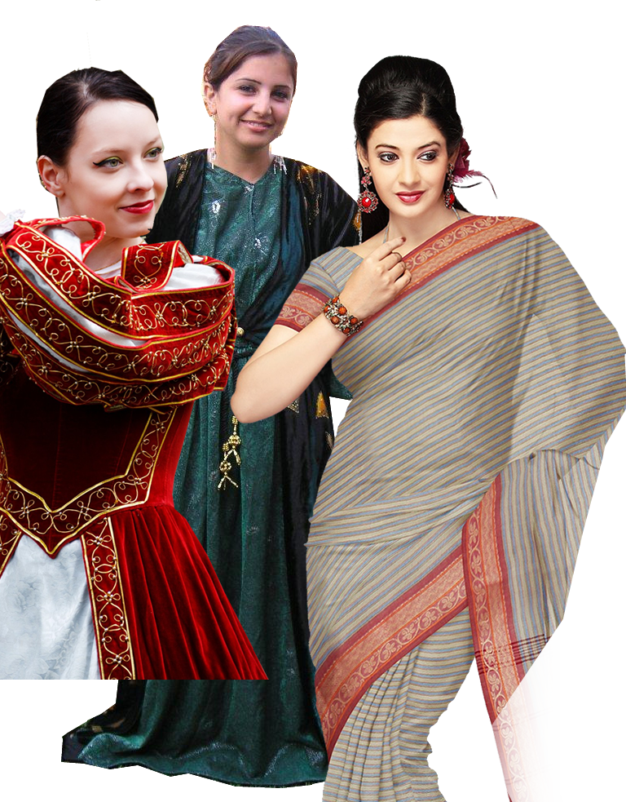
There were “some girls” 9:11-13
¹¹ As they went up the hill to the city, they met young women coming out to
draw water and said to them,
"Is the seer here?“
Notes:
https://c.pxhere.com/photos/cc/05/medieval_dance_history_dancer_girl_costume_historical_historic-985036.jpg!d
https://pixabay.com/fr/photos/sari-v%C3%AAtements-indiens-la-mode-soie-351106/
https://upload.wikimedia.org/wikipedia/en/7/75/Assyrianzakho.JPG

Slide 26
There were “some girls” 9:11-13
¹² They answered,
"He is; behold, he is just ahead of you. Hurry. He has come just now to the city, ... ¹³ As soon as you enter the city you will find him, ....
Now go up, for you will meet him immediately."
Notes:
https://c.pxhere.com/photos/cc/05/medieval_dance_history_dancer_girl_costume_historical_historic-985036.jpg!d

Slide 27
It Just So Happened that ...

Slide 28
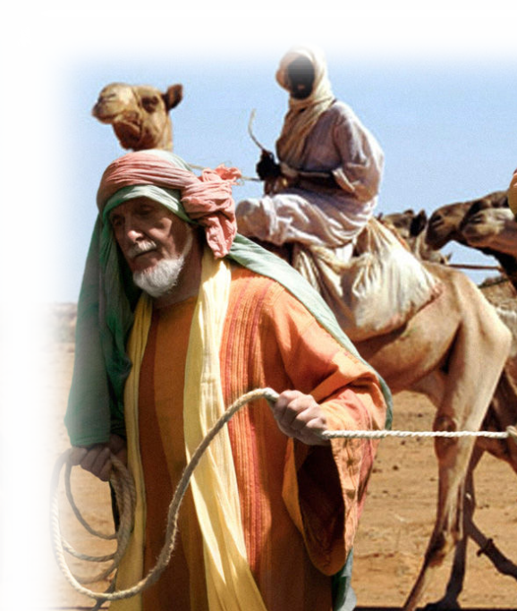
There was Samuel 9:14
¹⁴ So they went up to the city. As they were entering the city, they saw Samuel coming out toward them on his way up to the high place.
MERE COINCIDENCE OR ...

Slide 29
All According to God’s “Plan” 9:15

Slide 30
All According to God’s “Plan” 9:15
¹⁵ Now the day before Saul came,
the LORD had revealed to Samuel:

Slide 31
All According to God’s “Plan” 9:15
¹⁵ Now the day before Saul came,
the LORD had revealed to Samuel:
¹⁶ "Tomorrow about this time I will
send to you a man from the land of Benjamin, and you shall anoint him to
be prince over my people Israel. He shall save my people from the hand of the Philistines. For I have seen my people, because their cry has come to me.“

Slide 32
All According to God’s “Plan” 9:15
¹⁷ When Samuel saw Saul, the LORD told him,
"Here is the man of whom I spoke to
you! He it is who shall restrain my
people."

Slide 33
For the Providential Moment

Slide 34
For the Providential Moment
¹⁸ Then Saul approached Samuel in the gate and said,
"Tell me where is the house
of the seer?“

Slide 35

For the Providential Moment
¹⁹ Samuel answered Saul,
"I am the seer. Go up before me to the high place, for today you shall eat with me, and in the morning I will let you go and will tell you all that is on your mind.
NO ACCIDENT – DIVINE PROVIDENCE

Slide 36
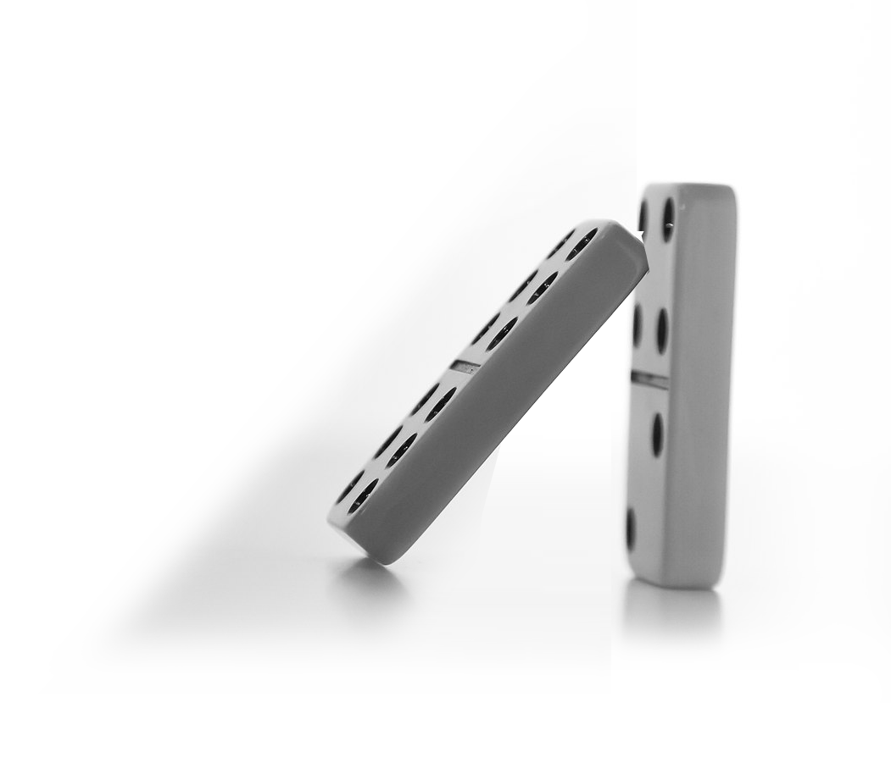
All because of LOST DONKEYS
²⁰ As for your donkeys that were lost three days ago, do not set your mind on them, for they have been found.
CURSE or BLESSING?
Notes:
What is your lost donkey? What is your pain in the neck? What is it the messes up your day? Who is it? What is it?
Fable Curse or Blessing? Time will tell!
Were the lost donkeys a curse? Seemed so at the beginning! Or were they a blessing? Seems so at the end!
You were looking for donkeys—but all Israel is looking for you!

Slide 37
All because of LOST DONKEYS
²⁰ As for your donkeys that were lost three days ago, do not set your mind on them, for they have been found.
CURSE or BLESSING?
Notes:
What is your lost donkey? What is your pain in the neck? What is it the messes up your day? Who is it? What is it?
Curse or Blessing? Time will tell!
Were the lost donkeys a curse? Seemed so at the beginning! Or were they a blessing? Seems so at the end!
You were looking for donkeys—but all Israel is looking for you!

Slide 38
So What’s the Point?
²⁰ As for your donkeys that were lost three days ago, do not set your mind on them, for they have been found. And for whom is all that is desirable in Israel? Is it not for you and for all your father's house?“
While you were looking for lost donkeys …
All Israel was looking for YOU!
?
Notes:
What is your lost donkey? What is your pain in the neck? What is it the messes up your day? Who is it? What is it?
Curse or Blessing? Time will tell!
Were the lost donkeys a curse? Seemed so at the beginning! Or were they a blessing? Seems so at the end!
You were looking for donkeys—but all Israel is looking for you!

Slide 39
The Point: To foster overwhelming unworthiness
²¹ Saul answered,
"Am I not a Benjaminite, from the least of the tribes of Israel? And is not my clan the humblest of all the clans of the tribe of Benjamin? Why then have you spoken to me in this way?
Notes:
I’m like the insignificant donkey, the least of all the tribes. Why me?

Slide 40
Because, it was all preplanned!
²² Then Samuel took Saul and his young man and brought them into the hall and gave them a place at the head of those who had been invited, who were about thirty persons.

Slide 41
Because, it was all preplanned!
²³ And Samuel said to the cook,
"Bring the portion I gave you, of which I said to you, 'Put it aside.’”
²⁴ So the cook took up the leg and what was on it and set them before Saul. And Samuel said,

Slide 42
Because, it was all preplanned!
"See, what was kept is set before you. Eat, because it was kept for
you until the hour appointed, that you might eat with the guests."
So Saul ate with Samuel that day. ²⁵ And when they came down from the high place into the city, a bed was spread for Saul on the roof, and he lay down to sleep.

Slide 43
Because, it was all preplanned!
²⁶ Then at the break of dawn Samuel called to Saul on the roof,
"Up, that I may send you on
your way."
So Saul arose, and both he and Samuel went out into the street.

Slide 44
Because, it was all preplanned!
²⁷ As they were going down to the outskirts of the city, Samuel said to Saul,
"Tell the servant to pass on
before us, and when he has passed on, stop here yourself
for a while, that I may make known to you the word of God."

Slide 45
Because, it was all preplanned!
²⁷ As they were going down to the outskirts of the city, Samuel said to Saul,
"Tell the servant to pass on
before us, and when he has passed on, stop here yourself
for a while, that I may make known to you the word of God."
We’ll pick-up here next time

Slide 46
What do we do with these truths?
Believe that there are no accidents in your life—
only divine appointments!
²⁸ And we know that
for those who love
God all things work
together for good,
(Romans 8:28)

Slide 47
Let’s Pray
Notes:
https://watermark.lovepik.com/photo/50083/4881.jpg_wh1200.jpg

