Slide 1
Lesson 8
This series uses “Hemi Head Rg” Font
You can get the font FREE at: https://www.dafont.com/hemi-head.font
Or https://fontsfree.net/hemi-head-rg-bold-italic-font-download.html
Or https://www.1001fonts.com/hemi-head-426-font.html
Notes:
Copyright © 2006−2021. All rights reserved. Bible Point is a registered trademark of Dennis Henderson. All other trademarks acknowledged.
Bible Point contains graphics from Bible Point artists. These illustrations belong to Bible Point and the respective artists. You may use the designs and illustrations for graphical illustration of lessons free and without special permission, provided they are not used in any way that maligns the Christian faith. Furthermore, republication or production of any illustration by any other graphic service whether it be in book, in a machine-readable form, or in any other design resource is strictly prohibited. Furthermore, they cannot be duplicated or resold as any other form of publishing, clip art, or graphic resource.
So What does it mean? (A simple translations of the legal jargon)
So, if you don’t own the presentation(s), graphic(s), and text(s) how can you legally use them? The purchase of the license allows you to use all the images in the product. However, the actual ownership and copyright of the presentation(s), graphic(s), and text(s) remain the property of Bible Point and its licensors. If you had plans on using this product in your “for sale” work—think again!
License Agreement
Article 1: License Grant
All the graphics and text in Bible Point presentations (excluding quotes from the Bible and stated sources) are the intellectual and real property of Bible Point and its licensors, and is protected by law, including United States copyright laws and international treaties. Bible Point grants to you a license:
1. To use the presentation in a single church, single school, or single office of a Christian organization.
2. To make a single archival back-up copy of the program.
3. To modify the presentation(s) and merge with other presentations in a single church, school, or Christian organization.
4. To transfer to another party if that party agrees to accept the terms and conditions of this agreement, and you do not retain any copies of the presentation, whether printed, machine readable, modified, or merged form.
Article 2: Terms
This license is effective until terminated. You may terminate the license at any time by destroying the presentation(s), graphic(s), or text(s) together with all copies, modifications and merged portions in any form. Bible Point may terminate your license if you fail to comply with this Agreement. You agree, upon such termination, for any reason, to destroy the presentation(s), graphics, and text(s) with all copies, modifications, and merged portions in any form.
Article 3: Disclaimers
1. Bible Point presentations, graphics, and texts are licensed to you As Is. You, the consumer, bear the entire risk relating to the quality and performance of the presentation(s), graphic(s), or text(s). In no event will Bible Point be liable for damages resulting from any defect.
2. Thirty-day limited warrantee on disks. Bible Point warrants the disks to be free of defects in material and workmanship under normal use for 30 days after purchase. During the 30-day period you may return a defective presentation, graphic, or text with proof of purchase and it will be replaced without charge, unless the presentation is damaged by misuse.
Article 4: General
1. You may not sub-license, assign, or transfer the license of the presentation(s), graphic(s), or text(s) except as provided by this Agreement.
2. This Agreement will be governed by the laws of the State of Michigan.
So What does it mean? (A simple translations of the legal jargon)
May I let someone borrow or copy my licensed Bible Point presentation (even after I modified it)? As long as it is within your local church, or single school, or the immediate office of a Christian organization you may. Otherwise, please refer the person interested in borrowing to: http://www.biblepoint.com or E-mail: dennis@DrDH.net with any related questions.

Slide 2


Finding Victory by …
Notes:
https://watermark.lovepik.com/photo/50083/4881.jpg_wh1200.jpg

Slide 3
Avoiding Buyer’s Remorse
Notes:
https://upload.wikimedia.org/wikipedia/commons/c/c6/The_Holy_Bible_containing_the_Old_and_New_Testaments_%281896%29_%2814766299765%29.jpg

Slide 4
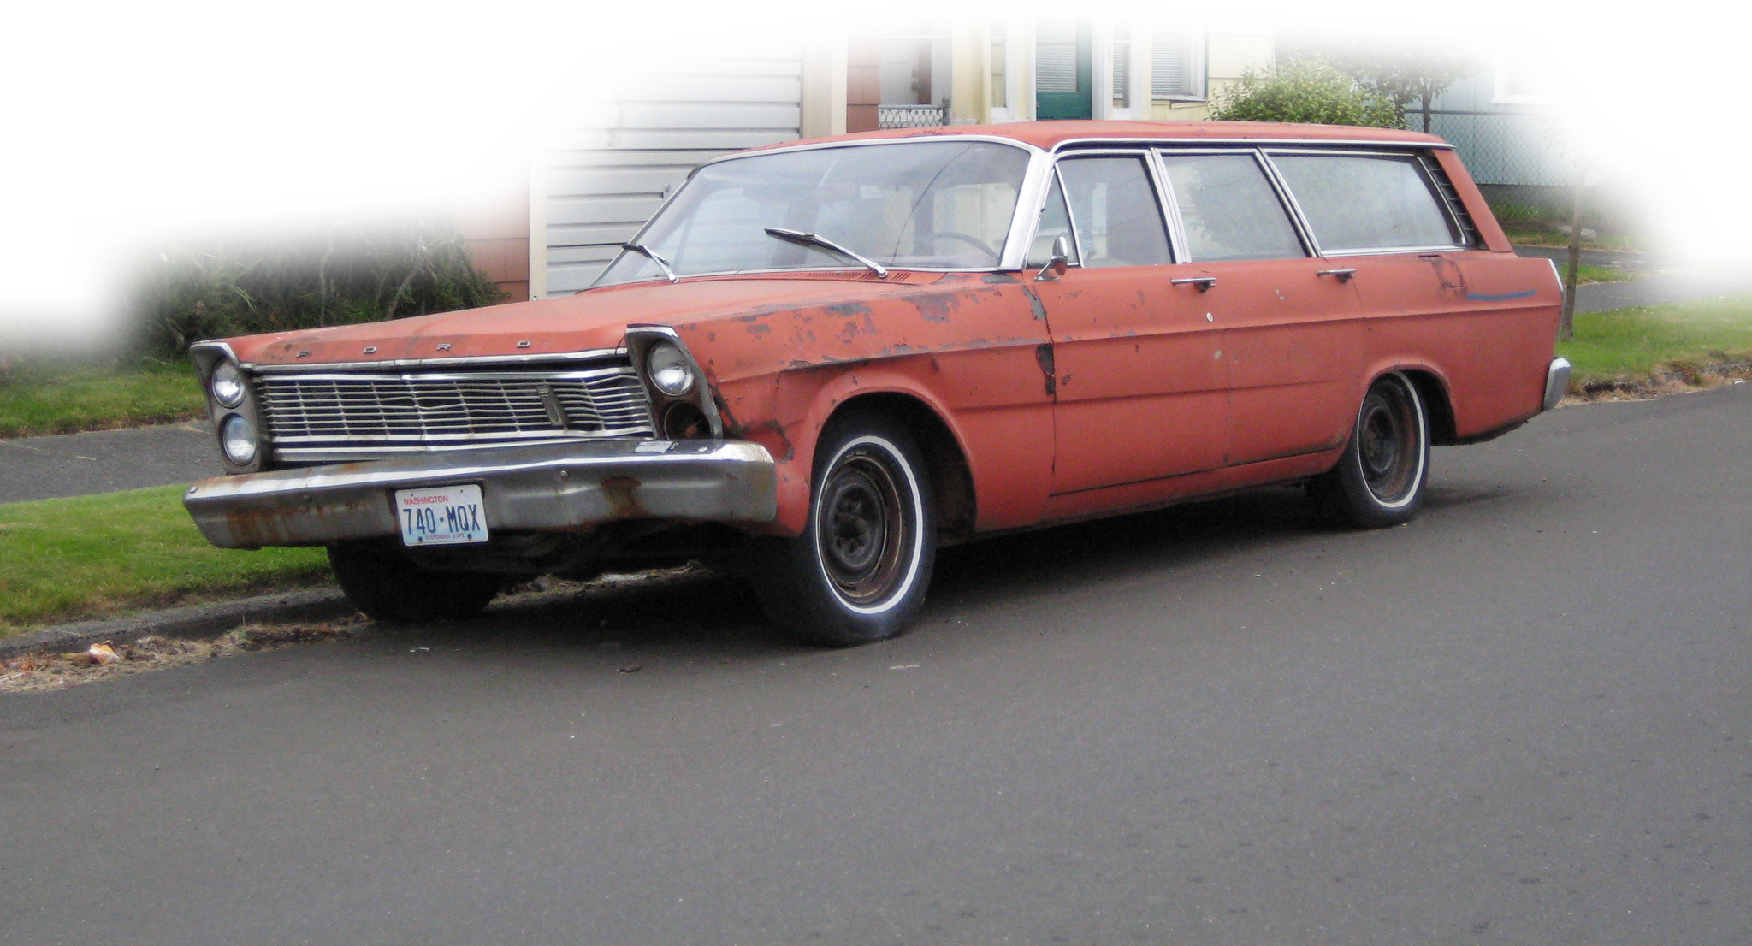
Buyer’s Remorse
Starts by justifying “the need for a new car.”
Notes:
https://www.piqsels.com/en/public-domain-photo-jhicd

Slide 5

Buyer’s Remorse
Starts by justifying “the need for a new car.”
Leads to dreaming “what a new one would be like.”
Notes:
https://www.flickr.com/photos/hugo90/2697509552

Slide 6

Buyer’s Remorse
Starts by justifying “the need for a new car.”
Leads to dreaming “what a new one would be like.”
Then ignoring “the hidden cost!”
Notes:
http://res.publicdomainfiles.com/pdf_view/75/13933737616712.png

Slide 7

Buyer’s Remorse
Starts by justifying “the need for a new car.”
Leads to dreaming “what a new one would be like.”
Then ignoring “the hidden cost!”
Finally, insisting ...
“I don’t care what it
costs, I want it.”
Notes:
https://pixabay.com/fr/photos/furieux-bouleverser-personne-femme-2514031/

Slide 8
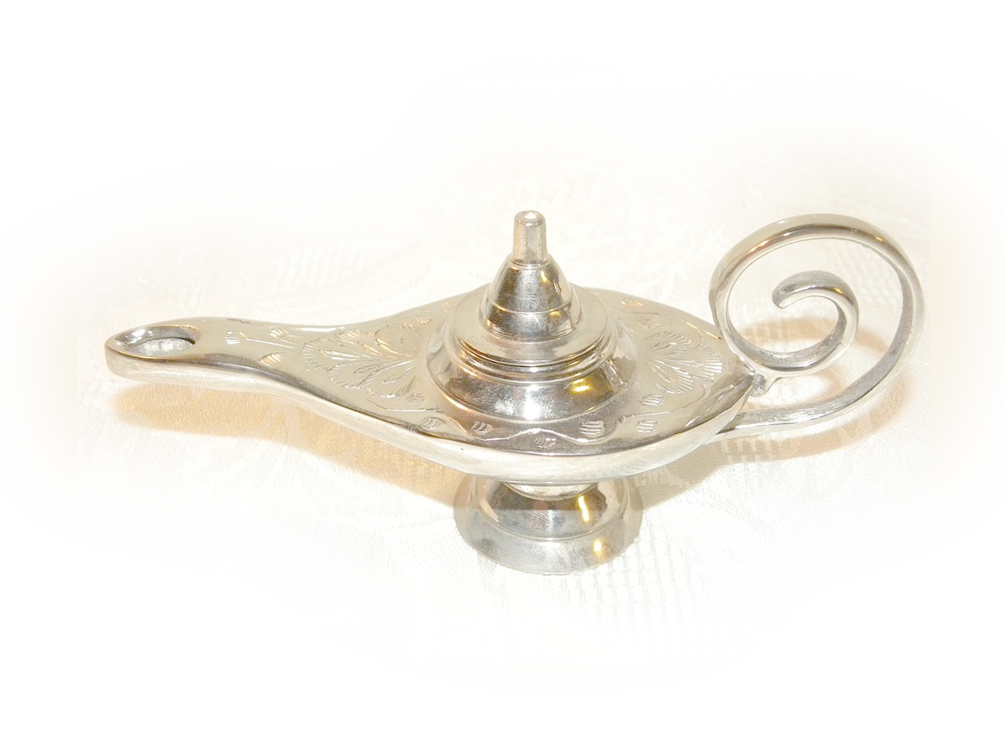
Be Careful What You Wish For!
Notes:
https://commons.wikimedia.org/wiki/File:Genie_Lamps_007.JPG

Slide 9
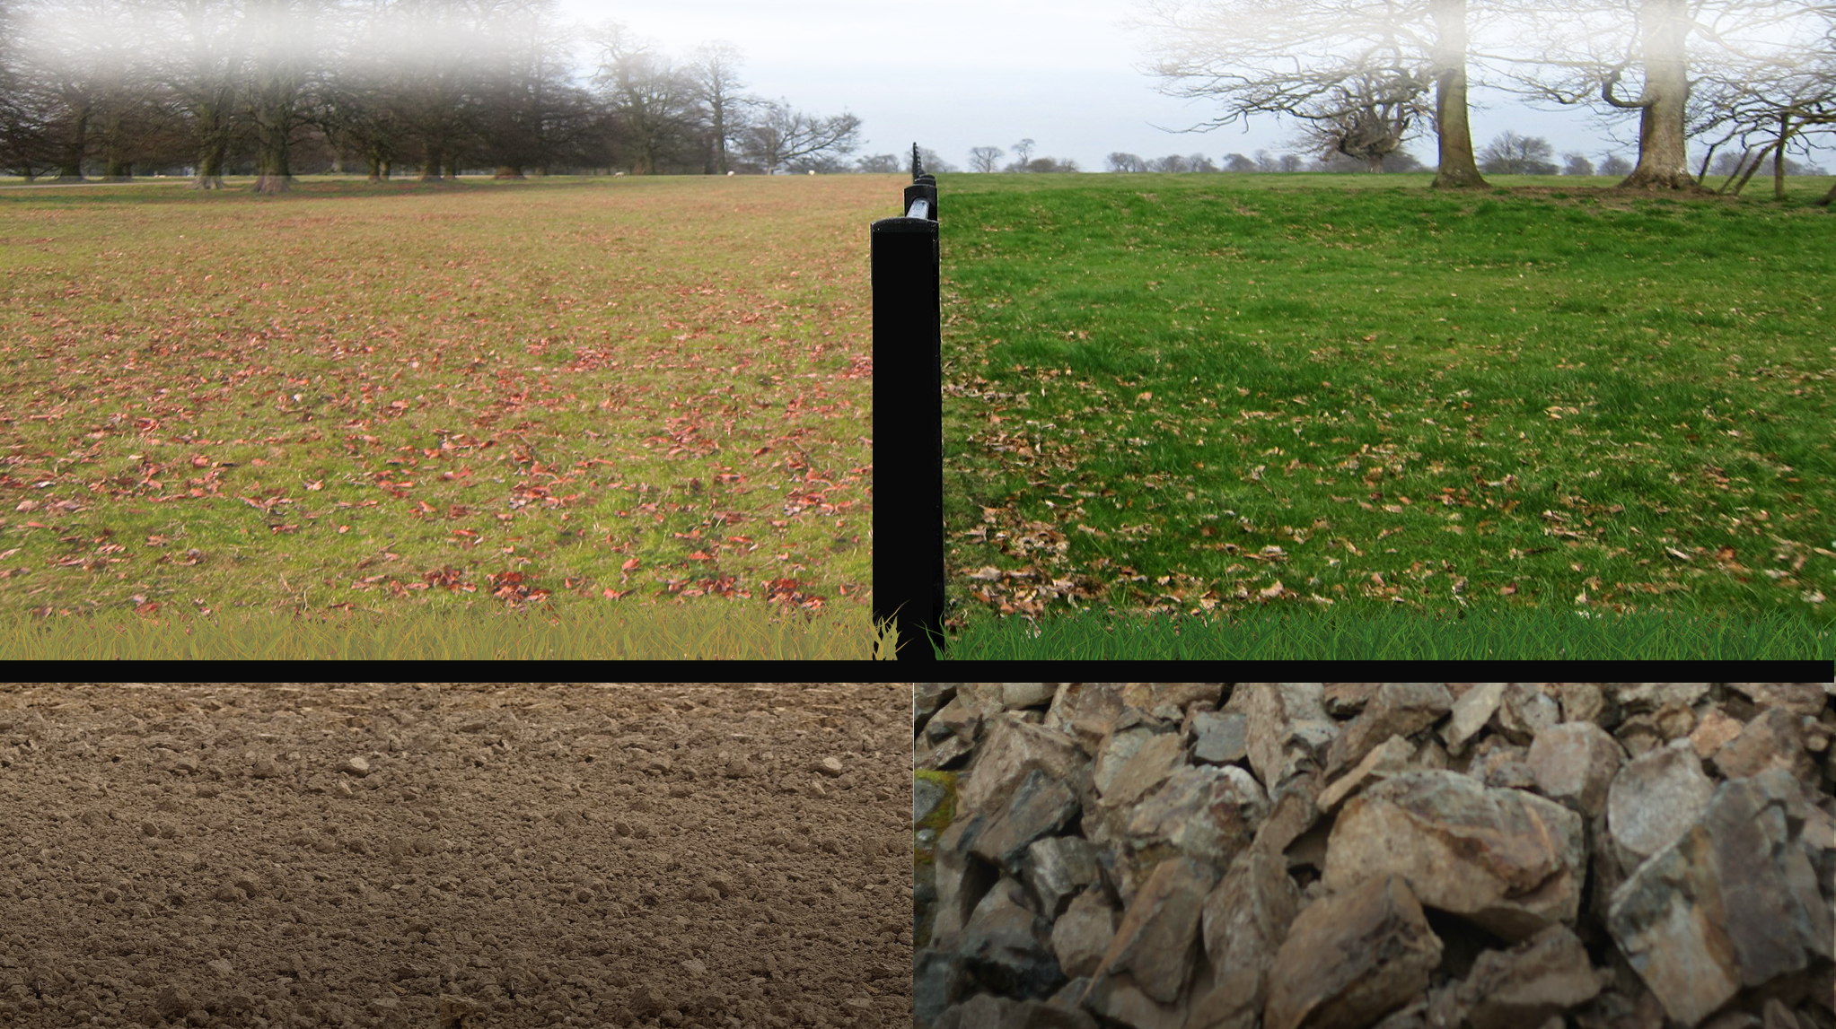
Grass is Greener on the Other Side
Notes:
https://www.flickr.com/photos/su-may/6888459262
https://www.flickr.com/photos/tracy_olson/2225369336/
https://www.pikrepo.com/falnm/brown-dirt
https://pixabay.com/illustrations/grass-lawn-green-nature-summer-1874524/

Slide 10

Buyer’s Remorse comes from …
Notes:
http://www.publicdomainfiles.com/show_file.php?id=13933735228577

Slide 11
Buyer’s Remorse came from …

Slide 12

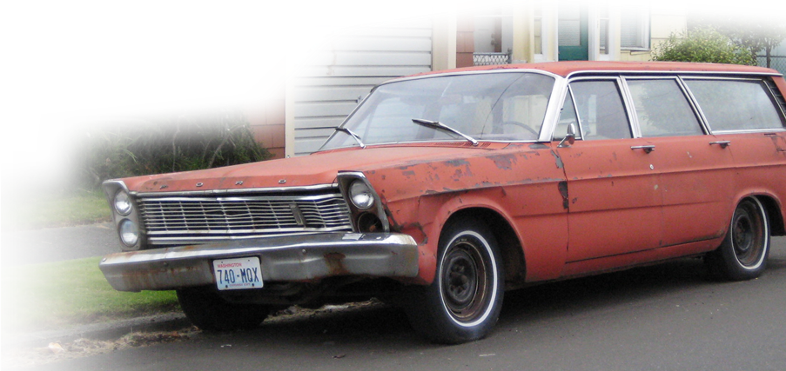
Justifying the Need for a King 8:1-3
^{1Sam8:1} When Samuel became old, he made his sons judges over Israel. ² The name of his firstborn son was Joel, and the name of his second, Abijah; they were judges in Beersheba.
Notes:
https://www.flickr.com/photos/143601516@N03/27571702173

Slide 13
Justifying the Need for a King 8:1-3
^{1Sam8:1} When Samuel became old, he made his sons judges over Israel. ² The name of his firstborn son was Joel, and the name of his second, Abijah; they were judges in Beersheba.
Notes:
https://www.flickr.com/photos/143601516@N03/27571702173

Slide 14

Justifying the Need for a King 8:1-3
^{1Sam8:1} When Samuel became old, he made his sons judges over Israel. ² The name of his firstborn son was Joel, and the name of his second, Abijah; they were judges in Beersheba. ³ Yet his sons did
not walk in his ways but turned aside after gain. They took bribes and perverted justice.
Notes:
https://www.needpix.com/photo/128610/gleise-seemed-railway-away-straight

Slide 15

Justifying the Need for a King 8:1-3
^{1Sam8:1} When Samuel became old, he made his sons judges over Israel. ² The name of his firstborn son was Joel, and the name of his second, Abijah; they were judges in Beersheba. ³ Yet his sons did
not walk in his ways but turned aside after gain. They took bribes and perverted justice.
Notes:
https://www.flickr.com/photos/143601516@N03/27571702173

Slide 16
Dreaming of Having a King 8:4-8

Slide 17


Dreaming of Having a King 8:4-8
⁴ Then all the elders of Israel gathered together and came to Samuel at Ramah ⁵ and said to him, "Behold, you are old and your sons do not walk in your ways. Now appoint for us a king to judge us like all the nations."

Slide 18
Dreaming of Having a King 8:4-8
⁶ But the thing displeased Samuel when they said, "Give us a king to judge us." And Samuel prayed to the LORD. ⁷ And the LORD said to Samuel, "Obey the voice of the people in all that they say to you, for they have not rejected you, but they have rejected me from being king over them.

Slide 19
Dreaming of Having a King 8:4-8
⁸ According to all the deeds that they have done, from the day I brought them up out of Egypt even to this day, forsaking me and serving other gods, so
they are also doing to you.
Notes:
https://www.flickr.com/photos/gsfc/5635018418

Slide 20
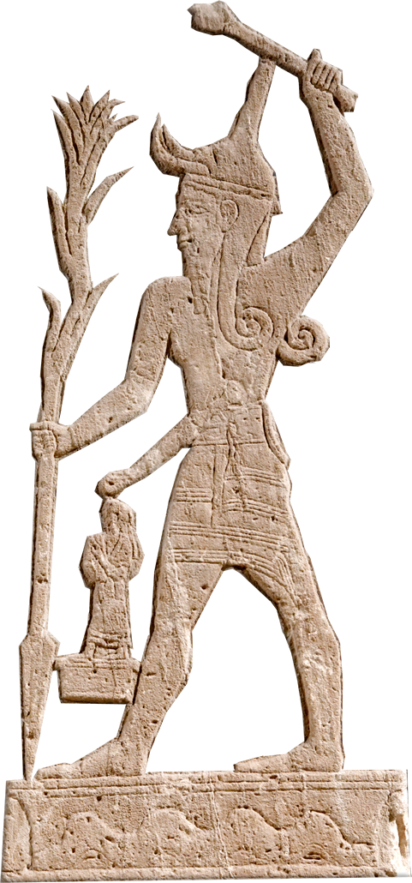
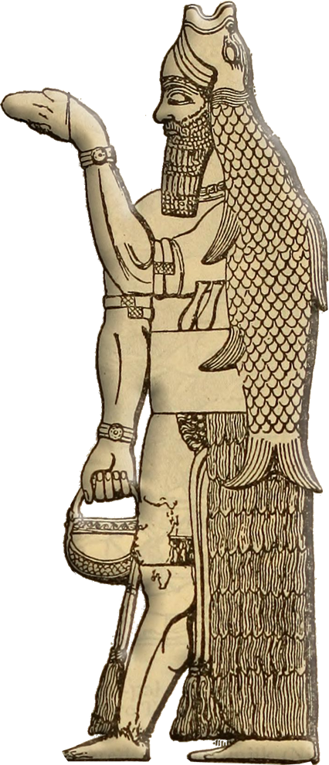
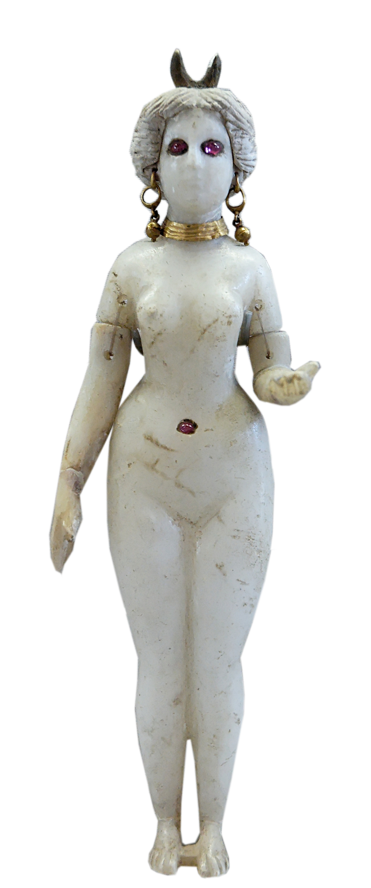
Dreaming of Having a King 8:4-8
⁸ According to all the deeds that they have done, from the day I brought them up out of Egypt even to this day, forsaking me and serving other gods, so
they are also doing to you.

Slide 21

Dreaming of Having a King 8:4-8
⁸ According to all the deeds that they have done, from the day I brought them up out of Egypt even to this day, forsaking me and serving other gods, so
they are also doing to you.

Slide 22
Dreaming of Having a King 8:4-8
⁹ Now then, obey their voice; only you shall solemnly warn them and show them the ways of the king who shall reign over them."
Just give them what they want!

Slide 23
Dreaming of Having a King 8:4-8
⁹ Now then, obey their voice; only you shall solemnly warn them and show them the ways of the king who shall reign over them."
Just give them what they want!
But tell them what it will cost!

Slide 24
Ignoring the Cost of a King 8:10-18

Slide 25
Ignoring the Cost of a King 8:10-18
¹⁰ So Samuel told all the words of the LORD to the people who were asking for a king from him.
¹¹ He said, "These will be the ways of the king who will reign over you:

Slide 26

Ignoring the Cost of a King 8:10-18
¹⁰ So Samuel told all the words of the LORD to the people who were asking for a king from him.
¹¹ He said, "These will be the ways of the king who will reign over you: he will take your sons and appoint them to his chariots and to be his horsemen and to run before his chariots.

Slide 27
Ignoring the Cost of a King 8:10-18
¹² And he will appoint for himself commanders of thousands and commanders of fifties, and some to plow his ground and to reap his harvest, and to make his implements of war and the equipment of his chariots.

Slide 28
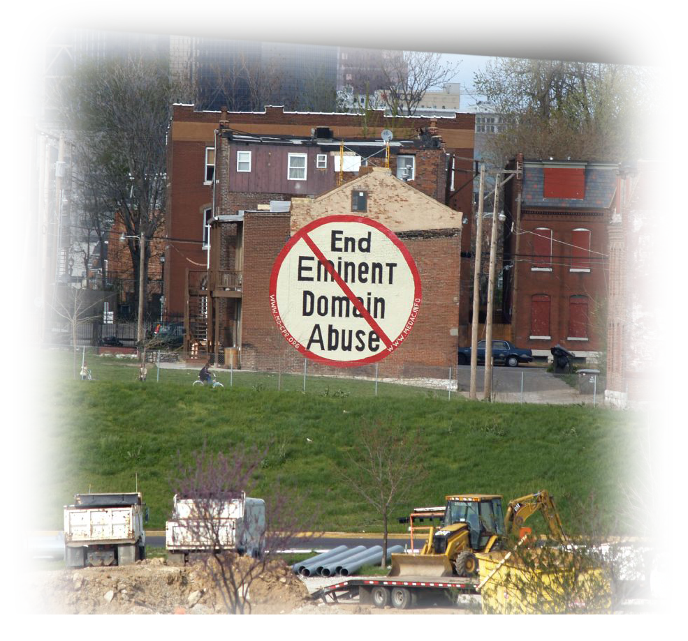
Ignoring the Cost of a King 8:10-18
¹³ He will take your daughters to be perfumers and cooks and bakers.
¹⁴ He will take the best of your fields and vineyards and olive orchards and give them to his servants. ¹⁵ He will take the tenth of your grain and of your vineyards and give it to his officers and to his servants.
Notes:
https://www.flickr.com/photos/paparutzi/461776347

Slide 29
Ignoring the Cost of a King 8:10-18
¹⁶ He will take your male servants and female servants and the best of your young men and your donkeys, and put them to his work.
¹⁷ He will take the tenth of your flocks, and you shall be his slaves.
Notes:
https://www.flickr.com/photos/paparutzi/461776347

Slide 30

Ignoring the Cost of a King 8:10-18
¹⁸ And in that day you will cry out because of your king, whom you have chosen for yourselves, but the LORD will not answer you in that day."
Notes:
https://pixabay.com/photos/person-human-man-male-face-cry-802502/

Slide 31
Ignoring the Cost of a King 8:10-18
¹⁸ And in that day you will cry out because of your king, whom you have chosen for yourselves, but the LORD will not answer you in that day."
Notes:
https://pixabay.com/photos/person-human-man-male-face-cry-802502/

Slide 32
Ignoring the Cost of a King 8:10-18
¹⁸ And in that day you will cry out because of your king, whom you have chosen for yourselves, but the LORD will not answer you in that day."
Notes:
https://pixabay.com/photos/person-human-man-male-face-cry-802502/
People often say to me, “Why doesn’t God answer my prayers?” I want to answer, “Is He really the King in your life?” Or are you just like Israel demanding your own king, your own way and just going to Him in time of need?” Israel is bringing it on themselves … and God is telling them in advance. So don’t say, “Where is God when I need Him?” Because you chose a different king—let that king deliver you!”

Slide 33
Insisting on Having a King 8:19-22
Notes:
https://upload.wikimedia.org/wikipedia/commons/c/c6/The_Holy_Bible_containing_the_Old_and_New_Testaments_%281896%29_%2814766299765%29.jpg

Slide 34
Insisting on Having a King 8:19-22
¹⁹ But the people refused to obey the voice of Samuel. And they said, "No! But there shall be a king over us, ²⁰ that we also may be like all the nations, and that our king may judge us and go out before us and fight our battles."
Notes:
https://upload.wikimedia.org/wikipedia/commons/c/c6/The_Holy_Bible_containing_the_Old_and_New_Testaments_%281896%29_%2814766299765%29.jpg

Slide 35
Insisting on Having a King 8:19-22
¹⁹ But the people refused to obey the voice of Samuel. And they said, "No! But there shall be a king over us, ²⁰ that we also may be like all the nations, and that our king may judge us and go out before us and fight our battles."
Notes:
https://upload.wikimedia.org/wikipedia/commons/c/c6/The_Holy_Bible_containing_the_Old_and_New_Testaments_%281896%29_%2814766299765%29.jpg

Slide 36
Insisting on Having a King 8:19-22
¹⁹ But the people refused to obey the voice of Samuel. And they said, "No! But there shall be a king over us, ²⁰ that we also may be like all the nations, and that our king may judge us and go out before us and fight our battles."
Notes:
https://upload.wikimedia.org/wikipedia/commons/c/c6/The_Holy_Bible_containing_the_Old_and_New_Testaments_%281896%29_%2814766299765%29.jpg

Slide 37

Coming Remorse over a King 8:21-22

Slide 38
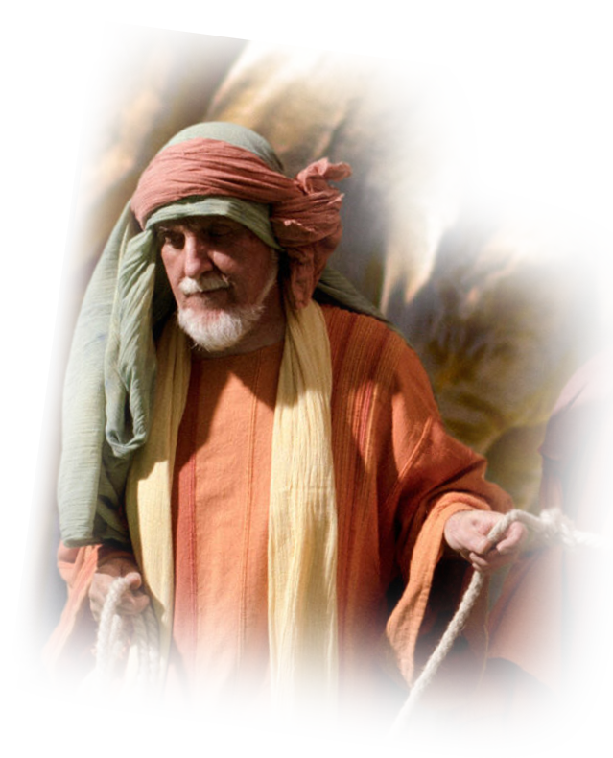
Coming Remorse over a King 8:21-22
²¹ And when Samuel had heard
all the words of the people, he repeated them in the ears of the LORD.
Notes:
Samuel is a priest. A priest takes the people to God.
He is also a prophet. A prophet takes God to the people.

Slide 39
Coming Remorse over a King 8:21-22
²² And the LORD
said to Samuel,
"Obey their voice and
make them a king."

Slide 40
Coming Remorse over a King 8:21-22
Samuel then said to the men of Israel,
"Go every man to his city."
Notes:
The people will get a king. He is everything they outwardly want. Handsome, tall, a warrior. But in the end, King Saul is carnal-fleshly—like this people. And they will regret they make him king.
That’s what happens when we insist on our own way!

Slide 41
How to Avoid Buyer’s Remorse

Slide 42
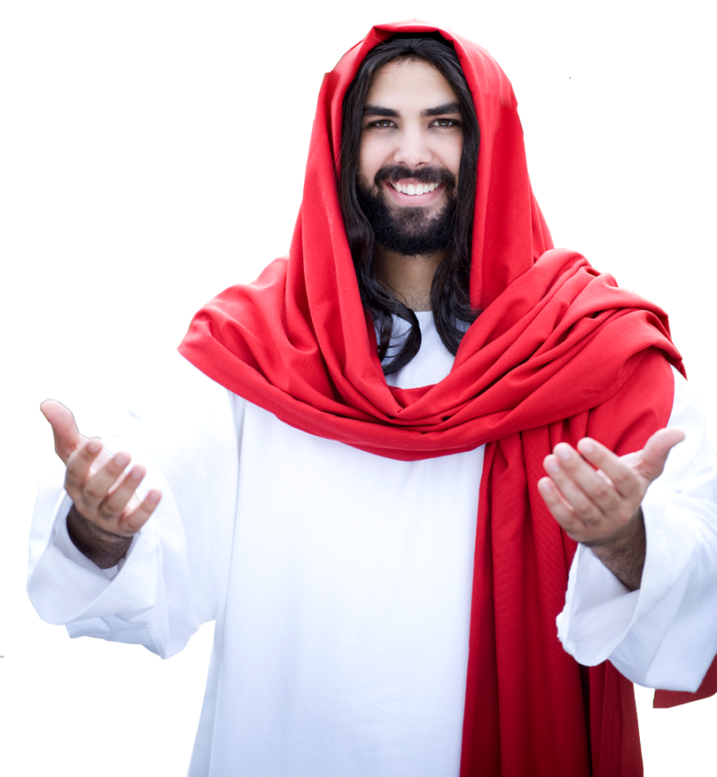
How to Avoid Buyer’s Remorse
Don’t COVET!
"Take care, and be on your guard against all covetousness, for one's life does not consist in the abundance of his possessions." (Luke 12:15)

Slide 43
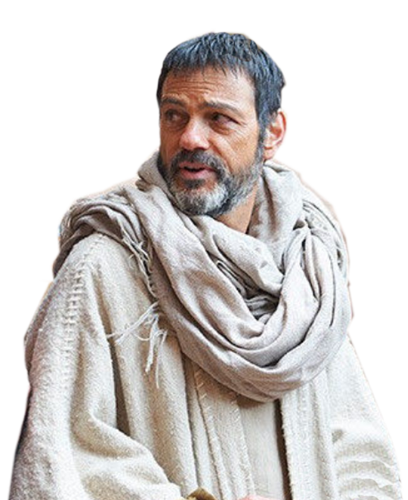
How to Avoid Buyer’s Remorse
Be CONTENT!
I have learned in whatever situation I am to be content. ¹² I know how to be brought low, and I know how to abound.
(Philippians 4:11-12)

Slide 44
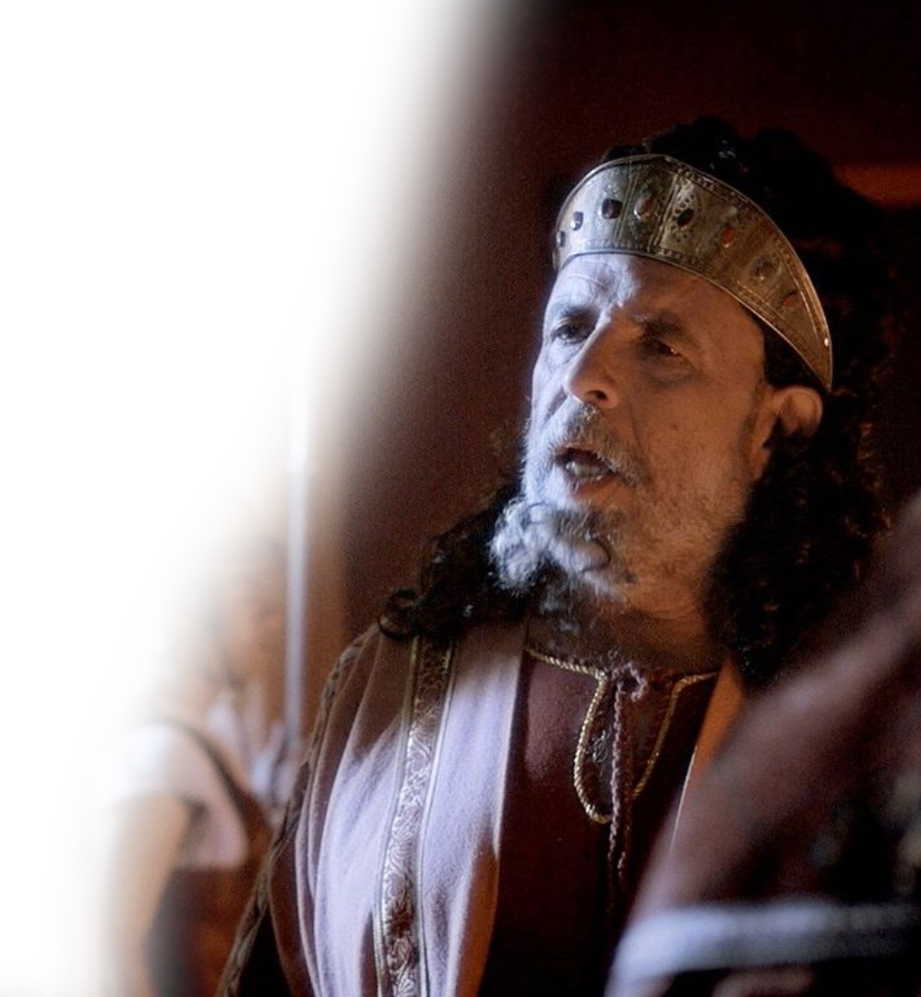
How to Avoid Buyer’s Remorse
TRUST God!
⁵ Trust in the LORD with all your heart, and do not lean on your own understanding. ⁶ In all your ways acknowledge him, and he will make straight your paths. (Proverbs 3:5-6)

Slide 45
Let’s Pray
Notes:
https://watermark.lovepik.com/photo/50083/4881.jpg_wh1200.jpg

