Slide 1
Lesson 6
This series uses “Hemi Head Rg” Font
You can get the font FREE at: https://www.dafont.com/hemi-head.font
Or https://fontsfree.net/hemi-head-rg-bold-italic-font-download.html
Or https://www.1001fonts.com/hemi-head-426-font.html
Notes:
Copyright © 2006−2021. All rights reserved. Bible Point is a registered trademark of Dennis Henderson. All other trademarks acknowledged.
Bible Point contains graphics from Bible Point artists. These illustrations belong to Bible Point and the respective artists. You may use the designs and illustrations for graphical illustration of lessons free and without special permission, provided they are not used in any way that maligns the Christian faith. Furthermore, republication or production of any illustration by any other graphic service whether it be in book, in a machine-readable form, or in any other design resource is strictly prohibited. Furthermore, they cannot be duplicated or resold as any other form of publishing, clip art, or graphic resource.
So What does it mean? (A simple translations of the legal jargon)
So, if you don’t own the presentation(s), graphic(s), and text(s) how can you legally use them? The purchase of the license allows you to use all the images in the product. However, the actual ownership and copyright of the presentation(s), graphic(s), and text(s) remain the property of Bible Point and its licensors. If you had plans on using this product in your “for sale” work—think again!
License Agreement
Article 1: License Grant
All the graphics and text in Bible Point presentations (excluding quotes from the Bible and stated sources) are the intellectual and real property of Bible Point and its licensors, and is protected by law, including United States copyright laws and international treaties. Bible Point grants to you a license:
1. To use the presentation in a single church, single school, or single office of a Christian organization.
2. To make a single archival back-up copy of the program.
3. To modify the presentation(s) and merge with other presentations in a single church, school, or Christian organization.
4. To transfer to another party if that party agrees to accept the terms and conditions of this agreement, and you do not retain any copies of the presentation, whether printed, machine readable, modified, or merged form.
Article 2: Terms
This license is effective until terminated. You may terminate the license at any time by destroying the presentation(s), graphic(s), or text(s) together with all copies, modifications and merged portions in any form. Bible Point may terminate your license if you fail to comply with this Agreement. You agree, upon such termination, for any reason, to destroy the presentation(s), graphics, and text(s) with all copies, modifications, and merged portions in any form.
Article 3: Disclaimers
1. Bible Point presentations, graphics, and texts are licensed to you As Is. You, the consumer, bear the entire risk relating to the quality and performance of the presentation(s), graphic(s), or text(s). In no event will Bible Point be liable for damages resulting from any defect.
2. Thirty-day limited warrantee on disks. Bible Point warrants the disks to be free of defects in material and workmanship under normal use for 30 days after purchase. During the 30-day period you may return a defective presentation, graphic, or text with proof of purchase and it will be replaced without charge, unless the presentation is damaged by misuse.
Article 4: General
1. You may not sub-license, assign, or transfer the license of the presentation(s), graphic(s), or text(s) except as provided by this Agreement.
2. This Agreement will be governed by the laws of the State of Michigan.
So What does it mean? (A simple translations of the legal jargon)
May I let someone borrow or copy my licensed Bible Point presentation (even after I modified it)? As long as it is within your local church, or single school, or the immediate office of a Christian organization you may. Otherwise, please refer the person interested in borrowing to: http://www.biblepoint.com or E-mail: dennis@DrDH.net with any related questions.

Slide 2


Finding Victory
Notes:
https://watermark.lovepik.com/photo/50083/4881.jpg_wh1200.jpg

Slide 3
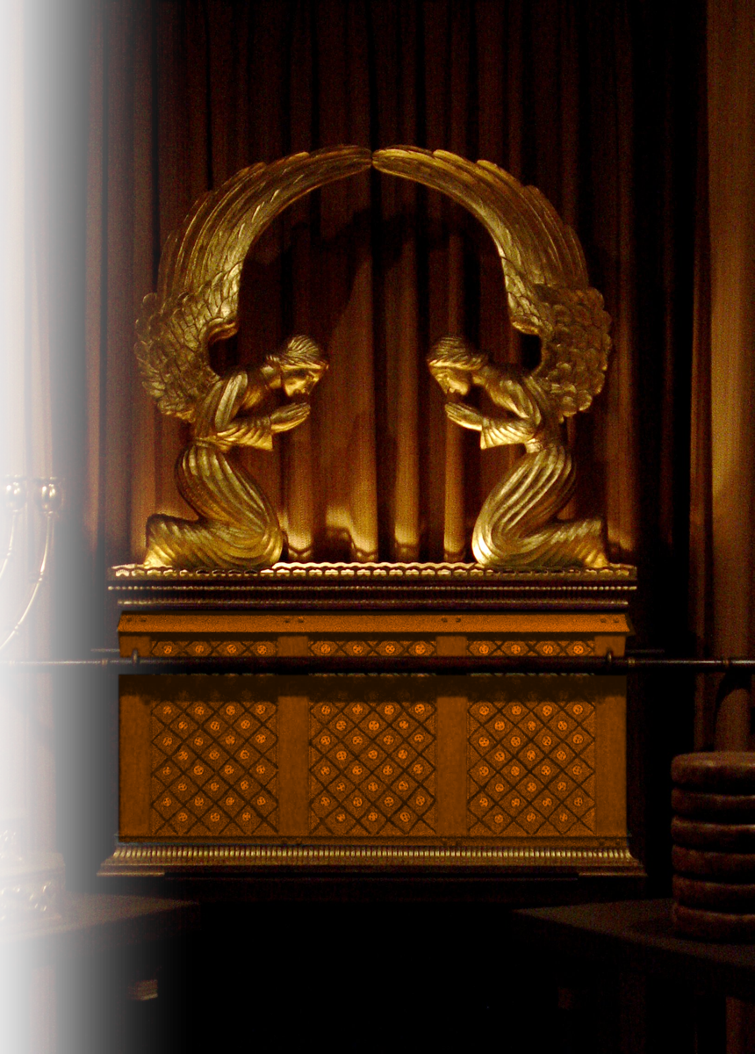
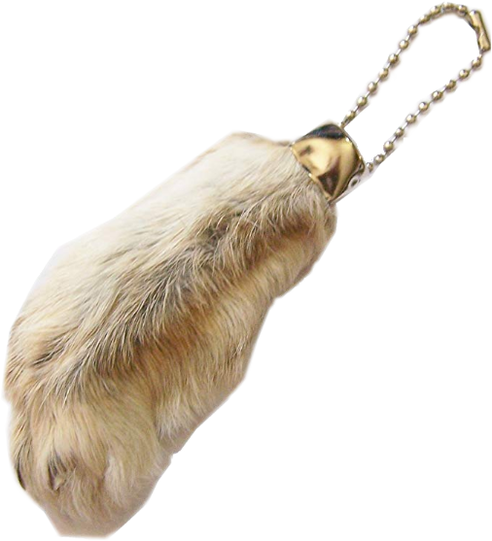
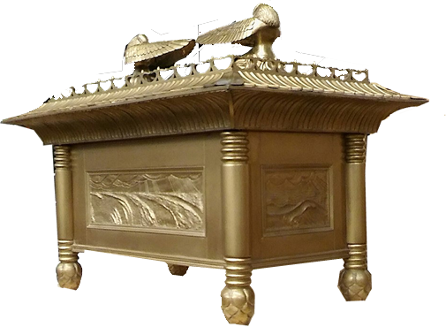
Victory from the Jaws of Defeat 5:1-7:1
The word ark is found
35 times in chap 4-6.
In chapter 4, Israel treated the ark like a rabbit’s foot and lost it in battle.

Slide 4
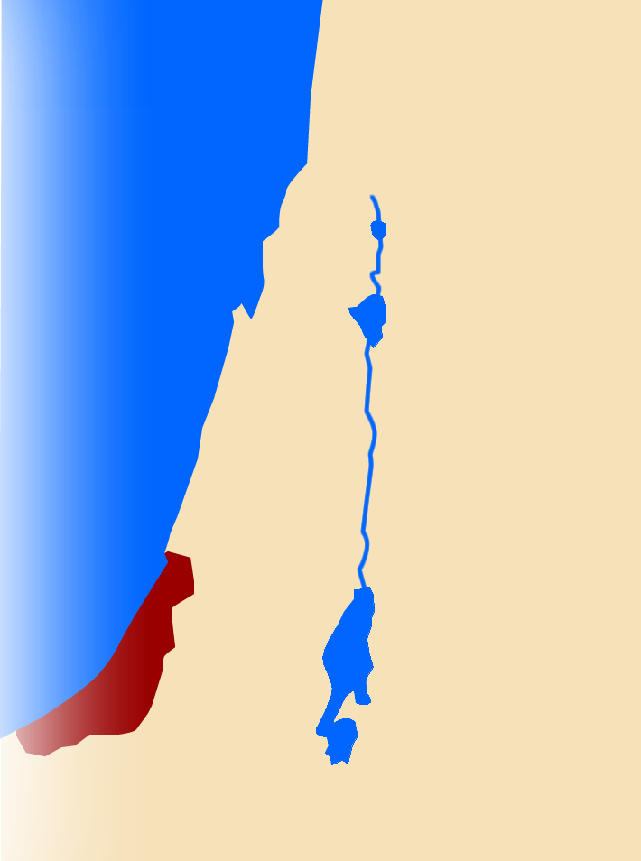
Captured but not Conquered 5:1
^{1 Sam 5:1} When the Philistines captured the ark of God, they brought it from Ebenezer to Ashdod.
Ebenezer
Shiloh
Ashdod
Philistines

Slide 5
Battle of the Gods 5:2-5
^{1 Sam 5:1} When the Philistines captured the ark of God, they brought it from Ebenezer to Ashdod.
Ebenezer
Shiloh
Ashdod
Philistines

Slide 6
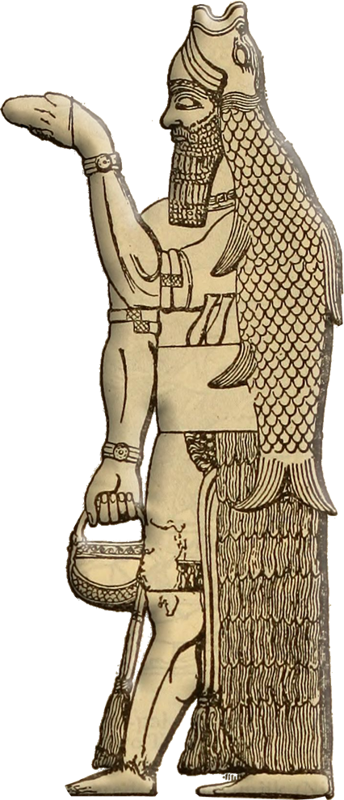
The Face-Off 5:2
² Then they carried the ark into Dagon's temple and set it beside Dagon.

Slide 7
The Smack Down 5:3-4
³ And when the people of Ashdod rose early the next day, behold, Dagon had fallen face downward on the ground before the ark of the LORD.

Slide 8
The Smack Down 5:3-4
So they took Dagon and put him back in his place. ⁴ But when
they rose early
on the next morning, behold, ...

Slide 9
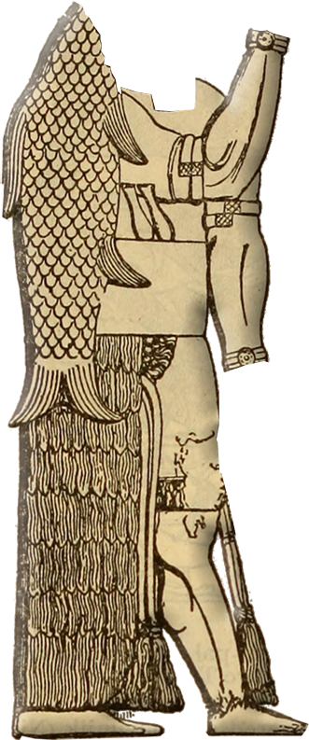
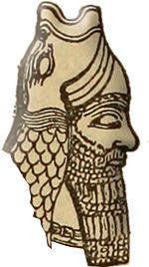


Down and Out 5:4-5
Dagon had fallen face downward on the ground before the ark of the LORD,
and the head of Dagon and both
his hands were lying cut off
on the threshold. Only the trunk
of Dagon was left to him.
Notes:
“Cut into pieces”

Slide 10
Down and Out 5:4-5
⁵ This is why the priests of Dagon and all who enter the house of Dagon do not tread on the threshold of
Dagon in Ashdod to this day.

Slide 11
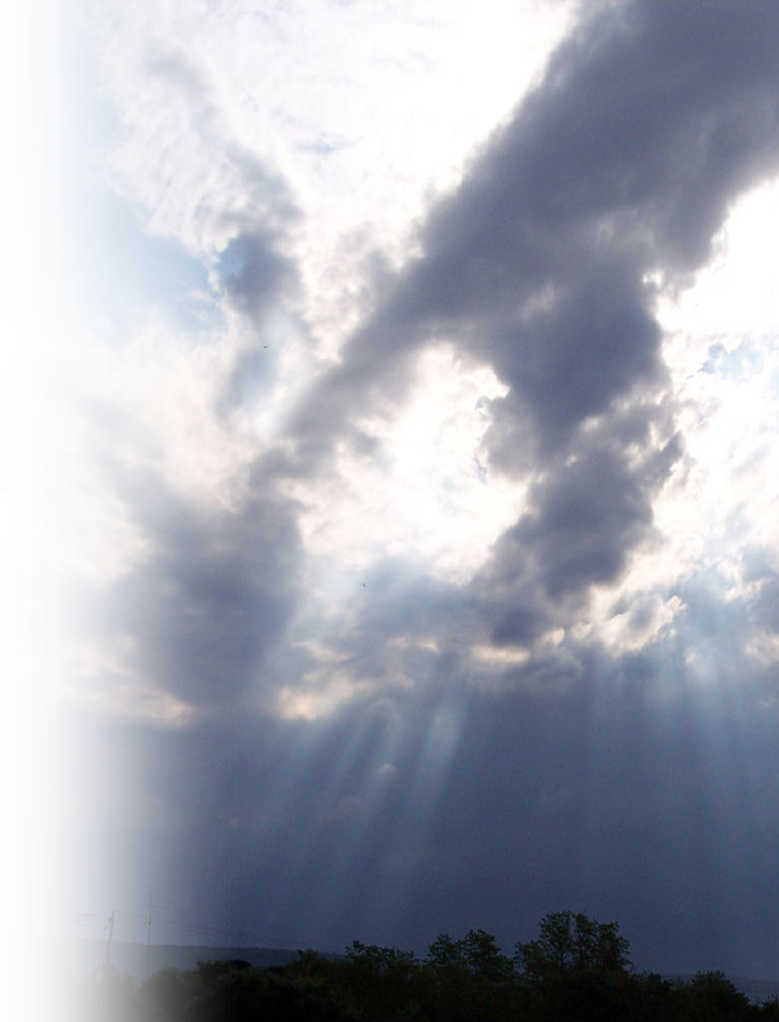
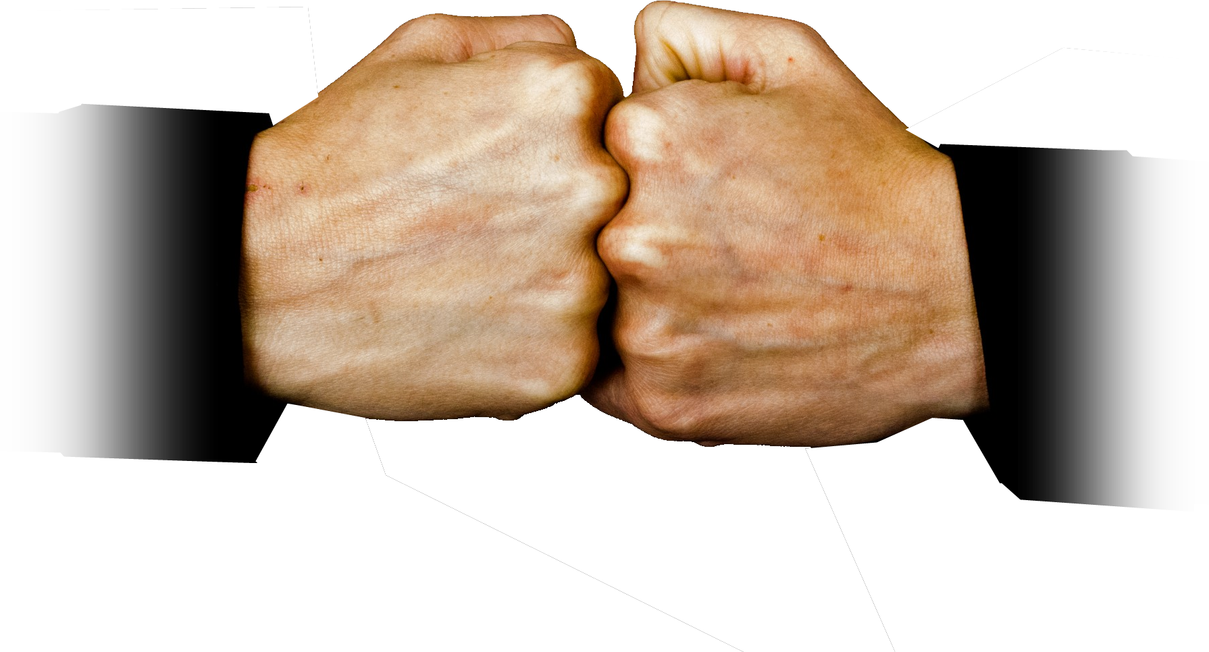
Hand to Hand Combat 5:6-6:9
The “hand of the LORD/God” is referred to 7 times in this passage.
Notes:
https://www.publicdomainpictures.net/en/view-image.php?image=54440&picture=to-beat-two-fists
Reference to the “Hand” of the Lord/God will be 7 times in our passage today. Each time with a negative context.
Heavy Hand of the LORD 5:6
Hard Hand of God 5:7
Oppositional Hand of the LORD 5:8-9
Very Heavy Hand of God 5:10-11-12
Unrelenting Hand of God 6:1-3
Lightened Hand of God 6:4-5
Striking Hand of God 6:6-9

Slide 12
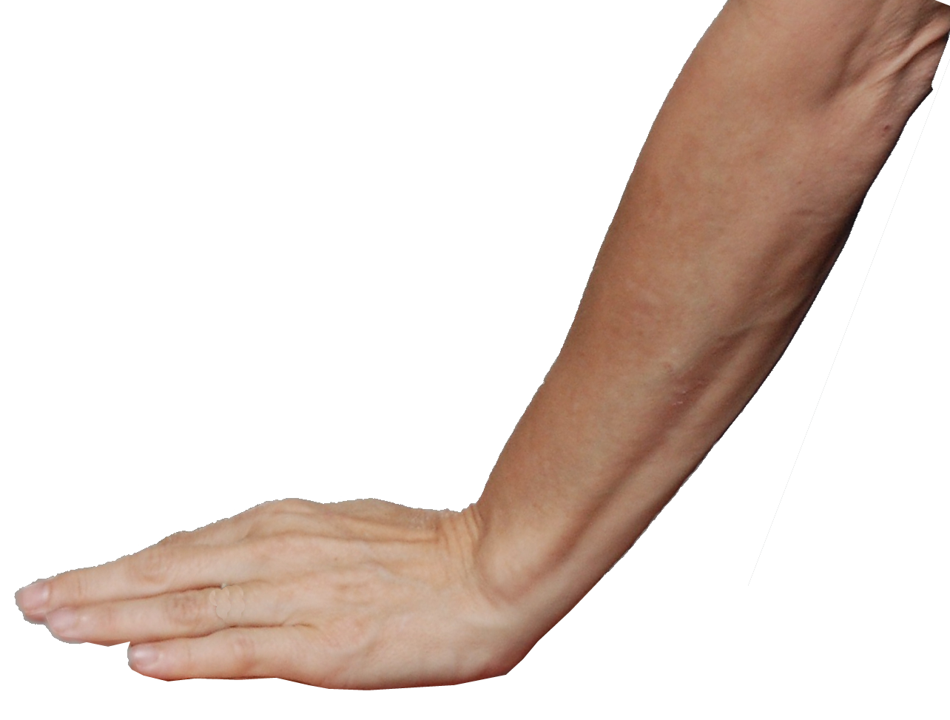
Heavy Hand of the LORD 5:6
⁶ The hand of the LORD was heavy against the people of Ashdod, and he terrified and afflicted them with tumors, both Ashdod and its territory.
Notes:
https://upload.wikimedia.org/wikipedia/commons/e/e2/Push_Hands-close_up.jpg
Heavy Hand of the LORD 5:6
Hard Hand of God 5:7
Oppositional Hand of the LORD 5:8-9
Very Heavy Hand of God 5:10-11-12
Unrelenting Hand of God 6:1-3
Lightened Hand of God 6:4-5
Striking Hand of God 6:6-9

Slide 13
Heavy Hand of the LORD 5:6
⁶ The hand of the LORD was heavy against the people of Ashdod, and he terrified and afflicted them with tumors, both Ashdod and its territory.
KJV = emerods
NASB = hemorrhoids
Notes:
https://upload.wikimedia.org/wikipedia/commons/e/e2/Push_Hands-close_up.jpg
Heard the expression a “pain in the butt?” These tumors were a real pain in the butt!
Heavy Hand of the LORD 5:6
Hard Hand of God 5:7
Oppositional Hand of the LORD 5:8-9
Very Heavy Hand of God 5:10-11-12
Unrelenting Hand of God 6:1-3
Lightened Hand of God 6:4-5
Striking Hand of God 6:6-9

Slide 14
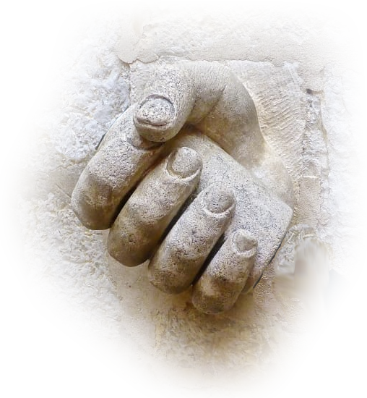
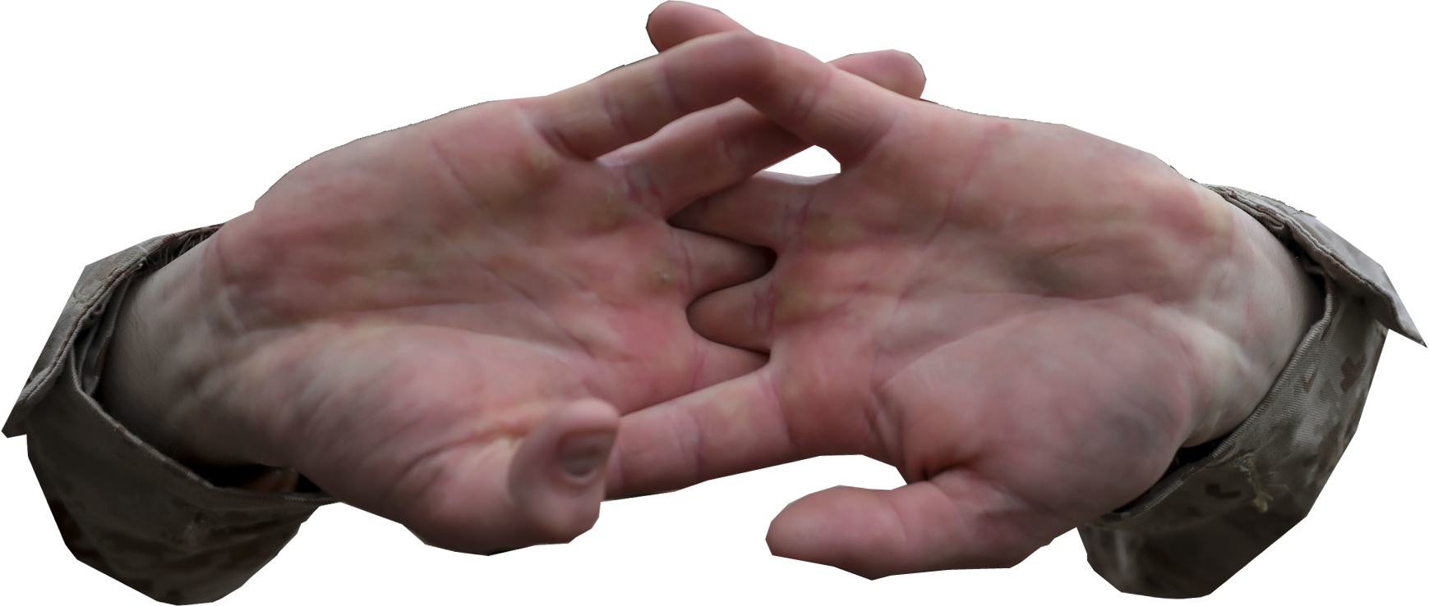
Hard Hand of God 5:7
⁷ And when the men of Ashdod saw how things were, they said, "The ark of the God of Israel must not remain with us, for his hand is hard against us and against Dagon our god."
Notes:
http://www.peakpx.com/618694/beige-concrete-hand-holding-black-metal-pole
Heavy Hand of the LORD 5:6
Hard Hand of God 5:7
Oppositional Hand of the LORD 5:8-9
Very Heavy Hand of God 5:10-11-12
Unrelenting Hand of God 6:1-3
Lightened Hand of God 6:4-5
Striking Hand of God 6:6-9

Slide 15
Oppositional Hand of the LORD 5:8-9
⁸ So they sent and gathered together all the lords of the Philistines and said, "What shall we do with the ark of the God of Israel?" They answered, "Let the ark of the God of Israel be brought around to Gath."
So they brought the ark of the God of Israel there.
Ebenezer
Shiloh
Ashdod
Gath
Notes:
https://upload.wikimedia.org/wikipedia/commons/e/e2/Push_Hands-close_up.jpg
https://upload.wikimedia.org/wikipedia/commons/e/e2/Push_Hands-close_up.jpHeavy Hand of the LORD 5:6
Hard Hand of God 5:7
Oppositional Hand of the LORD 5:8-9
Very Heavy Hand of God 5:10-11-12
Unrelenting Hand of God 6:1-3
Lightened Hand of God 6:4-5
Striking Hand of God 6:6-9

Slide 16
Oppositional Hand of the LORD 5:8-9
⁹ But after they had brought it around, the hand of the LORD was against the city, causing a very great panic, and he afflicted the men of the city, both young and old, so that tumors broke out on them.
Ebenezer
Shiloh
Ashdod
Gath
Notes:
https://upload.wikimedia.org/wikipedia/commons/e/e2/Push_Hands-close_up.jpg
Heavy Hand of the LORD 5:6
Hard Hand of God 5:7
Oppositional Hand of the LORD 5:8-9
Very Heavy Hand of God 5:10-11-12
Unrelenting Hand of God 6:1-3
Lightened Hand of God 6:4-5
Striking Hand of God 6:6-9

Slide 17
Very Heavy Hand of God 5:10-11-12
¹⁰ So they sent the ark of God to Ekron. But as soon as the ark of God came to Ekron, the people
of Ekron cried out,
Ebenezer
Shiloh
Ekron
Ashdod
Gath
Notes:
Heavy Hand of the LORD 5:6
Hard Hand of God 5:7
Oppositional Hand of the LORD 5:8-9
Very Heavy Hand of God 5:10-11-12
Unrelenting Hand of God 6:1-3
Lightened Hand of God 6:4-5
Striking Hand of God 6:6-9

Slide 18
Very Heavy Hand of God 5:10-11-12
¹⁰ So they sent the ark of God to Ekron. But as soon as the ark of God came to Ekron, the people
of Ekron cried out,
"They have brought around
to us the ark of the God of
Israel to kill us and our
people.“
Ebenezer
Shiloh
Ekron
Ashdod
Gath
Notes:
Heavy Hand of the LORD 5:6
Hard Hand of God 5:7
Oppositional Hand of the LORD 5:8-9
Very Heavy Hand of God 5:10-11-12
Unrelenting Hand of God 6:1-3
Lightened Hand of God 6:4-5
Striking Hand of God 6:6-9

Slide 19
Very Heavy Hand of God 5:10-11-12
¹¹ They sent therefore and gathered together all the lords of the Philistines and said,
"Send away the ark of the
God of Israel, and let it
return to its own place,
that it may not kill us
and our people."
Ebenezer
Shiloh
Ekron
Ashdod
Gath
Notes:
Heavy Hand of the LORD 5:6
Hard Hand of God 5:7
Oppositional Hand of the LORD 5:8-9
Very Heavy Hand of God 5:10-11-12
Unrelenting Hand of God 6:1-3
Lightened Hand of God 6:4-5
Striking Hand of God 6:6-9

Slide 20
Very Heavy Hand of God 5:10-11-12
For there was a deathly panic throughout the whole city.
The hand of God was very
heavy there. ¹² The men
who did not die were
struck with tumors, and
the cry of the city went up to heaven.
Ebenezer
Shiloh
Ekron
Ashdod
Gath
Notes:
Being out of God’s will can be a pain in the butt! Literally!
Heavy Hand of the LORD 5:6
Hard Hand of God 5:7
Oppositional Hand of the LORD 5:8-9
Very Heavy Hand of God 5:10-11-12
Unrelenting Hand of God 6:1-3
Lightened Hand of God 6:4-5
Striking Hand of God 6:6-9

Slide 21
Unrelenting Hand of God 6:1-3
^{6:1} The ark of the LORD was in the country of the Philistines seven months. ² And the Philistines called for the priests and the diviners and said,
"What shall we do with the ark of the LORD? Tell us with what we shall send it to its place.“
Notes:
What white flag of surrender do we send with It?
Heavy Hand of the LORD 5:6
Hard Hand of God 5:7
Oppositional Hand of the LORD 5:8-9
Very Heavy Hand of God 5:10-11-12
Unrelenting Hand of God 6:1-3
Lightened Hand of God 6:4-5
Striking Hand of God 6:6-9

Slide 22

Unrelenting Hand of God 6:1-3
³ They said,
"If you send away the ark of the God of Israel, do not send it empty, but by all means return him a guilt offering. Then you will be healed, and it will be known to you why his hand does not turn away from you.“
Notes:
https://www.publicdomainpictures.net/en/view-image.php?image=54440&picture=to-beat-two-fists
Heavy Hand of the LORD 5:6
Hard Hand of God 5:7
Oppositional Hand of the LORD 5:8-9
Very Heavy Hand of God 5:10-11-12
Unrelenting Hand of God 6:1-3
Lightened Hand of God 6:4-5
Striking Hand of God 6:6-9

Slide 23
Lightened Hand of God 6:4-5
⁴ And they said,
"What is the guilt offering that
we shall return to him?"
Notes:
https://pixabay.com/fr/photos/main-palm-lumi%C3%A8re-main-dans-la-main-1044883/
Heavy Hand of the LORD 5:6
Hard Hand of God 5:7
Oppositional Hand of the LORD 5:8-9
Very Heavy Hand of God 5:10-11-12
Unrelenting Hand of God 6:1-3
Lightened Hand of God 6:4-5
Striking Hand of God 6:6-9

Slide 24
Lightened Hand of God 6:4-5
⁴ And they said,
"What is the guilt offering that
we shall return to him?"
They answered,
"Five golden tumors and five golden mice, according to the number of the lords of the Philistines, for the same plague was on all of you and on your lords.
Notes:
https://pixabay.com/fr/photos/main-palm-lumi%C3%A8re-main-dans-la-main-1044883/
Heavy Hand of the LORD 5:6
Hard Hand of God 5:7
Oppositional Hand of the LORD 5:8-9
Very Heavy Hand of God 5:10-11-12
Unrelenting Hand of God 6:1-3
Lightened Hand of God 6:4-5
Striking Hand of God 6:6-9

Slide 25
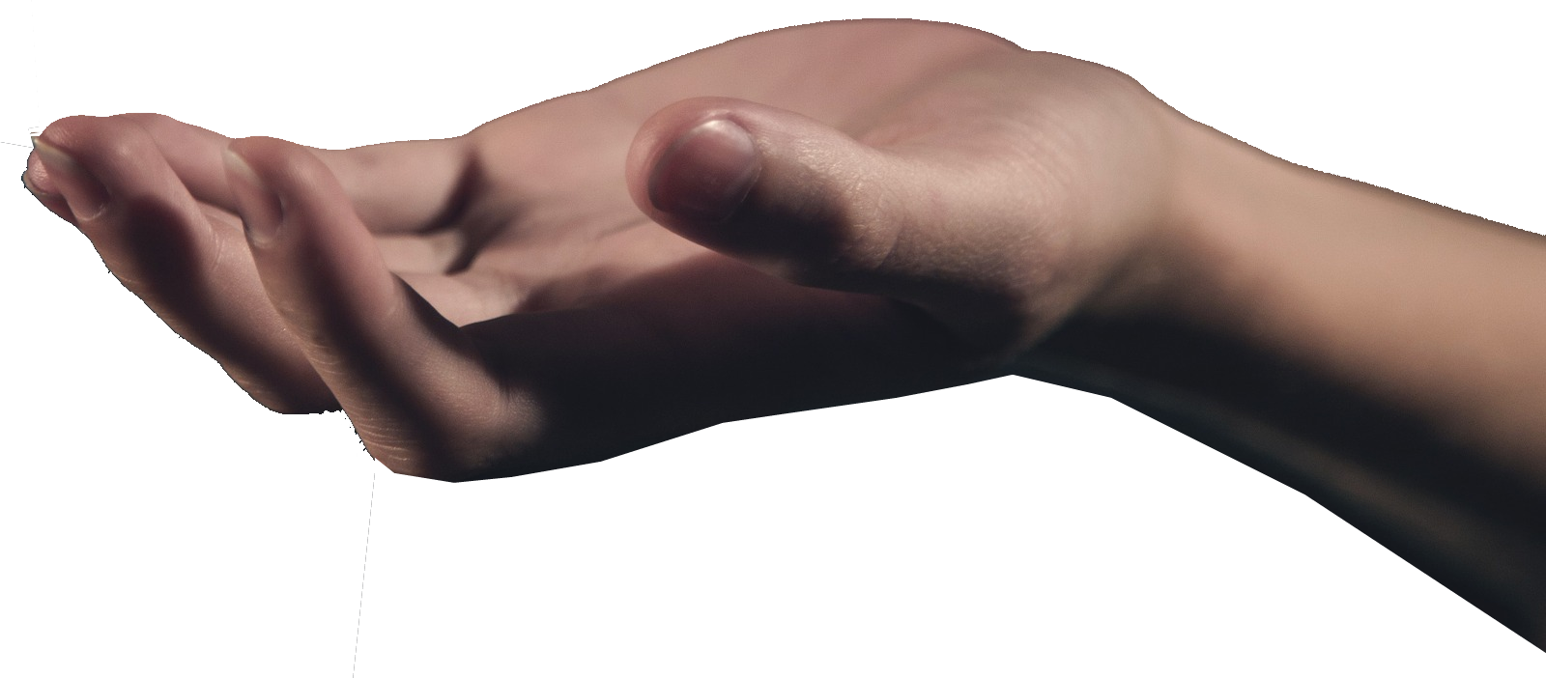
Lightened Hand of God 6:4-5
⁵ So you must make images of your tumors and images of your mice that ravage the land, and give glory to the God of Israel. Perhaps he will lighten his hand from off you and your gods and your land.
Ezra & Nehemiah
“Gracious Hand”
Notes:
https://pixabay.com/fr/photos/main-palm-lumi%C3%A8re-main-dans-la-main-1044883/
Heavy Hand of the LORD 5:6
Hard Hand of God 5:7
Oppositional Hand of the LORD 5:8-9
Very Heavy Hand of God 5:10-11-12
Unrelenting Hand of God 6:1-3
Lightened Hand of God 6:4-5
Striking Hand of God 6:6-9

Slide 26
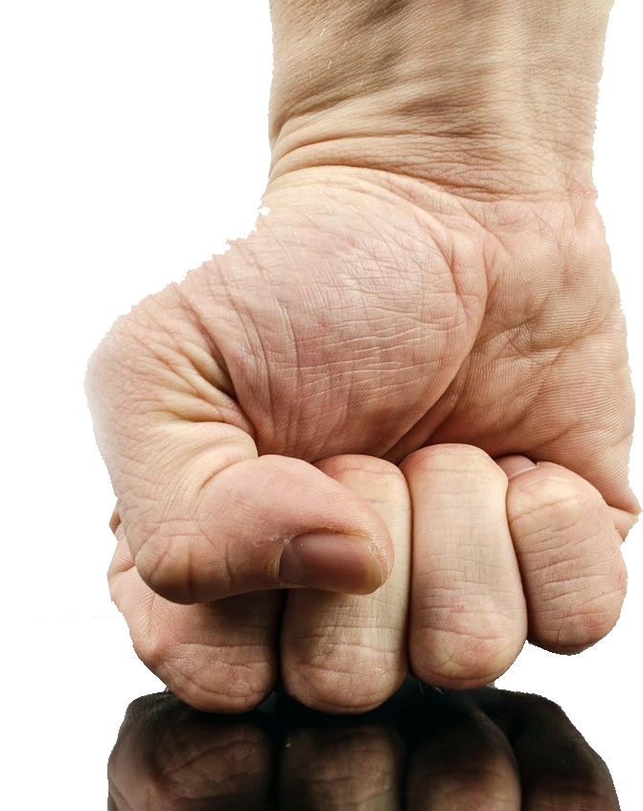
Striking Hand of God 6:6-9
⁶ Why should you harden your hearts as the Egyptians and Pharaoh hardened their hearts? After he had dealt severely with them, did they not send the people away, and they departed?
Notes:
https://pixabay.com/fr/photos/punch-poing-main-la-force-isol%C3%A9-316605/
Heavy Hand of the LORD 5:6
Hard Hand of God 5:7
Oppositional Hand of the LORD 5:8-9
Very Heavy Hand of God 5:10-11-12
Unrelenting Hand of God 6:1-3
Lightened Hand of God 6:4-5
Striking Hand of God 6:6-9

Slide 27
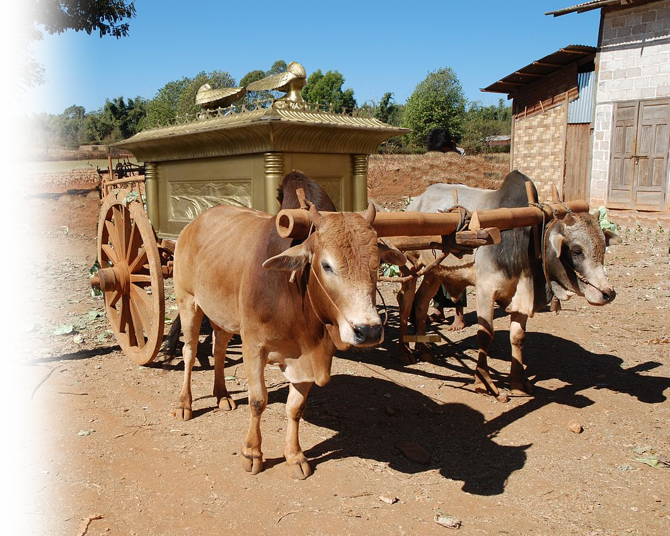
Striking Hand of God 6:6-9
⁷ Now then, take and prepare a new cart and two milk cows on which there has never come a yoke, and yoke the cows to the cart, but take their calves home, away from them.
Notes:
https://pixabay.com/fr/photos/punch-poing-main-la-force-isol%C3%A9-316605/
Heavy Hand of the LORD 5:6
Hard Hand of God 5:7
Oppositional Hand of the LORD 5:8-9
Very Heavy Hand of God 5:10-11-12
Unrelenting Hand of God 6:1-3
Lightened Hand of God 6:4-5
Striking Hand of God 6:6-9

Slide 28
Striking Hand of God 6:6-9
⁸ And take the ark of the LORD and place it on the cart and put in a box at its side the figures of gold, which you are returning to him as a guilt offering. Then send it off and let it go its way
Notes:
https://pixabay.com/fr/photos/punch-poing-main-la-force-isol%C3%A9-316605/
Heavy Hand of the LORD 5:6
Hard Hand of God 5:7
Oppositional Hand of the LORD 5:8-9
Very Heavy Hand of God 5:10-11-12
Unrelenting Hand of God 6:1-3
Lightened Hand of God 6:4-5
Striking Hand of God 6:6-9

Slide 29
Striking Hand of God 6:6-9
⁹ and watch. If it goes up on the way to its own land, to Beth-shemesh, then it is he who has done us this great harm, but if not, then we shall know that it is not his hand that struck us; it happened to us by coincidence."
Notes:
https://pixabay.com/fr/photos/punch-poing-main-la-force-isol%C3%A9-316605/
Heavy Hand of the LORD 5:6
Hard Hand of God 5:7
Oppositional Hand of the LORD 5:8-9
Very Heavy Hand of God 5:10-11-12
Unrelenting Hand of God 6:1-3
Lightened Hand of God 6:4-5
Striking Hand of God 6:6-9

Slide 30
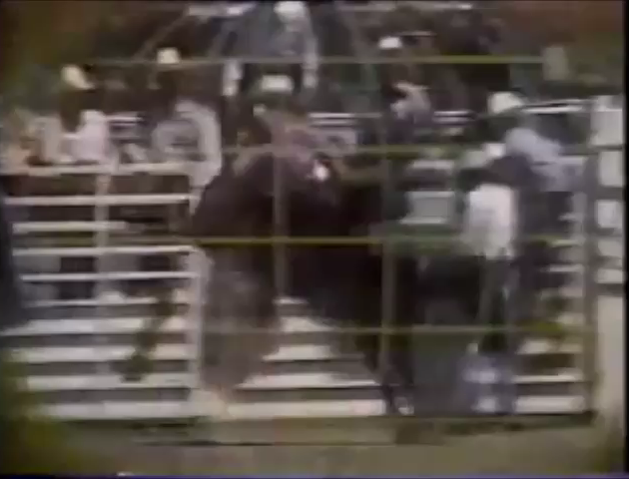
Thrill of Victory—Agony of Defeat

Slide 31
Thrill of Victory—6:10-18
¹⁰ The men did so, .... ¹² And the cows went straight in the direction of Beth-shemesh along one highway, lowing as they went. They turned neither
to the right nor to the left, and
the lords of the Philistines went
after them as far as the border
of Beth-shemesh.
Ebenezer
Shiloh
Ekron
Beth-
shemesh
Ashdod
Gath

Slide 32
Thrill of Victory—6:10-18
¹⁰ The men did so, .... ¹² And the cows went straight in the direction of Beth-shemesh along one highway, lowing as they went. They turned neither
to the right nor to the left, and
the lords of the Philistines went
after them as far as the border
of Beth-shemesh.
Ebenezer
Shiloh
Ekron
Beth-
shemesh
Ashdod
Gath

Slide 33
Thrill of Victory—6:10-18
¹³ Now the people of Beth-shemesh ... when they lifted up their eyes and saw the ark, they rejoiced to see it. ¹⁴ The cart came into the field of Joshua of Beth-shemesh and stopped there.
Notes:
https://upload.wikimedia.org/wikipedia/commons/thumb/a/a1/Ox-drawn_cart_Burma_3.jpg/1280px-Ox-drawn_cart_Burma_3.jpg

Slide 34
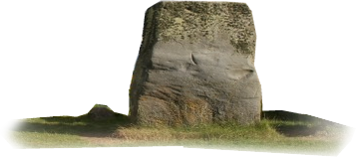
Thrill of Victory—6:10-18
¹⁴ ... A great stone was there. And they split up the wood of the cart and offered the cows as a burnt offering to the LORD.

Slide 35
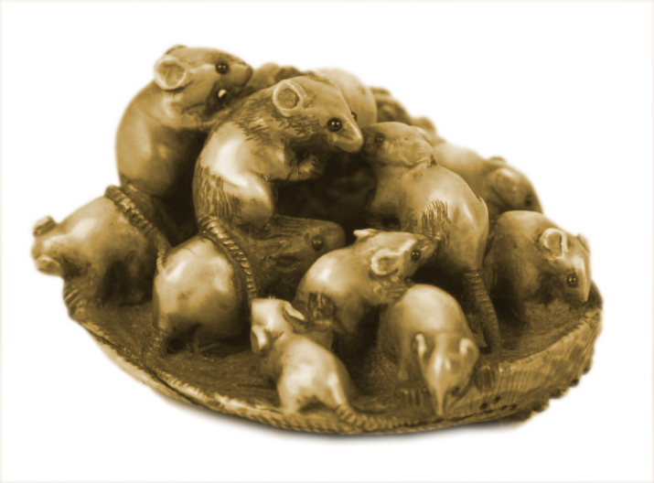
Thrill of Victory—6:10-18
¹⁵ And the Levites took down the ark of the
LORD and the box that was beside it, in
which were the golden figures, and
set them upon the great stone.
And the men of Beth-shemesh
offered burnt offerings
and sacrificed sacrifices on
that day to the LORD. ¹⁶ And
when the five lords of the
Philistines saw it, they
returned that day to Ekron.
Notes:
https://commons.wikimedia.org/wiki/File:Ark_of_covenant_replica.jpg
https://c.pxhere.com/photos/d9/f0/stonehenge_england_britain_monument_stone_uk_prehistoric_great-1201052.jpg!d
https://picryl.com/media/netsuke-of-a-group-of-rats-nestled-in-an-abalone-shell-1de09c?zoom=true

Slide 36
Thrill of Victory—6:10-18
¹⁷ These are the golden tumors that the Philistines returned as a guilt offering to the LORD .... ¹⁸ and the golden
mice, .... The great stone
beside which they set
down the ark of the LORD
is a witness to this day in
the field of Joshua of
Beth-shemesh.
Notes:
https://picryl.com/media/netsuke-of-a-group-of-rats-nestled-in-an-abalone-shell-1de09c?zoom=true

Slide 37
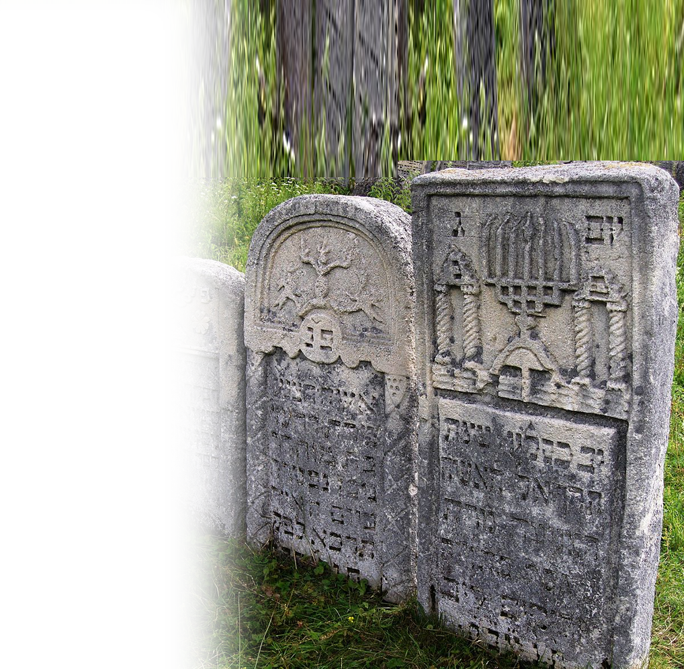
Agony of Defeat 6:19-21
¹⁹ And he struck some of the men of Beth-shemesh, because they looked upon the ark of the LORD. He struck seventy men of them, and the people mourned because the LORD had struck the people with a great blow.

Slide 38
Agony of Defeat 6:19-21
²⁰ Then the men of Beth-shemesh said,
"Who is able to stand before the LORD, this holy God? And to whom shall he go up away from us?"
Ebenezer
Shiloh
Ashdod
Beth-shemesh
Gath
Philistines

Slide 39
Agony of Defeat 6:19-21
²¹ So they sent messengers to the inhabitants of Kiriath-jearim, saying,
"The Philistines have returned the ark of the LORD. Come down and take it up to you."
Ebenezer
Shiloh
Kiriath-jearim
Ashdod
Beth-shemesh
Gath
Philistines

Slide 40
Agony of Defeat 6:19-21
1Samuel 7:1 And the men of Kiriath-jearim came and took up the ark of the LORD and brought it to the house of Abinadab on the hill. And they consecrated his son Eleazar to have charge of the ark of the LORD.
Ebenezer
Shiloh
Ekron
Kiriath-jearim
Kiriath-jearim
Ashdod
Beth-shemesh
Gath
Notes:
Not quite back to Shiloh. Kinda like “not quite in tune with God.” A little further to go.

Slide 41
Is your life the
“thrill of victory?”
or
“the agony of defeat?”

Slide 42
The Thrill of Victory comes ...
To those who know Him and serve Him.
When you stop thinking you can fool with Him.
Even when you think the foe is winning—he’s not!
God’s hand is surely against those who are against His people.
God’s good hand is upon those who are His people and who serve Him.

Slide 43
Let’s Pray
Notes:
https://watermark.lovepik.com/photo/50083/4881.jpg_wh1200.jpg

