Slide 1
Lesson 5
This series uses “Hemi Head Rg” Font
You can get the font FREE at: https://www.dafont.com/hemi-head.font
Or https://fontsfree.net/hemi-head-rg-bold-italic-font-download.html
Or https://www.1001fonts.com/hemi-head-426-font.html
Notes:
Copyright © 2006−2021. All rights reserved. Bible Point is a registered trademark of Dennis Henderson. All other trademarks acknowledged.
Bible Point contains graphics from Bible Point artists. These illustrations belong to Bible Point and the respective artists. You may use the designs and illustrations for graphical illustration of lessons free and without special permission, provided they are not used in any way that maligns the Christian faith. Furthermore, republication or production of any illustration by any other graphic service whether it be in book, in a machine-readable form, or in any other design resource is strictly prohibited. Furthermore, they cannot be duplicated or resold as any other form of publishing, clip art, or graphic resource.
So What does it mean? (A simple translations of the legal jargon)
So, if you don’t own the presentation(s), graphic(s), and text(s) how can you legally use them? The purchase of the license allows you to use all the images in the product. However, the actual ownership and copyright of the presentation(s), graphic(s), and text(s) remain the property of Bible Point and its licensors. If you had plans on using this product in your “for sale” work—think again!
License Agreement
Article 1: License Grant
All the graphics and text in Bible Point presentations (excluding quotes from the Bible and stated sources) are the intellectual and real property of Bible Point and its licensors, and is protected by law, including United States copyright laws and international treaties. Bible Point grants to you a license:
1. To use the presentation in a single church, single school, or single office of a Christian organization.
2. To make a single archival back-up copy of the program.
3. To modify the presentation(s) and merge with other presentations in a single church, school, or Christian organization.
4. To transfer to another party if that party agrees to accept the terms and conditions of this agreement, and you do not retain any copies of the presentation, whether printed, machine readable, modified, or merged form.
Article 2: Terms
This license is effective until terminated. You may terminate the license at any time by destroying the presentation(s), graphic(s), or text(s) together with all copies, modifications and merged portions in any form. Bible Point may terminate your license if you fail to comply with this Agreement. You agree, upon such termination, for any reason, to destroy the presentation(s), graphics, and text(s) with all copies, modifications, and merged portions in any form.
Article 3: Disclaimers
1. Bible Point presentations, graphics, and texts are licensed to you As Is. You, the consumer, bear the entire risk relating to the quality and performance of the presentation(s), graphic(s), or text(s). In no event will Bible Point be liable for damages resulting from any defect.
2. Thirty-day limited warrantee on disks. Bible Point warrants the disks to be free of defects in material and workmanship under normal use for 30 days after purchase. During the 30-day period you may return a defective presentation, graphic, or text with proof of purchase and it will be replaced without charge, unless the presentation is damaged by misuse.
Article 4: General
1. You may not sub-license, assign, or transfer the license of the presentation(s), graphic(s), or text(s) except as provided by this Agreement.
2. This Agreement will be governed by the laws of the State of Michigan.
So What does it mean? (A simple translations of the legal jargon)
May I let someone borrow or copy my licensed Bible Point presentation (even after I modified it)? As long as it is within your local church, or single school, or the immediate office of a Christian organization you may. Otherwise, please refer the person interested in borrowing to: http://www.biblepoint.com or E-mail: dennis@DrDH.net with any related questions.

Slide 2


Finding Victory
Notes:
https://watermark.lovepik.com/photo/50083/4881.jpg_wh1200.jpg

Slide 3
Victory is found in Correct Theology
Theology = “Study of God”
What you believe about
God matters!
Five kinds of theology emerge…
Notes:
What you believe matters …

Slide 4
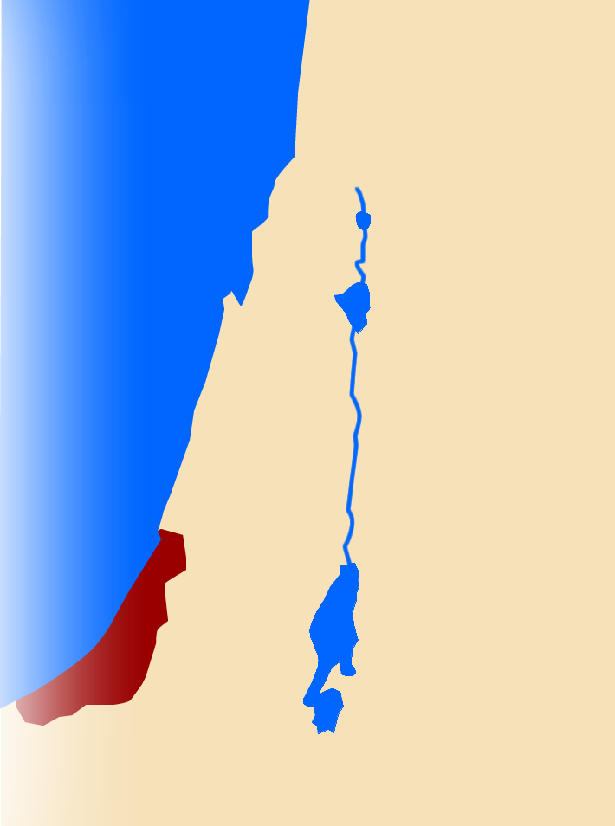
1. Rabbit Foot Theology 4:2-3
¹ And the word of Samuel came to all Israel. Now Israel went out to battle against the Philistines. They encamped at Ebenezer, and the Philistines encamped at Aphek.
Shiloh
Philistines

Slide 5
1. Rabbit Foot Theology 4:2-3
¹ And the word of Samuel came to all Israel. Now Israel went out to battle against the Philistines. They encamped at Ebenezer, and the Philistines encamped at Aphek.
Shiloh
Ebenezer
Philistines

Slide 6
1. Rabbit Foot Theology 4:2-3
¹ And the word of Samuel came to all Israel. Now Israel went out to battle against the Philistines. They encamped at Ebenezer, and the Philistines encamped at Aphek.
Aphek
Shiloh
Ebenezer
Philistines

Slide 7
1. Rabbit Foot Theology 4:2-3
² The Philistines drew up in line against Israel, and when the battle spread, Israel was defeated by the Philistines, who killed about four thousand men on the field of battle.
Aphek
Shiloh
Ebenezer
Philistines

Slide 8
1. Rabbit Foot Theology 4:2-3
³ And when the troops came to the camp, the elders of Israel said, "Why has the LORD defeated us today before the Philistines?
Aphek
Shiloh
Ebenezer
Philistines
Notes:
There may be some blame shifting going on here.

Slide 9
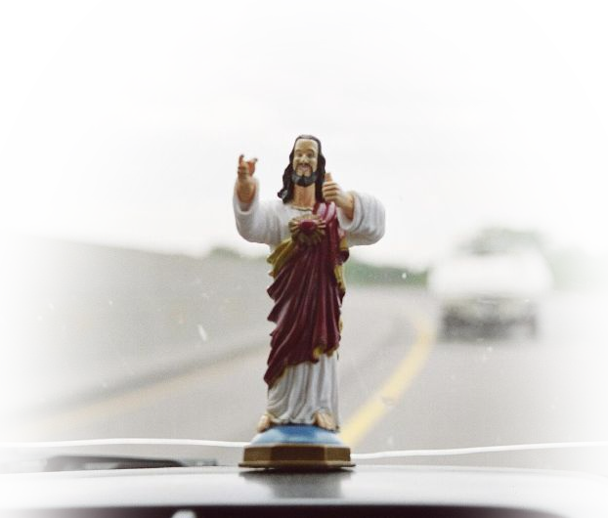
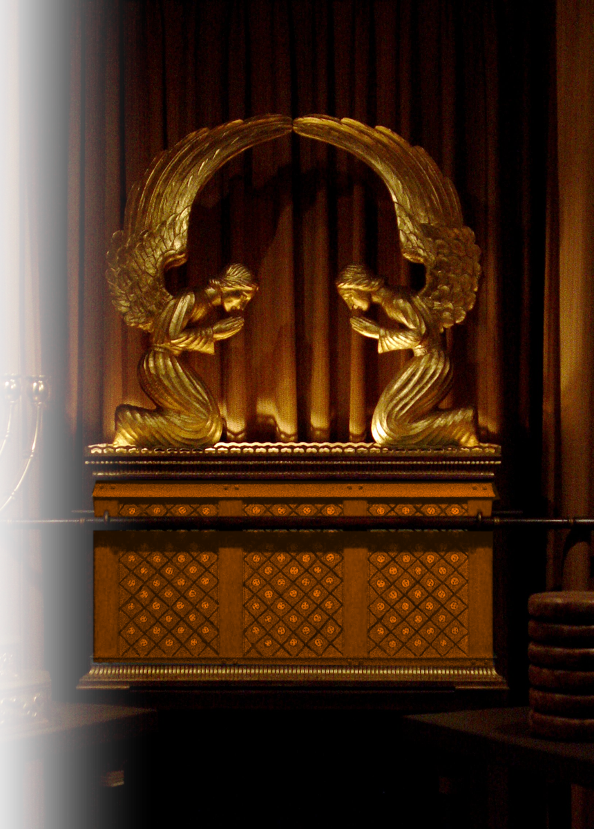
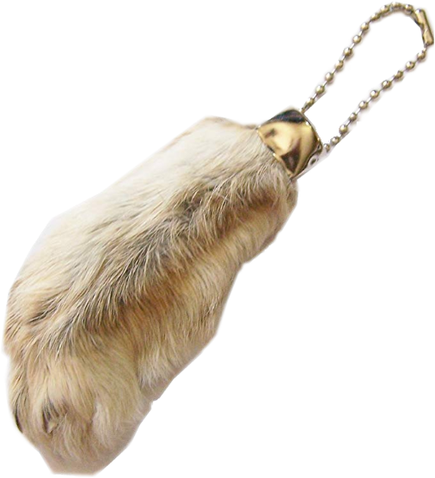
1. Rabbit Foot Theology 4:2-3
Let us bring the ark of the covenant of the LORD here from Shiloh, that it may come among us and save us from the power of our enemies."
Notes:
There may be some blame shifting going on here.

Slide 10
2. Biblical Theology 4:4-9

Slide 11
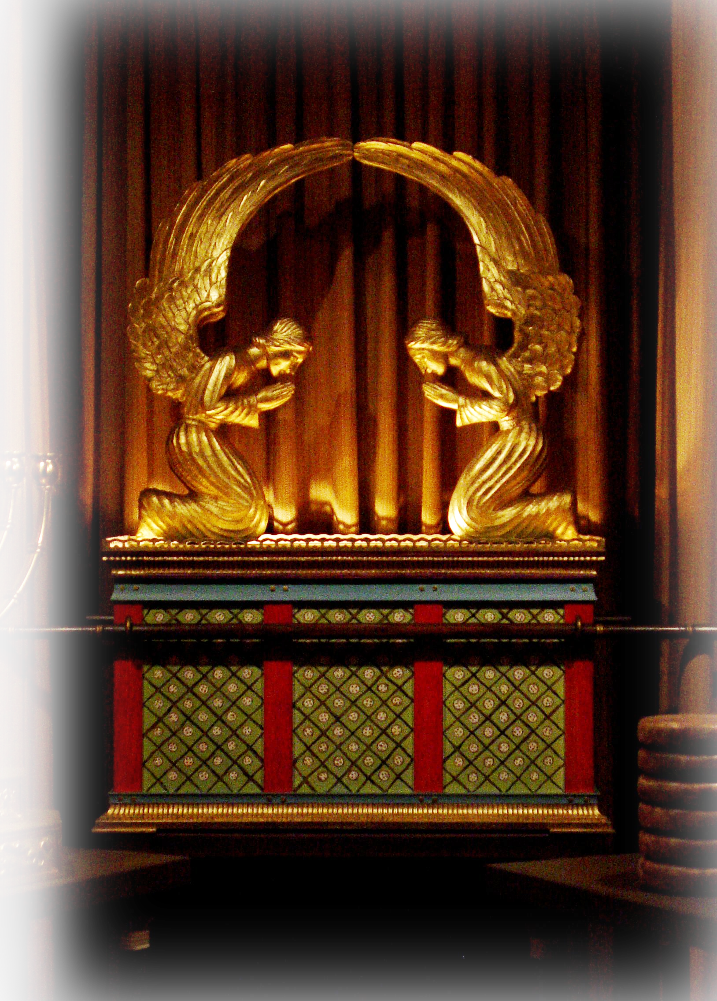
2. Biblical Theology 4:4-9
The Ark is a Throne 4
⁴ So the people sent to Shiloh and brought from there the ark of the covenant of the LORD of hosts, who is enthroned on the cherubim. And the two sons of Eli, Hophni and Phinehas, were there with the ark of the covenant of God.

Slide 12
2. Biblical Theology 4:4-9
The Lord of Armies’ Throne 4
⁴ So the people sent to Shiloh and brought from there the ark of the covenant of the LORD of hosts, who is enthroned on the cherubim. And the two sons of Eli, Hophni and Phinehas, were there with the ark of the covenant of God.

Slide 13
2. Biblical Theology 4:4-9
The God of Creation’s Throne 4
⁴ So the people sent to Shiloh and brought from there the ark of the covenant of the LORD of hosts, who is enthroned on the cherubim. And the two sons of Eli, Hophni and Phinehas, were there with the ark of the covenant of God.

Slide 14
2. Biblical Theology 4:4-9
The Celebrated Throne 5-7
⁵ As soon as the ark of the covenant of the LORD came into the camp, all Israel gave a mighty shout, so that the earth resounded.
WHY?

Slide 15
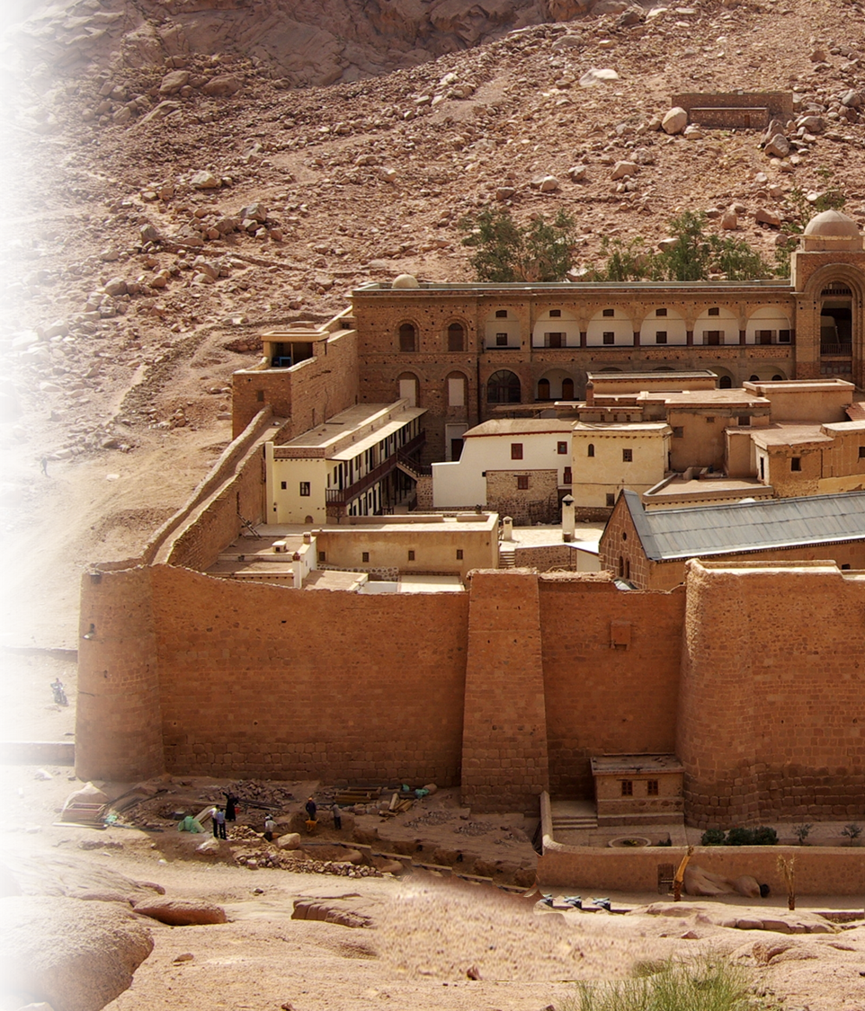
Past Experience
^{Joshya 6:1} Now Jericho was tightly shut up because of the Israelites. No one went out and no one came in. ² Then the LORD said to Joshua, "See, I have delivered Jericho into your hands, along with its king and its fighting men.
Notes:
https://upload.wikimedia.org/wikipedia/commons/6/6b/Katharinenkloster_Sinai_BW_2.jpg
This is what you are going to do with you life Joshua—Take Jericho my way. Here’ my strategy

Slide 16
Past Experience
³ March around the city once with all the armed men. Do this for six days. ⁴ Have seven priests carry trumpets of rams' horns in front of the ark. On the seventh day, march around the city seven times, with the priests blowing the trumpets.

Slide 17
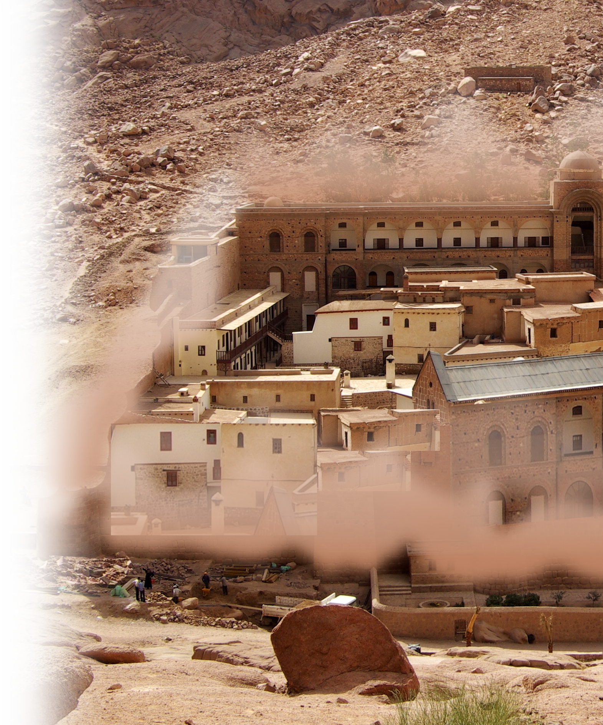
Past Experience
⁵ When you hear them sound a long blast on the trumpets, have all the people give a loud shout; then the wall of the city will collapse and the people will go up, every man straight in."
Notes:
That is one bizarre strategy...
Kind of like preaching the gospel --- it is foolishness to those who do not believe, but to us who do believe, it is the power of God to salvation.
Kind of like prayer – foolishness to those who do not believe.
Kind of like tithing – foolishness to those who do not believe.

Slide 18
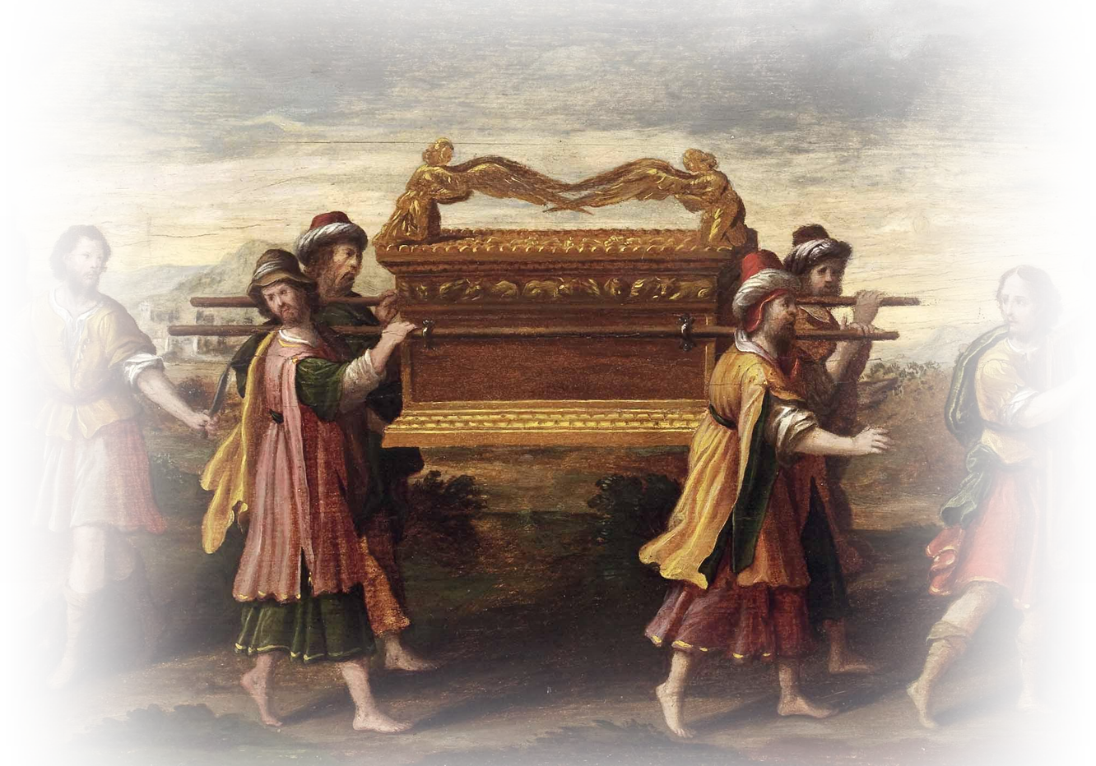
Past Experience
⁶ So Joshua son of Nun called the priests and said to them, "Take up the ark of the covenant of the LORD and have seven priests carry trumpets in front of it."
Notes:
Normally you would build battering rams, seize towers, catapults, and other machines of war to breach the walls of a city.
Don’t lean on your understanding—Lean on His—Put God in the lead.

Slide 19
2. Biblical Theology 4:4-9
The Celebrated Throne 5-7
⁵ As soon as the ark of the covenant of the LORD came into the camp, all Israel gave a mighty shout, so that the earth resounded.
THAT’S WHY!

Slide 20
3. Pagan-Spun Theology 4:6-7

Slide 21
3. Pagan-Spun Theology 4:5-7
?
Questionable Theology 6-7
⁶ And when the Philistines heard the noise of the shouting, they said,
"What does this great shouting in the camp of the Hebrews mean?"

Slide 22
3. Pagan-Spun Theology 4:5-9
Just another “god” 6-7
And when they learned that the ark of the LORD had come to the camp, ⁷ the Philistines were afraid, for they said,
"A god has come into the camp."

Slide 23
3. Pagan-Spun Theology 4:5-9
Among the mighty “gods” 7-8
And they said, "Woe to us! For nothing like this has happened before. ⁸ Woe to us! Who can deliver us from the power of these mighty gods?

Slide 24
3. Pagan-Spun Theology 4:5-9
Distorted Theology 8-9
These are the gods who struck the Egyptians with every sort of plague in the wilderness.

Slide 25
3. Pagan-Spun Theology 4:5-9
Fight these gods 8-9
⁹ Take courage, and be men,
O Philistines, lest you become slaves to the Hebrews as they have been to you; be men and fight."

Slide 26
4. Disastrous Theology 10-11

Slide 27
4. Disastrous Theology 10-11
¹⁰ So the Philistines fought, and Israel was defeated, and they fled, every man to his home. And there was a very great slaughter, for there fell of Israel thirty thousand foot soldiers. ¹¹ And the ark of God was captured, and the two sons of Eli, Hophni and Phinehas, died.

Slide 28
4. Disastrous Theology 10-11
¹⁰ So the Philistines fought, and Israel was defeated, and they fled, every man to his home. And there was a very great slaughter, for there fell of Israel thirty thousand foot soldiers. ¹¹ And the ark of God was captured, and the two sons of Eli, Hophni and Phinehas, died.
WHY?
Notes:
WHY? Rabbit Foot Theology. Trusted in the gold covered box—not God!
Like trusting in baptism, communion, church membership, good works, church attendance, good works ,tithing, etc. NOT JESUS CHRIST!
In Joshua’s day, God commanded them to do it. Here God never commanded them. They gave hocus-pocus power to the box—didn’t trust God, trusted the box as a magical fix.

Slide 29
5. Consequential Theology 12-21

Slide 30
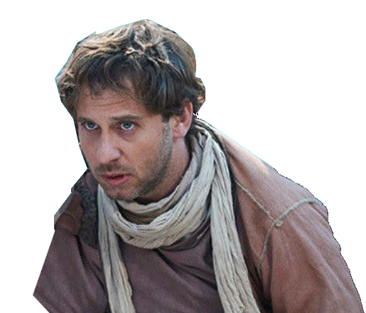
5. Consequential Theology 12-21
To Eli 12-18
¹² A man of Benjamin ran from the battle line and came to Shiloh the same day, with his clothes torn and with dirt on his head.

Slide 31
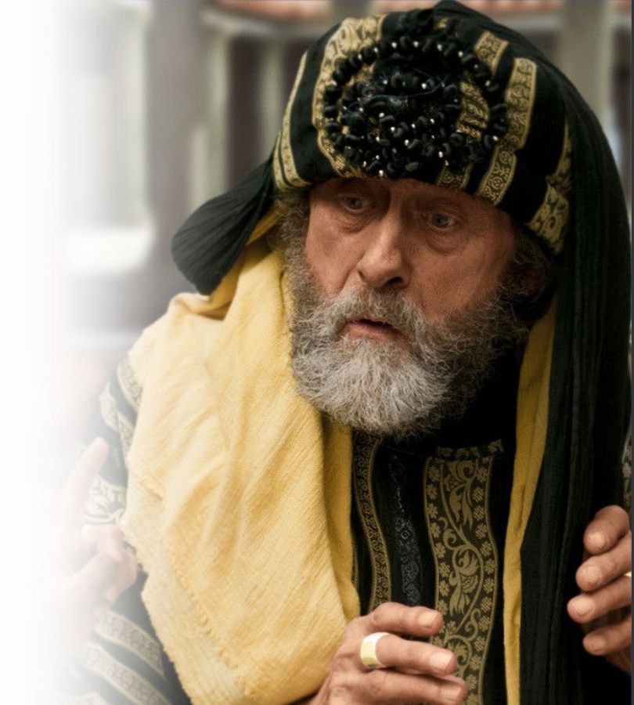
5. Consequential Theology 12-21
¹³ When he arrived, Eli was sitting on his seat by the road watching, for his heart trembled for the ark of God. And when the man came into the city and told the news, all the city cried out.

Slide 32
5. Consequential Theology 12-21
¹⁴ When Eli heard the sound of the outcry, he said,
"What is this uproar?" Then the man hurried and came and told Eli.
¹⁵ Now Eli was ninety-eight years old and his eyes were set so that he could not see.

Slide 33
5. Consequential Theology 12-21
¹⁶ And the man said to Eli,
"I am he who has
come from the
battle; I fled from
the battle today."
And he said,
"How did it go, my son?"

Slide 34
5. Consequential Theology 12-21
¹⁷ He who brought the news answered and said,
"Israel has fled before the Philistines, and there has also been a great defeat among the people. Your two sons also, Hophni and Phinehas, are dead, and the ark of God has been captured."

Slide 35
5. Consequential Theology 12-21
¹⁷ He who brought the news answered and said,
"Israel has fled before the Philistines, and there has also been a great defeat among the people. Your two sons also, Hophni and Phinehas, are dead, and the ark of God has been captured."

Slide 36
5. Consequential Theology 12-21
¹⁷ He who brought the news answered and said,
"Israel has fled before the Philistines, and there has also been a great defeat among the people. Your two sons also, Hophni and Phinehas, are dead, and the ark of God has been captured."

Slide 37
5. Consequential Theology 12-21
¹⁸ As soon as he mentioned the ark of God, Eli fell over backward from his seat by the side of the gate, and his neck was broken and he died, for the man was old and heavy. He had judged Israel forty years.

Slide 38
5. Consequential Theology 12-21
¹⁸ As soon as he mentioned the ark of God, Eli fell over backward from his seat by the side of the gate, and his neck was broken and he died, for the man was old and heavy. He had judged Israel forty years.

Slide 39

5. Consequential Theology 12-21
To pregnant daughter-in-law 19-21
¹⁹ Now his daughter-in-law, the wife of Phinehas, was pregnant, about to give birth. And when she heard the news
that the ark of God was captured,
and that her father-in-law and
her husband were dead, she
bowed and gave birth, for
her pains came upon her.
Notes:
When you surrender the “Glory of God” from the Word of God for Rabbit Foot Theology—the glory departs from that place, nation, or church.

Slide 40
5. Consequential Theology 12-21
To pregnant daughter-in-law 19-21
²⁰ And about the time of her death the women attending her said to her,
"Do not be afraid, for you have
borne a son."
But she did not answer or pay attention.
Notes:
When you surrender the “Glory of God” from the Word of God for Rabbit Foot Theology—the glory departs from that place, nation, or church.

Slide 41
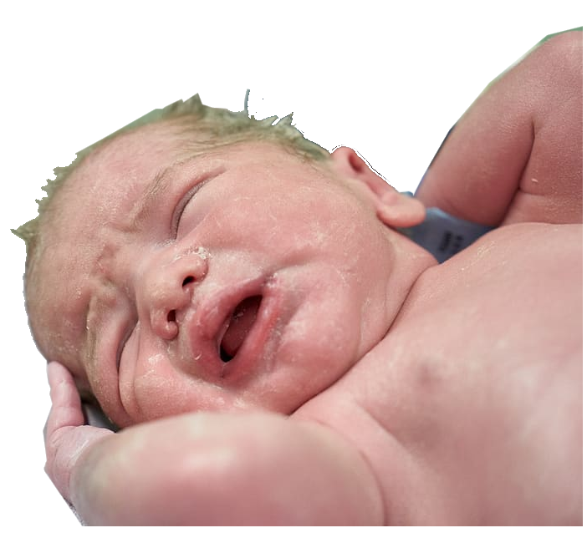
5. Consequential Theology 12-21
To the grandchild, Ichabod, “no glory” 19-22
²¹ And she named the child Ichabod, saying,
"The glory has departed
from Israel!“
because the ark of God had been
captured and because of her
father-in-law and her husband.
Notes:
When you surrender the “Glory of God” from the Word of God for Rabbit Foot Theology—the glory departs from that place, nation, or church.

Slide 42
5. Consequential Theology 12-21
To the grandchild, Ichabod, “no glory” 19-22
²² And she said,
"The glory has departed
from Israel, for the ark
of God has been captured."
Notes:
When you surrender the “Glory of God” from the Word of God for Rabbit Foot Theology—the glory departs from that place, nation, or church.

Slide 43
A Simple Summary …

Slide 44
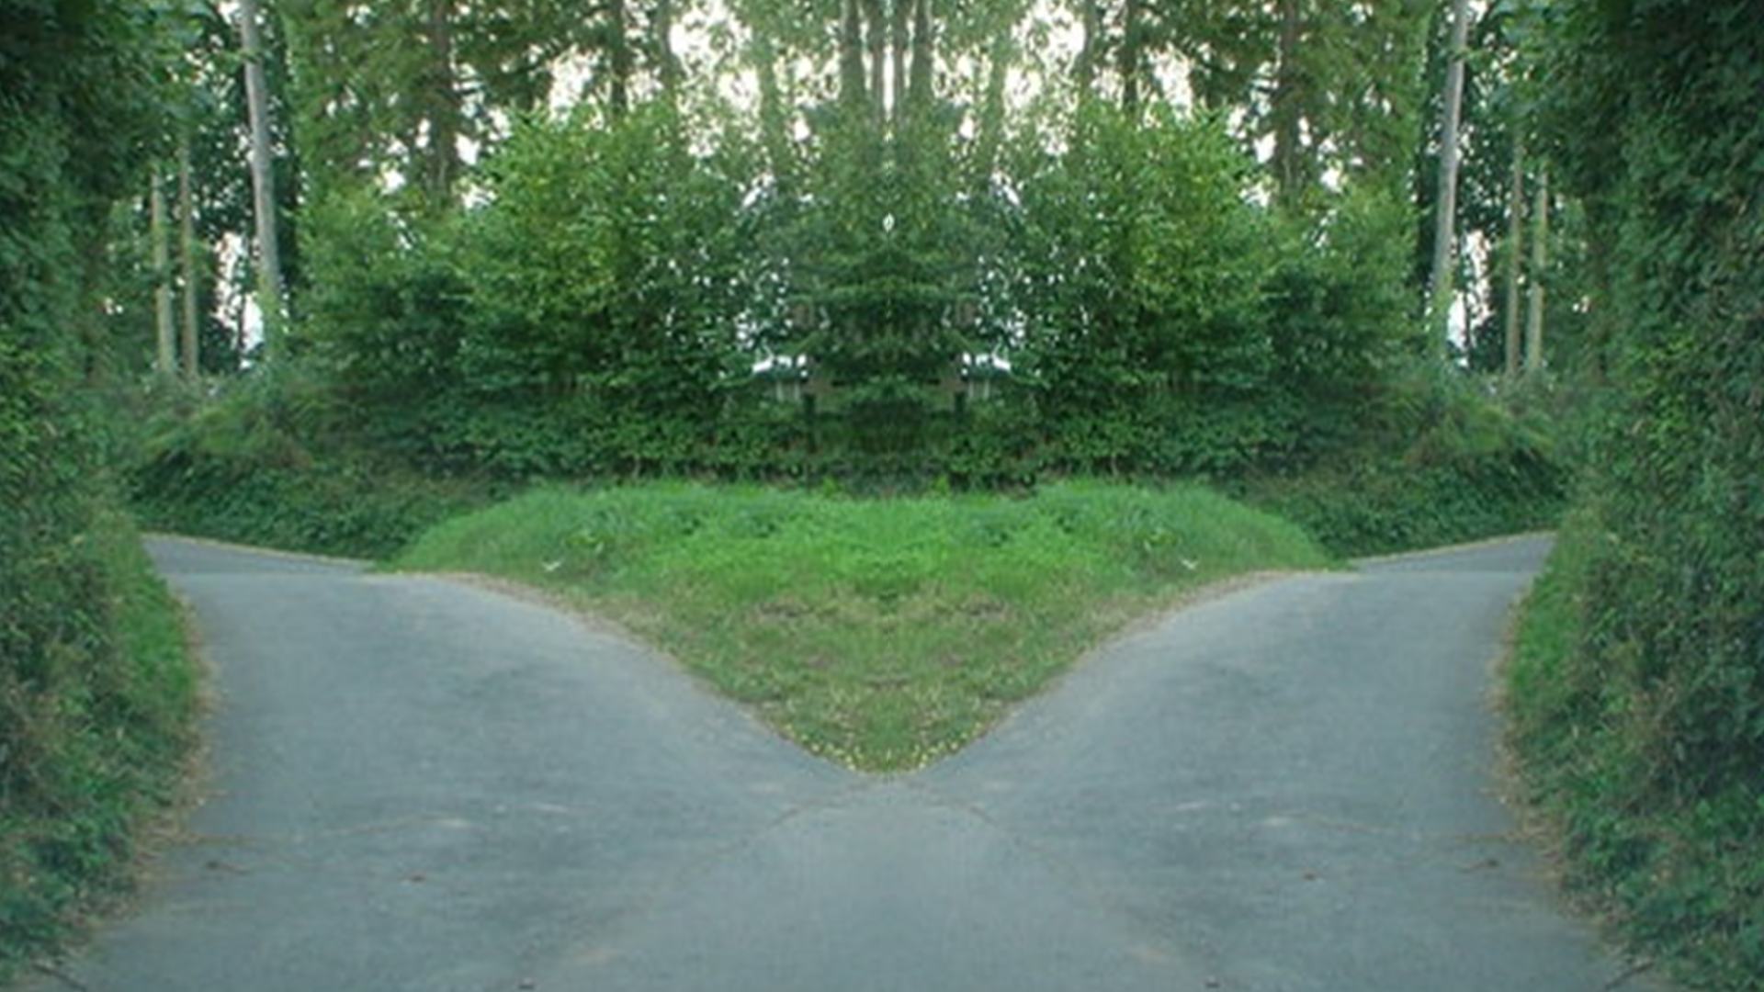
A Simple Summary …
DEATH
There is a way that seems right to a man, but in the end it leads to death. (Proverbs 16:25)

Slide 45
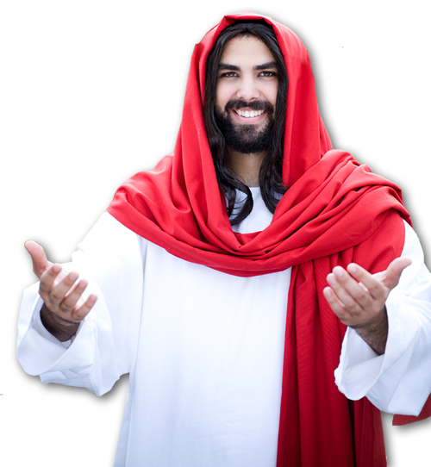
A Simple Summary …
DEATH
L
I
F
E
Jesus said to him,
"I am the way, and the truth, and the life. No one comes to the Father except through me. (John 14:6)

Slide 46
You see what you believe matters!
It did then …
It does now …
Accept Christ …

Slide 47
Let’s Pray
Notes:
https://watermark.lovepik.com/photo/50083/4881.jpg_wh1200.jpg

