Slide 1
Lesson 4
This series uses “Hemi Head Rg” Font
You can get the font FREE at: https://www.dafont.com/hemi-head.font
Or https://fontsfree.net/hemi-head-rg-bold-italic-font-download.html
Or https://www.1001fonts.com/hemi-head-426-font.html
Notes:
Copyright © 2006−2021. All rights reserved. Bible Point is a registered trademark of Dennis Henderson. All other trademarks acknowledged.
Bible Point contains graphics from Bible Point artists. These illustrations belong to Bible Point and the respective artists. You may use the designs and illustrations for graphical illustration of lessons free and without special permission, provided they are not used in any way that maligns the Christian faith. Furthermore, republication or production of any illustration by any other graphic service whether it be in book, in a machine-readable form, or in any other design resource is strictly prohibited. Furthermore, they cannot be duplicated or resold as any other form of publishing, clip art, or graphic resource.
So What does it mean? (A simple translations of the legal jargon)
So, if you don’t own the presentation(s), graphic(s), and text(s) how can you legally use them? The purchase of the license allows you to use all the images in the product. However, the actual ownership and copyright of the presentation(s), graphic(s), and text(s) remain the property of Bible Point and its licensors. If you had plans on using this product in your “for sale” work—think again!
License Agreement
Article 1: License Grant
All the graphics and text in Bible Point presentations (excluding quotes from the Bible and stated sources) are the intellectual and real property of Bible Point and its licensors, and is protected by law, including United States copyright laws and international treaties. Bible Point grants to you a license:
1. To use the presentation in a single church, single school, or single office of a Christian organization.
2. To make a single archival back-up copy of the program.
3. To modify the presentation(s) and merge with other presentations in a single church, school, or Christian organization.
4. To transfer to another party if that party agrees to accept the terms and conditions of this agreement, and you do not retain any copies of the presentation, whether printed, machine readable, modified, or merged form.
Article 2: Terms
This license is effective until terminated. You may terminate the license at any time by destroying the presentation(s), graphic(s), or text(s) together with all copies, modifications and merged portions in any form. Bible Point may terminate your license if you fail to comply with this Agreement. You agree, upon such termination, for any reason, to destroy the presentation(s), graphics, and text(s) with all copies, modifications, and merged portions in any form.
Article 3: Disclaimers
1. Bible Point presentations, graphics, and texts are licensed to you As Is. You, the consumer, bear the entire risk relating to the quality and performance of the presentation(s), graphic(s), or text(s). In no event will Bible Point be liable for damages resulting from any defect.
2. Thirty-day limited warrantee on disks. Bible Point warrants the disks to be free of defects in material and workmanship under normal use for 30 days after purchase. During the 30-day period you may return a defective presentation, graphic, or text with proof of purchase and it will be replaced without charge, unless the presentation is damaged by misuse.
Article 4: General
1. You may not sub-license, assign, or transfer the license of the presentation(s), graphic(s), or text(s) except as provided by this Agreement.
2. This Agreement will be governed by the laws of the State of Michigan.
So What does it mean? (A simple translations of the legal jargon)
May I let someone borrow or copy my licensed Bible Point presentation (even after I modified it)? As long as it is within your local church, or single school, or the immediate office of a Christian organization you may. Otherwise, please refer the person interested in borrowing to: http://www.biblepoint.com or E-mail: dennis@DrDH.net with any related questions.

Slide 2


Finding Victory
Notes:
https://watermark.lovepik.com/photo/50083/4881.jpg_wh1200.jpg

Slide 3

of GOD
Notes:
https://upload.wikimedia.org/wikipedia/commons/thumb/d/df/The_Voice_logo.svg/1000px-The_Voice_logo.svg.png
The Voice is an American singing competition television series broadcast on NBC. It premiered during the spring television cycle on April 26, 2011, and expanded into the fall cycle with the premiere of the third season on September The winner is determined by television viewers voting by telephone, internet, SMS text, and iTunes Store purchases of the audio-recorded artists' vocal performances. September 10, 2012. https://en.wikipedia.org/wiki/The_Voice_(American_TV_series)
We’re not talking about that today … we’re talking about the voice of God.

Slide 4
Victory is Found in His Voice
When was the last time you heard from God?
When you heard Him speak directly to your heart?
My message today is about God calling out to Samuel (and us too)!

Slide 5
His Voice Was ...

Slide 6

1- Rare 3:1
^{3:1} Now the young man Samuel was ministering to the LORD under Eli. And the word of the LORD was rare in those days; there was no frequent vision.
Notes:
It was rare because God was giving the silent treatment.

Slide 7




2- Intrusive 3:2-6
² At that time Eli, whose eyesight had begun to grow dim so that he could not see, was lying down in his own place. ³ The lamp of God had not yet gone out, and Samuel was lying down in the temple of the LORD, where the ark of God was.
Notes:
https://upload.wikimedia.org/wikipedia/commons/a/a4/Menorah_0307.jpg
At that time – it was God’s timing.
It was for me too, At age 8 ...

Slide 8
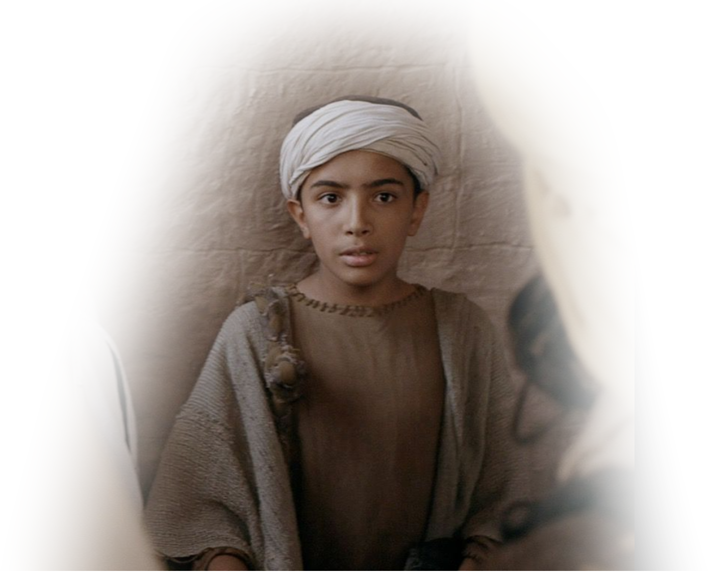
2- Intrusive 3:2-6
⁴ Then the LORD called Samuel, and he said,
"Here I am!“
⁵ and ran to Eli and said,
"Here I am, for you called me."
Notes:
At that time – it was God’s timing.
It was for me too, At age 8 ...

Slide 9
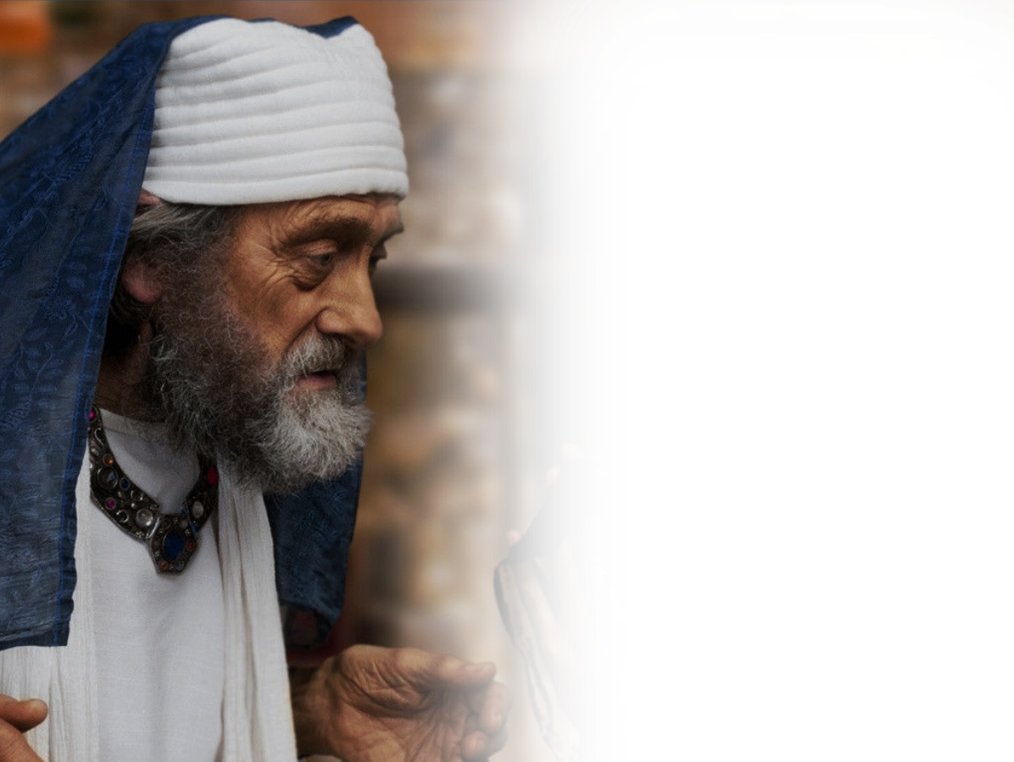
2- Intrusive 3:2-6
⁴ .... But he said,
"I did not call;
lie down again."
So he went and lay down.
Notes:
http://www.freebibleimages.org/photos/persistent-widow/
At that time – it was God’s timing.
It was for me too, At age 8 ...

Slide 10
2- Intrusive 3:2-6
⁶ And the LORD called again,
"Samuel!“
and Samuel arose and
went to Eli and said,
"Here I am, for
you called me."
Notes:
At that time – it was God’s timing.
It was for me too, At age 8 ...

Slide 11
2- Intrusive 3:2-6
⁶ .... But he said,
"I did not call, my son;
lie down again."
Notes:
At that time – it was God’s timing.
It was for me too, At age 8 ...

Slide 12
3- Missing 3:7
⁷ Now Samuel did not yet know the LORD, and the word of the LORD had not yet been revealed to him.
Notes:
Like the person who attends church week after week, but just doesn’t get it.
Know all about the Lord, but does not know the Lord personally.

Slide 13
4- Realized 3:8-9
⁸ And the LORD called Samuel again the third time. And he arose and went to Eli and said,
"Here I am, for
you called me."

Slide 14
4- Realized 3:8-9
... Then Eli perceived that the LORD was calling the young man. ⁹ Therefore Eli said to Samuel,
"Go, lie down, and if he calls you, you shall say, 'Speak, LORD, for your servant hears.’”
So Samuel went and lay down in his place.

Slide 15
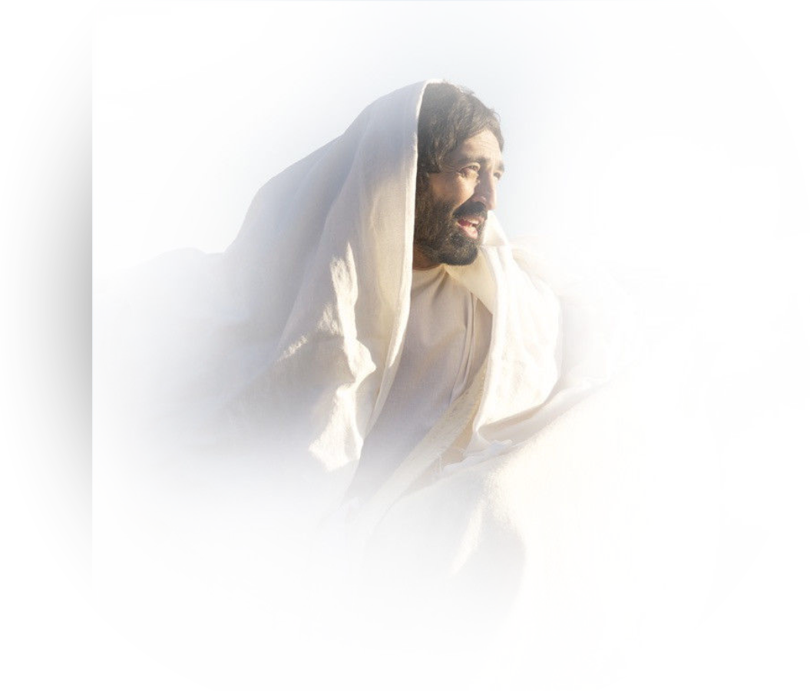
5- Unrelenting 3:10-14
¹⁰ And the LORD came and stood, calling as at other times,
"Samuel! Samuel!"

Slide 16
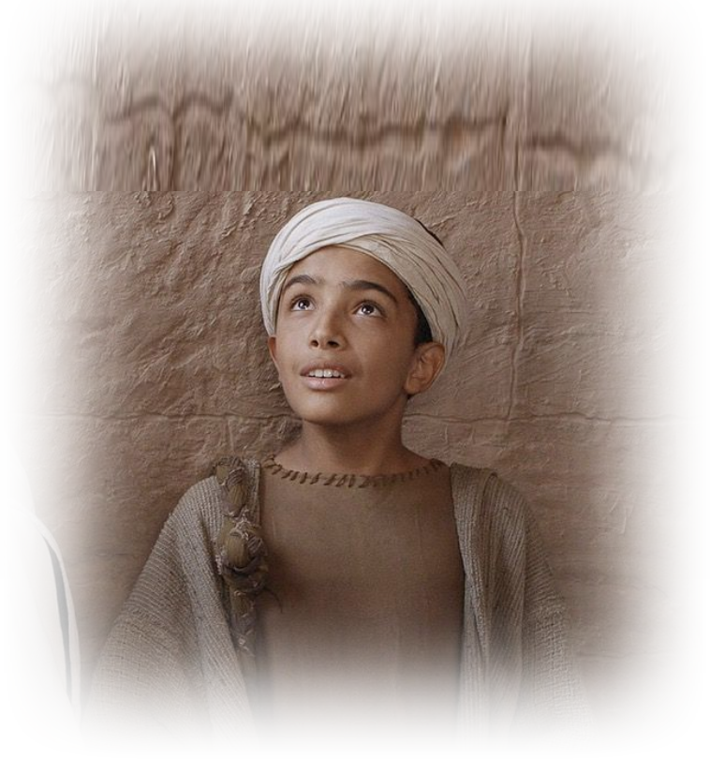
5- Unrelenting 3:10-14
And Samuel said,
"Speak, for your
servant hears.“

Slide 17
5- Unrelenting 3:10-14
¹¹ Then the LORD said to Samuel, "Behold, I am about to do a thing in Israel at which the two ears of everyone who hears it will tingle.
¹² On that day I will fulfill against Eli all that I have spoken concerning his house, from beginning to end.

Slide 18
5- Unrelenting 3:10-14
¹³ And I declare to him that I am about to punish his house forever, for the iniquity that he knew, because his sons were blaspheming God, and he did not restrain them. ¹⁴ Therefore I swear to the house of Eli that the iniquity of Eli's house shall not be atoned for by sacrifice or offering forever."

Slide 19
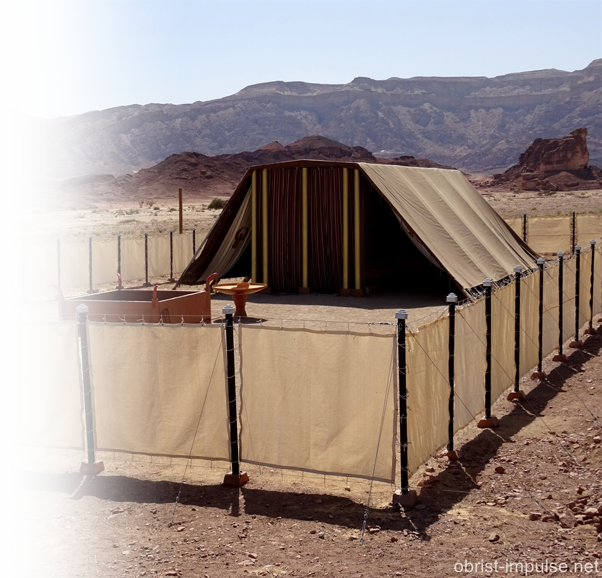
6- Convicting 3:15-18
¹⁵ Samuel lay until morning; then he opened the doors of the house of the LORD. And Samuel was afraid to tell the vision to Eli.

Slide 20
6- Convicting 3:15-18
¹⁶ But Eli called Samuel and said,
"Samuel, my son."

Slide 21
6- Convicting 3:15-18
And he said,
"Here I am."

Slide 22
6- Convicting 3:15-18
¹⁷ And Eli said,
"What was it that he told you? Do not hide it from me. May God do so to you and more also if you hide anything from me of all that he told you.“

Slide 23
6- Convicting 3:15-18
¹⁸ So Samuel told him everything and hid nothing from him. And he said,
"It is the LORD. Let him do what seems good to him."

Slide 24
7- Present 3:19-20
¹⁹ And Samuel grew, and the LORD was with him and let none of his words fall to the ground. ²⁰ And all Israel from Dan to Beersheba knew that Samuel was established as a prophet of the LORD.

Slide 25
8- Revealed 3:21
²¹ And the LORD appeared again at Shiloh, for the LORD revealed himself to Samuel at Shiloh by the word of the LORD.

Slide 26
8- Revealed 3:21
²¹ And the LORD appeared again at Shiloh, for the LORD revealed himself to Samuel at Shiloh by the word of the LORD.

Slide 27
Let me get personal with you ...
Has the Lord spoken to you lately?
Maybe you have never heard Him ...
Because you don’t know Him!
Ok, so let’s say you do know Him …
What’s He calling you to do?
Haven’t heard from Him lately? Why not?

Slide 28
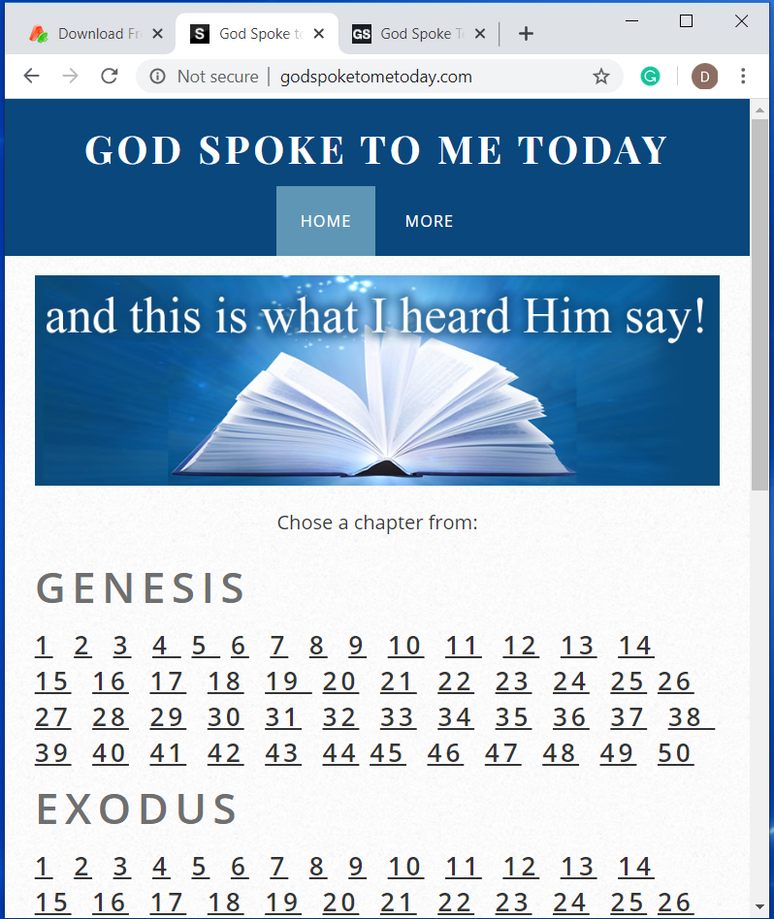
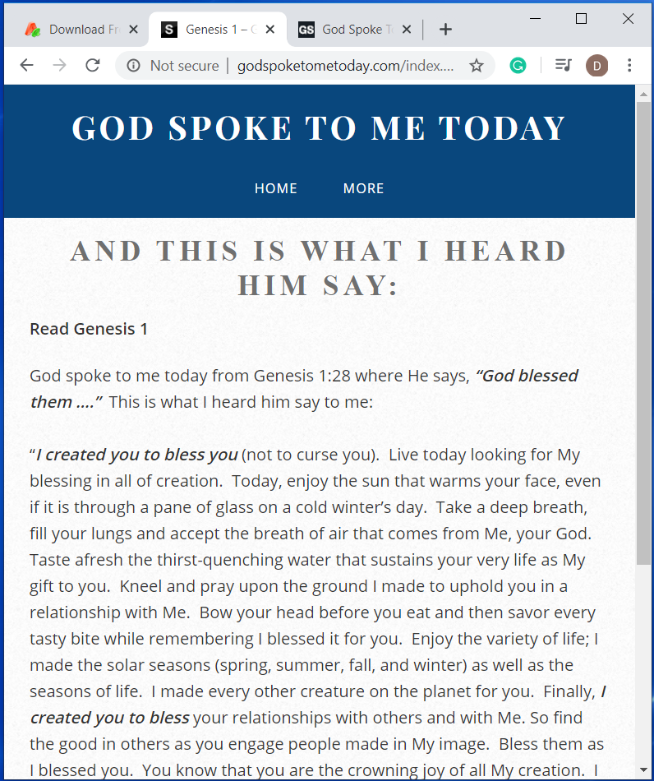
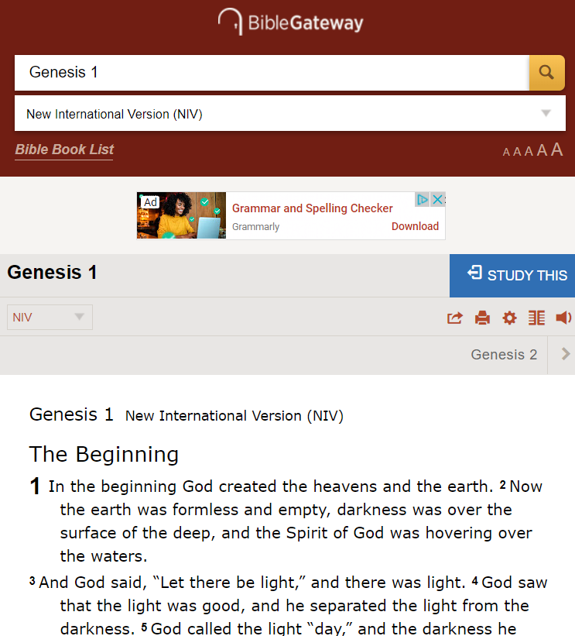
God speaks through His Word ...
It’s time to get
into His Word.
Notes:
Moses wrote 187 chapters, so I have around 80 to go .
The whole bible as 929 Chapters, so I have 800 to go.

Slide 29
GodSpokeToMeToday.com
Let’s Pray
Notes:
https://watermark.lovepik.com/photo/50083/4881.jpg_wh1200.jpg

