Slide 1
Lesson 3
This series uses “Hemi Head Rg” Font
You can get the font FREE at: https://www.dafont.com/hemi-head.font
Or https://fontsfree.net/hemi-head-rg-bold-italic-font-download.html
Or https://www.1001fonts.com/hemi-head-426-font.html
Notes:
Copyright © 2006−2021. All rights reserved. Bible Point is a registered trademark of Dennis Henderson. All other trademarks acknowledged.
Bible Point contains graphics from Bible Point artists. These illustrations belong to Bible Point and the respective artists. You may use the designs and illustrations for graphical illustration of lessons free and without special permission, provided they are not used in any way that maligns the Christian faith. Furthermore, republication or production of any illustration by any other graphic service whether it be in book, in a machine-readable form, or in any other design resource is strictly prohibited. Furthermore, they cannot be duplicated or resold as any other form of publishing, clip art, or graphic resource.
So What does it mean? (A simple translations of the legal jargon)
So, if you don’t own the presentation(s), graphic(s), and text(s) how can you legally use them? The purchase of the license allows you to use all the images in the product. However, the actual ownership and copyright of the presentation(s), graphic(s), and text(s) remain the property of Bible Point and its licensors. If you had plans on using this product in your “for sale” work—think again!
License Agreement
Article 1: License Grant
All the graphics and text in Bible Point presentations (excluding quotes from the Bible and stated sources) are the intellectual and real property of Bible Point and its licensors, and is protected by law, including United States copyright laws and international treaties. Bible Point grants to you a license:
1. To use the presentation in a single church, single school, or single office of a Christian organization.
2. To make a single archival back-up copy of the program.
3. To modify the presentation(s) and merge with other presentations in a single church, school, or Christian organization.
4. To transfer to another party if that party agrees to accept the terms and conditions of this agreement, and you do not retain any copies of the presentation, whether printed, machine readable, modified, or merged form.
Article 2: Terms
This license is effective until terminated. You may terminate the license at any time by destroying the presentation(s), graphic(s), or text(s) together with all copies, modifications and merged portions in any form. Bible Point may terminate your license if you fail to comply with this Agreement. You agree, upon such termination, for any reason, to destroy the presentation(s), graphics, and text(s) with all copies, modifications, and merged portions in any form.
Article 3: Disclaimers
1. Bible Point presentations, graphics, and texts are licensed to you As Is. You, the consumer, bear the entire risk relating to the quality and performance of the presentation(s), graphic(s), or text(s). In no event will Bible Point be liable for damages resulting from any defect.
2. Thirty-day limited warrantee on disks. Bible Point warrants the disks to be free of defects in material and workmanship under normal use for 30 days after purchase. During the 30-day period you may return a defective presentation, graphic, or text with proof of purchase and it will be replaced without charge, unless the presentation is damaged by misuse.
Article 4: General
1. You may not sub-license, assign, or transfer the license of the presentation(s), graphic(s), or text(s) except as provided by this Agreement.
2. This Agreement will be governed by the laws of the State of Michigan.
So What does it mean? (A simple translations of the legal jargon)
May I let someone borrow or copy my licensed Bible Point presentation (even after I modified it)? As long as it is within your local church, or single school, or the immediate office of a Christian organization you may. Otherwise, please refer the person interested in borrowing to: http://www.biblepoint.com or E-mail: dennis@DrDH.net with any related questions.

Slide 2


Finding Victory
Notes:
https://watermark.lovepik.com/photo/50083/4881.jpg_wh1200.jpg

Slide 3
Victory is Found in
Improving Your Serve
Notes:
Worship was a farce in Shiloh. The ministers were wicked.
There are five kinds of ministers mentioned in our passage today …
The wicked minister 1Sam 2:12-17 + 22 who had a godly father
Wicked Men 12
-Sons of Belial
-Did not know the Lord
Wicked Action
- Disregarded Sacrifices 13-17
Disregard Women 22
The compromising minister 1 Sam 2:18-21 + 26
Blesses the Righteous 19-21a
Tolerated the Wicked 22-25a
The growing minister 18 + 25b
But Samuel ministered before the Lord 18 [after discussing wicked ministers, “but…”]
- In the presence of the Lord = this is the key = spending time with the Lord
But Samuel was Christ-like 25b cf. Luke 2:52 [after discussing compromiser, “but …”]
- growing in stature
-growing in favor of God and man
The godly minister [=Micah 6:8 sums up the man of God in one neat verse: “He has showed you, O man, what is good. And what does the Lord require of you? To act justly and to love mercy and to walk humbly with your God.”] This guy is not a priest, he appears to be a prophet, sent to confront the priest.
Godly ministers confront sin 27-29
God Chose you
You Scorned God
Godly ministers proclaim God’s Word 30
Blessings 30a
and Curses 30b-34
Back to Samuel the growing minister … he will be …
The Faithful minister 35-36
Faithful 35
Obedient 35
Exalted 36
Conclusion: In the NT were told that we are all ministers and priest to God. So, we must examine our hearts and sincerely ask, “What kind of minister am I?”
Wicked? Compromising? Growing? Godly? Faithful?
More importantly, what kind of minister do you want to be? Answer: all of the last three, Growing, Godly, and Faithful.

Slide 4
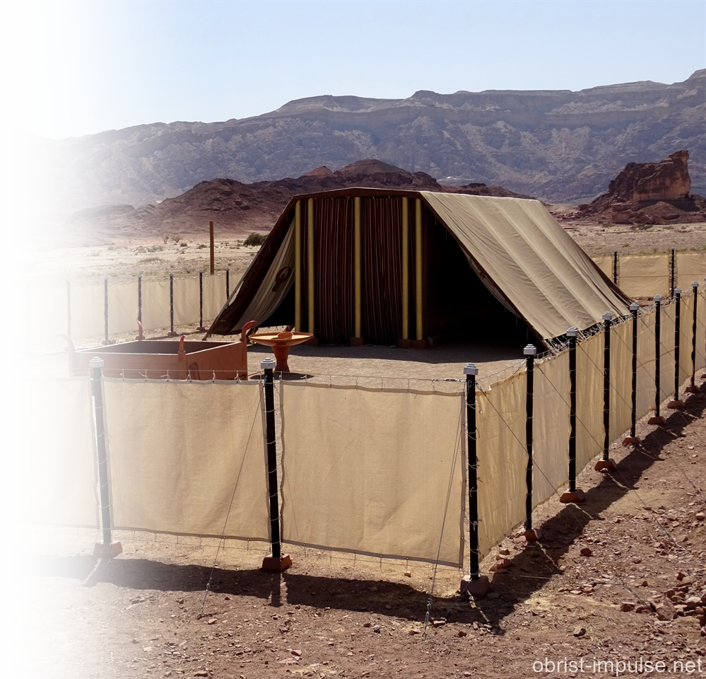
Worship was a farce in Shiloh.
It wasn’t because of the music ...
It wasn’t because of the fellowship ...
It wasn’t because of the youth program ...
It was because of the MINISTERS ...
There are five kinds of servants mentioned in our passage today …
Notes:
Worship was a farce in Shiloh. The ministers were wicked.
There are five kinds of ministers mentioned in our passage today …
The wicked minister 1Sam 2:12-17 + 22 who had a godly father
Wicked Men 12
-Sons of Belial
-Did not know the Lord
Wicked Action
- Disregarded Sacrifices 13-17
Disregard Women 22
The compromising minister 1 Sam 2:18-21 + 26
Blesses the Righteous 19-21a
Tolerated the Wicked 22-25a
The growing minister 18 + 25b
But Samuel ministered before the Lord 18 [after discussing wicked ministers, “but…”]
- In the presence of the Lord = this is the key = spending time with the Lord
But Samuel was Christ-like 25b cf. Luke 2:52 [after discussing compromiser, “but …”]
- growing in stature
-growing in favor of God and man
The godly minister [=Micah 6:8 sums up the man of God in one neat verse: “He has showed you, O man, what is good. And what does the Lord require of you? To act justly and to love mercy and to walk humbly with your God.”] This guy is not a priest, he appears to be a prophet, sent to confront the priest.
Godly ministers confront sin 27-29
God Chose you
You Scorned God
Godly ministers proclaim God’s Word 30
Blessings 30a
and Curses 30b-34
Back to Samuel the growing minister … he will be …
The Faithful minister 35-36
Faithful 35
Obedient 35
Exalted 36
Conclusion: In the NT were told that we are all ministers and priest to God. So, we must examine our hearts and sincerely ask, “What kind of minister am I?”
Wicked? Compromising? Growing? Godly? Faithful?
More importantly, what kind of minister do you want to be? Answer: all of the last three, Growing, Godly, and Faithful.

Slide 5

The Wicked Servant 2:12-17 + 22
Notes:
https://pixabay.com/fr/photos/art-sombre-d%C3%A9mon-la-sorci%C3%A8re-2838965/
Worship was a farce in Shiloh. The ministers were wicked.
There are five kinds of ministers mentioned in our passage today …
The wicked minister 1Sam 2:12-17 + 22 who had a godly father
Wicked Men 12
-Sons of Belial
-Did not know the Lord
Wicked Action
- Disregarded Sacrifices 13-17
Disregard Women 22
The compromising minister 1 Sam 2:18-21 + 26
Blesses the Righteous 19-21a
Tolerated the Wicked 22-25a
The growing minister 18 + 25b
But Samuel ministered before the Lord 18 [after discussing wicked ministers, “but…”]
- In the presence of the Lord = this is the key = spending time with the Lord
But Samuel was Christ-like 25b cf. Luke 2:52 [after discussing compromiser, “but …”]
- growing in stature
-growing in favor of God and man
The godly minister [=Micah 6:8 sums up the man of God in one neat verse: “He has showed you, O man, what is good. And what does the Lord require of you? To act justly and to love mercy and to walk humbly with your God.”] This guy is not a priest, he appears to be a prophet, sent to confront the priest.
Godly ministers confront sin 27-29
God Chose you
You Scorned God
Godly ministers proclaim God’s Word 30
Blessings 30a
and Curses 30b-34
Back to Samuel the growing minister … he will be …
The Faithful minister 35-36
Faithful 35
Obedient 35
Exalted 36
Conclusion: In the NT were told that we are all ministers and priest to God. So, we must examine our hearts and sincerely ask, “What kind of minister am I?”
Wicked? Compromising? Growing? Godly? Faithful?
More importantly, what kind of minister do you want to be? Answer: all of the last three, Growing, Godly, and Faithful.

Slide 6
Wicked Character 2:12
WORTHLESS MEN
¹² Now the sons of Eli were worthless men.
¹² Now the sons of Eli were sons of Belial; (KJV)
Notes:
https://pixabay.com/fr/photos/art-sombre-d%C3%A9mon-la-sorci%C3%A8re-2838965/
Worship was a farce in Shiloh. The ministers were wicked.
There are five kinds of ministers mentioned in our passage today …
The wicked minister 1Sam 2:12-17 + 22 who had a godly father
Wicked Men 12
-Sons of Belial
-Did not know the Lord
Wicked Action
- Disregarded Sacrifices 13-17
Disregard Women 22
The compromising minister 1 Sam 2:18-21 + 26
Blesses the Righteous 19-21a
Tolerated the Wicked 22-25a
The growing minister 18 + 25b
But Samuel ministered before the Lord 18 [after discussing wicked ministers, “but…”]
- In the presence of the Lord = this is the key = spending time with the Lord
But Samuel was Christ-like 25b cf. Luke 2:52 [after discussing compromiser, “but …”]
- growing in stature
-growing in favor of God and man
The godly minister [=Micah 6:8 sums up the man of God in one neat verse: “He has showed you, O man, what is good. And what does the Lord require of you? To act justly and to love mercy and to walk humbly with your God.”] This guy is not a priest, he appears to be a prophet, sent to confront the priest.
Godly ministers confront sin 27-29
God Chose you
You Scorned God
Godly ministers proclaim God’s Word 30
Blessings 30a
and Curses 30b-34
Back to Samuel the growing minister … he will be …
The Faithful minister 35-36
Faithful 35
Obedient 35
Exalted 36
Conclusion: In the NT were told that we are all ministers and priest to God. So, we must examine our hearts and sincerely ask, “What kind of minister am I?”
Wicked? Compromising? Growing? Godly? Faithful?
More importantly, what kind of minister do you want to be? Answer: all of the last three, Growing, Godly, and Faithful.

Slide 7
Wicked Character 2:12
IGNORANT MEN
¹² ... They did not know the LORD.
Notes:
https://pixabay.com/fr/photos/art-sombre-d%C3%A9mon-la-sorci%C3%A8re-2838965/
They did not know the Lord ... They knew about Him ... But did not know Him.
Did the priestly service ... Did not know Him.
²¹ "Not everyone who says to me, 'Lord, Lord,' will enter the kingdom of heaven, but the one who does the will of my Father who is in heaven.
²² On that day many will say to me, 'Lord, Lord, did we not prophesy in your name, and cast out demons in your name, and do many mighty works in your name?'
²³ And then will I declare to them, 'I never knew you; depart from me, you workers of lawlessness.' (Mat 7:21-23 ESV)

Slide 8
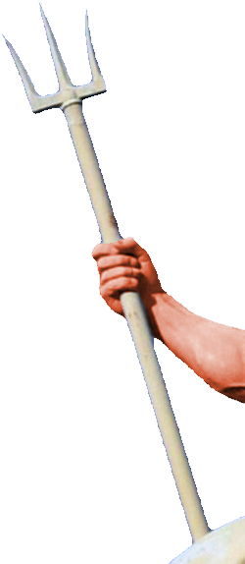

Wicked Actions 2:12
DISRESPECTFUL TO GOD 13-17
¹³ The custom of the priests with the people was that when any man offered sacrifice, the priest's servant would come, while the meat was boiling, with a three-pronged fork in his hand,
Notes:
https://www.needpix.com/photo/download/1753305/historical-cooking-historical-pot-historical-fire-fire-swirl-dark-ages-vikings-viking-camping
Two fold charge of wickedness:
1- indiscriminately taking the sacrifice. 13-14
The priest were to be assigned the breast and right thigh.
But they were indiscriminately taking whatever came up from the pot.
2- Next slide (verse 15) – They also would demand the meat before offered to the Lord or boiled for the sacrifice.
This was blasphemous to the Lord.

Slide 9

Wicked Actions 2:12
¹⁴ and he would thrust it into the pan or kettle or cauldron or pot.
All that the fork brought up the priest would take for himself. This is what they did at Shiloh to all the Israelites who came there.
Notes:
Two fold charge of wickedness:
1- indiscriminately taking the sacrifice. 13-14
The priest were to be assigned the breast and right thigh.
But they were indiscriminately taking whatever came up from the pot.
2- Next slide (verse 15) – They also would demand the meat before offered to the Lord or boiled for the sacrifice.
This was blasphemous to the Lord.

Slide 10
Wicked Actions 2:12
¹⁵ Moreover, before the fat was burned, the priest's servant would come and say to the man who was sacrificing, "Give meat for the priest to roast, for he will not accept boiled meat from you but only raw."
Notes:
Two fold charge of wickedness:
1- indiscriminately taking the sacrifice. 13-14
The priest were to be assigned the breast and right thigh.
But they were indiscriminately taking whatever came up from the pot.
2- Next slide (verse 15) – They also would demand the meat before offered to the Lord or boiled for the sacrifice.
This was blasphemous to the Lord.

Slide 11
Wicked Actions 2:12
¹⁶ And if the man said to him, "Let them burn the fat first, and then take as much as you wish," he would say, "No, you must give it now, and if not, I will take it by force."
¹⁷ Thus the sin of the young men was very great in the sight of the LORD, for the men treated the offering of the LORD with contempt.
Notes:
Two fold charge of wickedness:
1- indiscriminately taking the sacrifice. 13-14
The priest were to be assigned the breast and right thigh.
But they were indiscriminately taking whatever came up from the pot.
2- Next slide (verse 15) – They also would demand the meat before offered to the Lord or boiled for the sacrifice.
This was blasphemous to the Lord.

Slide 12
Wicked Actions 2:22
DISRESPECTFUL TO WOMEN 22
²² Now Eli was very old, and he kept hearing all that his sons were doing to all Israel, and how they lay with the women who were serving at the entrance to the tent of meeting.
Notes:
Jump down to verse 22 the also were disrespectful to the women who served the Lord. See Exodus 38:8
NET Bible note 38:8 says the word “served” is as in war = conscripted/drafted. They were organized to serve at the entrance of the tent.

Slide 13

The Compromising Servant
Both Hot and Cold
Notes:
https://pxhere.com/en/photo/732741
Tolerates wickedness // TV program “God Friended Me” has a clergyman living with a woman and is portrayed not as sinful but a progressive. Our PC Hollywood degenerate culture may find that progressive---God calls it adultery, wickedness, disobedience, unfaithfulness, immorality—an eternal offense against God that needs the saving grace of God for forgiveness to a repented sinner.
The fictional TV character is a microcosm of the problem of the church today—compromising on eternal principles of gender identity, sexuality, marriage, family, truth and morality.
Worship was a farce in Shiloh. The ministers were wicked.
There are five kinds of ministers mentioned in our passage today …
The wicked minister 1Sam 2:12-17 + 22 who had a godly father
Wicked Men 12
-Sons of Belial
-Did not know the Lord
Wicked Action
- Disregarded Sacrifices 13-17
Disregard Women 22
The compromising minister 1 Sam 2:18-21 + 26
Blesses the Righteous 19-21a
Tolerated the Wicked 22-25a
The growing minister 18 + 25b
But Samuel ministered before the Lord 18 [after discussing wicked ministers, “but…”]
- In the presence of the Lord = this is the key = spending time with the Lord
But Samuel was Christ-like 25b cf. Luke 2:52 [after discussing compromiser, “but …”]
- growing in stature
-growing in favor of God and man
The godly minister [=Micah 6:8 sums up the man of God in one neat verse: “He has showed you, O man, what is good. And what does the Lord require of you? To act justly and to love mercy and to walk humbly with your God.”] This guy is not a priest, he appears to be a prophet, sent to confront the priest.
Godly ministers confront sin 27-29
God Chose you
You Scorned God
Godly ministers proclaim God’s Word 30
Blessings 30a
and Curses 30b-34
Back to Samuel the growing minister … he will be …
The Faithful minister 35-36
Faithful 35
Obedient 35
Exalted 36
Conclusion: In the NT were told that we are all ministers and priest to God. So, we must examine our hearts and sincerely ask, “What kind of minister am I?”
Wicked? Compromising? Growing? Godly? Faithful?
More importantly, what kind of minister do you want to be? Answer: all of the last three, Growing, Godly, and Faithful.

Slide 14
The Compromising Servant
He Blesses the Righteous 19-21a
²⁰ Then Eli would bless Elkanah and his wife, and say, "May the LORD give you children by this woman for the petition she asked of the LORD." So then they would return to their home. ²¹ Indeed the LORD visited Hannah, and she conceived and bore three sons and two daughters. And the young man Samuel grew in the presence of the LORD.
Notes:
https://pxhere.com/en/photo/732741
Tolerates wickedness // TV program “God Friended Me” has a clergyman living with a woman and is portrayed not as sinful but a progressive. Our PC Hollywood degenerate culture may find that progressive---God calls it adultery, wickedness, disobedience, unfaithfulness, immorality—an eternal offense against God that needs the saving grace of God for forgiveness to a repented sinner.
The fictional TV character is a microcosm of the problem of the church today—compromising on eternal principles of gender identity, sexuality, marriage, family, truth and morality.
Worship was a farce in Shiloh. The ministers were wicked.
There are five kinds of ministers mentioned in our passage today …
The wicked minister 1Sam 2:12-17 + 22 who had a godly father
Wicked Men 12
-Sons of Belial
-Did not know the Lord
Wicked Action
- Disregarded Sacrifices 13-17
Disregard Women 22
The compromising minister 1 Sam 2:18-21 + 26
Blesses the Righteous 19-21a
Tolerated the Wicked 22-25a
The growing minister 18 + 25b
But Samuel ministered before the Lord 18 [after discussing wicked ministers, “but…”]
- In the presence of the Lord = this is the key = spending time with the Lord
But Samuel was Christ-like 25b cf. Luke 2:52 [after discussing compromiser, “but …”]
- growing in stature
-growing in favor of God and man
The godly minister [=Micah 6:8 sums up the man of God in one neat verse: “He has showed you, O man, what is good. And what does the Lord require of you? To act justly and to love mercy and to walk humbly with your God.”] This guy is not a priest, he appears to be a prophet, sent to confront the priest.
Godly ministers confront sin 27-29
God Chose you
You Scorned God
Godly ministers proclaim God’s Word 30
Blessings 30a
and Curses 30b-34
Back to Samuel the growing minister … he will be …
The Faithful minister 35-36
Faithful 35
Obedient 35
Exalted 36
Conclusion: In the NT were told that we are all ministers and priest to God. So, we must examine our hearts and sincerely ask, “What kind of minister am I?”
Wicked? Compromising? Growing? Godly? Faithful?
More importantly, what kind of minister do you want to be? Answer: all of the last three, Growing, Godly, and Faithful.

Slide 15
The Compromising Servant
He Tolerated the Wicked 22-25a
²² Now Eli was very old, and he kept hearing all that his sons were doing to all Israel, and how they lay with the women who were serving at the entrance to the tent of meeting. ²³ And he said to them, "Why do you do such things? For I hear of your evil dealings from all the people.
Notes:
https://pxhere.com/en/photo/732741
Tolerates wickedness // TV program “God Friended Me” has a clergyman living with a woman and is portrayed not as sinful but a progressive. Our PC Hollywood degenerate culture may find that progressive---God calls it adultery, wickedness, disobedience, unfaithfulness, immorality—an eternal offense against God that needs the saving grace of God for forgiveness to a repented sinner.
The fictional TV character is a microcosm of the problem of the church today—compromising on eternal principles of gender identity, sexuality, marriage, family, truth and morality.
Worship was a farce in Shiloh. The ministers were wicked.
There are five kinds of ministers mentioned in our passage today …
The wicked minister 1Sam 2:12-17 + 22 who had a godly father
Wicked Men 12
-Sons of Belial
-Did not know the Lord
Wicked Action
- Disregarded Sacrifices 13-17
Disregard Women 22
The compromising minister 1 Sam 2:18-21 + 26
Blesses the Righteous 19-21a
Tolerated the Wicked 22-25a
The growing minister 18 + 25b
But Samuel ministered before the Lord 18 [after discussing wicked ministers, “but…”]
- In the presence of the Lord = this is the key = spending time with the Lord
But Samuel was Christ-like 25b cf. Luke 2:52 [after discussing compromiser, “but …”]
- growing in stature
-growing in favor of God and man
The godly minister [=Micah 6:8 sums up the man of God in one neat verse: “He has showed you, O man, what is good. And what does the Lord require of you? To act justly and to love mercy and to walk humbly with your God.”] This guy is not a priest, he appears to be a prophet, sent to confront the priest.
Godly ministers confront sin 27-29
God Chose you
You Scorned God
Godly ministers proclaim God’s Word 30
Blessings 30a
and Curses 30b-34
Back to Samuel the growing minister … he will be …
The Faithful minister 35-36
Faithful 35
Obedient 35
Exalted 36
Conclusion: In the NT were told that we are all ministers and priest to God. So, we must examine our hearts and sincerely ask, “What kind of minister am I?”
Wicked? Compromising? Growing? Godly? Faithful?
More importantly, what kind of minister do you want to be? Answer: all of the last three, Growing, Godly, and Faithful.

Slide 16
The Compromising Servant
He Tolerated the Wicked 22-25a
²⁴ No, my sons; it is no good report that I hear the people of the LORD spreading abroad. ²⁵ If someone sins against a man, God will mediate for him, but if someone sins against the LORD, who can intercede for him?" But they would not listen to the voice of their father, for it was the will of the LORD to put them to death.
Notes:
https://pxhere.com/en/photo/732741
Tolerates wickedness // TV program “God Friended Me” has a clergyman living with a woman and is portrayed not as sinful but a progressive. Our PC Hollywood degenerate culture may find that progressive---God calls it adultery, wickedness, disobedience, unfaithfulness, immorality—an eternal offense against God that needs the saving grace of God for forgiveness to a repented sinner.
The fictional TV character is a microcosm of the problem of the church today—compromising on eternal principles of gender identity, sexuality, marriage, family, truth and morality.
Worship was a farce in Shiloh. The ministers were wicked.
There are five kinds of ministers mentioned in our passage today …
The wicked minister 1Sam 2:12-17 + 22 who had a godly father
Wicked Men 12
-Sons of Belial
-Did not know the Lord
Wicked Action
- Disregarded Sacrifices 13-17
Disregard Women 22
The compromising minister 1 Sam 2:18-21 + 26
Blesses the Righteous 19-21a
Tolerated the Wicked 22-25a
The growing minister 18 + 25b
But Samuel ministered before the Lord 18 [after discussing wicked ministers, “but…”]
- In the presence of the Lord = this is the key = spending time with the Lord
But Samuel was Christ-like 25b cf. Luke 2:52 [after discussing compromiser, “but …”]
- growing in stature
-growing in favor of God and man
The godly minister [=Micah 6:8 sums up the man of God in one neat verse: “He has showed you, O man, what is good. And what does the Lord require of you? To act justly and to love mercy and to walk humbly with your God.”] This guy is not a priest, he appears to be a prophet, sent to confront the priest.
Godly ministers confront sin 27-29
God Chose you
You Scorned God
Godly ministers proclaim God’s Word 30
Blessings 30a
and Curses 30b-34
Back to Samuel the growing minister … he will be …
The Faithful minister 35-36
Faithful 35
Obedient 35
Exalted 36
Conclusion: In the NT were told that we are all ministers and priest to God. So, we must examine our hearts and sincerely ask, “What kind of minister am I?”
Wicked? Compromising? Growing? Godly? Faithful?
More importantly, what kind of minister do you want to be? Answer: all of the last three, Growing, Godly, and Faithful.

Slide 17
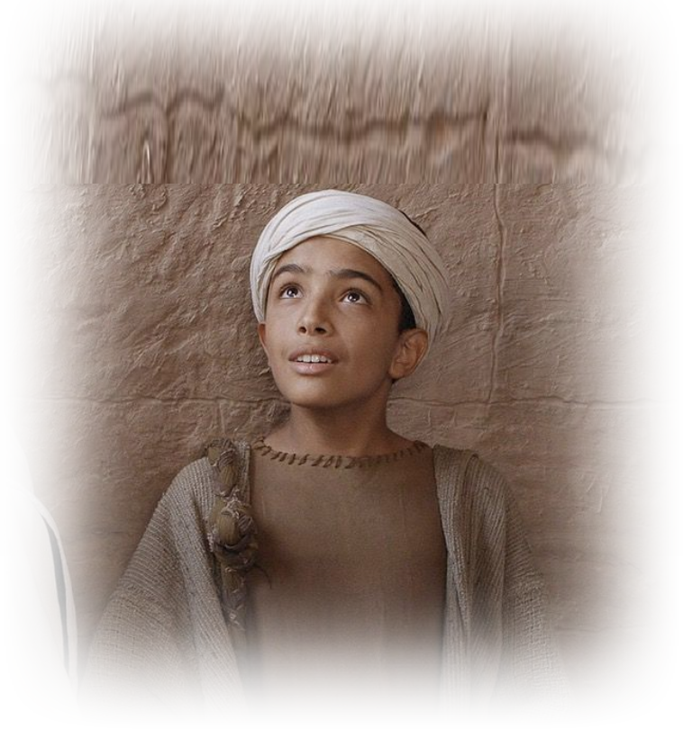
The Growing Servant 2:18-19 + 26
But Samuel ministered before the Lord 18
¹⁸ Samuel was ministering before
the LORD, a boy clothed with a linen
ephod. ¹⁹ And his mother used to
make for him a little robe and take
it to him each year when she went
up with her husband to offer
the yearly sacrifice.
Notes:
Worship was a farce in Shiloh. The ministers were wicked.
There are five kinds of ministers mentioned in our passage today …
The wicked minister 1Sam 2:12-17 + 22 who had a godly father
Wicked Men 12
-Sons of Belial
-Did not know the Lord
Wicked Action
- Disregarded Sacrifices 13-17
Disregard Women 22
The compromising minister 1 Sam 2:18-21 + 26
Blesses the Righteous 19-21a
Tolerated the Wicked 22-25a
The growing minister 18 + 25b
But Samuel ministered before the Lord 18 [after discussing wicked ministers, “but…”]
- In the presence of the Lord = this is the key = spending time with the Lord
But Samuel was Christ-like 25b cf. Luke 2:52 [after discussing compromiser, “but …”]
- growing in stature
-growing in favor of God and man
The godly minister [=Micah 6:8 sums up the man of God in one neat verse: “He has showed you, O man, what is good. And what does the Lord require of you? To act justly and to love mercy and to walk humbly with your God.”] This guy is not a priest, he appears to be a prophet, sent to confront the priest.
Godly ministers confront sin 27-29
God Chose you
You Scorned God
Godly ministers proclaim God’s Word 30
Blessings 30a
and Curses 30b-34
Back to Samuel the growing minister … he will be …
The Faithful minister 35-36
Faithful 35
Obedient 35
Exalted 36
Conclusion: In the NT were told that we are all ministers and priest to God. So, we must examine our hearts and sincerely ask, “What kind of minister am I?”
Wicked? Compromising? Growing? Godly? Faithful?
More importantly, what kind of minister do you want to be? Answer: all of the last three, Growing, Godly, and Faithful.

Slide 18
The Growing Servant 2:18-19 + 26
Samuel was growing 2:26
²⁶ Now the young man Samuel continued to grow both in stature and in favor with the LORD and also with man.
Notes:
Worship was a farce in Shiloh. The ministers were wicked.
There are five kinds of ministers mentioned in our passage today …
The wicked minister 1Sam 2:12-17 + 22 who had a godly father
Wicked Men 12
-Sons of Belial
-Did not know the Lord
Wicked Action
- Disregarded Sacrifices 13-17
Disregard Women 22
The compromising minister 1 Sam 2:18-21 + 26
Blesses the Righteous 19-21a
Tolerated the Wicked 22-25a
The growing minister 18 + 25b
But Samuel ministered before the Lord 18 [after discussing wicked ministers, “but…”]
- In the presence of the Lord = this is the key = spending time with the Lord
But Samuel was Christ-like 25b cf. Luke 2:52 [after discussing compromiser, “but …”]
- growing in stature
-growing in favor of God and man
The godly minister [=Micah 6:8 sums up the man of God in one neat verse: “He has showed you, O man, what is good. And what does the Lord require of you? To act justly and to love mercy and to walk humbly with your God.”] This guy is not a priest, he appears to be a prophet, sent to confront the priest.
Godly ministers confront sin 27-29
God Chose you
You Scorned God
Godly ministers proclaim God’s Word 30
Blessings 30a
and Curses 30b-34
Back to Samuel the growing minister … he will be …
The Faithful minister 35-36
Faithful 35
Obedient 35
Exalted 36
Conclusion: In the NT were told that we are all ministers and priest to God. So, we must examine our hearts and sincerely ask, “What kind of minister am I?”
Wicked? Compromising? Growing? Godly? Faithful?
More importantly, what kind of minister do you want to be? Answer: all of the last three, Growing, Godly, and Faithful.

Slide 19
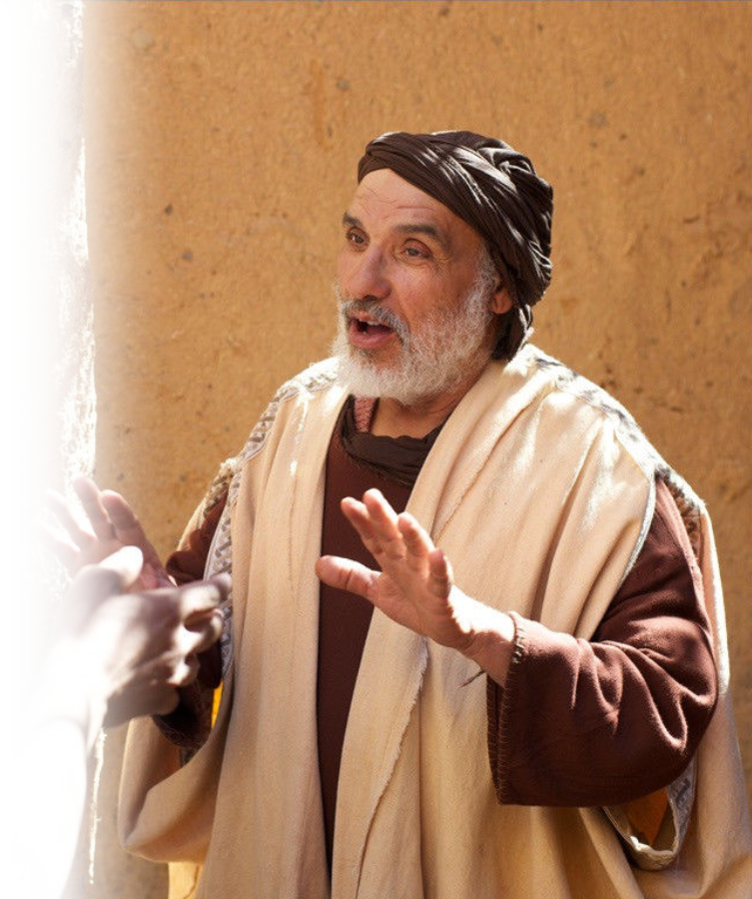
The Godly Servant
This guy is not a priest,
He appears to be a prophet,
He was sent to confront the priest.
Micah 6:8 sums up the man of God
in one neat verse: “He has showed you, O man, what is good. And what does the Lord require of you? To act justly and to love mercy and to walk humbly with your God.”
Notes:
Worship was a farce in Shiloh. The ministers were wicked.
There are five kinds of ministers mentioned in our passage today …
The wicked minister 1Sam 2:12-17 + 22 who had a godly father
Wicked Men 12
-Sons of Belial
-Did not know the Lord
Wicked Action
- Disregarded Sacrifices 13-17
Disregard Women 22
The compromising minister 1 Sam 2:18-21 + 26
Blesses the Righteous 19-21a
Tolerated the Wicked 22-25a
The growing minister 18 + 25b
But Samuel ministered before the Lord 18 [after discussing wicked ministers, “but…”]
- In the presence of the Lord = this is the key = spending time with the Lord
But Samuel was Christ-like 25b cf. Luke 2:52 [after discussing compromiser, “but …”]
- growing in stature
-growing in favor of God and man
The godly minister [=Micah 6:8 sums up the man of God in one neat verse: “He has showed you, O man, what is good. And what does the Lord require of you? To act justly and to love mercy and to walk humbly with your God.”] This guy is not a priest, he appears to be a prophet, sent to confront the priest.
Godly ministers confront sin 27-29
God Chose you
You Scorned God
Godly ministers proclaim God’s Word 30
Blessings 30a
and Curses 30b-34
Back to Samuel the growing minister … he will be …
The Faithful minister 35-36
Faithful 35
Obedient 35
Exalted 36
Conclusion: In the NT were told that we are all ministers and priest to God. So, we must examine our hearts and sincerely ask, “What kind of minister am I?”
Wicked? Compromising? Growing? Godly? Faithful?
More importantly, what kind of minister do you want to be? Answer: all of the last three, Growing, Godly, and Faithful.

Slide 20
The Godly Servant
Reviews Past Slavery 27
²⁷ And there came a man of God to Eli and said to him,
"Thus the LORD has said, 'Did
I indeed reveal myself to the house of your father when they were in Egypt subject to the house of Pharaoh?.
Notes:
Worship was a farce in Shiloh. The ministers were wicked.
There are five kinds of ministers mentioned in our passage today …
The wicked minister 1Sam 2:12-17 + 22 who had a godly father
Wicked Men 12
-Sons of Belial
-Did not know the Lord
Wicked Action
- Disregarded Sacrifices 13-17
Disregard Women 22
The compromising minister 1 Sam 2:18-21 + 26
Blesses the Righteous 19-21a
Tolerated the Wicked 22-25a
The growing minister 18 + 25b
But Samuel ministered before the Lord 18 [after discussing wicked ministers, “but…”]
- In the presence of the Lord = this is the key = spending time with the Lord
But Samuel was Christ-like 25b cf. Luke 2:52 [after discussing compromiser, “but …”]
- growing in stature
-growing in favor of God and man
The godly minister [=Micah 6:8 sums up the man of God in one neat verse: “He has showed you, O man, what is good. And what does the Lord require of you? To act justly and to love mercy and to walk humbly with your God.”] This guy is not a priest, he appears to be a prophet, sent to confront the priest.
Godly ministers confront sin 27-29
God Chose you
You Scorned God
Godly ministers proclaim God’s Word 30
Blessings 30a
and Curses 30b-34
Back to Samuel the growing minister … he will be …
The Faithful minister 35-36
Faithful 35
Obedient 35
Exalted 36
Conclusion: In the NT were told that we are all ministers and priest to God. So, we must examine our hearts and sincerely ask, “What kind of minister am I?”
Wicked? Compromising? Growing? Godly? Faithful?
More importantly, what kind of minister do you want to be? Answer: all of the last three, Growing, Godly, and Faithful.

Slide 21
The Godly Servant
Reviews God’s Calling 28
²⁸ Did I choose him out of all the tribes of Israel to be my priest,
to go up to my altar, to burn incense, to wear an ephod before me? I gave to the house of your father all my offerings
by fire from the people of Israel.
Notes:
Worship was a farce in Shiloh. The ministers were wicked.
There are five kinds of ministers mentioned in our passage today …
The wicked minister 1Sam 2:12-17 + 22 who had a godly father
Wicked Men 12
-Sons of Belial
-Did not know the Lord
Wicked Action
- Disregarded Sacrifices 13-17
Disregard Women 22
The compromising minister 1 Sam 2:18-21 + 26
Blesses the Righteous 19-21a
Tolerated the Wicked 22-25a
The growing minister 18 + 25b
But Samuel ministered before the Lord 18 [after discussing wicked ministers, “but…”]
- In the presence of the Lord = this is the key = spending time with the Lord
But Samuel was Christ-like 25b cf. Luke 2:52 [after discussing compromiser, “but …”]
- growing in stature
-growing in favor of God and man
The godly minister [=Micah 6:8 sums up the man of God in one neat verse: “He has showed you, O man, what is good. And what does the Lord require of you? To act justly and to love mercy and to walk humbly with your God.”] This guy is not a priest, he appears to be a prophet, sent to confront the priest.
Godly ministers confront sin 27-29
God Chose you
You Scorned God
Godly ministers proclaim God’s Word 30
Blessings 30a
and Curses 30b-34
Back to Samuel the growing minister … he will be …
The Faithful minister 35-36
Faithful 35
Obedient 35
Exalted 36
Conclusion: In the NT were told that we are all ministers and priest to God. So, we must examine our hearts and sincerely ask, “What kind of minister am I?”
Wicked? Compromising? Growing? Godly? Faithful?
More importantly, what kind of minister do you want to be? Answer: all of the last three, Growing, Godly, and Faithful.

Slide 22
The Godly Servant
Confronts Their Sins 28
²⁹ Why then do you scorn my sacrifices and my offerings that I commanded, and honor your sons above me by fattening yourselves on the choicest parts of every offering of my people Israel?’
Notes:
Worship was a farce in Shiloh. The ministers were wicked.
There are five kinds of ministers mentioned in our passage today …
The wicked minister 1Sam 2:12-17 + 22 who had a godly father
Wicked Men 12
-Sons of Belial
-Did not know the Lord
Wicked Action
- Disregarded Sacrifices 13-17
Disregard Women 22
The compromising minister 1 Sam 2:18-21 + 26
Blesses the Righteous 19-21a
Tolerated the Wicked 22-25a
The growing minister 18 + 25b
But Samuel ministered before the Lord 18 [after discussing wicked ministers, “but…”]
- In the presence of the Lord = this is the key = spending time with the Lord
But Samuel was Christ-like 25b cf. Luke 2:52 [after discussing compromiser, “but …”]
- growing in stature
-growing in favor of God and man
The godly minister [=Micah 6:8 sums up the man of God in one neat verse: “He has showed you, O man, what is good. And what does the Lord require of you? To act justly and to love mercy and to walk humbly with your God.”] This guy is not a priest, he appears to be a prophet, sent to confront the priest.
Godly ministers confront sin 27-29
God Chose you
You Scorned God
Godly ministers proclaim God’s Word 30
Blessings 30a
and Curses 30b-34
Back to Samuel the growing minister … he will be …
The Faithful minister 35-36
Faithful 35
Obedient 35
Exalted 36
Conclusion: In the NT were told that we are all ministers and priest to God. So, we must examine our hearts and sincerely ask, “What kind of minister am I?”
Wicked? Compromising? Growing? Godly? Faithful?
More importantly, what kind of minister do you want to be? Answer: all of the last three, Growing, Godly, and Faithful.

Slide 23
The Godly Servant
Confronts Their Sins 28
²⁹ Why then do you scorn my sacrifices and my offerings that I commanded, and honor your sons above me by fattening yourselves on the choicest parts of every offering of my people Israel?’
Notes:
Worship was a farce in Shiloh. The ministers were wicked.
There are five kinds of ministers mentioned in our passage today …
The wicked minister 1Sam 2:12-17 + 22 who had a godly father
Wicked Men 12
-Sons of Belial
-Did not know the Lord
Wicked Action
- Disregarded Sacrifices 13-17
Disregard Women 22
The compromising minister 1 Sam 2:18-21 + 26
Blesses the Righteous 19-21a
Tolerated the Wicked 22-25a
The growing minister 18 + 25b
But Samuel ministered before the Lord 18 [after discussing wicked ministers, “but…”]
- In the presence of the Lord = this is the key = spending time with the Lord
But Samuel was Christ-like 25b cf. Luke 2:52 [after discussing compromiser, “but …”]
- growing in stature
-growing in favor of God and man
The godly minister [=Micah 6:8 sums up the man of God in one neat verse: “He has showed you, O man, what is good. And what does the Lord require of you? To act justly and to love mercy and to walk humbly with your God.”] This guy is not a priest, he appears to be a prophet, sent to confront the priest.
Godly ministers confront sin 27-29
God Chose you
You Scorned God
Godly ministers proclaim God’s Word 30
Blessings 30a
and Curses 30b-34
Back to Samuel the growing minister … he will be …
The Faithful minister 35-36
Faithful 35
Obedient 35
Exalted 36
Conclusion: In the NT were told that we are all ministers and priest to God. So, we must examine our hearts and sincerely ask, “What kind of minister am I?”
Wicked? Compromising? Growing? Godly? Faithful?
More importantly, what kind of minister do you want to be? Answer: all of the last three, Growing, Godly, and Faithful.

Slide 24
The Godly Servant
Confronts Their Sins 28
²⁹ Why then do you scorn my sacrifices and my offerings that I commanded, and honor your sons above me by fattening yourselves on the choicest parts of every offering of my people Israel?’
Notes:
Worship was a farce in Shiloh. The ministers were wicked.
There are five kinds of ministers mentioned in our passage today …
The wicked minister 1Sam 2:12-17 + 22 who had a godly father
Wicked Men 12
-Sons of Belial
-Did not know the Lord
Wicked Action
- Disregarded Sacrifices 13-17
Disregard Women 22
The compromising minister 1 Sam 2:18-21 + 26
Blesses the Righteous 19-21a
Tolerated the Wicked 22-25a
The growing minister 18 + 25b
But Samuel ministered before the Lord 18 [after discussing wicked ministers, “but…”]
- In the presence of the Lord = this is the key = spending time with the Lord
But Samuel was Christ-like 25b cf. Luke 2:52 [after discussing compromiser, “but …”]
- growing in stature
-growing in favor of God and man
The godly minister [=Micah 6:8 sums up the man of God in one neat verse: “He has showed you, O man, what is good. And what does the Lord require of you? To act justly and to love mercy and to walk humbly with your God.”] This guy is not a priest, he appears to be a prophet, sent to confront the priest.
Godly ministers confront sin 27-29
God Chose you
You Scorned God
Godly ministers proclaim God’s Word 30
Blessings 30a
and Curses 30b-34
Back to Samuel the growing minister … he will be …
The Faithful minister 35-36
Faithful 35
Obedient 35
Exalted 36
Conclusion: In the NT were told that we are all ministers and priest to God. So, we must examine our hearts and sincerely ask, “What kind of minister am I?”
Wicked? Compromising? Growing? Godly? Faithful?
More importantly, what kind of minister do you want to be? Answer: all of the last three, Growing, Godly, and Faithful.

Slide 25
The Godly Servant
Godly ministers proclaim God’s Word 30
The Blessings 30a
³⁰ Therefore the LORD, the God
of Israel, declares: 'I promised
that your house and the house
of your father should go in and
out before me forever,’
Notes:
Every preacher loves this part—Telling of the love and blessings of God to all who follow Him.
A Future with God. His presence. Etc.

Slide 26
The Godly Servant
Godly ministers proclaim God’s Word 30
and Curses 30b-34
³¹ Behold, the days are coming
when I will cut off your strength
and the strength of your father’s
house, so that there will not be
an old man in your house.
Notes:
Every preacher dreads this part. The curses that come from rejecting Him.
But this too is part of the gospel. See 2 Corinthians 2

Slide 27
The Godly Servant
Godly ministers proclaim God’s Word 30
and Curses 30b-34
³² Then in distress you will look
with envious eye on all the
prosperity that shall be bestow-
ed on Israel, and there shall not
be an old man in your house
forever.
Notes:
Worship was a farce in Shiloh. The ministers were wicked.
There are five kinds of ministers mentioned in our passage today …
The wicked minister 1Sam 2:12-17 + 22 who had a godly father
Wicked Men 12
-Sons of Belial
-Did not know the Lord
Wicked Action
- Disregarded Sacrifices 13-17
Disregard Women 22
The compromising minister 1 Sam 2:18-21 + 26
Blesses the Righteous 19-21a
Tolerated the Wicked 22-25a
The growing minister 18 + 25b
But Samuel ministered before the Lord 18 [after discussing wicked ministers, “but…”]
- In the presence of the Lord = this is the key = spending time with the Lord
But Samuel was Christ-like 25b cf. Luke 2:52 [after discussing compromiser, “but …”]
- growing in stature
-growing in favor of God and man
The godly minister [=Micah 6:8 sums up the man of God in one neat verse: “He has showed you, O man, what is good. And what does the Lord require of you? To act justly and to love mercy and to walk humbly with your God.”] This guy is not a priest, he appears to be a prophet, sent to confront the priest.
Godly ministers confront sin 27-29
God Chose you
You Scorned God
Godly ministers proclaim God’s Word 30
Blessings 30a
and Curses 30b-34
Back to Samuel the growing minister … he will be …
The Faithful minister 35-36
Faithful 35
Obedient 35
Exalted 36
Conclusion: In the NT were told that we are all ministers and priest to God. So, we must examine our hearts and sincerely ask, “What kind of minister am I?”
Wicked? Compromising? Growing? Godly? Faithful?
More importantly, what kind of minister do you want to be? Answer: all of the last three, Growing, Godly, and Faithful.

Slide 28
The Godly Servant
Godly ministers proclaim God’s Word 30
and Curses 30b-34
³³ The only one of you whom I
shall not cut off from my altar
shall be spared to weep his eyes
out to grieve his heart, and all
the descendants of your house
shall die by the sword of men.
Notes:
Worship was a farce in Shiloh. The ministers were wicked.
There are five kinds of ministers mentioned in our passage today …
The wicked minister 1Sam 2:12-17 + 22 who had a godly father
Wicked Men 12
-Sons of Belial
-Did not know the Lord
Wicked Action
- Disregarded Sacrifices 13-17
Disregard Women 22
The compromising minister 1 Sam 2:18-21 + 26
Blesses the Righteous 19-21a
Tolerated the Wicked 22-25a
The growing minister 18 + 25b
But Samuel ministered before the Lord 18 [after discussing wicked ministers, “but…”]
- In the presence of the Lord = this is the key = spending time with the Lord
But Samuel was Christ-like 25b cf. Luke 2:52 [after discussing compromiser, “but …”]
- growing in stature
-growing in favor of God and man
The godly minister [=Micah 6:8 sums up the man of God in one neat verse: “He has showed you, O man, what is good. And what does the Lord require of you? To act justly and to love mercy and to walk humbly with your God.”] This guy is not a priest, he appears to be a prophet, sent to confront the priest.
Godly ministers confront sin 27-29
God Chose you
You Scorned God
Godly ministers proclaim God’s Word 30
Blessings 30a
and Curses 30b-34
Back to Samuel the growing minister … he will be …
The Faithful minister 35-36
Faithful 35
Obedient 35
Exalted 36
Conclusion: In the NT were told that we are all ministers and priest to God. So, we must examine our hearts and sincerely ask, “What kind of minister am I?”
Wicked? Compromising? Growing? Godly? Faithful?
More importantly, what kind of minister do you want to be? Answer: all of the last three, Growing, Godly, and Faithful.

Slide 29
The Godly Servant
Godly ministers proclaim God’s Word 30
and Curses 30b-34
³⁴ And this that shall come upon
your two sons, Hophni and
Phinehas, shall be the sign to
you: both of them shall die on
the same day.
Notes:
Worship was a farce in Shiloh. The ministers were wicked.
There are five kinds of ministers mentioned in our passage today …
The wicked minister 1Sam 2:12-17 + 22 who had a godly father
Wicked Men 12
-Sons of Belial
-Did not know the Lord
Wicked Action
- Disregarded Sacrifices 13-17
Disregard Women 22
The compromising minister 1 Sam 2:18-21 + 26
Blesses the Righteous 19-21a
Tolerated the Wicked 22-25a
The growing minister 18 + 25b
But Samuel ministered before the Lord 18 [after discussing wicked ministers, “but…”]
- In the presence of the Lord = this is the key = spending time with the Lord
But Samuel was Christ-like 25b cf. Luke 2:52 [after discussing compromiser, “but …”]
- growing in stature
-growing in favor of God and man
The godly minister [=Micah 6:8 sums up the man of God in one neat verse: “He has showed you, O man, what is good. And what does the Lord require of you? To act justly and to love mercy and to walk humbly with your God.”] This guy is not a priest, he appears to be a prophet, sent to confront the priest.
Godly ministers confront sin 27-29
God Chose you
You Scorned God
Godly ministers proclaim God’s Word 30
Blessings 30a
and Curses 30b-34
Back to Samuel the growing minister … he will be …
The Faithful minister 35-36
Faithful 35
Obedient 35
Exalted 36
Conclusion: In the NT were told that we are all ministers and priest to God. So, we must examine our hearts and sincerely ask, “What kind of minister am I?”
Wicked? Compromising? Growing? Godly? Faithful?
More importantly, what kind of minister do you want to be? Answer: all of the last three, Growing, Godly, and Faithful.

Slide 30
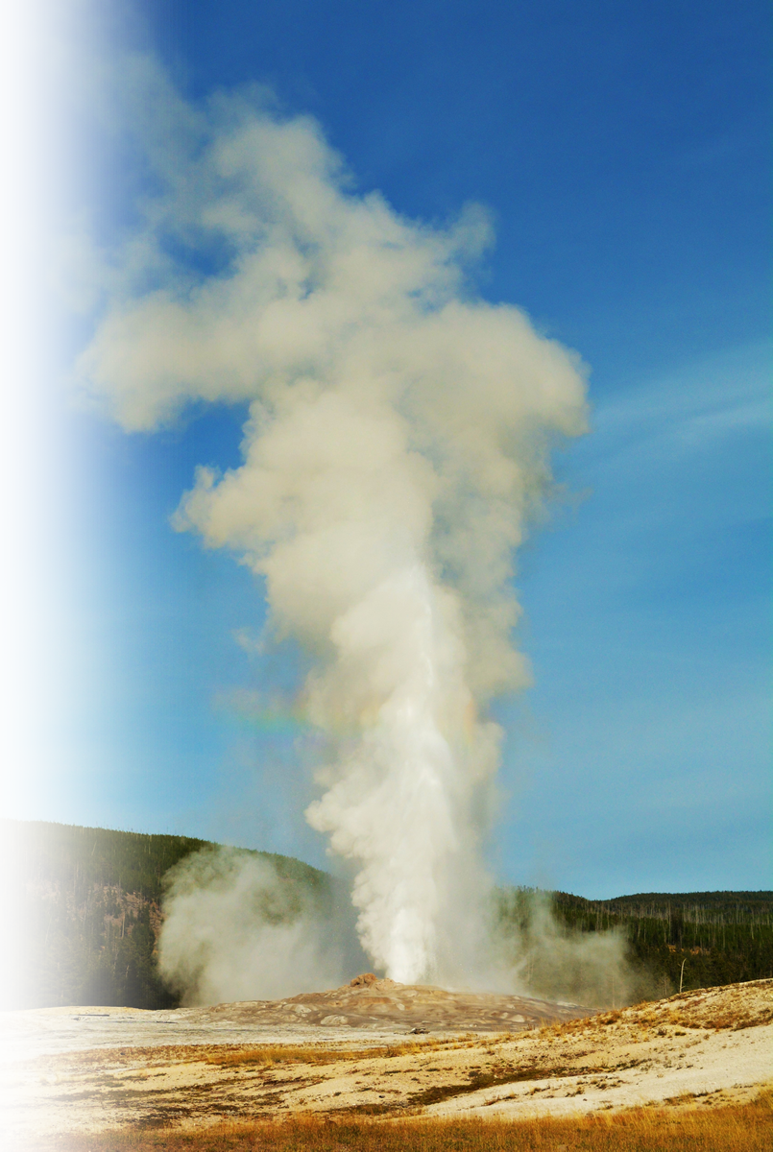
The Faithful Servant
He’s Faithful 35
³⁵ And I will raise up for myself a faithful priest,
Notes:
Worship was a farce in Shiloh. The ministers were wicked.
There are five kinds of ministers mentioned in our passage today …
The wicked minister 1Sam 2:12-17 + 22 who had a godly father
Wicked Men 12
-Sons of Belial
-Did not know the Lord
Wicked Action
- Disregarded Sacrifices 13-17
Disregard Women 22
The compromising minister 1 Sam 2:18-21 + 26
Blesses the Righteous 19-21a
Tolerated the Wicked 22-25a
The growing minister 18 + 25b
But Samuel ministered before the Lord 18 [after discussing wicked ministers, “but…”]
- In the presence of the Lord = this is the key = spending time with the Lord
But Samuel was Christ-like 25b cf. Luke 2:52 [after discussing compromiser, “but …”]
- growing in stature
-growing in favor of God and man
The godly minister [=Micah 6:8 sums up the man of God in one neat verse: “He has showed you, O man, what is good. And what does the Lord require of you? To act justly and to love mercy and to walk humbly with your God.”] This guy is not a priest, he appears to be a prophet, sent to confront the priest.
Godly ministers confront sin 27-29
God Chose you
You Scorned God
Godly ministers proclaim God’s Word 30
Blessings 30a
and Curses 30b-34
Back to Samuel the growing minister … he will be …
The Faithful minister 35-36
Faithful 35
Obedient 35
Exalted 36
Conclusion: In the NT were told that we are all ministers and priest to God. So, we must examine our hearts and sincerely ask, “What kind of minister am I?”
Wicked? Compromising? Growing? Godly? Faithful?
More importantly, what kind of minister do you want to be? Answer: all of the last three, Growing, Godly, and Faithful.

Slide 31
The Faithful Servant
He’s Obedient 35
who shall do according to what is in my heart and in my mind. And I will build him a sure house, and he shall go in and out before my anointed forever.
Notes:
Worship was a farce in Shiloh. The ministers were wicked.
There are five kinds of ministers mentioned in our passage today …
The wicked minister 1Sam 2:12-17 + 22 who had a godly father
Wicked Men 12
-Sons of Belial
-Did not know the Lord
Wicked Action
- Disregarded Sacrifices 13-17
Disregard Women 22
The compromising minister 1 Sam 2:18-21 + 26
Blesses the Righteous 19-21a
Tolerated the Wicked 22-25a
The growing minister 18 + 25b
But Samuel ministered before the Lord 18 [after discussing wicked ministers, “but…”]
- In the presence of the Lord = this is the key = spending time with the Lord
But Samuel was Christ-like 25b cf. Luke 2:52 [after discussing compromiser, “but …”]
- growing in stature
-growing in favor of God and man
The godly minister [=Micah 6:8 sums up the man of God in one neat verse: “He has showed you, O man, what is good. And what does the Lord require of you? To act justly and to love mercy and to walk humbly with your God.”] This guy is not a priest, he appears to be a prophet, sent to confront the priest.
Godly ministers confront sin 27-29
God Chose you
You Scorned God
Godly ministers proclaim God’s Word 30
Blessings 30a
and Curses 30b-34
Back to Samuel the growing minister … he will be …
The Faithful minister 35-36
Faithful 35
Obedient 35
Exalted 36
Conclusion: In the NT were told that we are all ministers and priest to God. So, we must examine our hearts and sincerely ask, “What kind of minister am I?”
Wicked? Compromising? Growing? Godly? Faithful?
More importantly, what kind of minister do you want to be? Answer: all of the last three, Growing, Godly, and Faithful.

Slide 32
The Faithful Servant
He’s Exalted 36
³⁶ And everyone who is left in your house shall come to implore him for a piece of silver or a loaf of bread and shall say, "Please put me in one of the priests' places, that I may eat a morsel of bread."'"
Notes:
Worship was a farce in Shiloh. The ministers were wicked.
There are five kinds of ministers mentioned in our passage today …
The wicked minister 1Sam 2:12-17 + 22 who had a godly father
Wicked Men 12
-Sons of Belial
-Did not know the Lord
Wicked Action
- Disregarded Sacrifices 13-17
Disregard Women 22
The compromising minister 1 Sam 2:18-21 + 26
Blesses the Righteous 19-21a
Tolerated the Wicked 22-25a
The growing minister 18 + 25b
But Samuel ministered before the Lord 18 [after discussing wicked ministers, “but…”]
- In the presence of the Lord = this is the key = spending time with the Lord
But Samuel was Christ-like 25b cf. Luke 2:52 [after discussing compromiser, “but …”]
- growing in stature
-growing in favor of God and man
The godly minister [=Micah 6:8 sums up the man of God in one neat verse: “He has showed you, O man, what is good. And what does the Lord require of you? To act justly and to love mercy and to walk humbly with your God.”] This guy is not a priest, he appears to be a prophet, sent to confront the priest.
Godly ministers confront sin 27-29
God Chose you
You Scorned God
Godly ministers proclaim God’s Word 30
Blessings 30a
and Curses 30b-34
Back to Samuel the growing minister … he will be …
The Faithful minister 35-36
Faithful 35
Obedient 35
Exalted 36
Conclusion: In the NT were told that we are all ministers and priest to God. So, we must examine our hearts and sincerely ask, “What kind of minister am I?”
Wicked? Compromising? Growing? Godly? Faithful?
More importantly, what kind of minister do you want to be? Answer: all of the last three, Growing, Godly, and Faithful.

Slide 33
Conclusion:
In the NT we’re told that we are all ministers and priest to God.
So, we must examine our hearts and sincerely ask, “What kind of minister am I?”
Wicked?
Compromising?
Faithful?
Godly?
Growing?
Notes:
Worship was a farce in Shiloh. The ministers were wicked.
There are five kinds of ministers mentioned in our passage today …
The wicked minister 1Sam 2:12-17 + 22 who had a godly father
Wicked Men 12
-Sons of Belial
-Did not know the Lord
Wicked Action
- Disregarded Sacrifices 13-17
Disregard Women 22
The compromising minister 1 Sam 2:18-21 + 26
Blesses the Righteous 19-21a
Tolerated the Wicked 22-25a
The growing minister 18 + 25b
But Samuel ministered before the Lord 18 [after discussing wicked ministers, “but…”]
- In the presence of the Lord = this is the key = spending time with the Lord
But Samuel was Christ-like 25b cf. Luke 2:52 [after discussing compromiser, “but …”]
- growing in stature
-growing in favor of God and man
The godly minister [=Micah 6:8 sums up the man of God in one neat verse: “He has showed you, O man, what is good. And what does the Lord require of you? To act justly and to love mercy and to walk humbly with your God.”] This guy is not a priest, he appears to be a prophet, sent to confront the priest.
Godly ministers confront sin 27-29
God Chose you
You Scorned God
Godly ministers proclaim God’s Word 30
Blessings 30a
and Curses 30b-34
Back to Samuel the growing minister … he will be …
The Faithful minister 35-36
Faithful 35
Obedient 35
Exalted 36
Conclusion: In the NT were told that we are all ministers and priest to God. So, we must examine our hearts and sincerely ask, “What kind of minister am I?”
Wicked? Compromising? Growing? Godly? Faithful?
More importantly, what kind of minister do you want to be? Answer: all of the last three, Growing, Godly, and Faithful.

Slide 34
Conclusion:
What kind of servant do you want to be?
Where will you start today
to improve your serve?
Notes:
Worship was a farce in Shiloh. The ministers were wicked.
There are five kinds of ministers mentioned in our passage today …
The wicked minister 1Sam 2:12-17 + 22 who had a godly father
Wicked Men 12
-Sons of Belial
-Did not know the Lord
Wicked Action
- Disregarded Sacrifices 13-17
Disregard Women 22
The compromising minister 1 Sam 2:18-21 + 26
Blesses the Righteous 19-21a
Tolerated the Wicked 22-25a
The growing minister 18 + 25b
But Samuel ministered before the Lord 18 [after discussing wicked ministers, “but…”]
- In the presence of the Lord = this is the key = spending time with the Lord
But Samuel was Christ-like 25b cf. Luke 2:52 [after discussing compromiser, “but …”]
- growing in stature
-growing in favor of God and man
The godly minister [=Micah 6:8 sums up the man of God in one neat verse: “He has showed you, O man, what is good. And what does the Lord require of you? To act justly and to love mercy and to walk humbly with your God.”] This guy is not a priest, he appears to be a prophet, sent to confront the priest.
Godly ministers confront sin 27-29
God Chose you
You Scorned God
Godly ministers proclaim God’s Word 30
Blessings 30a
and Curses 30b-34
Back to Samuel the growing minister … he will be …
The Faithful minister 35-36
Faithful 35
Obedient 35
Exalted 36
Conclusion: In the NT were told that we are all ministers and priest to God. So, we must examine our hearts and sincerely ask, “What kind of minister am I?”
Wicked? Compromising? Growing? Godly? Faithful?
More importantly, what kind of minister do you want to be? Answer: all of the last three, Growing, Godly, and Faithful.

Slide 35
Let’s Pray
Notes:
https://watermark.lovepik.com/photo/50083/4881.jpg_wh1200.jpg

