Slide 1
Lesson 2
This series uses “Hemi Head Rg” Font
You can get the font FREE at: https://www.dafont.com/hemi-head.font
Or https://fontsfree.net/hemi-head-rg-bold-italic-font-download.html
Or https://www.1001fonts.com/hemi-head-426-font.html
Notes:
Copyright © 2006−2021. All rights reserved. Bible Point is a registered trademark of Dennis Henderson. All other trademarks acknowledged.
Bible Point contains graphics from Bible Point artists. These illustrations belong to Bible Point and the respective artists. You may use the designs and illustrations for graphical illustration of lessons free and without special permission, provided they are not used in any way that maligns the Christian faith. Furthermore, republication or production of any illustration by any other graphic service whether it be in book, in a machine-readable form, or in any other design resource is strictly prohibited. Furthermore, they cannot be duplicated or resold as any other form of publishing, clip art, or graphic resource.
So What does it mean? (A simple translations of the legal jargon)
So, if you don’t own the presentation(s), graphic(s), and text(s) how can you legally use them? The purchase of the license allows you to use all the images in the product. However, the actual ownership and copyright of the presentation(s), graphic(s), and text(s) remain the property of Bible Point and its licensors. If you had plans on using this product in your “for sale” work—think again!
License Agreement
Article 1: License Grant
All the graphics and text in Bible Point presentations (excluding quotes from the Bible and stated sources) are the intellectual and real property of Bible Point and its licensors, and is protected by law, including United States copyright laws and international treaties. Bible Point grants to you a license:
1. To use the presentation in a single church, single school, or single office of a Christian organization.
2. To make a single archival back-up copy of the program.
3. To modify the presentation(s) and merge with other presentations in a single church, school, or Christian organization.
4. To transfer to another party if that party agrees to accept the terms and conditions of this agreement, and you do not retain any copies of the presentation, whether printed, machine readable, modified, or merged form.
Article 2: Terms
This license is effective until terminated. You may terminate the license at any time by destroying the presentation(s), graphic(s), or text(s) together with all copies, modifications and merged portions in any form. Bible Point may terminate your license if you fail to comply with this Agreement. You agree, upon such termination, for any reason, to destroy the presentation(s), graphics, and text(s) with all copies, modifications, and merged portions in any form.
Article 3: Disclaimers
1. Bible Point presentations, graphics, and texts are licensed to you As Is. You, the consumer, bear the entire risk relating to the quality and performance of the presentation(s), graphic(s), or text(s). In no event will Bible Point be liable for damages resulting from any defect.
2. Thirty-day limited warrantee on disks. Bible Point warrants the disks to be free of defects in material and workmanship under normal use for 30 days after purchase. During the 30-day period you may return a defective presentation, graphic, or text with proof of purchase and it will be replaced without charge, unless the presentation is damaged by misuse.
Article 4: General
1. You may not sub-license, assign, or transfer the license of the presentation(s), graphic(s), or text(s) except as provided by this Agreement.
2. This Agreement will be governed by the laws of the State of Michigan.
So What does it mean? (A simple translations of the legal jargon)
May I let someone borrow or copy my licensed Bible Point presentation (even after I modified it)? As long as it is within your local church, or single school, or the immediate office of a Christian organization you may. Otherwise, please refer the person interested in borrowing to: http://www.biblepoint.com or E-mail: dennis@DrDH.net with any related questions.

Slide 2


Finding Victory
Notes:
https://watermark.lovepik.com/photo/50083/4881.jpg_wh1200.jpg

Slide 3
In Keeping Your Word!

Slide 4
It was the best of times and
It was the worst of times
Notes:
Tale of Two Cities

Slide 5
It was the best of times and
It was the worst of times
best

Slide 6
1- It was the BEST of Times

Slide 7

Hannah made a PROMISE 1:11
¹¹ And she vowed a vow and said, "O LORD of hosts, if you will indeed look on the affliction of your servant and remember me and not forget your servant, but will give to your servant a son, then I will give him to the LORD all the days of his life, and no razor shall touch his head."
WEDDING
BUSINESS LOANS
PERSONAL PROMISES
Notes:
Vow = contract

Slide 8
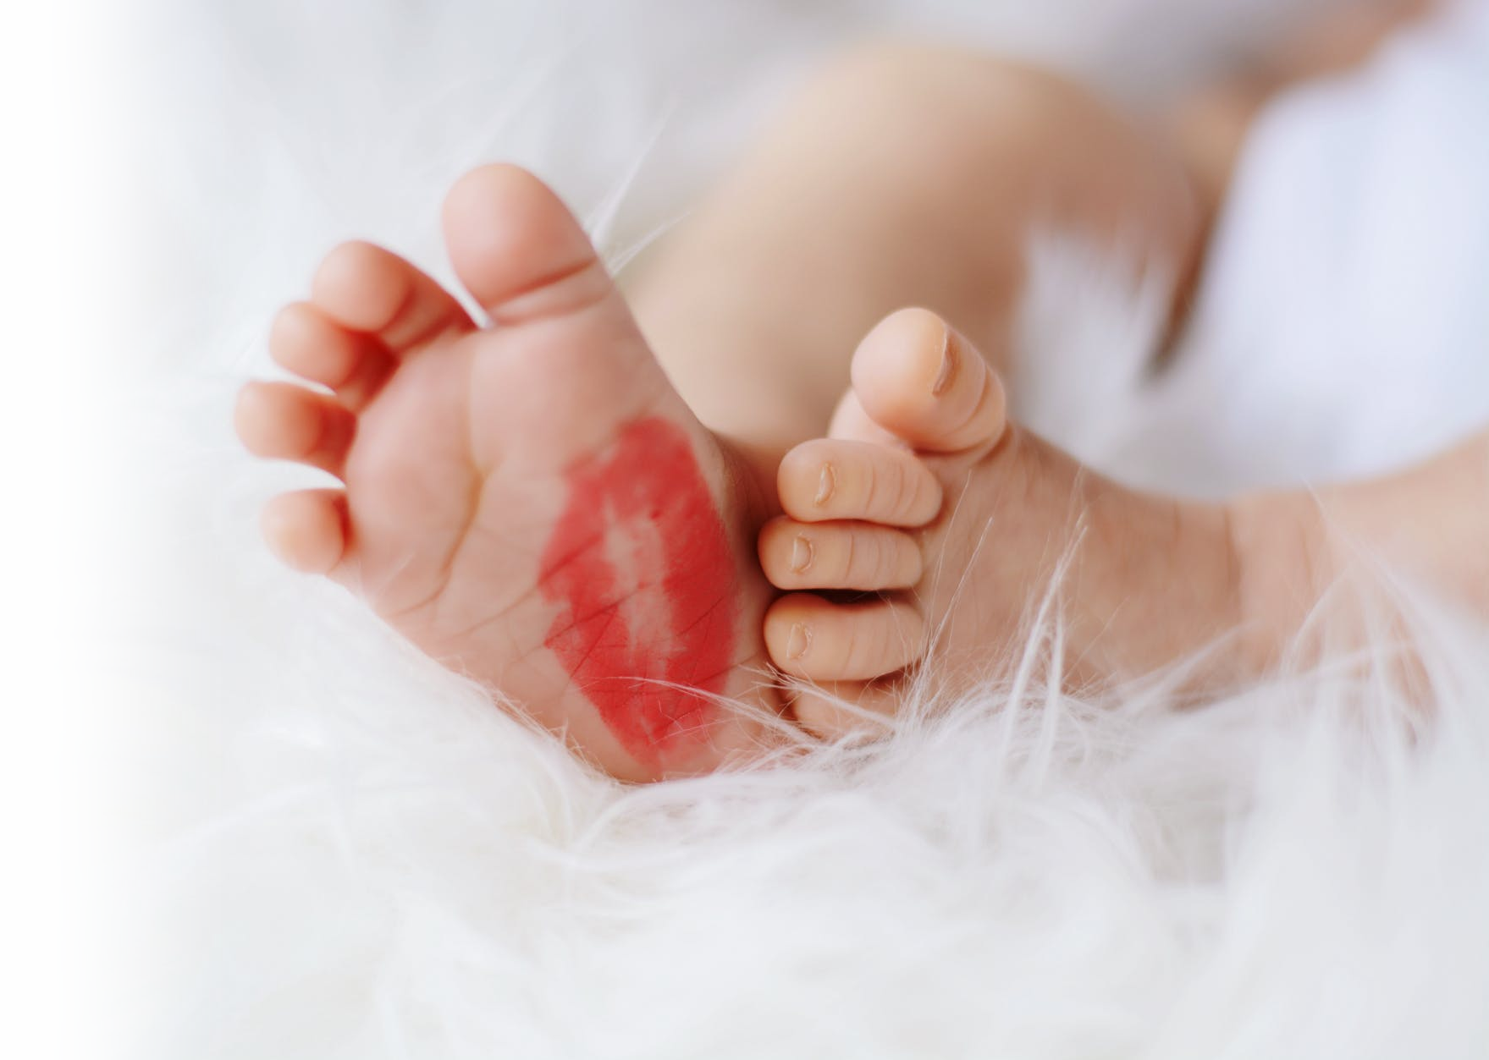
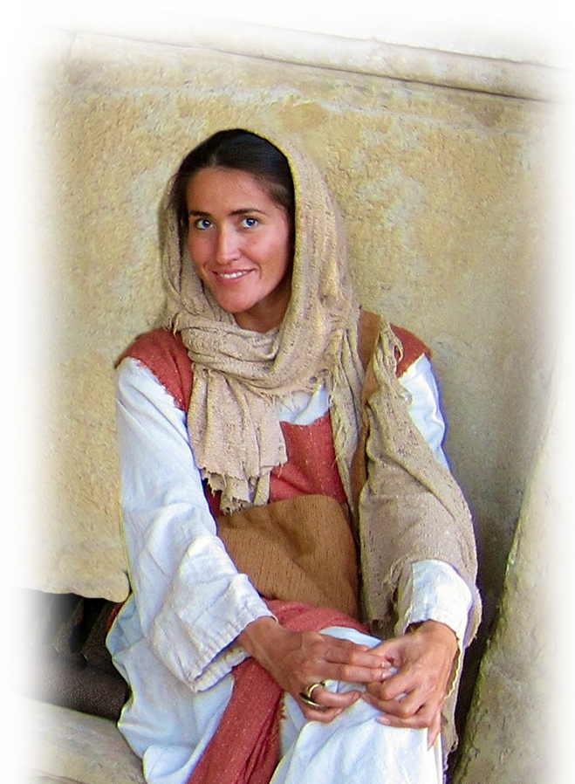
Hannah had a SON 19-20
²⁰ And in due time Hannah conceived and bore a son, and she called his name Samuel, for she said,
"I have asked for him from the LORD."
Notes:
https://images.pexels.com/photos/733878/pexels-photo-733878.jpeg?auto=compress&cs=tinysrgb&dpr=2&h=650&w=940

Slide 9
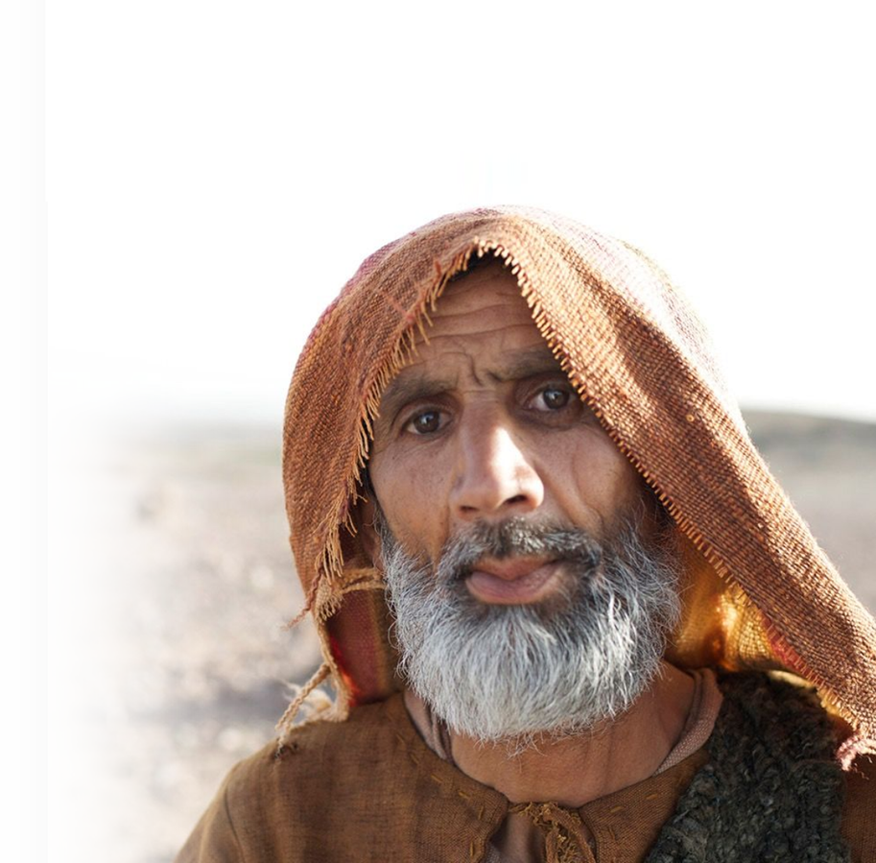
Sounds Like Second Thoughts
²¹ When the man Elkanah went up with all his family to offer the annual sacrifice to the LORD and to fulfill his vow,

Slide 10
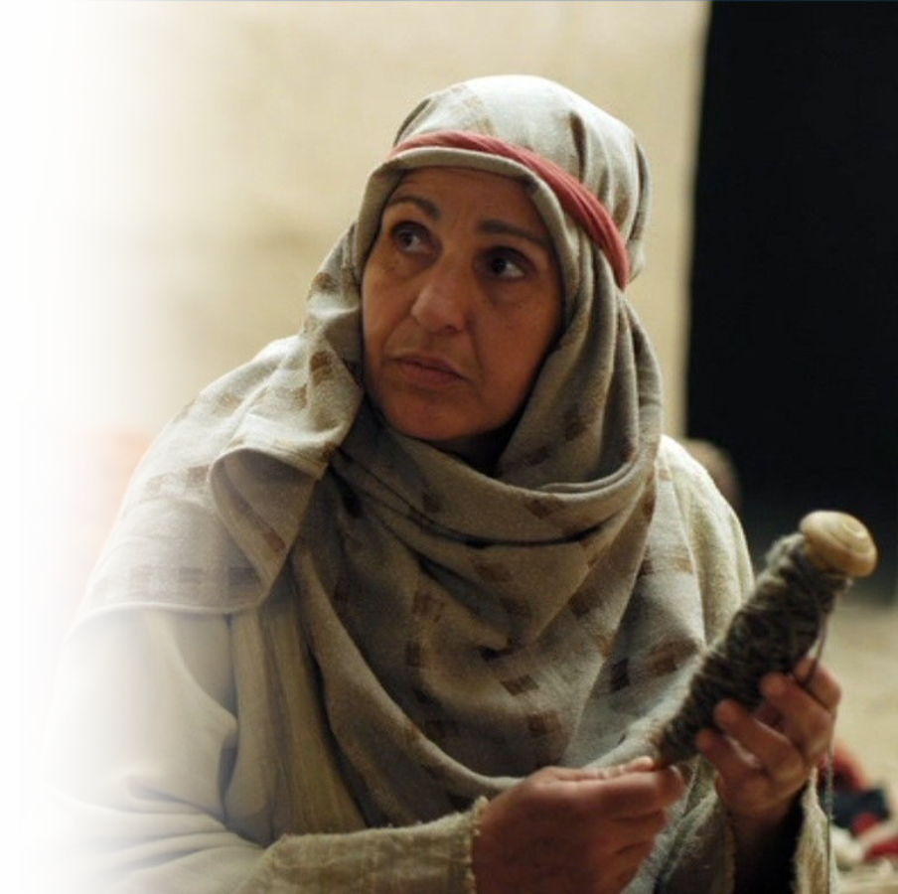
Sounds Like Second Thoughts
²¹ When the man Elkanah went up with all his family to offer the annual sacrifice to the LORD and to fulfill his vow, ²² Hannah did not go. She said to her husband,
"After the boy is weaned, I will take him and present him before the LORD, and he will live there always."
Notes:
A Syrophoenician woman begs Jesus for help
// not so lord Acts

Slide 11
Remember God Keeps His Word
⁴ When you vow a vow to God, do not delay paying it, for he has no pleasure in fools. Pay what you vow. ⁵ It is better that you should not vow than that you should vow and not pay. ⁶ Let not your mouth lead you into sin, and do not say before the messenger that it was a mistake
²³ "Do what seems best to you," Elkanah her husband told her. "Stay here until you have weaned him; only may the LORD make good his word." So the woman stayed at home and nursed her son until she had weaned him.
Notes:
The Sept. reads “The Lord establish that which is gone forth out of thy mouth.
Perhaps it means what Ecclesiastes will say in years ahead:
⁴ When you make a vow to God, do not delay in fulfilling it. He has no pleasure in fools; fulfill your vow.
⁵ It is better not to vow than to make a vow and not fulfill it.
⁶ Do not let your mouth lead you into sin. And do not protest to the temple messenger, "My vow was a mistake." Why should God be angry at what you say and destroy the work of your hands?
⁷ Much dreaming and many words are meaningless. Therefore stand in awe of God. (Ecc 5:4-7 NIV)

Slide 12
Remember God Keeps His Word
²³ "Do what seems best to you," Elkanah her husband told her. "Stay here until you have weaned him; only may the LORD make good his word." So the woman stayed at home and nursed her son until she had weaned him.
Why should God be angry at your voice and destroy the work of your hands?
⁷ For when dreams increase and words grow many, there is vanity; but God is the one you must fear. (Ecclesiastes 5:4-7)
Notes:
The Sept. reads “The Lord establish that which is gone forth out of thy mouth.
Perhaps it means what Ecclesiastes will say in years ahead:
⁴ When you make a vow to God, do not delay in fulfilling it. He has no pleasure in fools; fulfill your vow.
⁵ It is better not to vow than to make a vow and not fulfill it.
⁶ Do not let your mouth lead you into sin. And do not protest to the temple messenger, "My vow was a mistake." Why should God be angry at what you say and destroy the work of your hands?
⁷ Much dreaming and many words are meaningless. Therefore stand in awe of God. (Ecc 5:4-7 NIV)

Slide 13
Remember God Keeps His Word
²³ "Do what seems best to you," Elkanah her husband told her. "Stay here until you have weaned him; only may the LORD make good his word." So the woman stayed at home and nursed her son until she had weaned him.
Notes:
The Sept. reads “The Lord establish that which is gone forth out of thy mouth.
Perhaps it means what Ecclesiastes will say in years ahead:
⁴ When you make a vow to God, do not delay in fulfilling it. He has no pleasure in fools; fulfill your vow.
⁵ It is better not to vow than to make a vow and not fulfill it.
⁶ Do not let your mouth lead you into sin. And do not protest to the temple messenger, "My vow was a mistake." Why should God be angry at what you say and destroy the work of your hands?
⁷ Much dreaming and many words are meaningless. Therefore stand in awe of God. (Ecc 5:4-7 NIV)

Slide 14
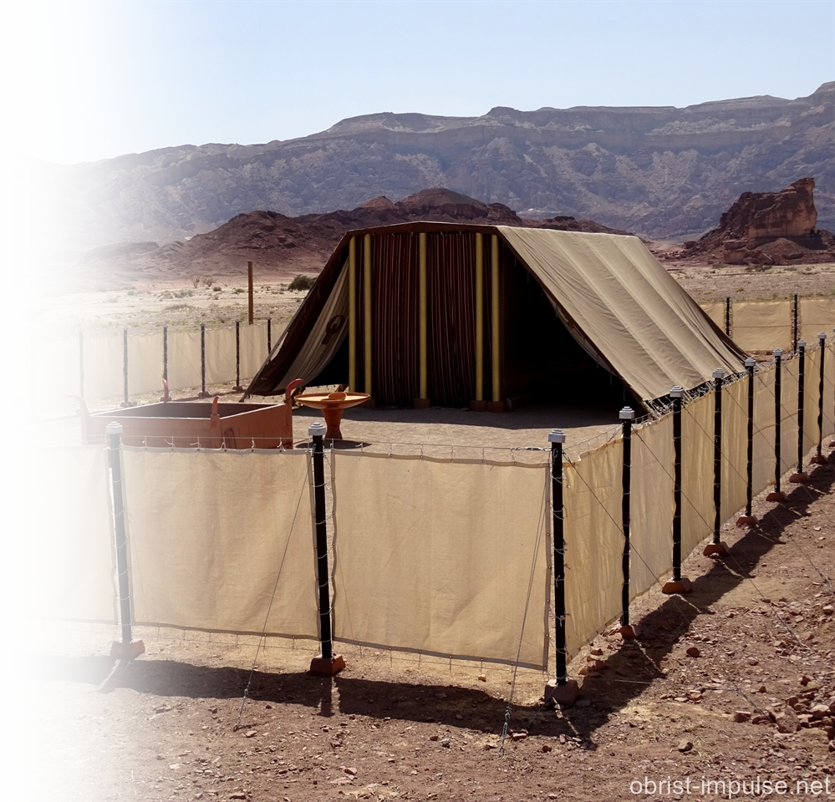
The Time Had Come
²⁴ After he was weaned, she took the boy with her, young as he was, along with a three-year-old bull, an ephah of flour and a skin of wine, and brought him to the house of the LORD at Shiloh. ²⁵ When they had slaughtered the bull, they brought the boy to Eli,
Notes:
Tabernacle = https://www.flickr.com/photos/obrist-impulse/29968524713

Slide 15
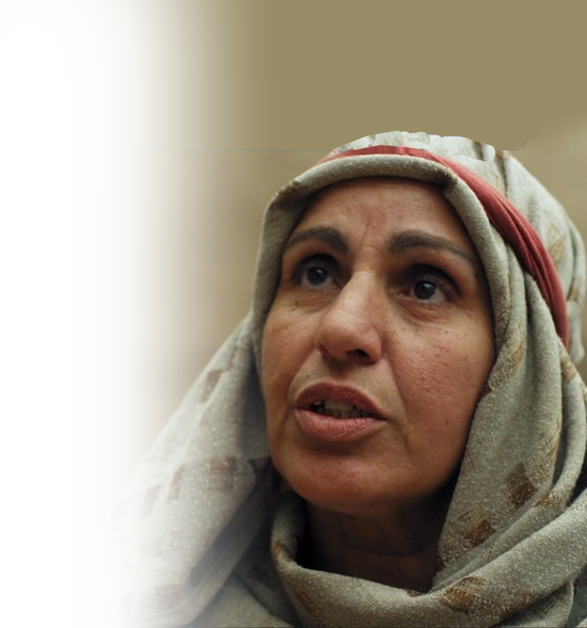
The Time Had Come
²⁶ and she said to him,
"As surely as you live, my lord, I am the woman who stood here beside you praying to the LORD. ²⁷ I prayed for this child, and the LORD has granted me what I asked of him.

Slide 16
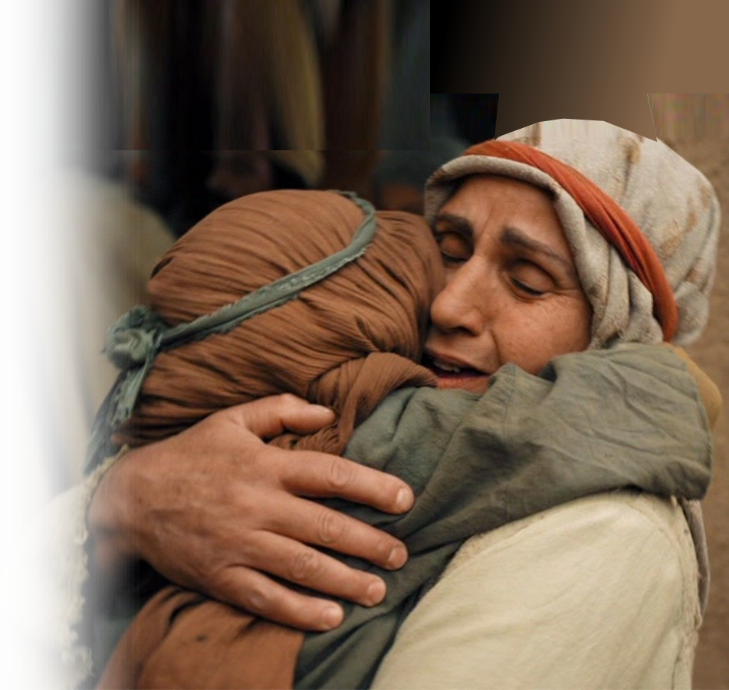
To Fulfill Her Promise
²⁸ So now I give him to the LORD. For his whole life he will be given over to the LORD."
Notes:
As impossible as it may seem, the antecedent to he appears to be a three-year-old child. Neve underestimate the work of God in a person’s life.

Slide 17
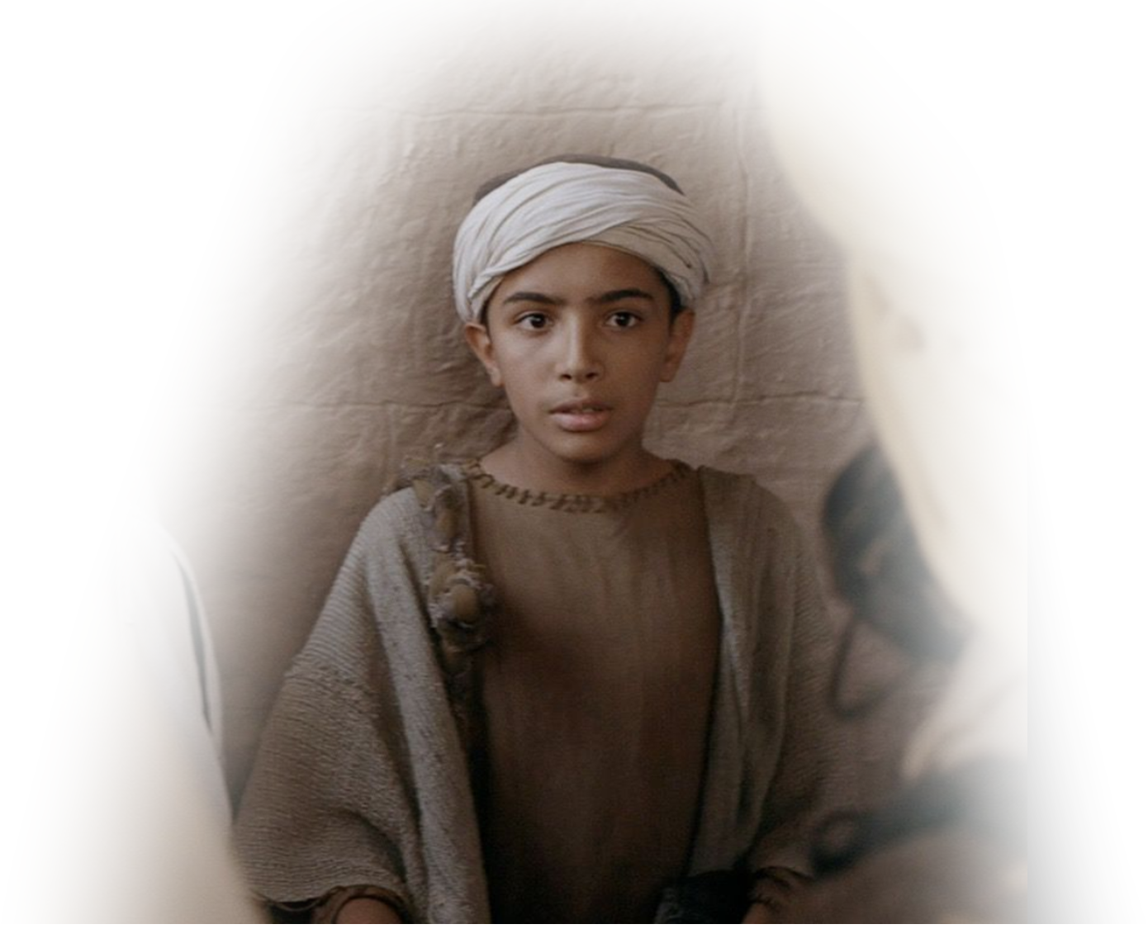
To Fulfill Her Promise
And he worshiped the LORD there.
Notes:
As impossible as it may seem, the antecedent to he appears to be a three-year-old child. Neve underestimate the work of God in a person’s life.

Slide 18
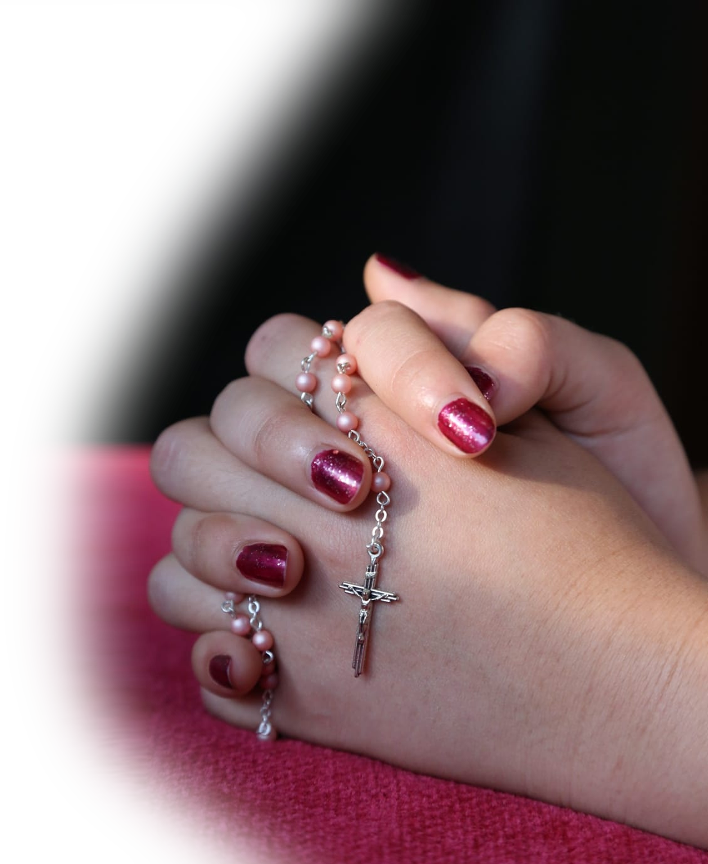
2- It was the BEST of Times
As seen in her prayer.
She knows ...

Slide 19

... the Joy of the Lord
^{2:1} Then Hannah prayed and said:
"My heart rejoices in the LORD;
in the LORD my horn is
lifted high. My mouth
boasts over my enemies,
for I delight in your
deliverance.
Notes:
https://pixabay.com/fr/vectors/se-sentir-libre-silhouette-joy-3566550/

Slide 20
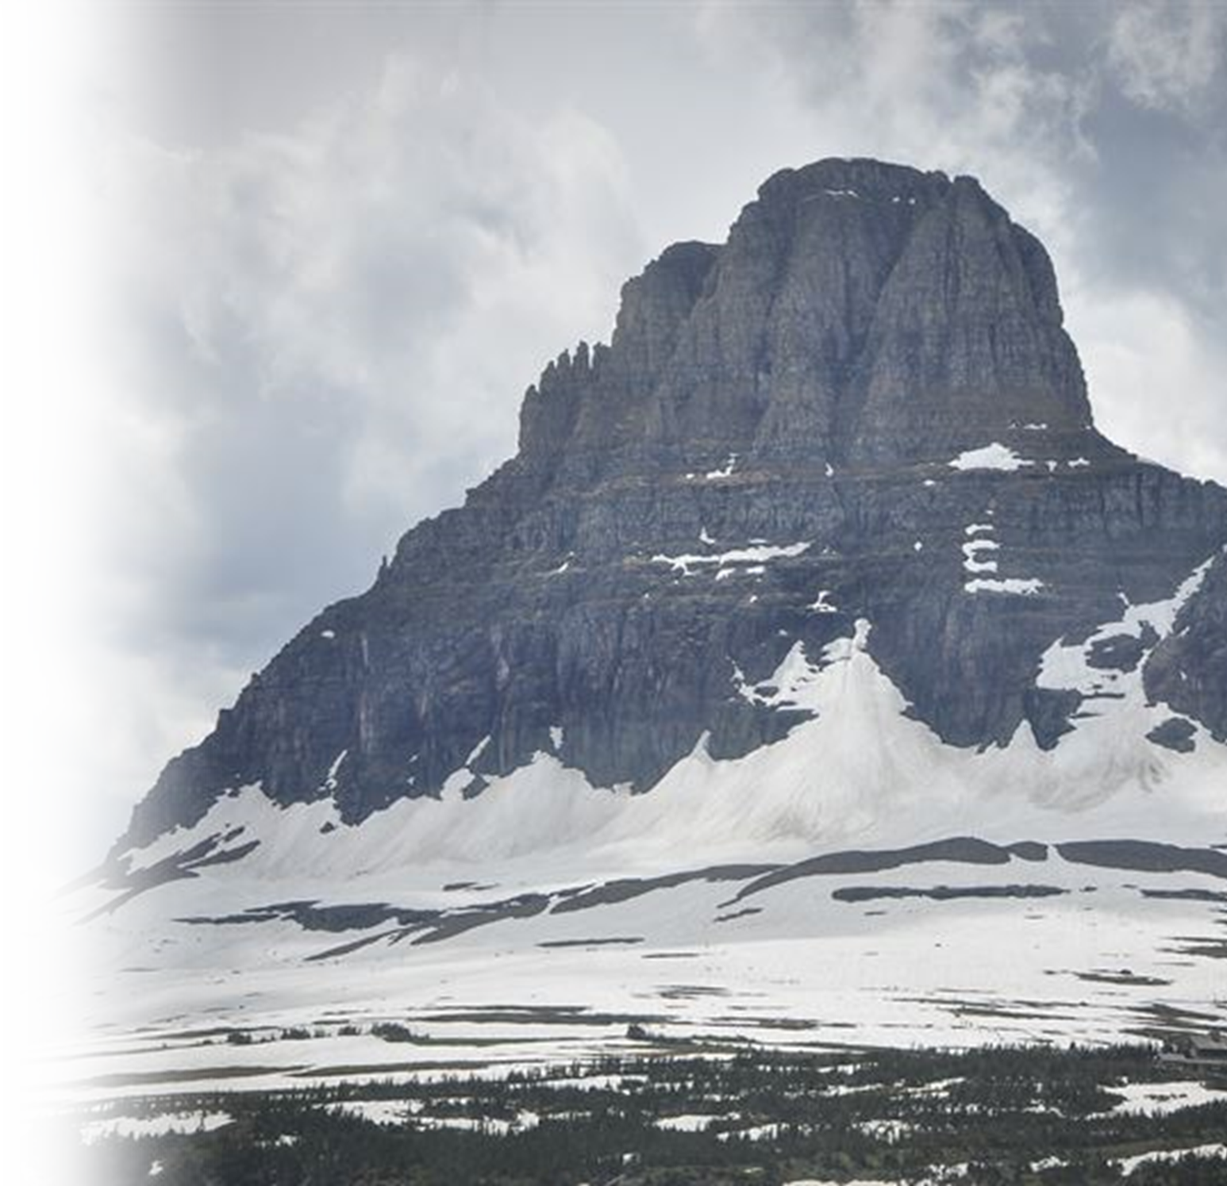
... the Majesty of the Lord
² "There is no one holy like the LORD; there is no one besides you; there is no Rock like our God. ³ "Do not keep talking so proudly or let your mouth speak such arrogance, for the LORD is a God who knows, and by him deeds are weighed.
Notes:
He is holy
He is unique
He is the Rock
He is all knowing
He is judge

Slide 21
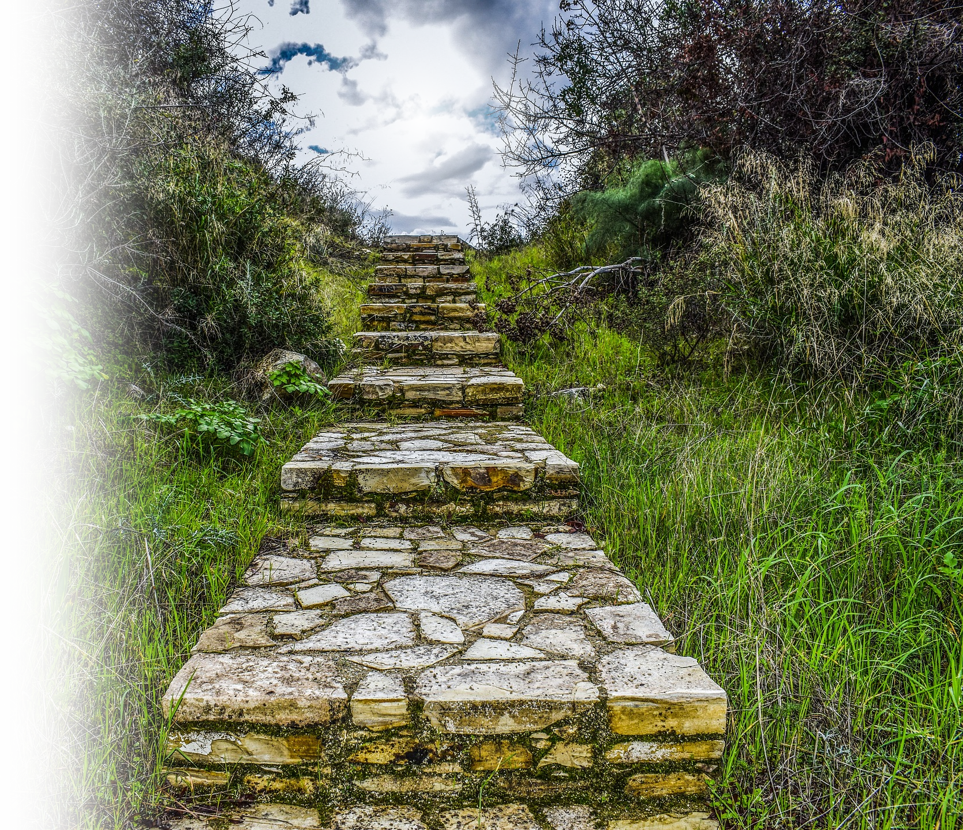
... the Ways of the Lord
⁴ "The bows of the warriors are broken, but those who stumbled are armed with strength. ⁵ Those who were full hire themselves out for food, but those who were hungry hunger no more. She who was barren has borne seven children, but she who has had many sons pines away.
^{2:21} Indeed the LORD visited Hannah, and she conceived and bore three sons and two daughters. And the young man Samuel grew in the presence of the LORD.
Notes:
https://pixabay.com/fr/photos/escaliers-pierre-stairway-to-heaven-3096103/

Slide 22
... the Ways of the Lord
⁶ "The LORD brings death and makes alive; he brings down to the grave and raises up. ⁷ The LORD sends poverty and wealth; he humbles and he exalts. ⁸ "For the foundations of the earth are the LORD's; upon them he has set the world.

Slide 23
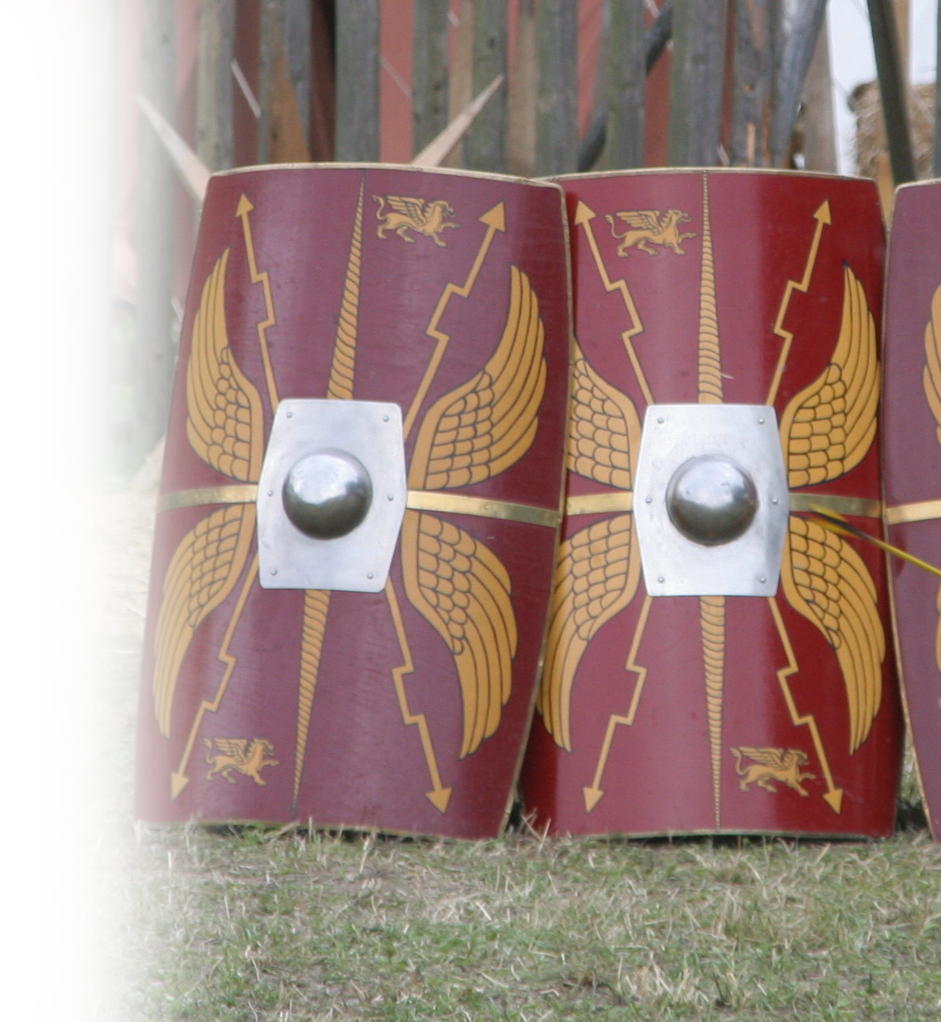
... the Protection of the Lord
⁹ He will guard the feet of his saints, but the wicked will be silenced in darkness. "It is not by strength that one prevails; ¹⁰ those who oppose the LORD will be shattered. He will thunder against them from heaven; the LORD will judge the ends of the earth.
Notes:
https://upload.wikimedia.org/wikipedia/commons/e/e2/Scutum_1.jpg

Slide 24
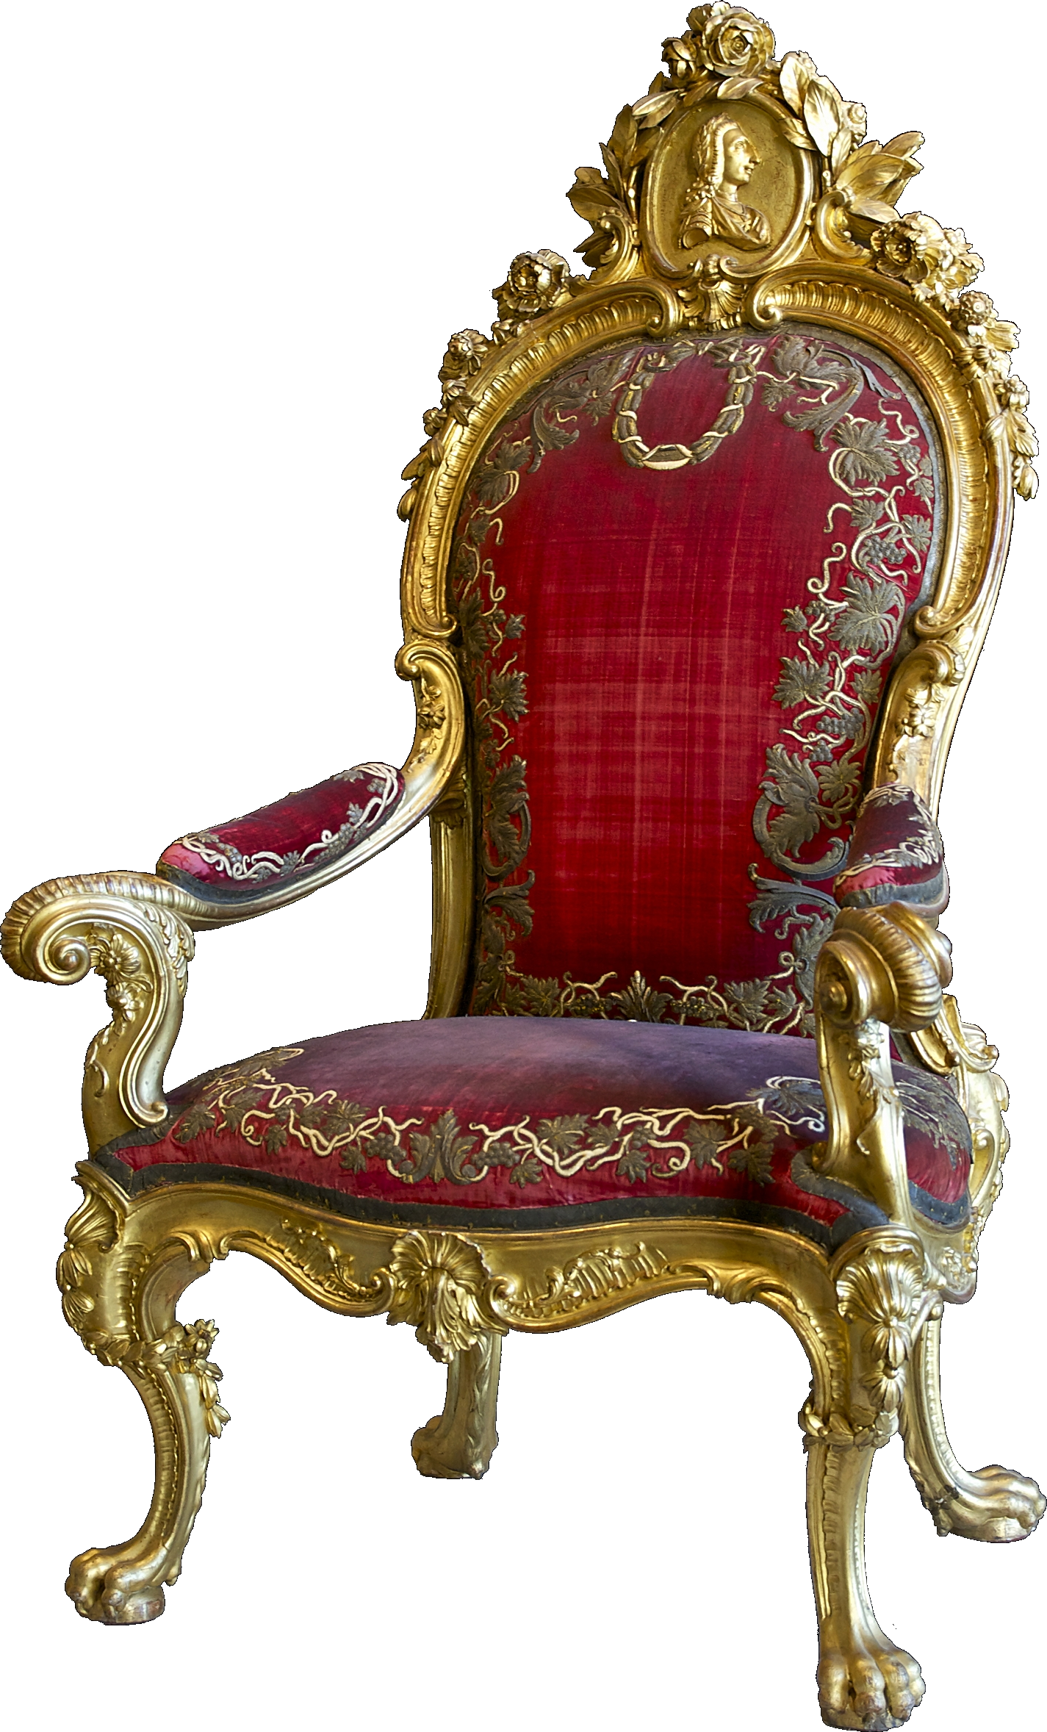
... the Reign of the Lord
"He will give strength to his king and exalt the horn of his anointed."
Notes:
https://upload.wikimedia.org/wikipedia/commons/1/10/Throne_Charles_III_of_Spain.jpg

Slide 25
3- It was the very BEST of Times
¹¹ Then Elkanah went home to Ramah, but the boy ministered before the LORD under Eli the priest.
Notes:
Not only did young Samuel “Worship” 1:28 but he “ministered”

Slide 26
So, what’s in this for me?
A reminder to KEEP your word
Do so with REJOICING
Discover the WAYS of the Lord
Great will be your REWARD

Slide 27
Let’s Pray
Notes:
https://watermark.lovepik.com/photo/50083/4881.jpg_wh1200.jpg

