Slide 1
Lesson 1
This series uses “Hemi Head Rg” Font
You can get the font FREE at: https://www.dafont.com/hemi-head.font
Or https://fontsfree.net/hemi-head-rg-bold-italic-font-download.html
Or https://www.1001fonts.com/hemi-head-426-font.html
Notes:
Copyright © 2006−2021. All rights reserved. Bible Point is a registered trademark of Dennis Henderson. All other trademarks acknowledged.
Bible Point contains graphics from Bible Point artists. These illustrations belong to Bible Point and the respective artists. You may use the designs and illustrations for graphical illustration of lessons free and without special permission, provided they are not used in any way that maligns the Christian faith. Furthermore, republication or production of any illustration by any other graphic service whether it be in book, in a machine-readable form, or in any other design resource is strictly prohibited. Furthermore, they cannot be duplicated or resold as any other form of publishing, clip art, or graphic resource.
So What does it mean? (A simple translations of the legal jargon)
So, if you don’t own the presentation(s), graphic(s), and text(s) how can you legally use them? The purchase of the license allows you to use all the images in the product. However, the actual ownership and copyright of the presentation(s), graphic(s), and text(s) remain the property of Bible Point and its licensors. If you had plans on using this product in your “for sale” work—think again!
License Agreement
Article 1: License Grant
All the graphics and text in Bible Point presentations (excluding quotes from the Bible and stated sources) are the intellectual and real property of Bible Point and its licensors, and is protected by law, including United States copyright laws and international treaties. Bible Point grants to you a license:
1. To use the presentation in a single church, single school, or single office of a Christian organization.
2. To make a single archival back-up copy of the program.
3. To modify the presentation(s) and merge with other presentations in a single church, school, or Christian organization.
4. To transfer to another party if that party agrees to accept the terms and conditions of this agreement, and you do not retain any copies of the presentation, whether printed, machine readable, modified, or merged form.
Article 2: Terms
This license is effective until terminated. You may terminate the license at any time by destroying the presentation(s), graphic(s), or text(s) together with all copies, modifications and merged portions in any form. Bible Point may terminate your license if you fail to comply with this Agreement. You agree, upon such termination, for any reason, to destroy the presentation(s), graphics, and text(s) with all copies, modifications, and merged portions in any form.
Article 3: Disclaimers
1. Bible Point presentations, graphics, and texts are licensed to you As Is. You, the consumer, bear the entire risk relating to the quality and performance of the presentation(s), graphic(s), or text(s). In no event will Bible Point be liable for damages resulting from any defect.
2. Thirty-day limited warrantee on disks. Bible Point warrants the disks to be free of defects in material and workmanship under normal use for 30 days after purchase. During the 30-day period you may return a defective presentation, graphic, or text with proof of purchase and it will be replaced without charge, unless the presentation is damaged by misuse.
Article 4: General
1. You may not sub-license, assign, or transfer the license of the presentation(s), graphic(s), or text(s) except as provided by this Agreement.
2. This Agreement will be governed by the laws of the State of Michigan.
So What does it mean? (A simple translations of the legal jargon)
May I let someone borrow or copy my licensed Bible Point presentation (even after I modified it)? As long as it is within your local church, or single school, or the immediate office of a Christian organization you may. Otherwise, please refer the person interested in borrowing to: http://www.biblepoint.com or E-mail: dennis@DrDH.net with any related questions.

Slide 2


Finding Victory
Notes:
https://watermark.lovepik.com/photo/50083/4881.jpg_wh1200.jpg
Or Winning Victory in 2020

Slide 3
Finding Victory in Prayer
Notes:
https://www.freepik.com/free-photo/silhouette-people-happy-time_3654373.htm#page=1&query=victory&position=2

Slide 4
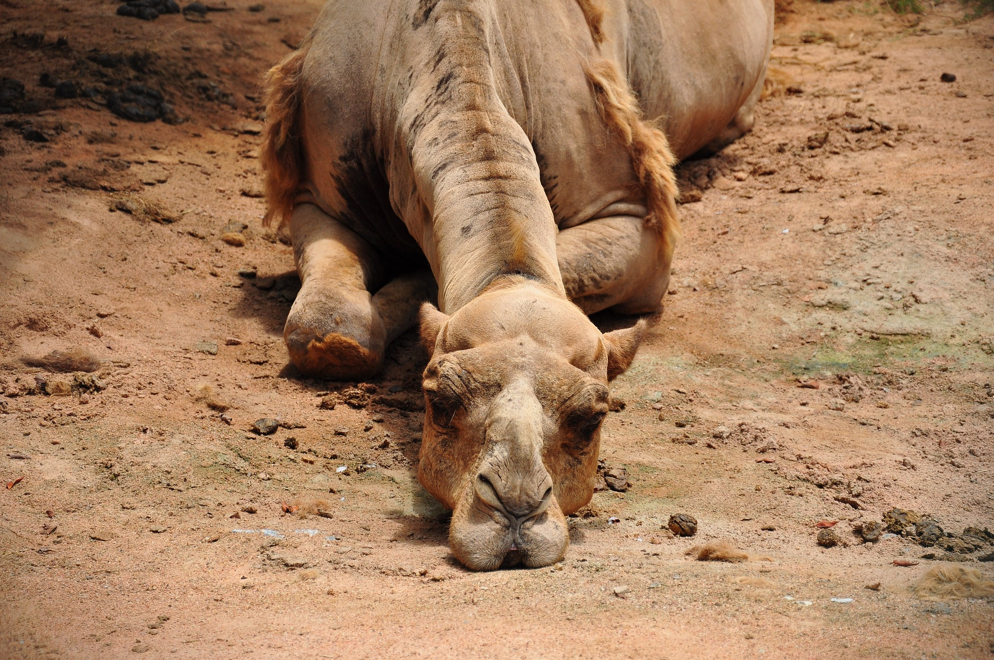
It was the last straw … 1:1-8

Slide 5
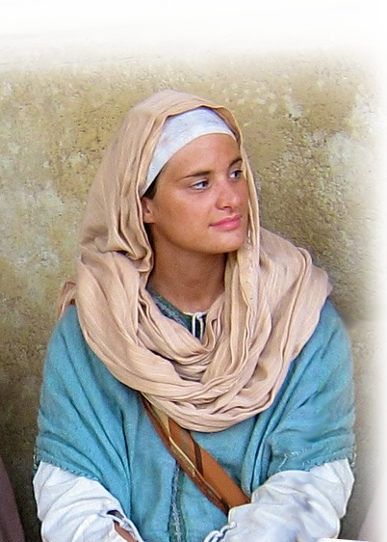


On the one hand, she had everything … 1:1-5
Married of social standing 1:1
There was a certain man of Ramathaim-zophim of the hill country of Ephraim whose name was Elkanah the son of Jeroham, son of Elihu, son of Tohu, son of Zuph, an Ephrathite. ² He had two wives.
Notes:
https://lannononsamuel.wordpress.com/2013/08/17/no-greater-love-than-a-mother-laying-down-her-son/samuel-dedicated-by-hannah-at-the-temple-by-frank-w-w-topham/Married of https://www.devostock.com/stock-photo/devostock-blue-sky-two-hands-hope-164696.html
social standing 1:1
Moderate wealth 1:2 (he could support two wives)
Family worship and piety 1:3-5
Really, truly loved 1:5

Slide 6
On the one hand, she had everything … 1:1-5
Moderate wealth 1:2
² He had two wives. The name of the one was Hannah, and the name of the other, Peninnah. And Peninnah had children, but Hannah had no children. (1Sa 1:2 ESV)
Notes:
https://lannononsamuel.wordpress.com/2013/08/17/no-greater-love-than-a-mother-laying-down-her-son/samuel-dedicated-by-hannah-at-the-temple-by-frank-w-w-topham/Married of https://www.devostock.com/stock-photo/devostock-blue-sky-two-hands-hope-164696.html
social standing 1:1
Moderate wealth 1:2 (he could support two wives)
Family worship and piety 1:3-5
Really, truly loved 1:5

Slide 7
On the one hand, she had everything … 1:1-5
Family worship and piety 1:3-4
³ Now this man used to go up year by year from his city to worship and to sacrifice to the LORD of hosts at Shiloh, where the two sons of Eli, Hophni and Phinehas, were priests of the LORD.
Really, truly loved 1:5
Notes:
https://lannononsamuel.wordpress.com/2013/08/17/no-greater-love-than-a-mother-laying-down-her-son/samuel-dedicated-by-hannah-at-the-temple-by-frank-w-w-topham/Married of https://www.devostock.com/stock-photo/devostock-blue-sky-two-hands-hope-164696.html
social standing 1:1
Moderate wealth 1:2 (he could support two wives)
Family worship and piety 1:3-5
Really, truly loved 1:5

Slide 8
On the one hand, she had everything … 1:1-5
Really, truly loved 1:4-5
⁴ On the day when Elkanah sacrificed, he would give portions to Peninnah his wife and to all her sons and daughters. ⁵ But to Hannah he gave a double portion, because he loved her, ....
Notes:
https://lannononsamuel.wordpress.com/2013/08/17/no-greater-love-than-a-mother-laying-down-her-son/samuel-dedicated-by-hannah-at-the-temple-by-frank-w-w-topham/Married of https://www.devostock.com/stock-photo/devostock-blue-sky-two-hands-hope-164696.html
social standing 1:1
Moderate wealth 1:2 (he could support two wives)
Family worship and piety 1:3-5
Really, truly loved 1:5

Slide 9

On the other hand, she had nothing , since…
She had no children 1:2d
The Lord Closed Her Womb 1:5b
The LORD had closed her womb. 1:6b

Slide 10
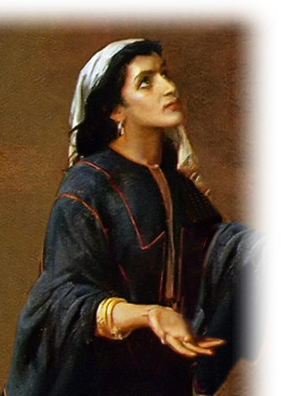
On the other hand, she had nothing , since…
Hannah shared the fellowship of those who were “barren”
before and after her.

Slide 11
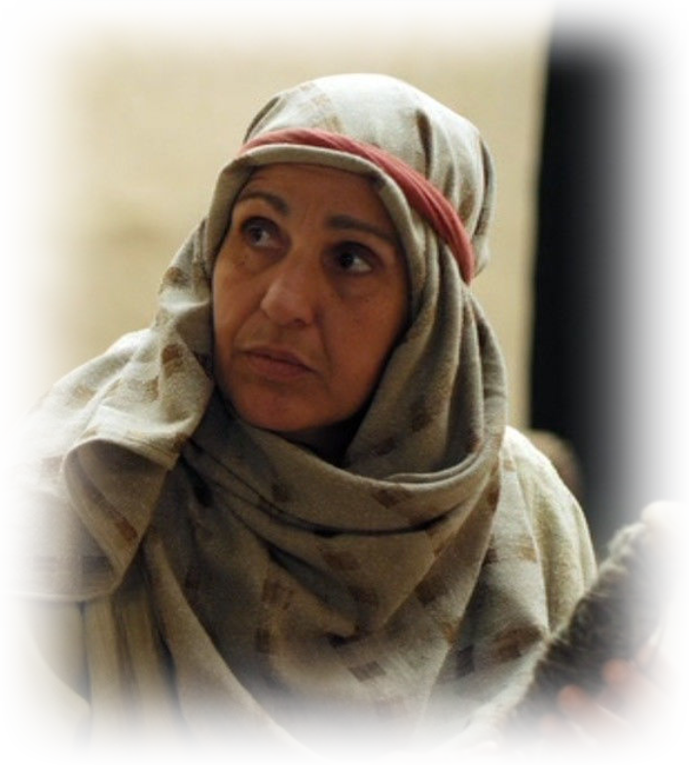
On the other hand, she had nothing , since…
Sarai Gen 11:30

Slide 12
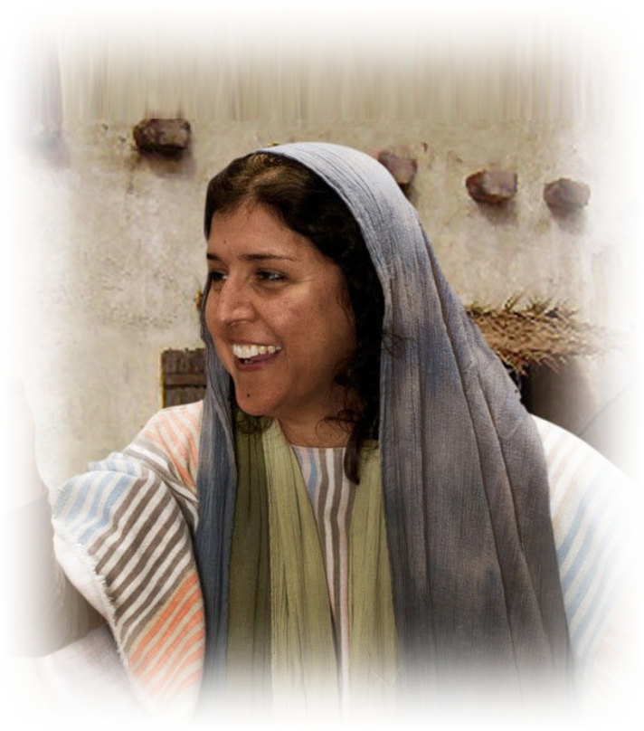
On the other hand, she had nothing , since…
Rebekah Gen 25, 29

Slide 13
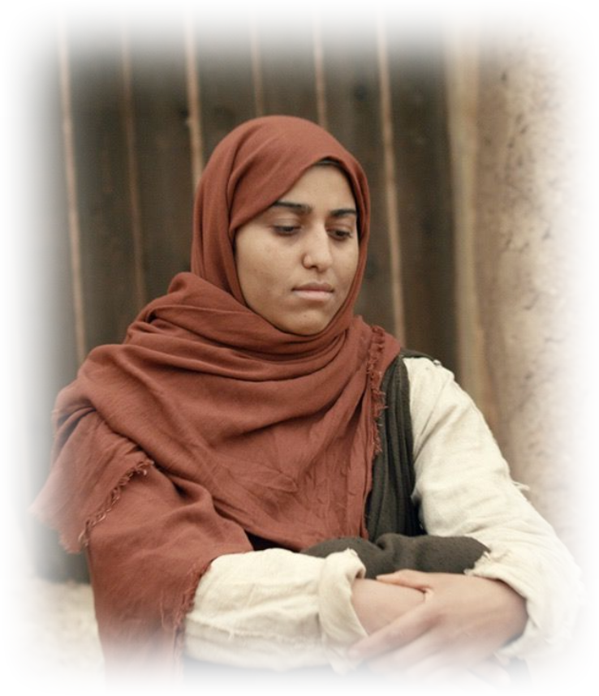
On the other hand, she had nothing , since…
Manoah’s wife Jud 13
NT Elizabeth Lk 1:5-25

Slide 14
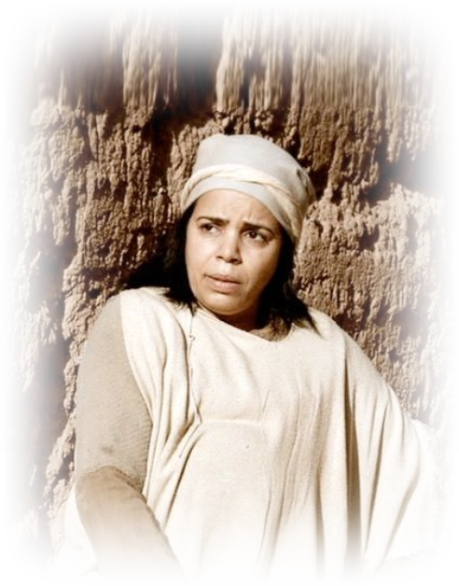
On the other hand, she had nothing , since…
NT Elizabeth Lk 1:5-25

Slide 15
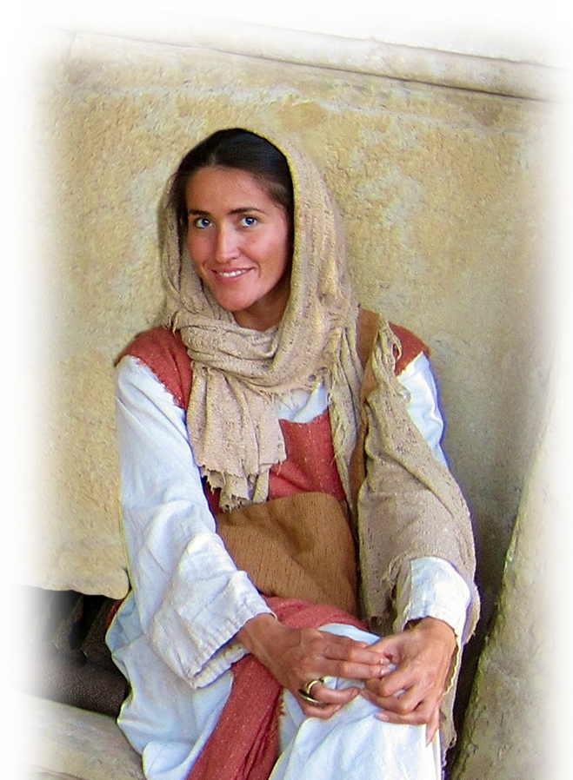

Last Straw--a bully 1:6-7
⁶ And her rival used to provoke her grievously to irritate her, because the LORD had closed her womb.
⁷ So it went on year by year. As often as she went up to the house of the LORD, she used to provoke her. Therefore Hannah wept and would not eat.
Notes:
https://pixabay.com/fr/illustrations/femme-face-l-intimidation-stress-2775271/

Slide 16
Last Straw--a loved one 1:8
⁸ And Elkanah, her husband, said to her,
"Hannah, why do you weep? And why do you not eat? And why is your heart sad? Am I not more to you than ten sons?" (1Sa 1:8 ESV)

Slide 17

What’s a person to do? 1:9-18
Go to the Lord ...
Notes:
https://pixabay.com/fr/photos/confondu-mains-jusqu-%C3%A0-incertain-2681507/

Slide 18

With your brokenness 1:9-10
⁹ After they had eaten and drunk in Shiloh, Hannah rose. Now Eli the priest was sitting on the seat beside the doorpost of the temple of the LORD.
¹⁰ She was deeply distressed and prayed to the LORD and wept bitterly.
Notes:
Shattered image

Slide 19

With your commitment 1:11
¹¹ And she vowed a vow and said, "O LORD of hosts, if you will indeed look on the affliction of your servant and remember me and not forget your servant, but will give to your servant a son, then I will give him to the LORD all the days of his life, and no razor shall touch his head."
Notes:
Vow = contract

Slide 20
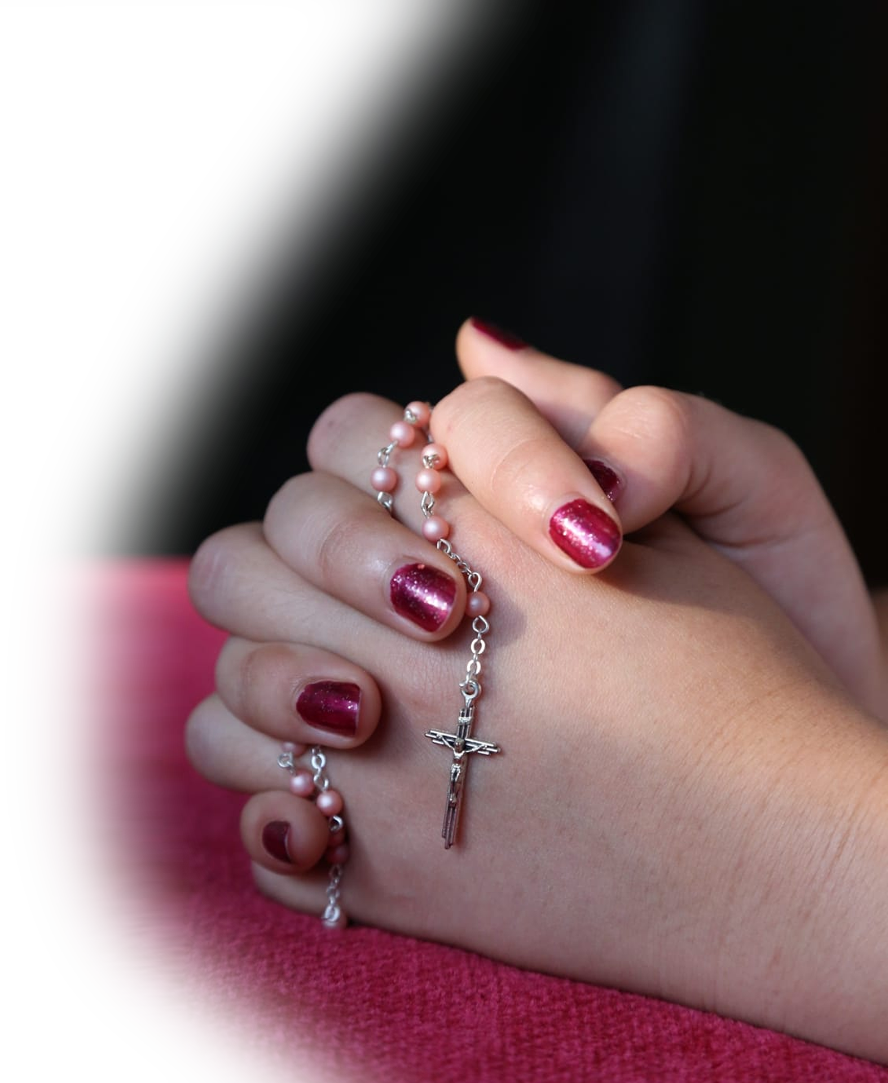
With your heartfelt prayer 1:12-13
¹² As she continued praying before the LORD, Eli observed her mouth.
¹³ Hannah was speaking in her heart; only her lips moved, and her voice was not heard.
Notes:
http://www.peakpx.com/602176/pink-and-silver-rosary

Slide 21

With your Misunderstandings
Therefore Eli took her to be a drunken woman.
¹⁴ And Eli said to her, "How long will you go on being drunk? Put your wine away from you."
Notes:
https://www.needpix.com/photo/download/832624/pouring-wine-wine-country-napa-wine-tour-wine-tasting-pouring-glass-drink-wine

Slide 22

With your out poured soul 1:15-16
¹⁵ But Hannah answered, "No, my lord, I am a woman troubled in spirit. I have drunk neither wine nor strong drink, but I have been pouring out my soul before the LORD. ¹⁶ Do not regard your servant as a worthless woman, for all along I have been speaking out of my great anxiety and vexation."
Notes:
https://pixabay.com/fr/photos/l-huile-huile-d-olive-2020789/

Slide 23

For your peace 17-18
¹⁷ Then Eli answered, "Go in peace, and the God of Israel grant your petition that you have made to him."
¹⁸ And she said, "Let your servant find favor in your eyes." Then the woman went her way and ate, and her face was no longer sad.
Notes:
https://pixabay.com/fr/photos/ciel-libert%C3%A9-le-bonheur-relev%C3%A9e-2667455/
Hand of God with a string on it
Action
Promise
Attention
blessing

Slide 24
What’s a person to expect?
Notes:
https://pixabay.com/fr/photos/confondu-mains-jusqu-%C3%A0-incertain-2681507/

Slide 25
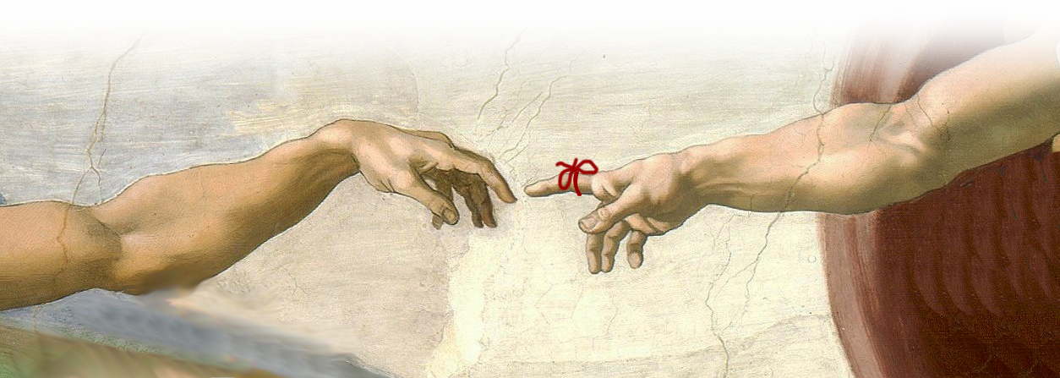
the Lord will remember 19-20
¹⁹ They rose early in the morning and worshiped before the LORD; then they went back to their house at Ramah. And Elkanah knew Hannah his wife,
and the LORD remembered her.
Notes:
https://en.wikipedia.org/wiki/Sistine_Chapel_ceiling#/media/File:Creaci%C3%B3n_de_Ad%C3%A1n.jpg
Hand of God with a string on it
Action
Promise
Attention
blessing

Slide 26
the Lord will remember 19-20
²⁰ And in due time Hannah conceived and bore a son, and she called his name Samuel, for she said, "I have asked for him from the LORD."
Notes:
Hand of God with a string on it
Action
Promise
Attention
blessing

Slide 27
So What Do We Take Away?

Slide 28
Let’s Pray
Notes:
https://watermark.lovepik.com/photo/50083/4881.jpg_wh1200.jpg

